Slide 1
(Methyl) iDES

Slide 2
Wrapper
Bed file to freq file
Freq file to bed file

Slide 3

Bed file to freq file
Methylation (reverse strand)
Bed file
Reverse strand depth
Freq file
chr1 78826 3 C 2 1
chr1 78827 2 G 2
Overall methylation rate
Methylation (forward strand)
Forward strand depth
m + u =depth
Beta=$\frac{m}{m+u}$
For C: m=C, u=T
For G: m=G, u= A
Freq file to bed file
Notes:
(0.67*3+1*2)/(3+2)=0.802

Slide 4
Result
No Background polishing
After Background polishing

Slide 5
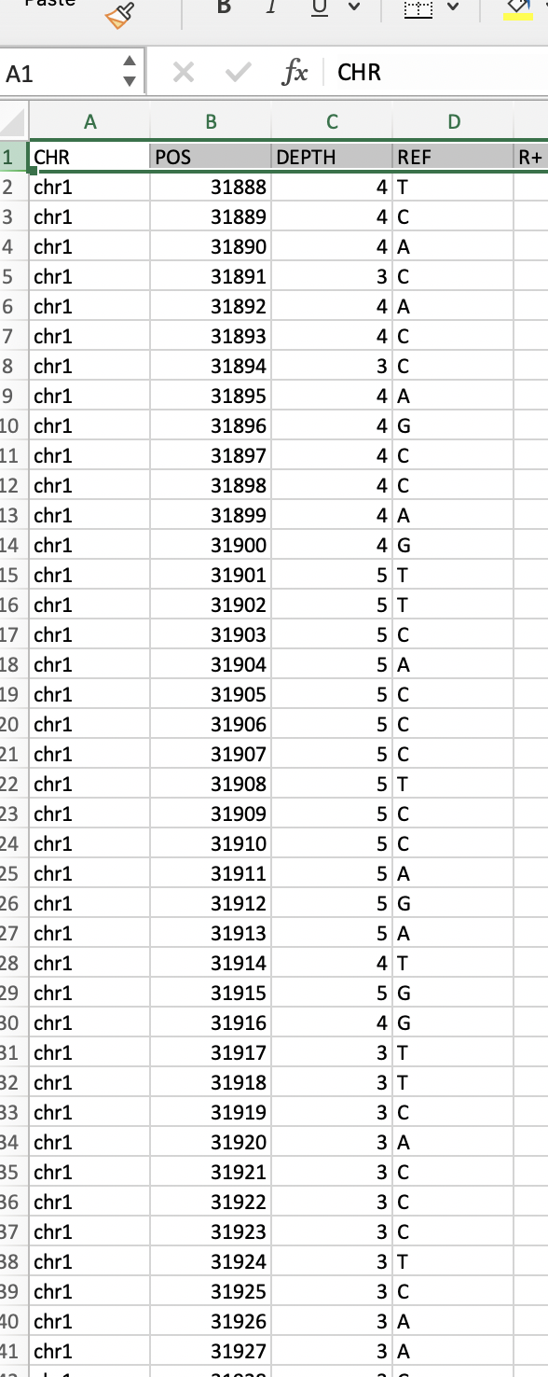
Issue
hg38
Freq File
What is the reference for methylation?
iDES tries to convert to reference genome (hyper methylated)

Slide 6
Raw (NOT inverted) CpG data
No Background polishing
After Background polishing

Slide 7
Technical Issue
Could not generate background database from all positions of a bedfile (around 2 GB each)
Process gets killed

Slide 8
Supp

Slide 9
After polish correlation

Slide 10
Original SM

