Slide 1
Towards read Based MHB

Slide 2
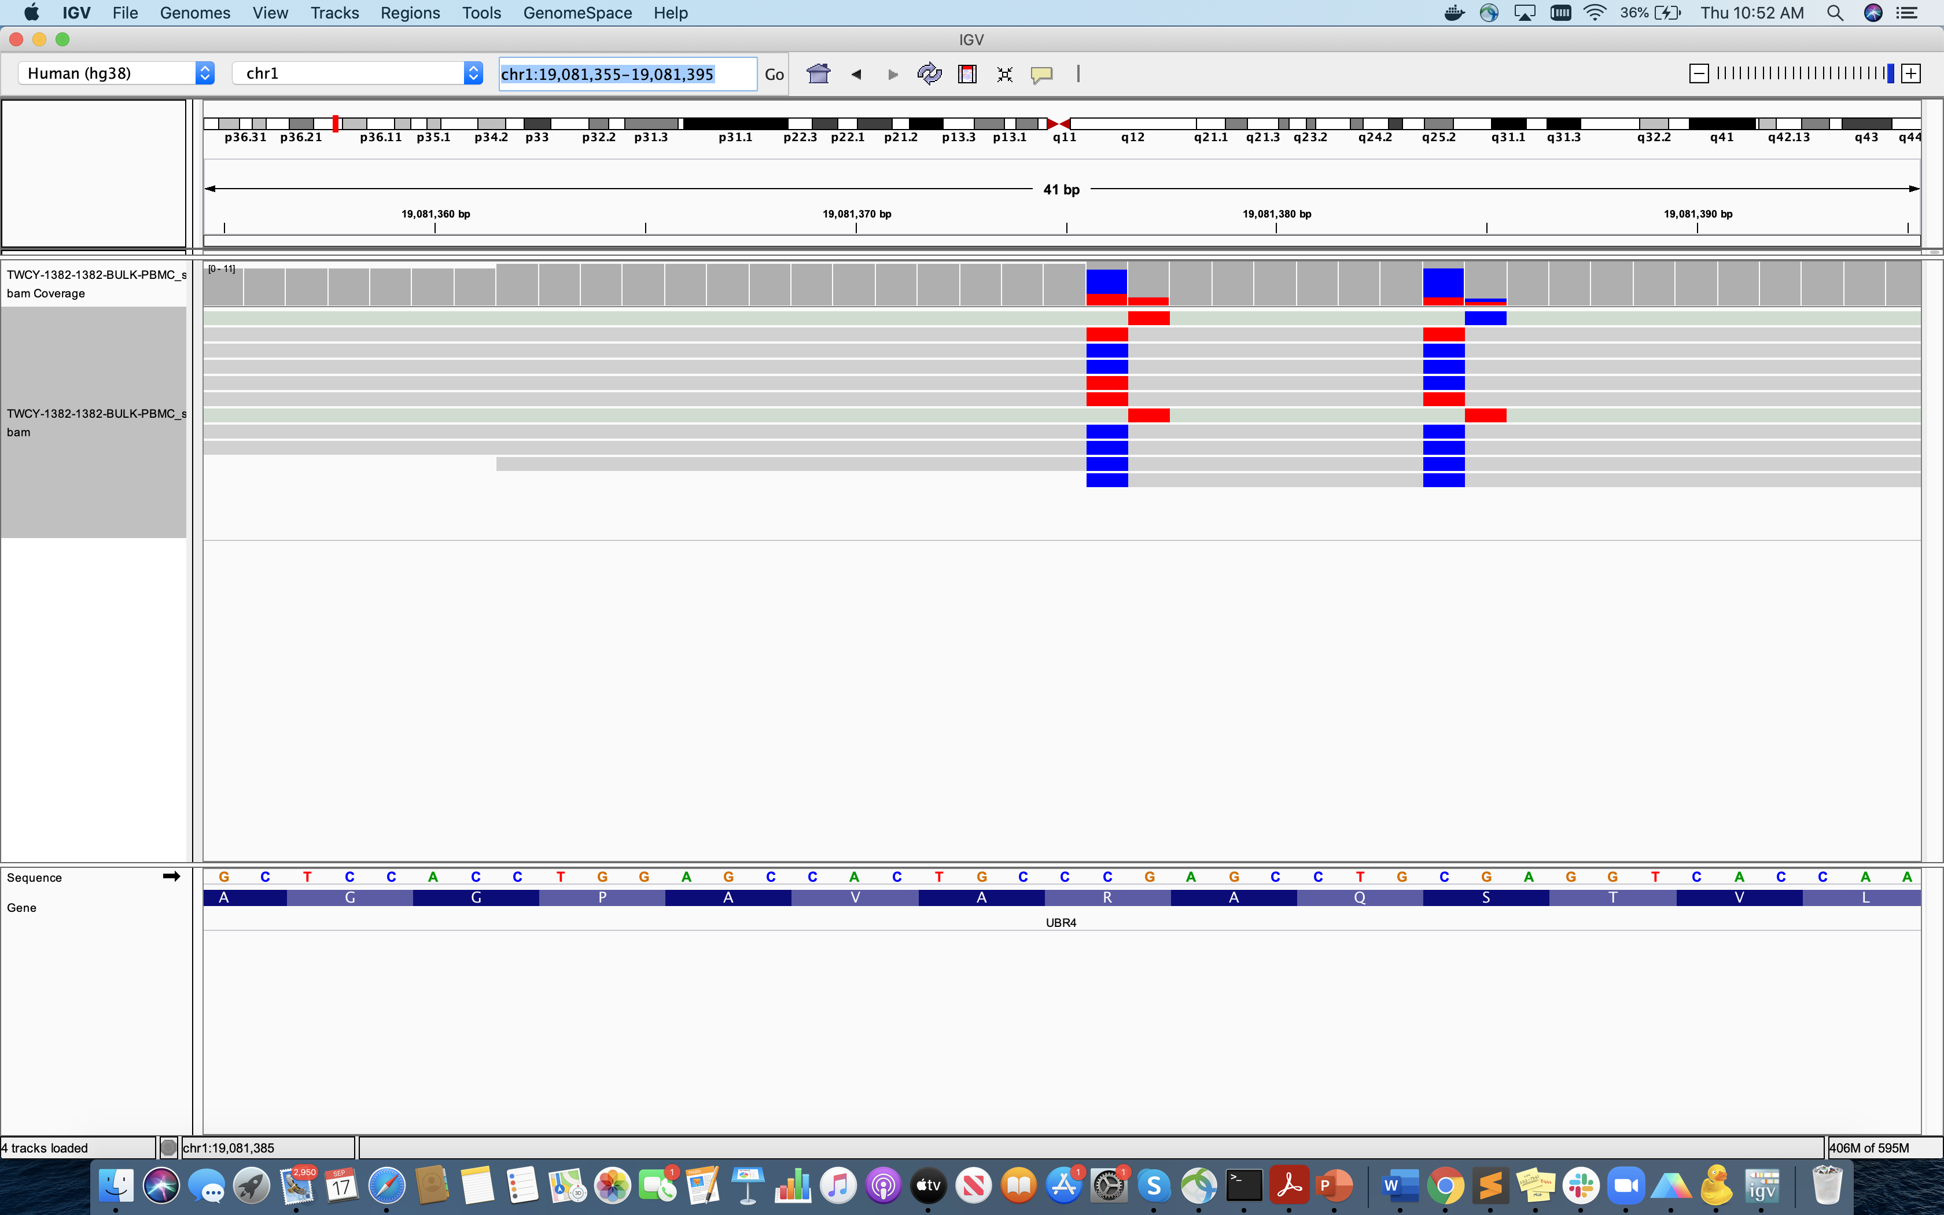
Confusion
Beta from igv
BISCUIT output
5/11=0.45
3/11=0.27

