Slide 1
CRC samples

Slide 2
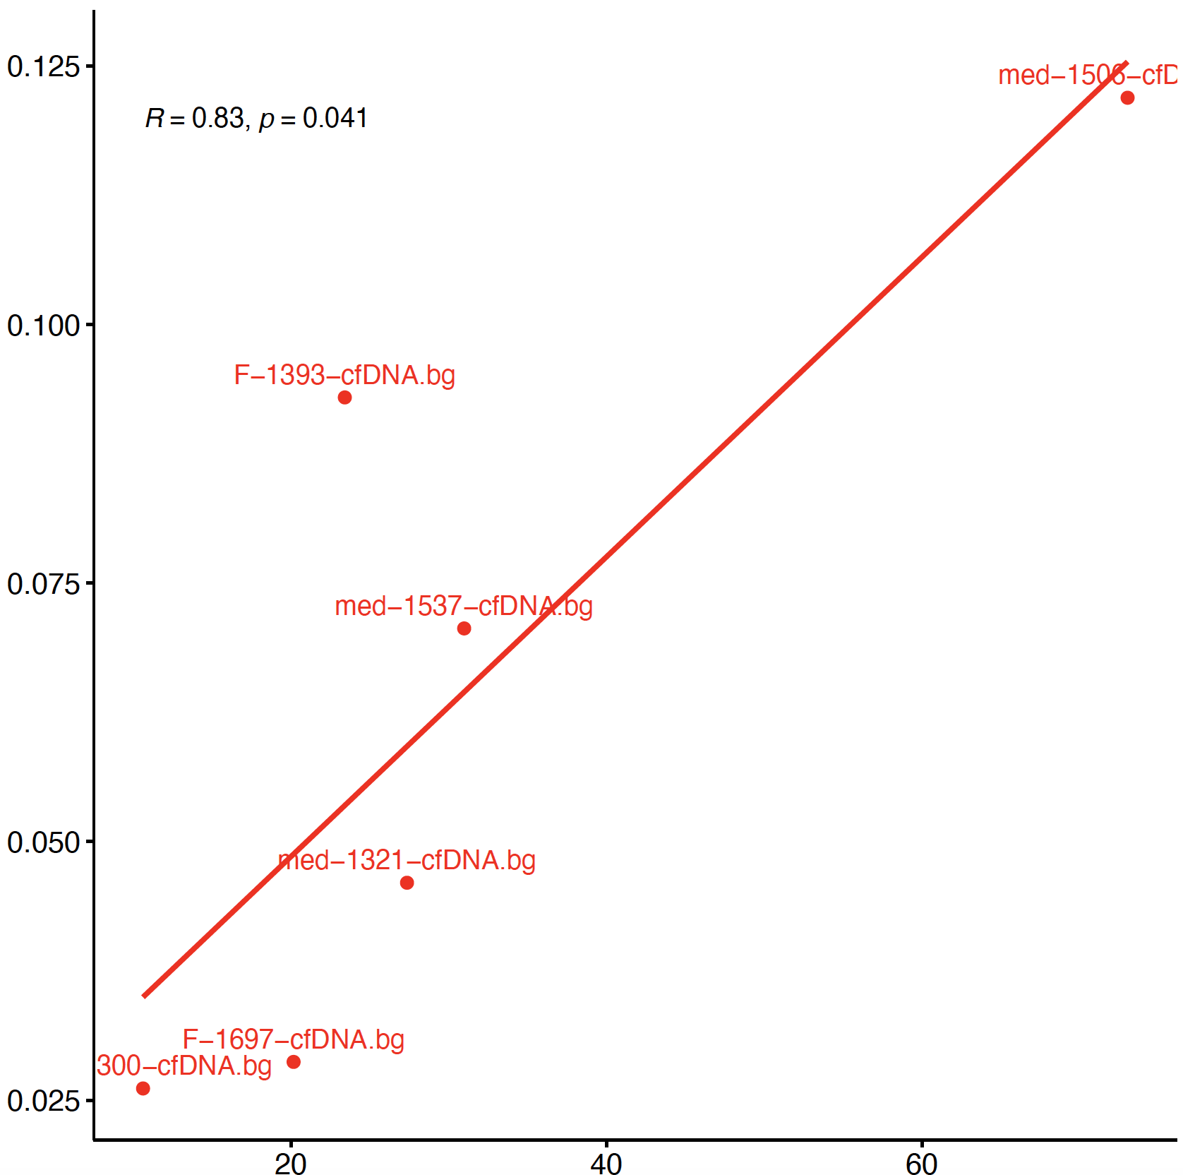
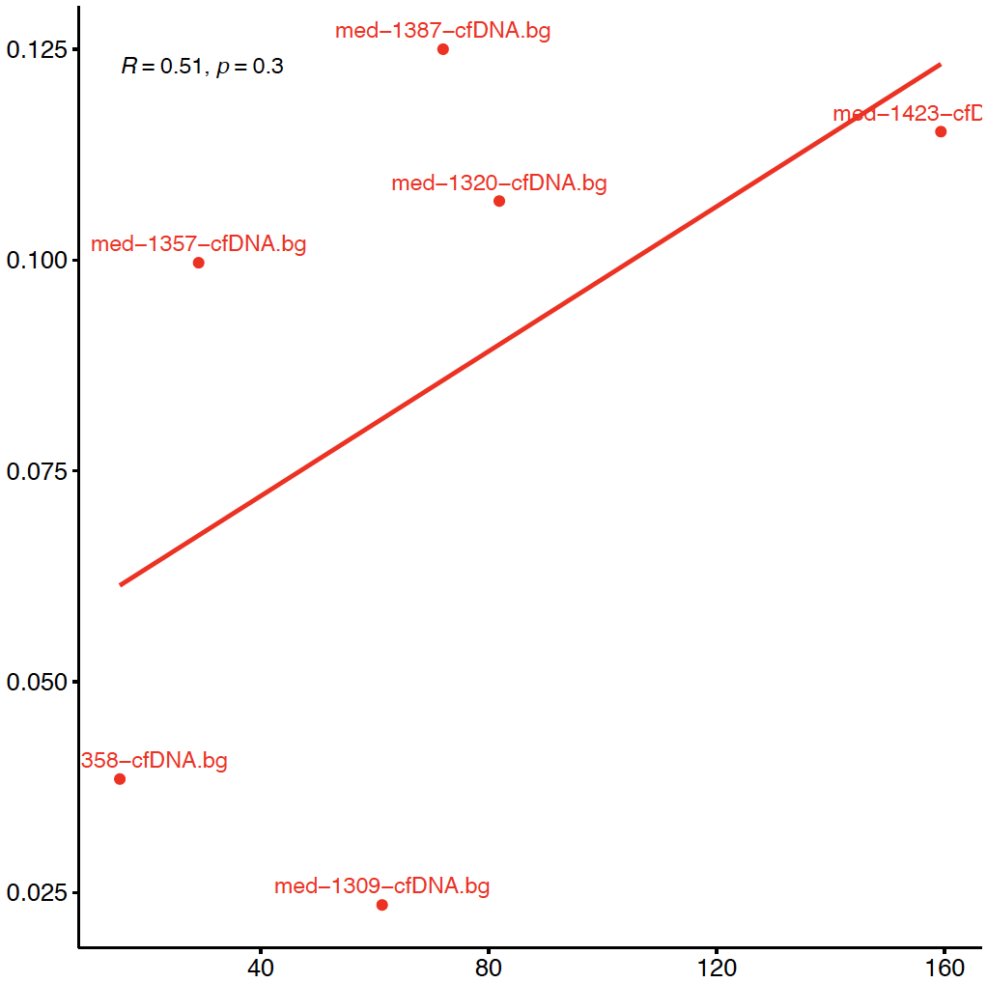


Review
#available fragment = [617,798]
#available fragment > 1000
Estimation
FACS CD45*tumor size
FACS CD45*tumor size
(#available fragment = #fragment corresponding to the “SM”)

Slide 3
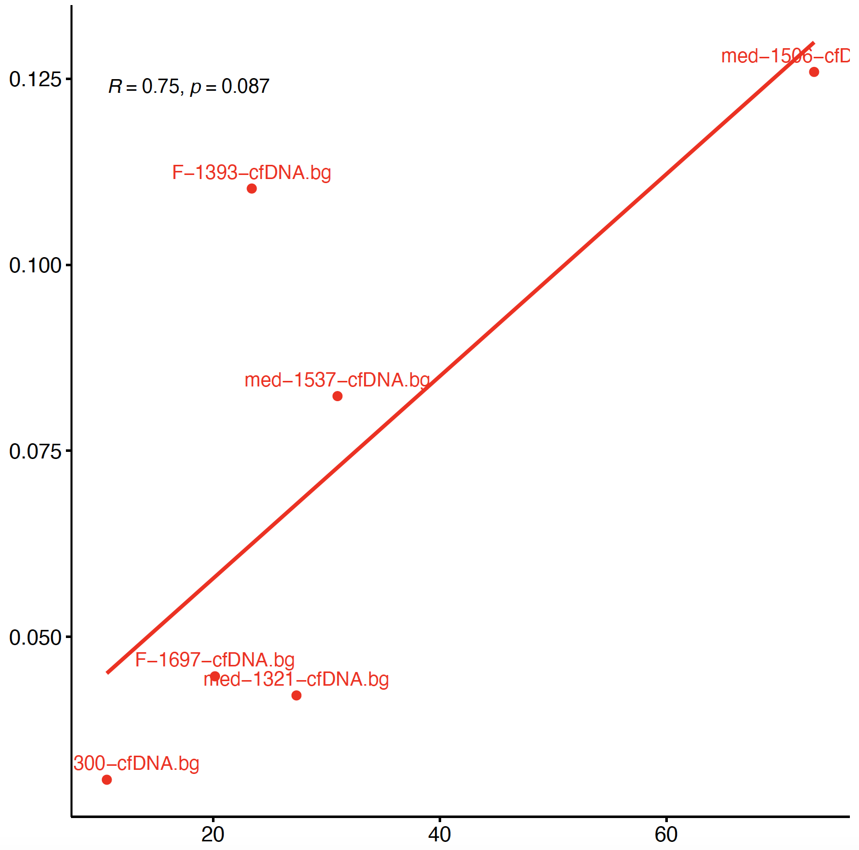

Down sampling (#fragment) “good” samples
Review
#available fragment = [617,798]
#available fragment > 1000
#available fragment = 650
Down sample
Estimation
FACS CD45*tumor size
FACS CD45*tumor size
FACS CD45*tumor size

Slide 4
Why all CRC samples not showing good correlation?
From the previous slide it seems down sampling the fragment does not reproduce the “bad” correlation.
So, we studied other qc of the CRC samples.
Mapping rate seems to be also related.

Slide 5
Effect of Mapping rate
Estimation
Estimation
FACS CD45*tumor size
FACS CD45*tumor size
To do: perform this analyses on melanoma cfDNA

Slide 6
In silico fragment length selection (melanoma cfDNA)

Slide 7
Median fragment length of samples
*these are the overall median fragment lengths

Slide 8
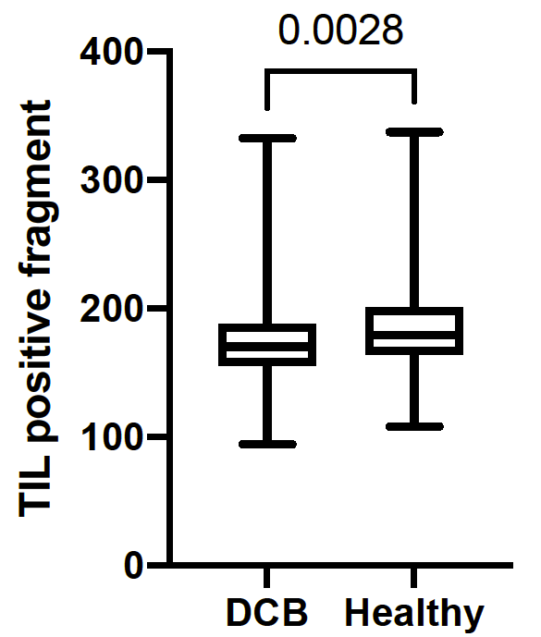
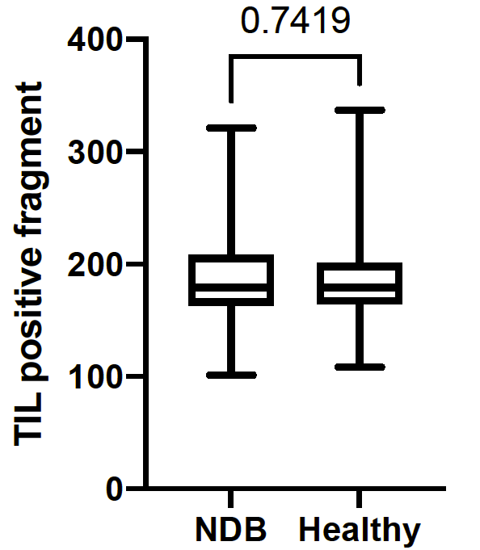
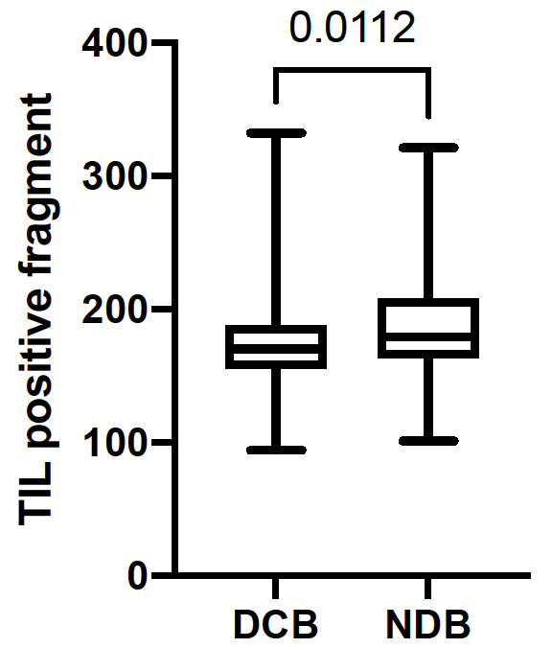
TIL specific fragment length
*these are the fragment lengths corresponding to signature matrix and read counting

Slide 9
In silico fragment length selection
The code to specify minimum and maximum fragment length for a specific cell type is ready.
From the previous slide, it seems maximum 170bp is a good choice for TIL fragment (median of DCB TIL fragment length is 170 bp)
On the next 2 slides, the results are shown for some maximum fragment length thresholds (we do not call a fragment TIL specific if the length is greater than the predefined threshold).
All results are shown in absolute mode, at least 3 cpg per fragment and for “good” melanoma and healthy cfNDA

Slide 10
No fragment size filtering
Fragment size <=170

Slide 11
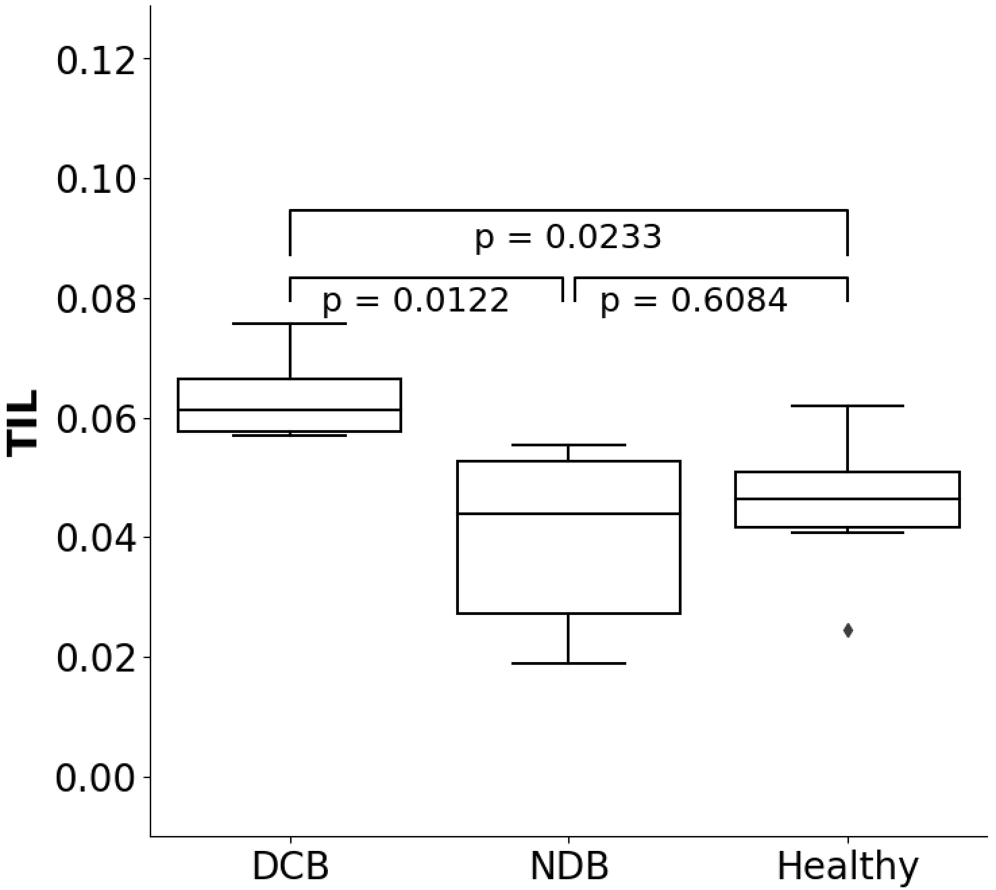
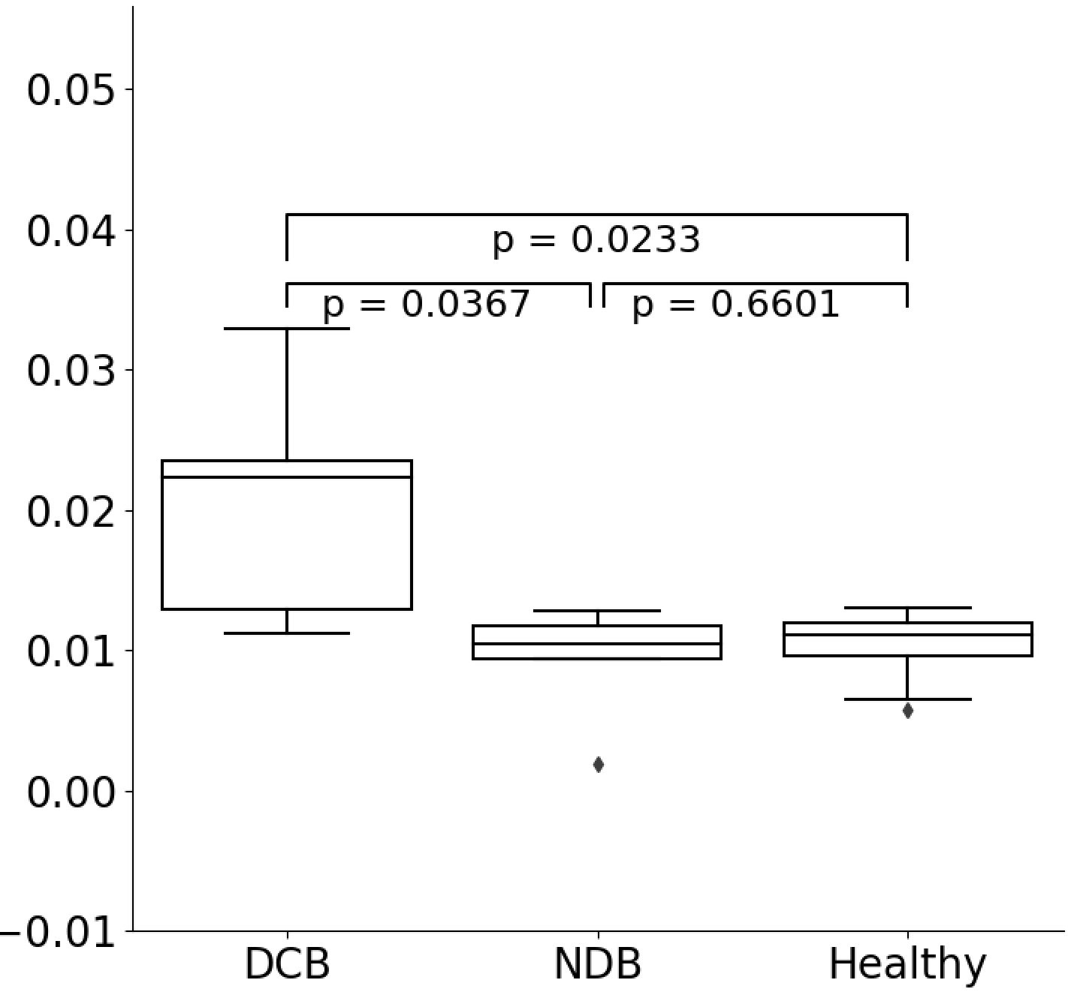
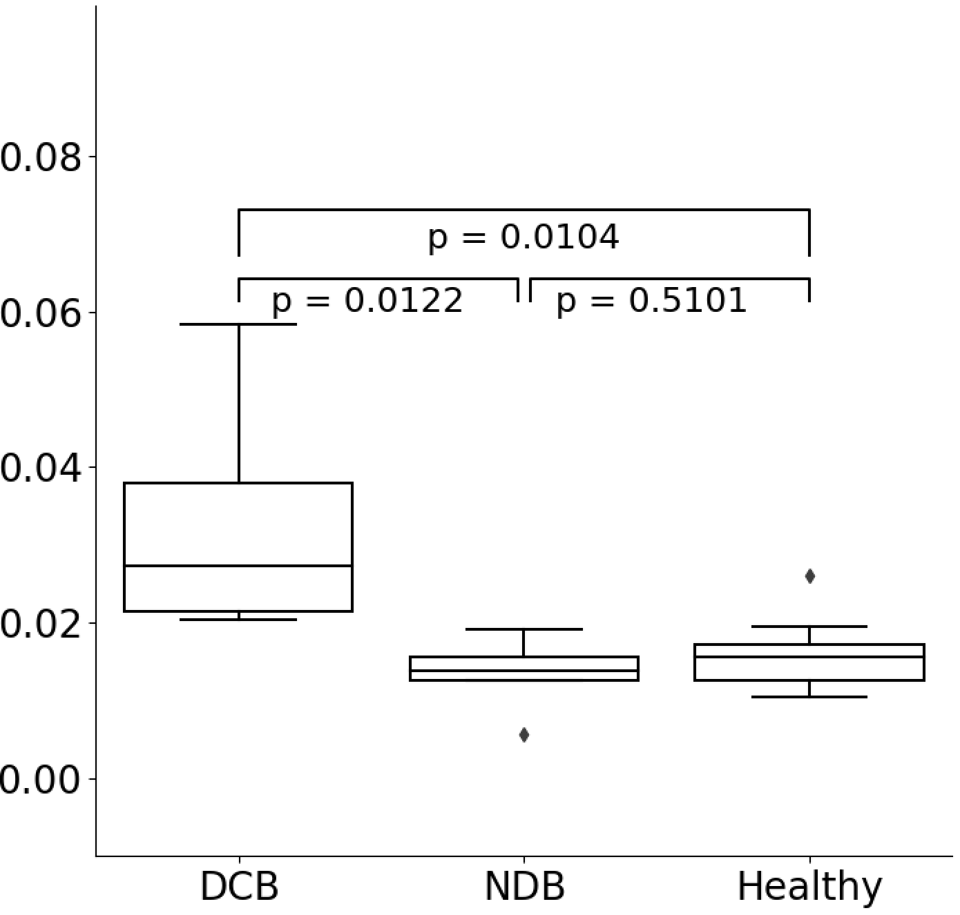
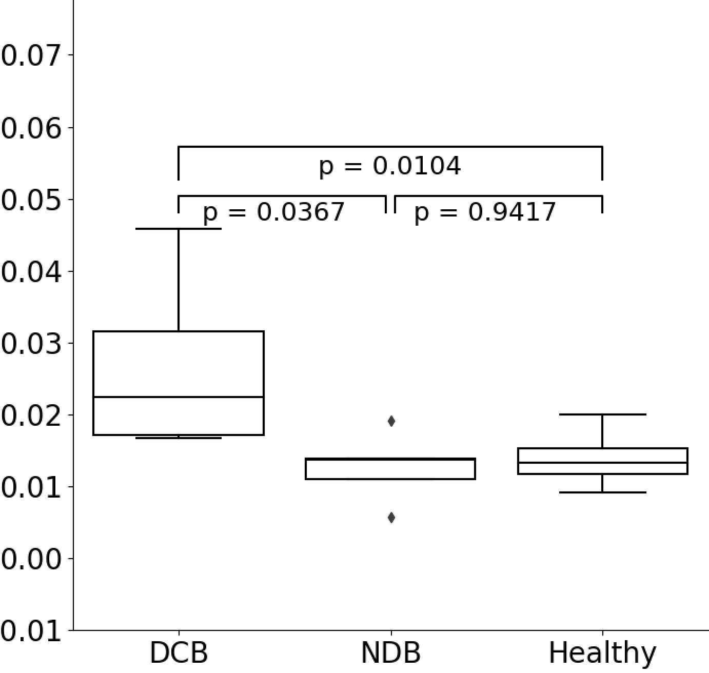
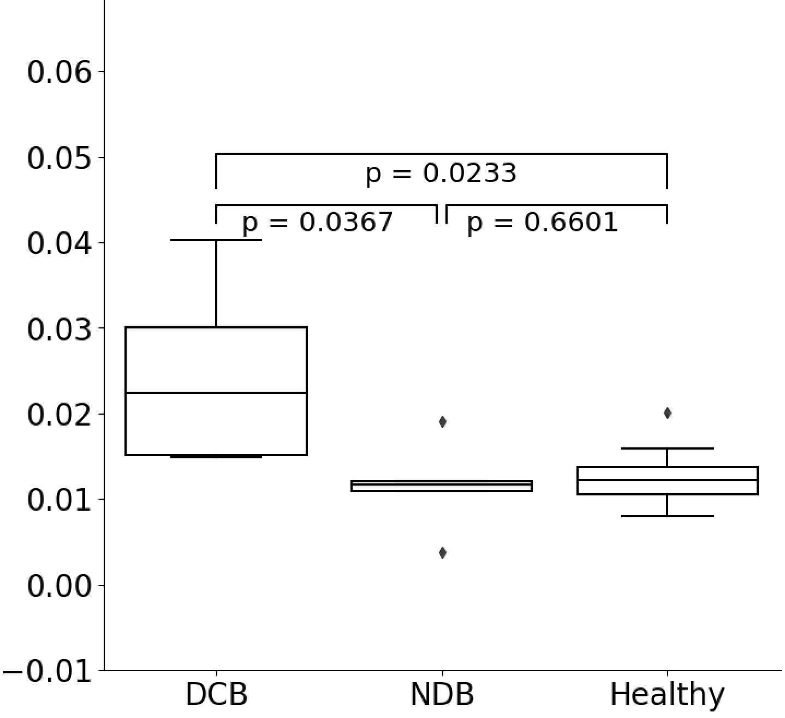
No fragment size filtering
Fragment size <=170
Fragment size <=167
Fragment size <=165
Fragment size <=160
TIL

Slide 12
Work in progress
Use in silico size selection for low fragment length samples
Updating the dashboard to include individual DMR AUC
Updating the DMR pipeline to include compartment wise delta (along with one vs rest delta)

