Slide 1
PBL, EPCAM, Mel_tumor

Slide 2
Data:
TCGA SKCM sample with high tumor and low TIL percentage
450k positions from our WGBS EPCAM and PBMC purified samples

Slide 3
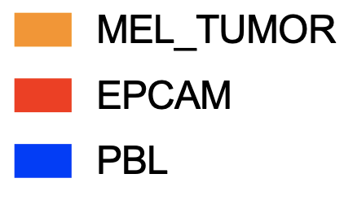

Slide 4
N
N
N
N
N
N
N
N

