Slide 1
Spike Experiment

Slide 2
SM
Spike Samples

Slide 3
CRC
Healthy
Spike Samples

Slide 4
Spike Samples

Slide 5
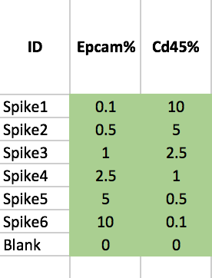
Spike Samples

