Slide 1
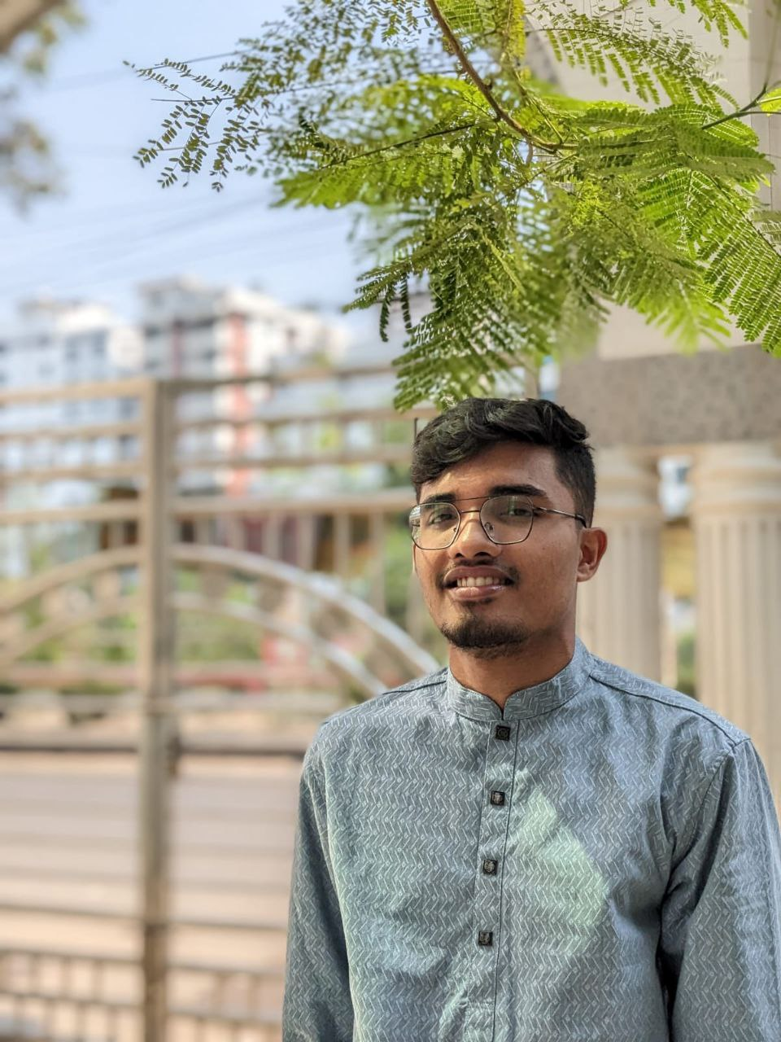
About Me
Undegraduate student looking for internship in the field of machine learning and data science
Education
2019
HSC
Dhaka College
GPA : 4.83
Irhamul Islam
2020-2025
Bachelor of Science(Eng.)
Student
Computer Science and Engineering,KUET
Proficiency skills
Machine Learning
Projects
Android Development
MS Office
News Paper Website
Problem Solving
Laravel,Php
Professional skills
GPA Prediction of student’s daily activity(application)
Machine Learning
Machine Learning,Android
Android Development
Compiler like C language
Web development
Bison,flex
Problem Solving
NewsPaper Database
Oracle,Sql
Personal Skills
Gym Management (Desktop Application
Team Work
Java,Mysql
Communication
Contact
Creative Thinking
Linkedln: Irhamul Islam
Mail : islam1907093@stud.kuet.ac.bd
Phone: 0152487936
Problem Solving

