Slide 1
Bangla Aspect Based Sentiment Analysis
CSE 4120
Technical Writing and Seminar
Supervised by:
Dr. K. M. Azharul Hasan
Professor
Department of CSE
KUET
Presented By:
Irhamul Islam Roll:1907093
Department of CSE
KUET
Sunanda Das
Assistant Professor
Department of CSE
KUET

Slide 2
Selected Papers
Table 1: Publication Details
Sl. No | Title | Author | Publisher | Source | Year
1 | Bangla Aspect-Based Sentiment Analysis Based on Corresponding Term Extraction | Forhad An Naim | Institute of Electrical and Electronics Engineers | International Conference on Information and Communication Technology | 2021
2 | Aspect Based Sentiment Analysis in Bangla Dataset Based on Aspect Term Extraction | Sabrina Haque Tasnim Rahman Asif Khan Shakir Md. Shohel Arman Khalid Been Biplob Farhan Anan Himu | Springer, Cham | Cyber Security and Computer Science: Second EAI International Conference | 2020
3 | BAN-ABSA: An Aspect-Based Sentiment Analysis dataset for Bengali and it’s baseline evaluation | Mahfuz Ahmed Sheikh Junayed Ayesha Tasnim Md Saiful Islam | Springer, Singapore | Proceedings of International Joint Conference on Advances in Computational Intelligence | 2021
2

Slide 3
Outlines
Introduction
Literature Review
Methodology
Result Analysis and Comparison
Findings
Recommendations
Conclusions
References
3

Slide 4
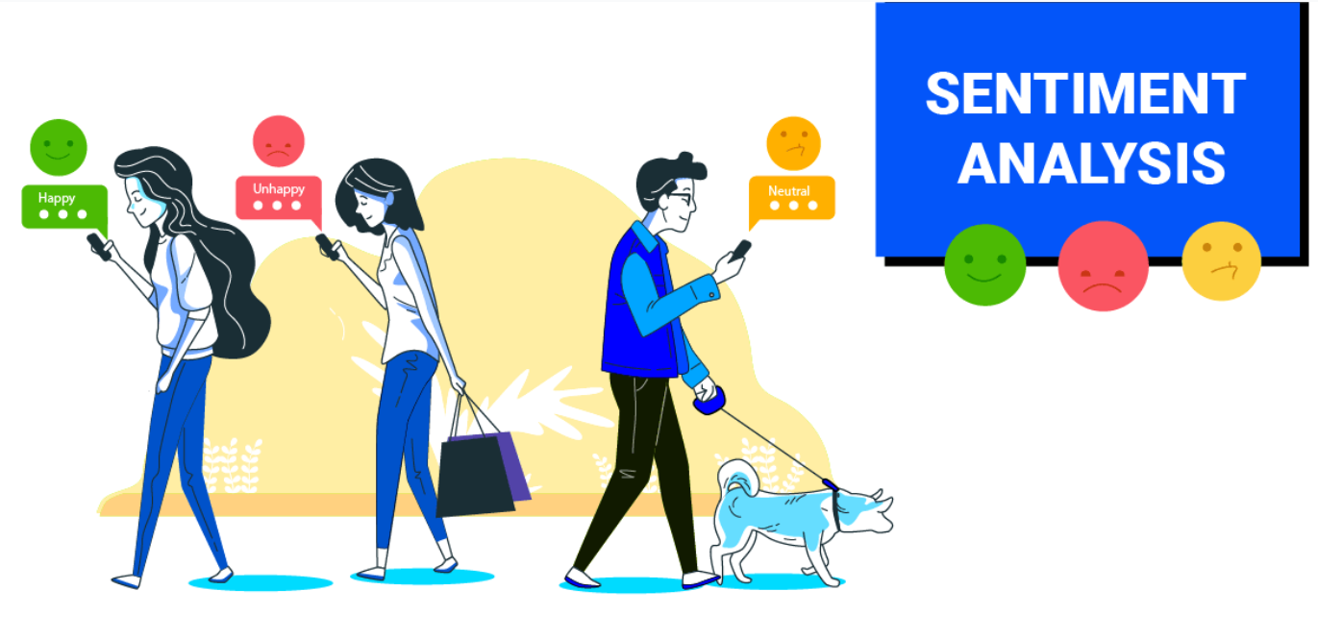
Introduction
The problem solved in these research papers is aspect-based sentiment analysis (ABSA) of Bangla text
ABSA works better than traditional sentiment analysis by identifying the specific aspects of a topic
For example, a review of a restaurant –.
“Although the food was good,the serving was bad”
ABSA would be able to identify "food" and "service" as the aspects and "good" and "slow" as the sentiments.
4

Slide 5

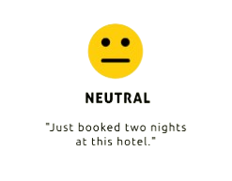
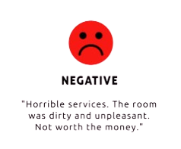
Introduction(Cont.)
Solving this problem is helpful as it can be used to understand customer reviews, social media monitoring, and market research.
to analyze customer reviews of their products
social media monitoring company to track the sentiment of public opinion
Great Servicfe or an
“Just booked two nights at this hotel.”
“Horrible services.The room
was dirty and unpleasant”.
“Great Service for an affordable price.We will come again”.
5

Slide 6
Literature Review
Table 2: Review
Name | Description
CNN[4] | determines whether the sentiment towards the identified aspect is positive, negative, or neutral
LSTM[5] | LSTMs can effectively capture long sequences, making them well-suited for analyzing text
Auto-encoders[6] | a type of deep learning architecture, for aspect classification
unsupervised machine learning[7] | techniques for customer review clustering, including:K-Means clustering,Density-Based Spatial Clustering of Applications with Noise (DBSCAN),Mean Shift clustering
6

Slide 7
Literature Review(Cont.)
Table 2: Review
Name | Description
Ontology Creation with CNN[8] | Ontologies are like semantic dictionaries that capture relationships between words and concepts.Converts words to numerical value
Attention-based Long Short-Term Memory Network[9] | allows the model to focus on relevant parts of the sentence depending on the specific aspect being analyzed
Cached Long Short-Term Memory networks[10] | addresses the shortcomings of RNNs for document-level sentiment analysis.
7

Slide 8
Methodology
Bangla Aspect-based Sentiment Analysis Based On Corresponding Term Extraction(1)
Dataset Collection : publicly available dataset
Pre-processing : Punctuation marks, numerical words, etc. were removed
Feature Engineering :
Used TF-IDF to tokenize the dataset into a matrix
Features that were constant or highly correlated were removed to improve model efficiency
8

Slide 9
Methodology(Cont.)
Bangla Aspect-based Sentiment Analysis Based On Corresponding Term Extraction(1)
Priority Sentence Part Weight Assignment (PSPWA) : New technique that focuses on nouns (considered the priority words) and the sentence parts containing them
Normalization: Data is normalized using a Min-Max classifier for better performance
Proposed method (including PSPWA) was evaluated using various machine learning algorithms
9

Slide 10
Methodology(Cont.)
Bangla Aspect-based Sentiment Analysis Based On Corresponding Term Extraction(1)
Dataset
Data Pre-Processing
PSPWA algorithm
Learning Algorithm
ABSA Model
Model Evaluation
Figure 1: Process chart of the proposed model
10

Slide 11

Methodology(Cont.)
Bangla Aspect-based Sentiment Analysis Based On Corresponding Term Extraction(1)
Calculate PL
Prepare Stem Library
PSPWA algorithm
Find greatest Part
Find Least Common part
Weight Assignment
11

Slide 12
Methodology(Cont.)
Aspect Based Sentiment Analysis in Bangla Dataset Based on Aspect Term Extraction(2)
Dataset Collection : publicly available dataset
Pre-processing : data cleaning by minimal pre-processing
Feature Extraction : Text reviews are converted into numerical features for machine learning algorithms.
Two techniques -
Bag-of-Words (BOW)
TF-IDF
12

Slide 13
Methodology(Cont.)
Aspect Based Sentiment Analysis in Bangla Dataset Based on Aspect Term Extraction(2)
Training Algorithm Selection : Choosing the best machine learning algorithm . The following are selected -
Support Vector Machine (SVM)
Random Forest (RF)
K-Nearest Neighbors (KNN)
Logistic Regression(LR)
Naïve Bayes(NB)
13

Slide 14
Methodology(Cont.)
Aspect Based Sentiment Analysis in Bangla Dataset Based on Aspect Term Extraction(2)
Collected Raw Data(Review)
Feature Extraction
Data Pre-processing
Split Dataset
Remove punctuation and special characters
Tokenization
Aspect Category Classifying
Predicting Category
Cleaned Data(Review)
Figure 2 : Proposed model for ABSA
14

Slide 15
Methodology(Cont.)
BAN-ABSA: An Aspect-Based Sentiment Analysis dataset for Bengali and it’s baseline evaluation(3)
Dataset Collection : Created a benchmark dataset,BAN-ABSA containing 9009 comments collected from news portals
Pre-processing : Remove comments containing English words , remove punctuation and tokenizing the data
Data Annotation : Based on -
Aspect | Politics | Sports | Religion | Others
Polarity | Positive | Negative | Neutral
15

Slide 16
Methodology(Cont.)
BAN-ABSA: An Aspect-Based Sentiment Analysis dataset for Bengali and it’s baseline evaluation(3)
Zipf's law was applied to analyze the annotator’s reliability in the dataset
Apply BiLSTM: why?
information only propagates in forward states.
Dependent only on past information
Can’t use forward information
In LSTM-
BiLSTM can overcome this shortcoming by using two layers -
One capture features of past
Other one captures feature of opposite direction
16

Slide 17
Methodology(Cont.)
BAN-ABSA: An Aspect-Based Sentiment Analysis dataset for Bengali and it’s baseline evaluation(3)
LSTM
LSTM
LSTM
Output Layer
Backward Layer
LSTM
LSTM
LSTM
Forward Layer
LSTM
LSTM
LSTM
Input Layer
Figure 3: BiLSTM Architecture
17

Slide 18
Methodology(Cont.)
BAN-ABSA: An Aspect-Based Sentiment Analysis dataset for Bengali and it’s baseline evaluation(3)
Data Collection
Data Preprocessing
Data Annotation
Ensuring Inter-Annotator Reliability
Zipf law was applied to analyze the distribution of words
Bi-LSTM Experiment
Figure 4: Proposed Method
18

Slide 19
Methodology(Cont.)
Table 3: Comparison of Methods
Paper 1 | Paper 2 | Paper 3
Publicly Available Dataset Used | Publicly Available Dataset Used | Created a High Quality dataset,named BAN-ABSA
Normal preprocessing | Minimal prerprocessing | Normal preprocessing with rigorous data annotations
PSPWA technique suggested | No new technique suggested | No new technique
Similar learning algorithms | Similar learning algorithms | Similar algorithms with Bi-LSTM showing better result
19

Slide 20
Result Analysis and Comparison
Table 4: F-1 Score using different methods
Method | Dataset | Paper 1 | Paper 2 | Paper 3
SVM
KNN
RF
Cricket
0.48
0.35
0.69
Restaurant
0.52
0.39
Cricket
0.31
0.27
0.47
Restaurant
0.39
0.38
Cricket
0.41
0.37
0.65
Restaurant
0.35
0.35
Using Bi-LSTM, Paper 3 achieves F1-score of 79.38%
20

Slide 21
Findings
In method of corresponding term extraction, research relies on publicly available datasets, which may not be representative of the broader Bangla language
addresses only the first part of ABSA (aspect term extraction).
If data pre processing is minimal then leading to higher performance.
BAN-ABSA solves the lack of Bengali datasets and creates a new high-quality standard
21

Slide 22
Findings(Cont.)
Also we found there-
By calculating the Intra-class Correlation Coefficient(ICC), the paper demonstrates a good level of agreement between the annotators
the use of Bi-directional Long Short-Term Memory (Bi-LSTM) models for the ABSA tasks achieving the best result
BAN-ABSA can be used for further research
22

Slide 23
Recommendation
I recommend paper 3 for researchers interested in Aspect-Based Sentiment Analysis (ABSA) in Bengali for better f1-score
addresses the scarcity of Bengali ABSA datasets by creating a new high-quality benchmark dataset called BAN-ABSA
details the data collection, pre-processing, and annotation processes, ensuring the dataset's reliability.
evaluates various machine learning models and establishes a baseline performance using Bi-LSTMs
23

Slide 24

Conclusion
We analyzed three research papers that solves the challenge of aspect-based sentiment analysis (ABSA) for Bangla text
Sentiment analysis is crucial for understanding customer reviews, social media trends, and market research
ABSA provides a deeper understanding by pinpointing the aspects being discussed and the associated sentiment
24

Slide 25
References
1. Naim, Forhad An. "Bangla aspect-based sentiment analysis based on corresponding term extraction." 2021 International Conference on Information and Communication Technology for Sustainable Development (ICICT4SD). IEEE, 2021.
2. Haque, Sabrina, et al. "Aspect based sentiment analysis in bangla dataset based on aspect term extraction." Cyber Security and Computer Science: Second EAI International Conference, ICONCS 2020, Dhaka, Bangladesh, February 15-16, 2020, Proceedings 2. Springer International Publishing, 2020.
3. Ahmed Masum, Mahfuz, et al. "BAN-ABSA: An Aspect-Based Sentiment Analysis dataset for Bengali and its baseline evaluation." Proceedings of International Joint Conference on Advances in Computational Intelligence: IJCACI 2020. Singapore: Springer Singapore, 2021.
25

Slide 26
References
4. Cahyadi, Alson, and Masayu Leylia Khodra. "Aspect-based sentiment analysis using convolutional neural network and bidirectional long short-term memory." 2018 5th international conference on advanced informatics: concept theory and applications (ICAICTA). IEEE, 2018.
5. Khine, Win Lei Kay, and Nyein Thwet Thwet Aung. "Applying deep learning approach to targeted aspect-based sentiment analysis for restaurant domain." 2019 International Conference on Advanced Information Technologies (ICAIT). IEEE, 2019.
6. Bodini, Matteo. "Aspect extraction from bangla reviews through stacked auto-encoders." Data 4.3 (2019): 121.
7. Jamil, Md Shah Jalal, et al. "Customer review analysis by hybrid unsupervised learning applying weight on priority data." Proceedings of International Joint Conference on Advances in Computational Intelligence: IJCACI 2020. Springer Singapore, 2021.
26

Slide 27
References
8. Kumar, Ravindra, Husanbir Singh Pannu, and Avleen Kaur Malhi. "Aspect-based sentiment analysis using deep networks and stochastic optimization." Neural Computing and Applications 32 (2020): 3221-3235.
9. Wang, Yequan, et al. "Attention-based LSTM for aspect-level sentiment classification." Proceedings of the 2016 conference on empirical methods in natural language processing. 2016.
10. Xu, Jiacheng, et al. "Cached long short-term memory neural networks for document-level sentiment classification." arXiv preprint arXiv:1610.04989 (2016).
27

Slide 28
Thank you..

