Slide 1
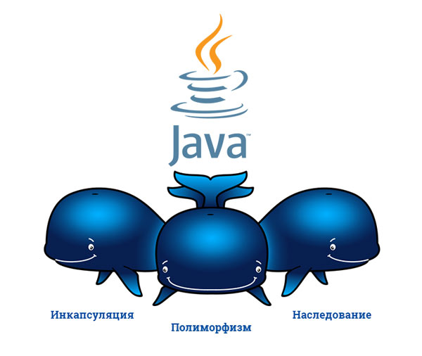
Принципы ООП

Slide 2
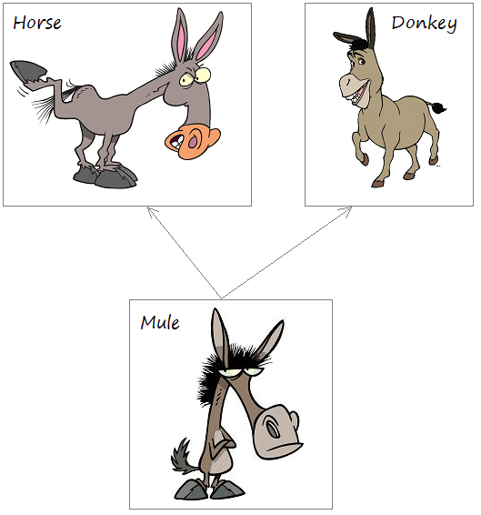
Наследование

Slide 3
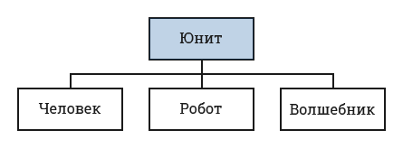
Наследование Java
public class Unit {
String name;
int health;
public Unit(String n, int h) {
name = n;
health = h;
}
void printInfo () { Log.i("Test", "Unit " + name); }
}

Slide 4
public class Human extends Unit{
…
}
public class Robot extends Unit{
…
}
public class Wizard extends Unit{
…
}
Наследование Java

Slide 5
public class Unit {
String name;
int health;
public Unit() {
}
public Unit(String n, int h) {
name = n;
health = h;
}
void printInfo () { Log.i("Test", "Unit " + name); }
}
public class Human extends Unit {
}
class Human
String name;
int health;
public Unit() {
}
void printInfo () { Log.i("Test", "Unit " + name); }

Slide 6
Unit unit = new Unit("heroU", 100); Human human = new Human(); unit.printInfo(); human.printInfo();
Создание объектов

Slide 7
public class Unit {
String name;
int health;
public Unit() { }
public Unit(String n, int h) {
name = n;
health = h;
}
void printInfo () { Log.i("Test", "Unit " + name); }
}
public class Human extends Unit {
public Human(String n, int h) {
name = n;
health = h;
}
@Override
void printInfo () { Log.i("Test", “Human " + name); }
}
Наследование Java

Slide 8
Unit unit = new Unit("heroU", 100); Human human = new Human("heroH", 100); unit.printInfo(); human.printInfo();
Создание объектов

Slide 9


Unit
Human
Ключевые слова this и super

Slide 10
public class Unit {
String name;
int health;
public Unit() { }
public Unit(String name, int health) {
this.name = name;
this.health = health;
}
…
}
public class Human extends Unit {
public Human(String name, int health) {
this.name = name;
this.health = health;
}
}
Ключевые слова this и super

Slide 11
Ключевое слово this
public class Unit {
String name;
int health;
public Unit() {
health = 100;
}
public Unit(String name) {
this();
this.name = name;
}
public Unit(String name, int health) {
this(name);
this.health = health;
}
}

Slide 12
public class Human extends Unit {
public Human(String name, int health) {
this.name = name;
this.health = health;
}
}
public class Unit {
String name;
int health;
public Unit() { }
public Unit(String name, int health) {
this.name = name;
this.health = health;
}
…
}
public class Human extends Unit {
public Human(String name, int health) {
super(name, health);
}
}
Ключевое слово super

