Slide 1

SurfaceView

Slide 2
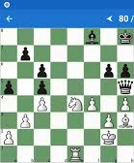

View vs SurfaceView

Slide 3
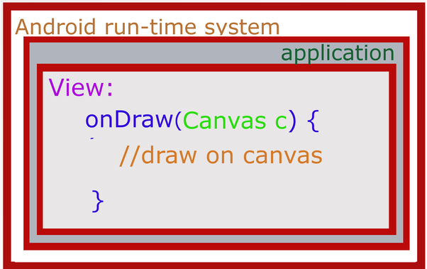
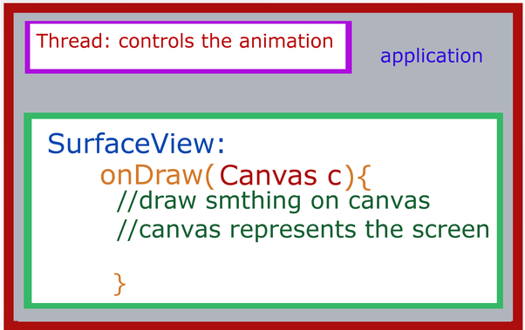
View vs SurfaceView

Slide 4
public class DrawView extends SurfaceView implements SurfaceHolder.Callback
Создание SurfaceView

Slide 5

Потоки

Slide 6
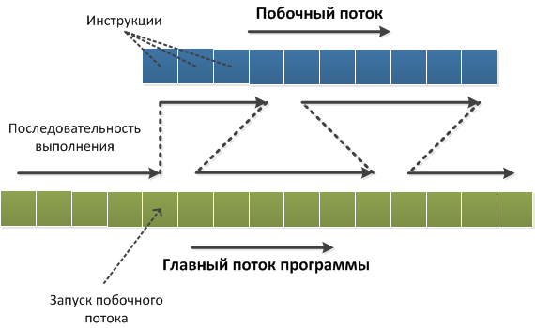
Потоки

Slide 7
public class DrawThread extends Thread private SurfaceHolder surfaceHolder; private boolean running = false;
@Override public void run() { }
Создание SurfaceView

