Slide 1
Pattern Match Study: Abbreviated Results
Iria Wang

Slide 2
Variables
Independent Variables
Dependent Variables
Template Length
Minimum Match Score (MMS)
Rotation Angle Range (RAR)
Resolution
Standard deviation
Accuracy
Mean
Time

Slide 3
General Results
MMS: 800
<800: usable, but likely to pattern match incorrectly
>800: usable, but likely not to pattern match
RAR: none
Takes 4x longer to pattern match
Template width: template should just encompass whole Fiducial Mark
Template length: there is an optimal range for each Fiducial Mark to minimize time and maximize accuracy
Studies were replicated on a second sensor with similar or the same results

Slide 4
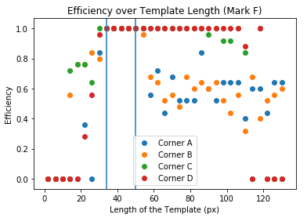


Mark F
Efficiency:
Time: <60 ms to pattern match
Accuracy: <2 um within expected
Optimal length: between 34 and 50 pixels
68x34
68x50

Slide 5
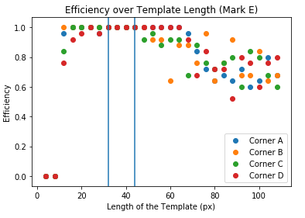


Mark E
Efficiency:
Time: <60 ms to pattern match
Accuracy: <2 um within expected
Optimal length: between 32 and 44 pixels
62x32
62x44

Slide 6
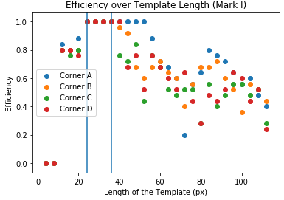

Mark I
Efficiency:
Time: <55 ms to pattern match
Accuracy: <2 um within expected
Optimal length: between 24 and 36 pixels
88x24
88x36

Slide 7
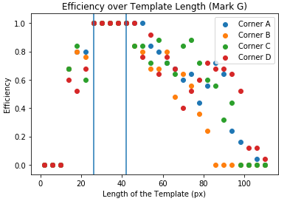

Mark G
Efficiency:
Time: <50 ms to pattern match
Accuracy: <2 um within expected
Optimal length: between 26 and 42 pixels
74x26
74x42

Slide 8
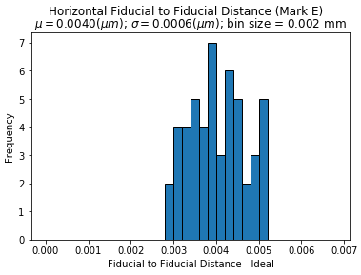
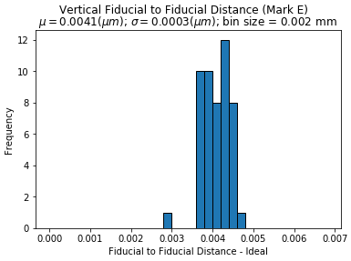
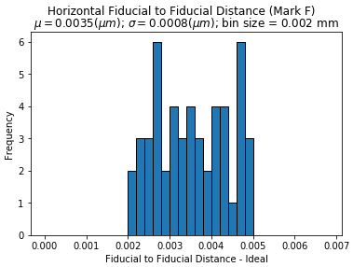
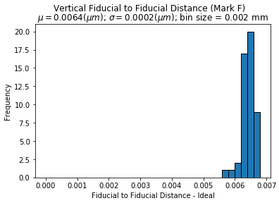
Problem…
Used optimal sizes to measure Fiducial to Fiducial – the skew is still there!!

Slide 9
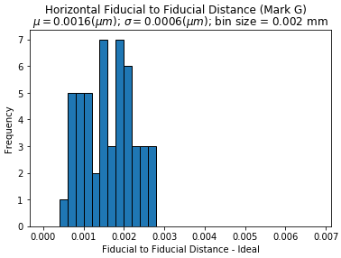
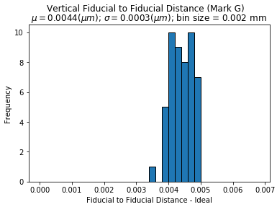
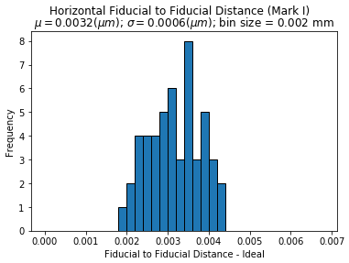
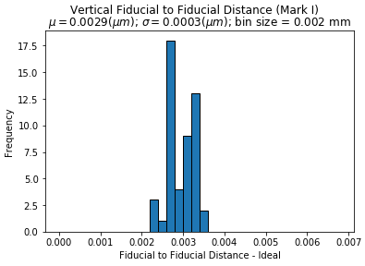
Problem…
Used optimal sizes to measure Fiducial to Fiducial – the skew is still there!!

