Slide 1

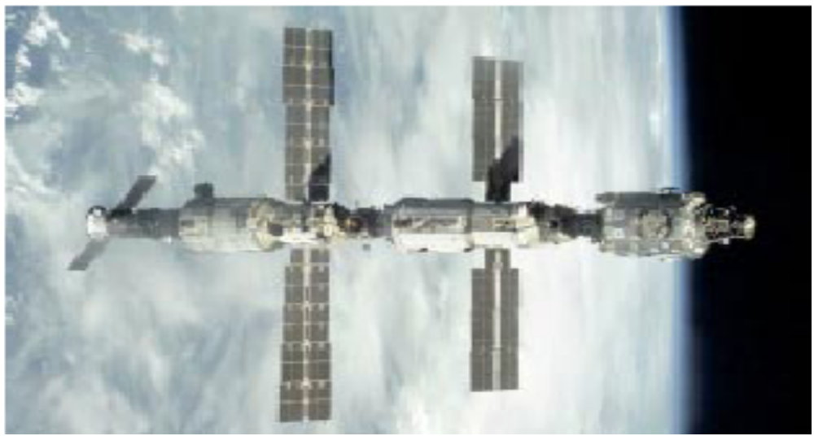
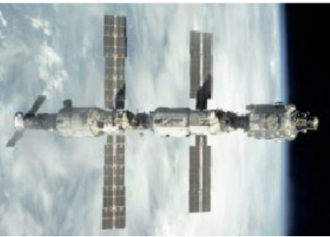
Chapter 4
Rigid Body Dynamics

Slide 2
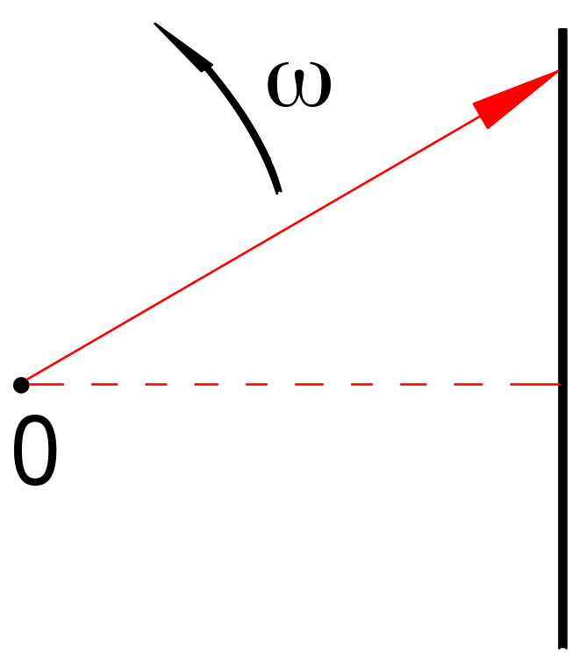
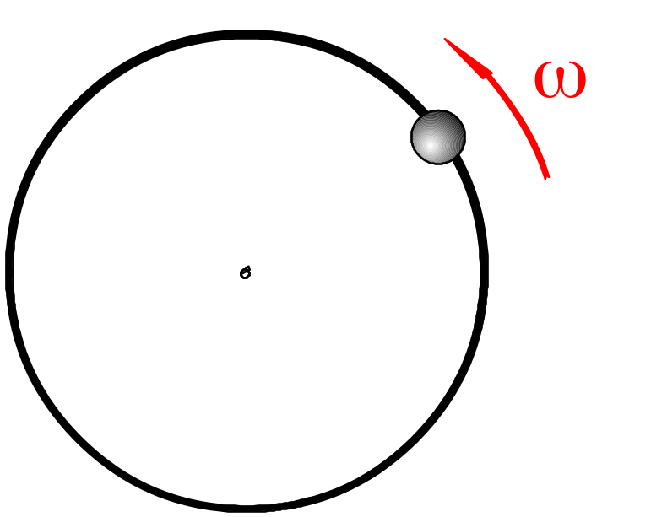
§1.Law of conservation of angular momentum
1-1 Angular momentum
Momentum: Some other
quantity is conserved
beside mechanical energy.

Slide 3
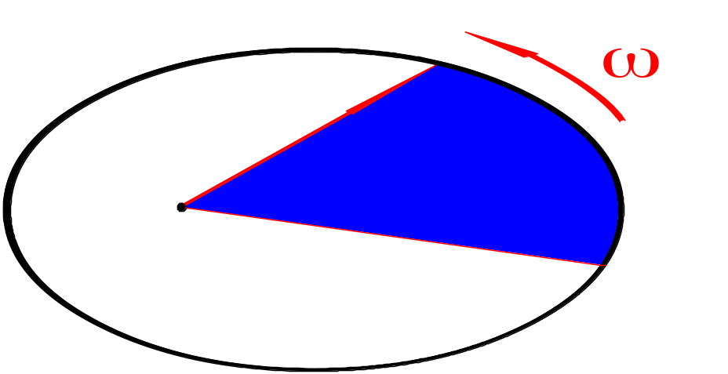

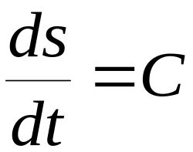
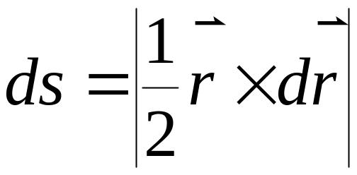
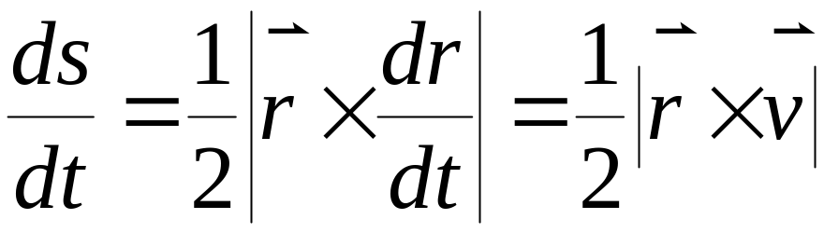
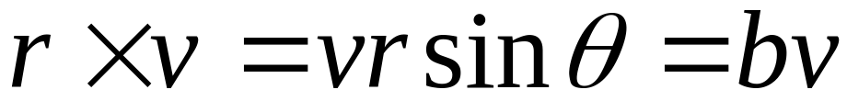
History Kepler ellipse

Slide 4
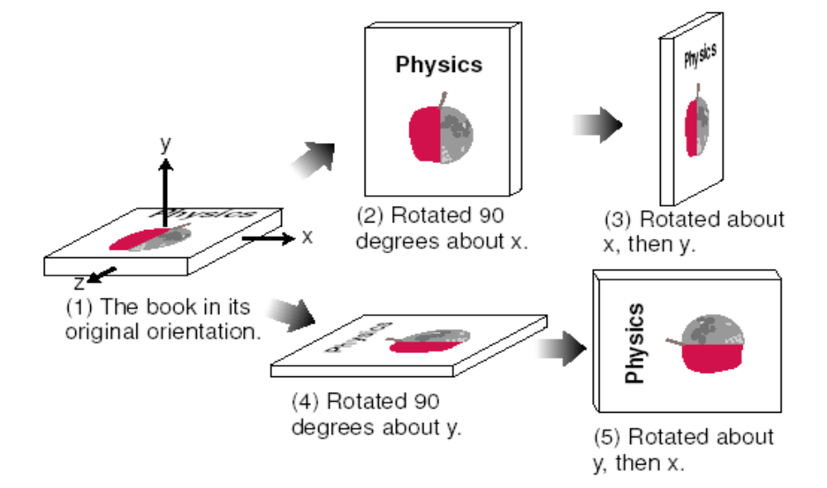
Notice:

Slide 5
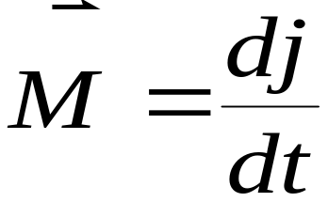

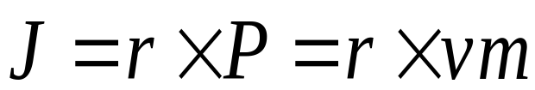
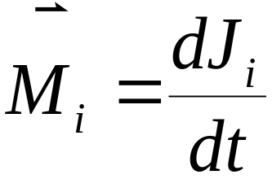
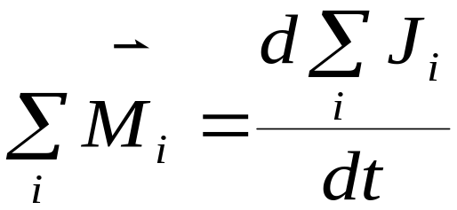
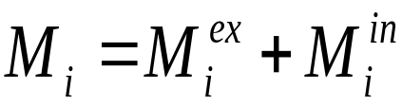
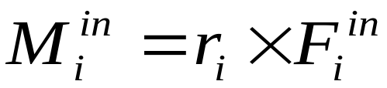
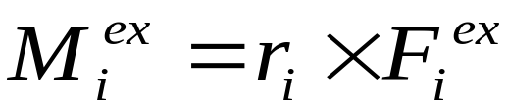
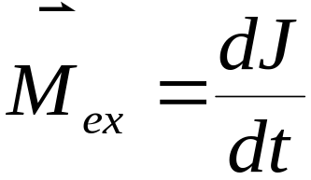
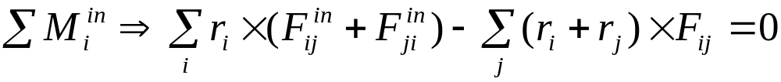
1-2 theorem of angular momentum
1. Particle
2. System of particles

Slide 6
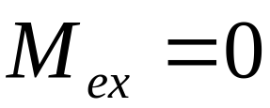

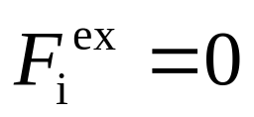
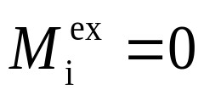
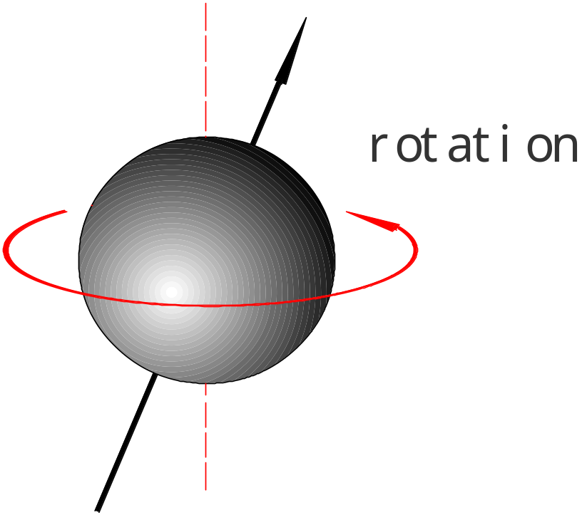
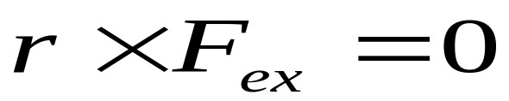

conservation of angular momentum
(1).Isolated system
(2).Central force
Pulsar
Neutron star

Slide 7
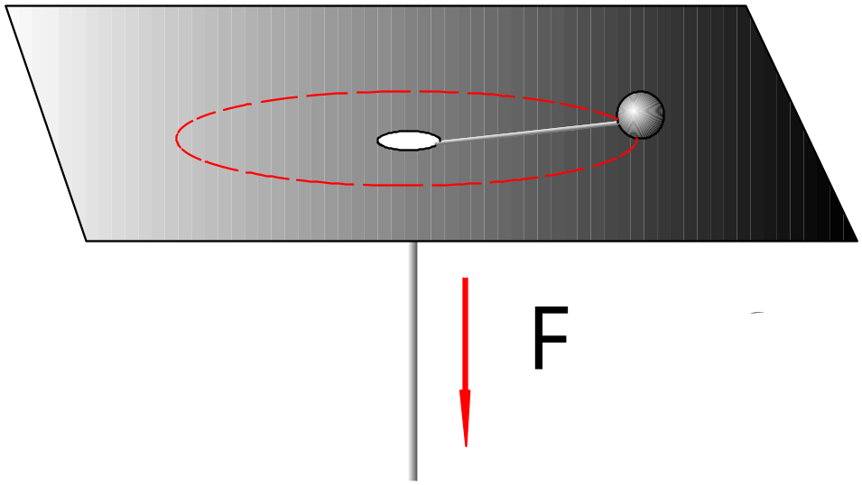
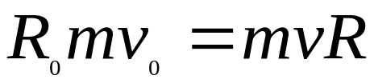
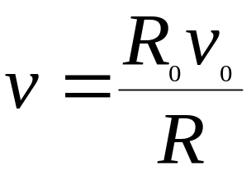
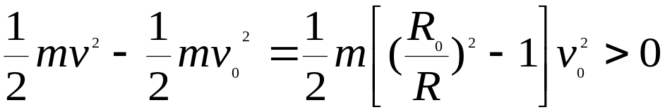
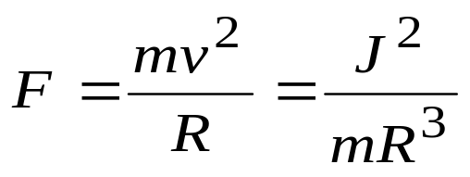
Example :
<helicopter>

V=?

How is the work down by F?
●
Express F by J ,M, R.
Solve:


●

Slide 8
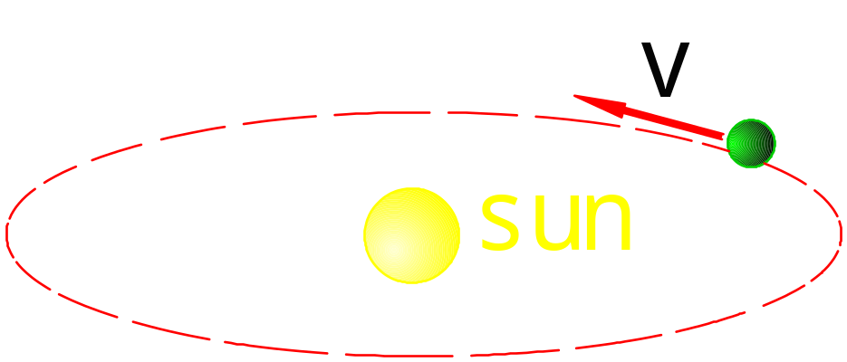
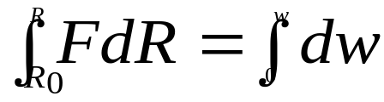
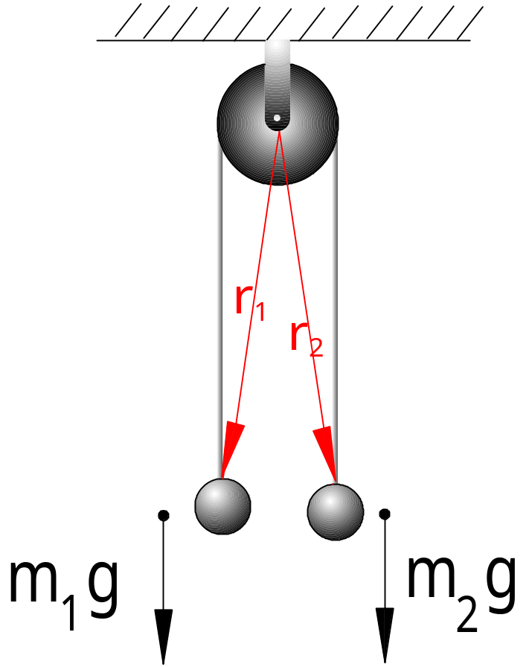
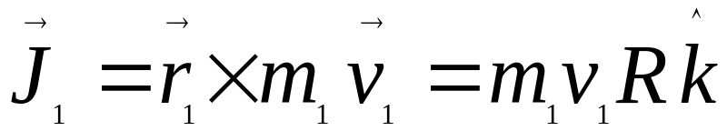
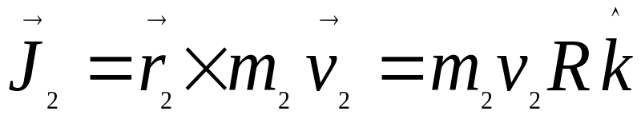
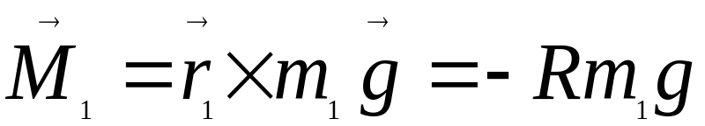
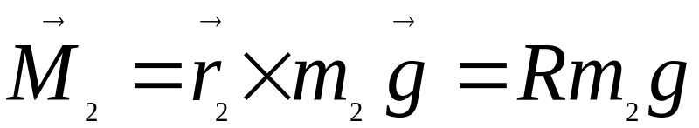
ellipse
Example:

Slide 9
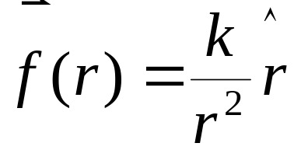
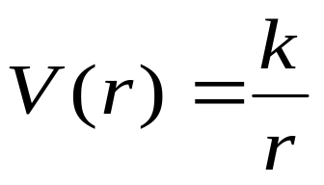
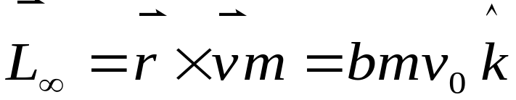
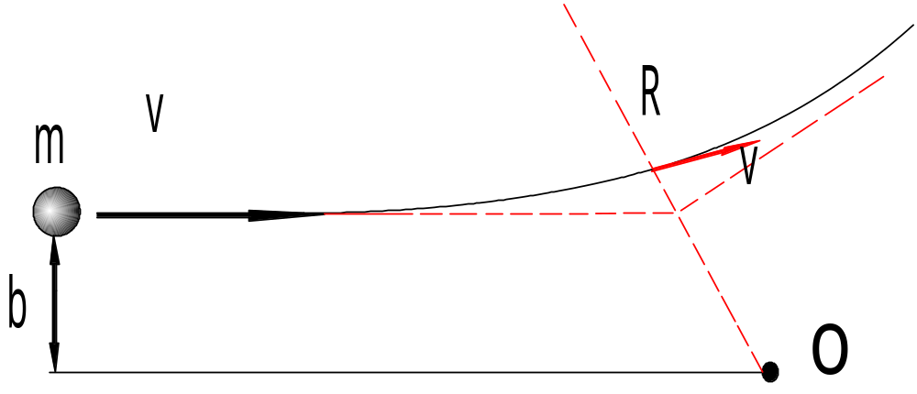
Problem 4-11
Center force:

Slide 10
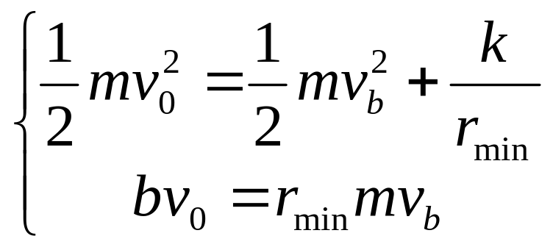
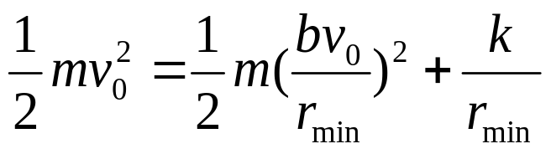
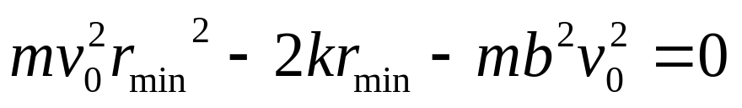
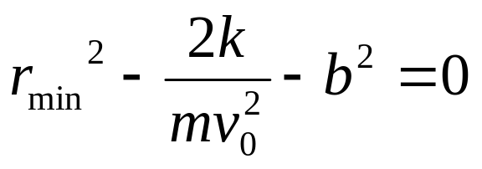
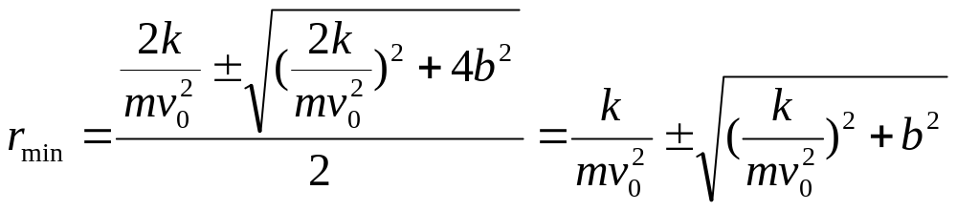
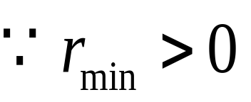
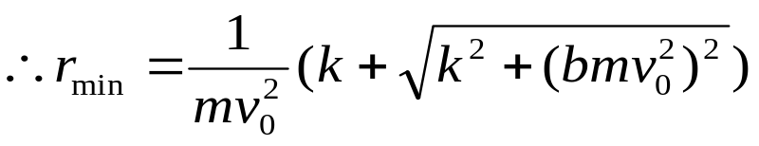

Slide 11
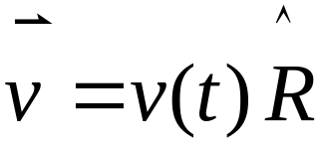
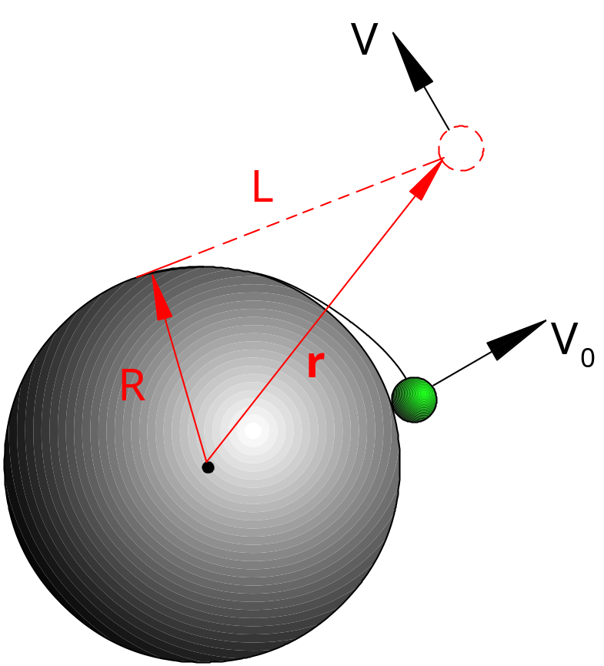
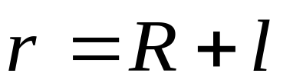






Example :



Slide 12







●
❍

Slide 13










1-3 Center of mass frame
available in inertia system.

Slide 14





Orbital angular momentum.
Proper angular momentum
spin : intrinsic spin
Atom:
Dirac
Story
Hesienberg

Slide 15








available in non-inertia system.
Why? How about inertia ?
then

Slide 16





1-4 Isotropy of space and J
Example for
Be care for
simple
“basic”
Problem!

Slide 17


§2. Rigid body kinematics
2-1 Definition
Any two points
2-2 Translation and Rotation
About center of mass not unique convenient!
But this kind of decomposition(center of mass) is not unique！
Generally :Motion =Translation +Rotation

Slide 18

Example :
Kinetic energy
Conservation
Momentum
Angular momentum

Slide 19












Slide 20



2-3Angular velocity
Finite angular is not vector ≠commutative
law.But angular velocity is vector !
Infinitesimal rotation:

Slide 21




§3. Fixed axis rotation
3-1 Relation between J and M
What we concern is ” Fixed axis rotation ”.

Slide 22


We don’t care why it rotates with fixed axis.
Only works ,taking Z as the fixed axis.

Slide 23






3-2 Moment of inertia
1.Uniform thin stick
(a)

Slide 24




(b)
2.Particle thin hoop uniform disk
Particle:

Slide 25





Hoop:
Disk:

Slide 26

Notice:the momentum of inertia of some shapes

Slide 27






3.The Parallel axis theorem

Slide 28





Example :
4.The perpendicular axis theorem

Slide 29






Example :
(1).
(2).

Slide 30


(3).
(4).

Slide 31









3-3 Fixed axis rotation
fixed axis
Example :
Atwood machine.
,a=?
, =？
Solution 1:


●

Slide 32






+

Slide 33




Solution 2:
a

Slide 34








Example :
Center of percussion.
Com.

Slide 35









3-4 Moment of impulse
Example: finding
Solution :

Slide 36




Or Conservation of angular momentum.
fixed axis
But
Non-coaxis.

Slide 37




3-5 Work and energy
1. Potential energy
2. Kinetic energy
3. Work done by moment of force

Slide 38






Example:

Slide 39









§4. Motion involving translation and
rotation
In general
Simple case <Plane_parallel motion >
(Axis moving in parallel)
(particle moving in one plane)
Com.
rotation
Example:
Find:
(1).

Slide 40









(Pure Rotation)

Slide 41











(2).
.
.
.

Slide 42








Example :
Pure rotation
Comment on “ ”is it about
“point” or “axis”?

Find:
Solution 1:

Slide 43




Discussion:(1).’f’ is static friction,’p’ is ”instantaneous
Center(of rotation)”.’f’ doesn’t do work in the inertial
frame. (2).But in com frame ‘f’ does work.
What is the role ‘f’ play?
Solution 2:

Slide 44




Similar case:
Lorentz force
Dissipative work:

Slide 45













Find the terminal and .
How much time does it take?
Solution :

Slide 46







At ‘ ’ :
Similar case:conction of Ping Pong.

Slide 47




Problem:3-15
Solution :



Slide 48









Slide 49








(1).
(2).

Slide 50






§5. Equilibrium of rigid body
translation
No
rotation

Slide 51



§6. Gyroscopic motion
Gyroscope
Game spinning top

Slide 52

Related problem:
There are no inertial force in the inertial frame.
Comment on “fiction”in pure rotation.

Slide 53




