Slide 1

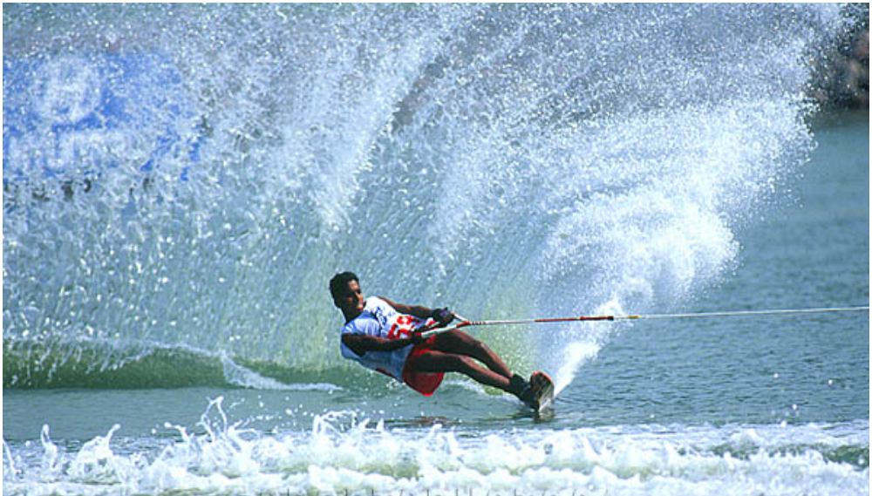
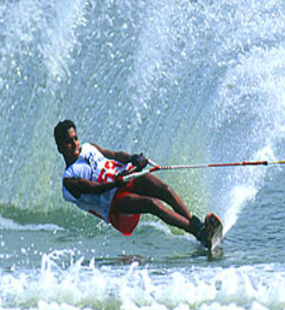
Chapter 2
Dynamics

Slide 2
1.Mass,momentum,force and impulse
1-1 Newton’s Laws

Newton’s first Law
It is always possible to find a coordinate system with
respect to which isolated bodies move uniformly.
Newton’s first Law of motion is the assertion that
inertial systems exist. SO
⇒
One part of 1st Law is definition
Definition of an inertial system.
⇒
Another part of 1st Law is experiment fact
such inertial systems exists.

Slide 3
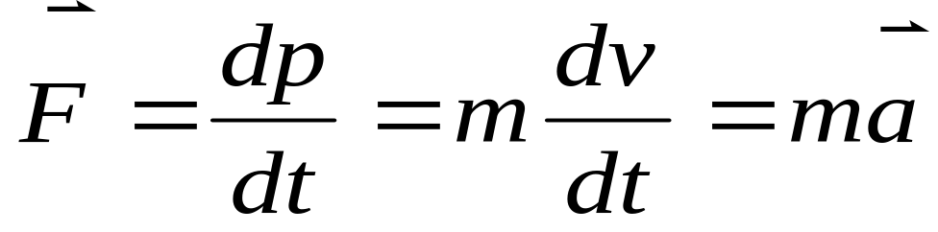

It raises a number of question:
“isolated body =?” “ inertial & non-inertial system”
are absolute?
⇒
In our text book:
Free particles always keep moving
uniformly.
unique particles in the world
Don’t use “Force” but “interaction”

Newton’s Second Law

Momentum:

Slide 4



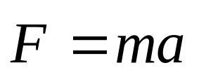
⇒
Key:
See text book about the history of momentum
①

  Definition of “Inertial Mass”. “Gravitational Mass”
Remarks:
①
and is relation of instantaneous effect.

  vector eq. (apply in coordinate system)
  Available for “particle”.
●
❍
  m is constant.
■
  Only valid for lower speed.

Slide 5
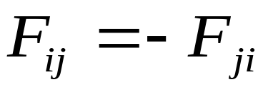
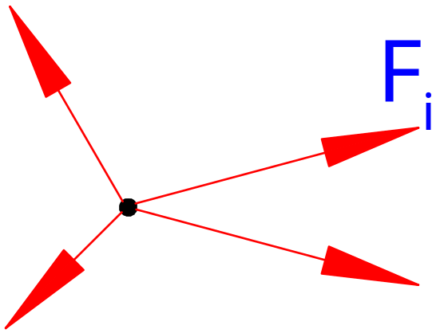

Newton’s Third Law: Bird law
Interaction between two particles.
Remarks:
①
Simultaneity(invalid for electro magnetic interaction)

Be valid in inertial or non-inertial frame
In modern physics, replaced by conservation law of
momentum.
●
1-2 System of particles
1.Superposition principle of forces.

Slide 6
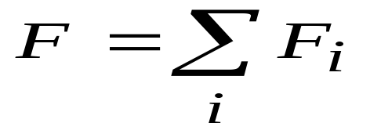
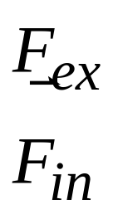
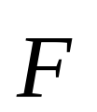
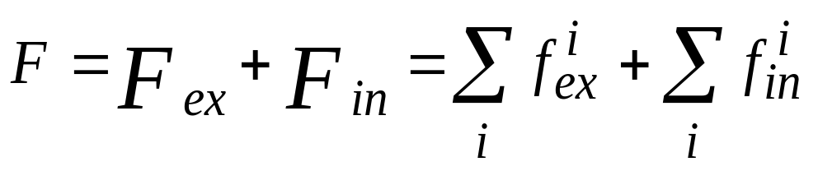
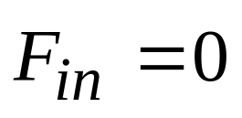
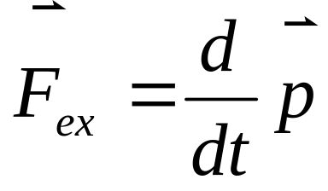
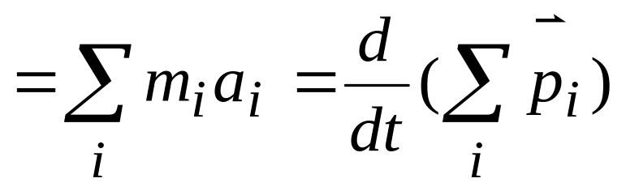
Force can be described by “vector”
Experimental fact

Newton’s Laws (for system of particles)
(external forces)
Total force:
(internal)


Slide 7
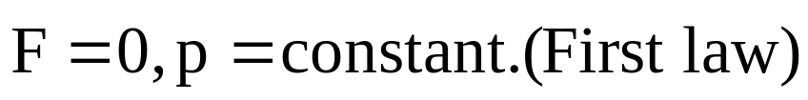
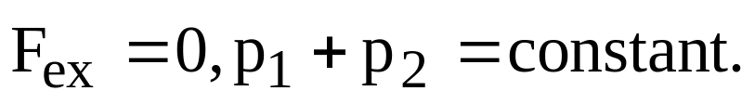
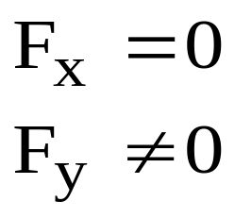
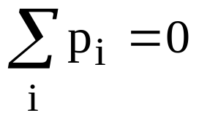
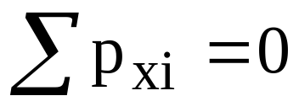

Law of conservation of momentum
One particle:
Two particles:
N-particles:
⇒
This law is very important,
especially in modern
Physics.
“Force” meaningless.
⇒
The discovery of Neutrino
spin 1/2
no charge
Mass less
weak interaction

Slide 8
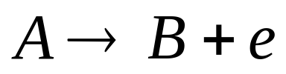


If A is static , motionless, B and e must
on a line. (Pauli 1930 predicted, 26y after observed in lab)
Electromagnetic field also has momentum.
cloud chamber
beer

Symmetries and conservation law:
Noether
theorem(German lady),
Invariance of translation in
space.
Application of the law:
Rocket
⇒
velocity of the rocket
velocity of the dm

Slide 9

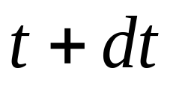
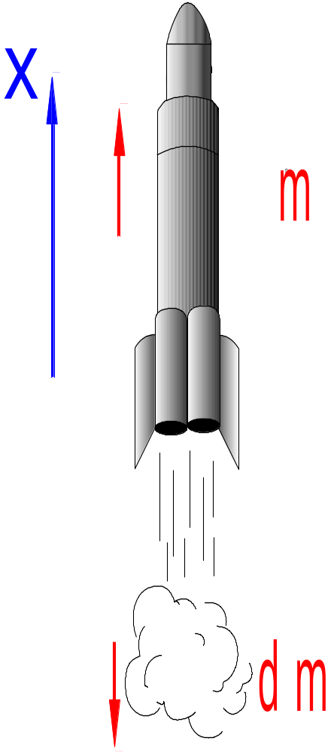




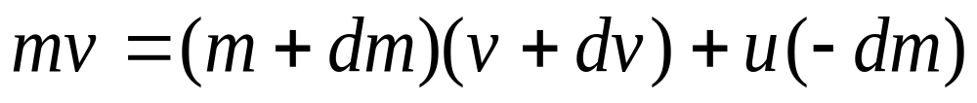

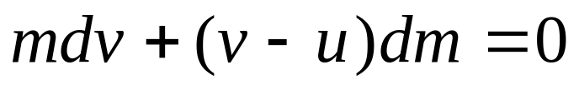
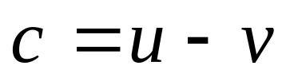
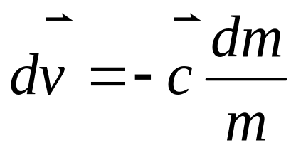
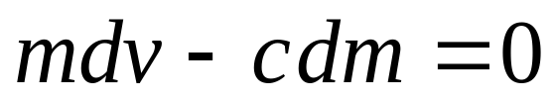

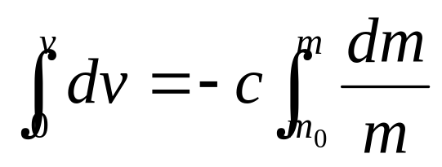
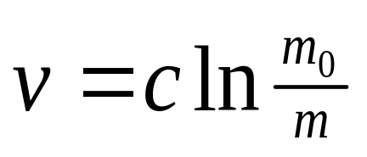

Slide 10
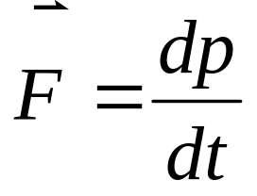
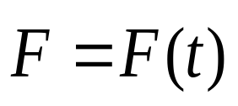
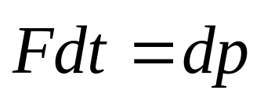
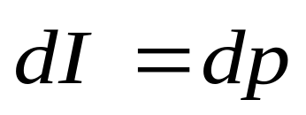
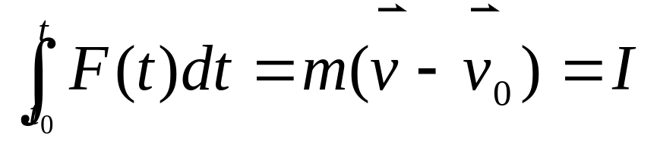

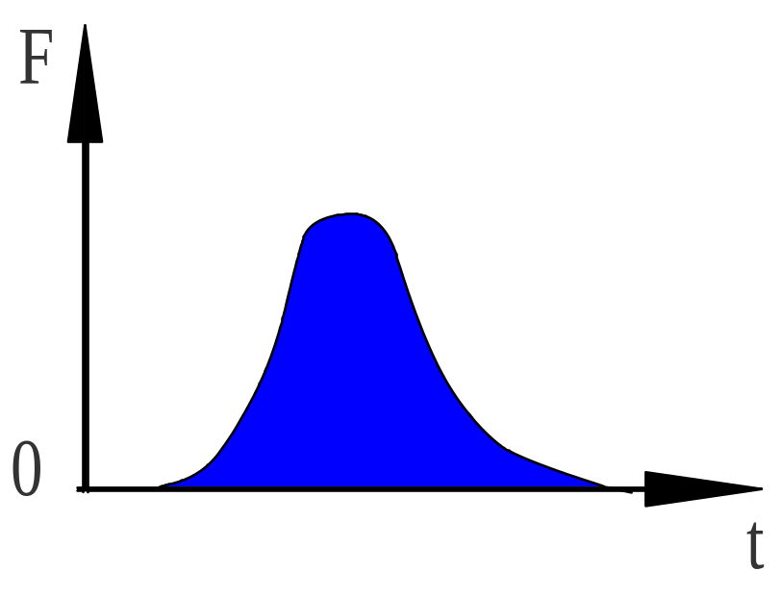

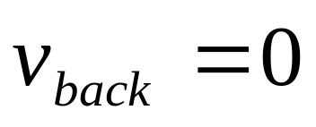

Impulse theorem of momentum
We only concern the effect of accumulation, don’t care
the process.
vector,”Flow of mass”
Example:
Finding pressure.
Particles: density n,speed v.
(1). Perfect inelastic collision.

Slide 11
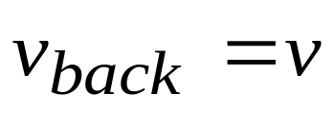
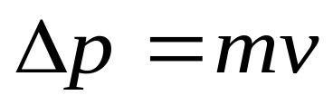
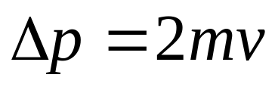
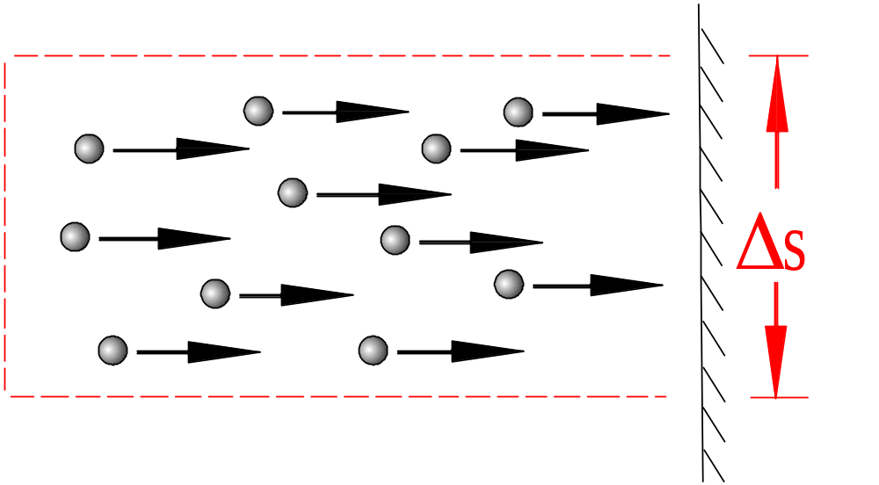

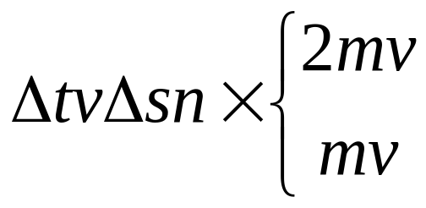
(2). Perfect elastic collision.
Question: how about the pressure?
Solution:
Each particle’s impulse exert on wall.
(2).
(1).
Interval:

Slide 12
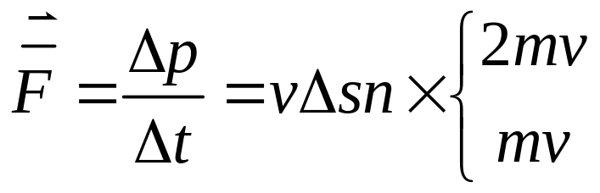
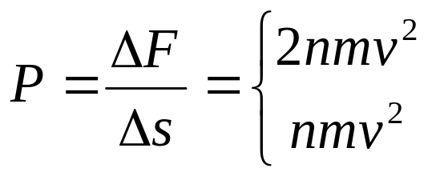
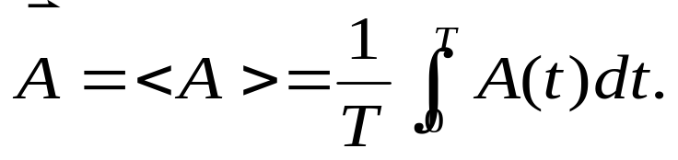
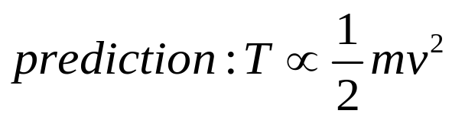
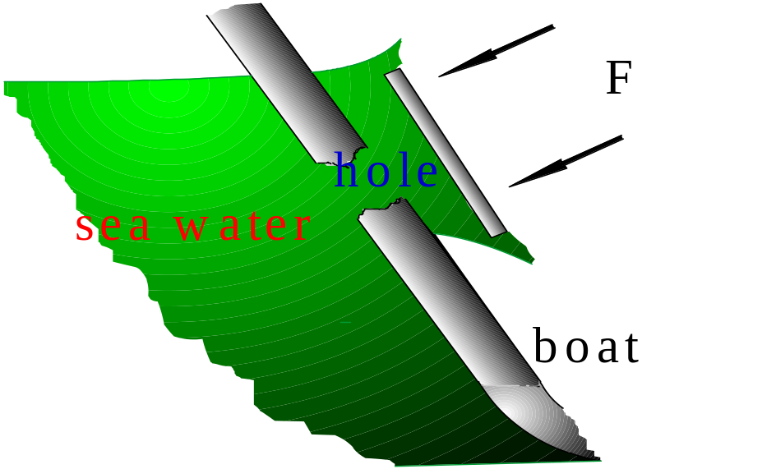
Average:
Relevant problems:
(1).
When the hole was not
made up, F is bigger than
that when the hole was .
Why?


Slide 13
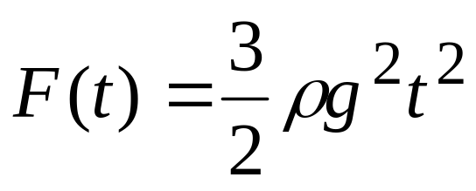
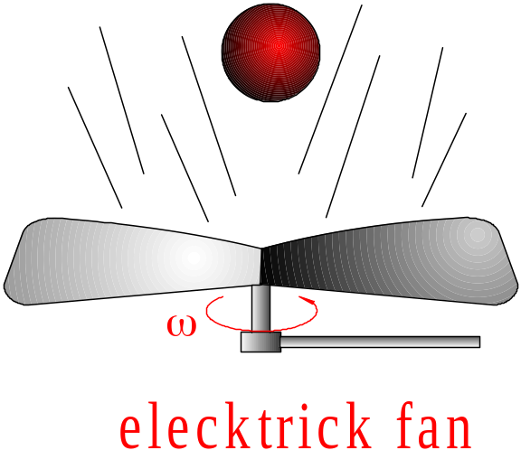
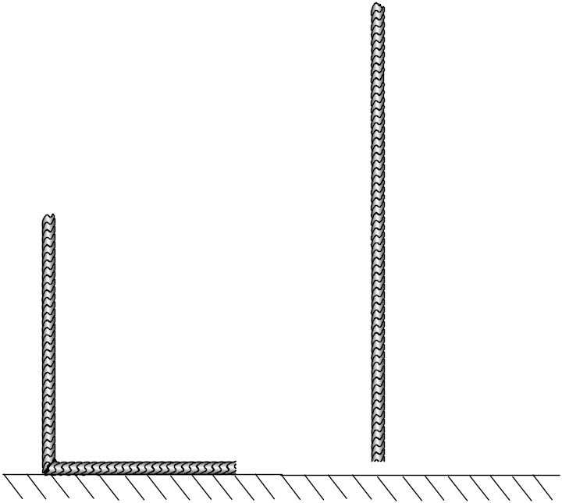
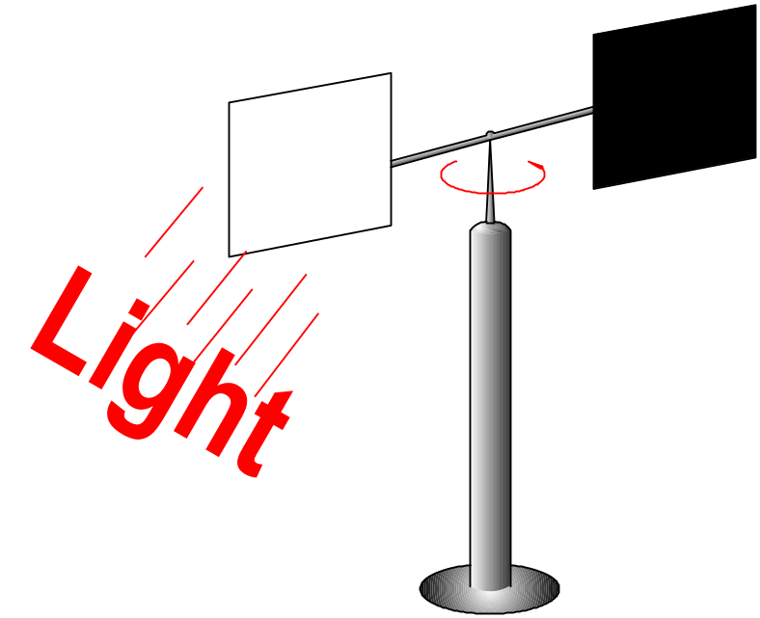
(2).
(3).
(4).
Light pressure: tail of comet

Slide 14
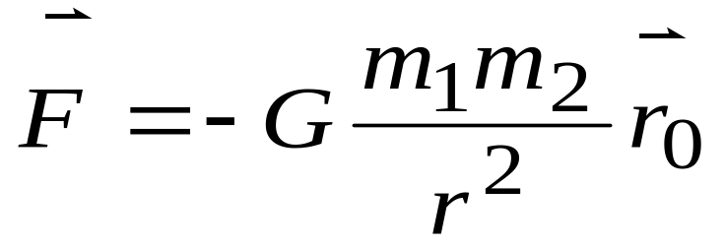
⇒
Cosmology:
White dwarf
⇒
Gravitational collapse
Supernova
Black hole
Neutron start
§2 Application of Newton’s Law
1.Forces in Nature
Strong
Electromagnetic
Weak
Interaction
Nature
①Gravitation gravity.

Slide 15


Remarks:
a.
.
Gravity F=?
(at point A)
b.
②.Electromagnetic int.
Friction
Tension
string spring

Slide 16



③.strong nucleon
Fermion
Boson
Hadron
lepton
Fundament
④.weak
hadron
decay
lepton
quark
2.Everyday forces
(1).
Gravity.
young modulus

Slide 17







Finding tension:

Free-body diagram

Slide 18




(2).
Elastic force.
Hooke. force:
(3).
Friction
Static friction
Sliding friction
(4).
Viscosity
Liquid air:

Slide 19






Why “dust” can suspend in the air ?
Example:
raindrop
a.
Finding terminal velocity.
(t=0,v=0)

Slide 20




b.
Finding x(t) .(t=0,x=0)
raindrop

Slide 21






Finding v(x).


Slide 22





Discussions:
①.
②.No friction limit.
Free fall.

Slide 23








Example:
Finding .
( enough circular motion)
Natural coordinate:

Slide 24






From this result,one can
get everything he wants.

Slide 25





For example: =? Circular motion is possible?
Relevant problem:
Frictional coefficient μ, t=0, .
Finding v(t),s(t).

Slide 26












Slide 27


§3. Galileo principle of Relativity & Non-inertial
Frame
3-1 Galileo Principle of Relativity (introduction)
Motivation:
Water drop , smoke in a boat.
⇒
All the inertial frames are equivalent.
⇒
All the experiment can’t be effected by the velocity
of the inertial frame.

Slide 28

3-2 The Galilean Transformations
How to describe the principle by mathematical language?
Cartesian coordinate :

Slide 29












t=0
Galilean transformations:
Space-time is absolute.
t
K:
K’:
be invariant under the
transformation.

Slide 30



3-3 Inertial force
Good method

Non-inertial Frame:
Rotating system.(frame)
Deep understanding:
origion of inertia

Slide 31





⇒
Newton’s laws are only available in “Inertial frame”,
but introduce “fictitious force”
Example:
Inertial centrifugal force:
(1).
In rotating frame,
take in the surface .
(Natural coordinate system, also.)

Slide 32








Slope:

Slide 33


(2).
Condition of stable.

Slide 34




3-4 Coriolis force
In polar coordinate acceleration:
Example:
How much force exert on ball by the plane?
Coriolis Force
Centrifugal Force
How does it happen?

Slide 35




For students : understanding
Coriolis
force in polar coordinate.
①Coriolis force is the same as centrifugal force.
②

Collect some story and guess:siphon.

Slide 36
3-5 Origin of the inertia
Newton’s law
inertial system.
Non-internal system
introducing fictitious force.

Is the “inertial force “real”?
⇒
No, why? No difference.
⇒
Yes, what is the origin of the fictitious force?
Mach
criticize the concept of absolute space and
time.
A.Einstein : “Inertial force is real.”
Origin Gravitation.

Slide 37



