Slide 1

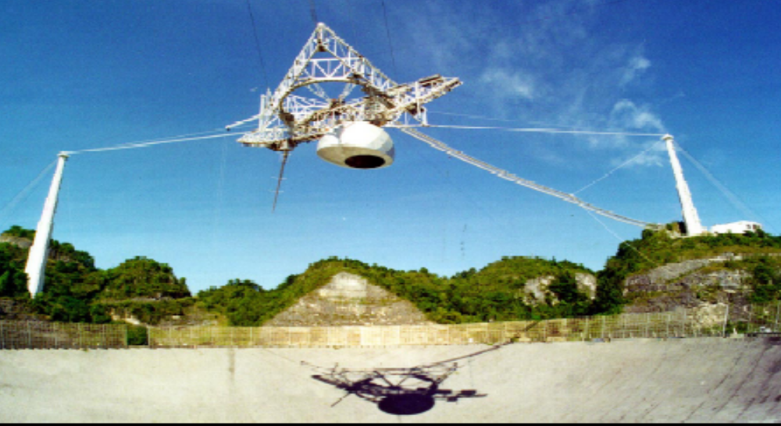
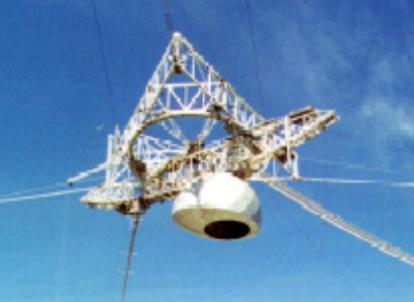
Chapter 6
Vibration and wave

Slide 2
Introduction:
One kind of motion.
Oscillator

Application of Newton’s Law.
Wave
Electromagnetism,Optics,Modern
But its result is
very important.
physics(Quantum Mechanics).
energy
Why
transport
information
All starts from……

Slide 3
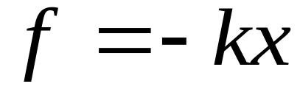
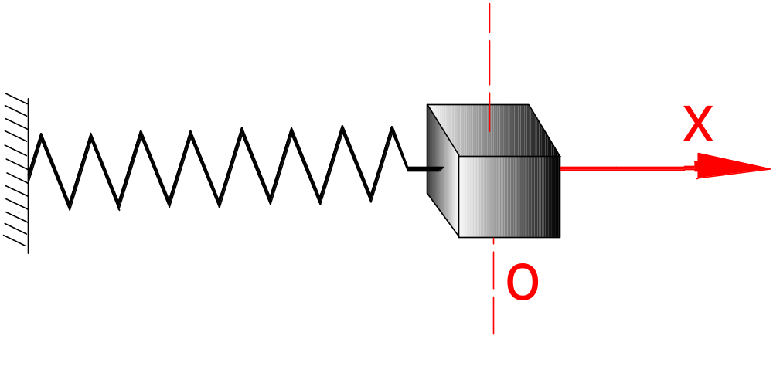
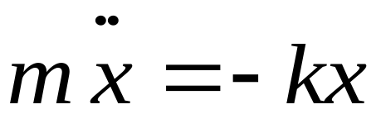
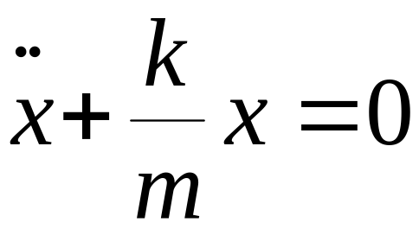
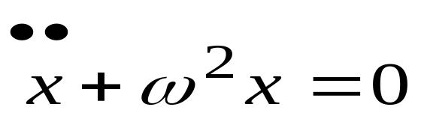
§1. Harmonic oscillation
1-1 Simple harmonic motion
Mass on a spring.
Differential e.q.
intrinsic

Slide 4
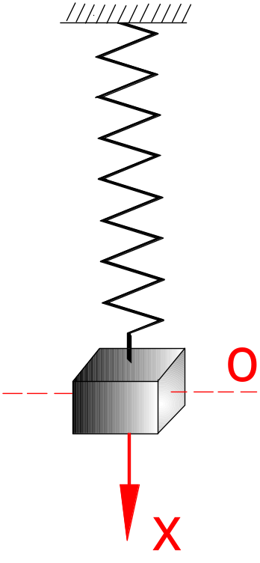
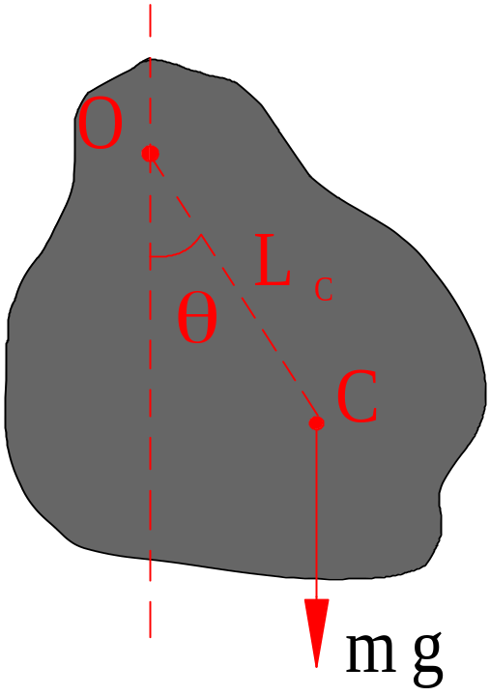
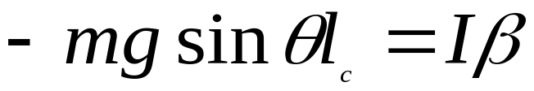
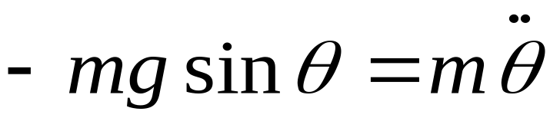
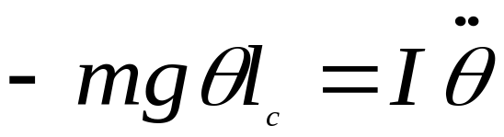
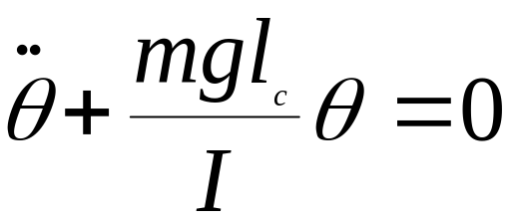
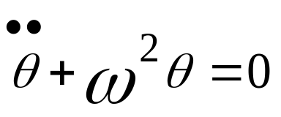
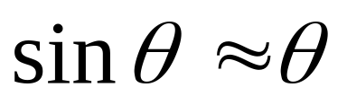
Simple pendulum
Pendulum
Compound pendulum


Slide 5
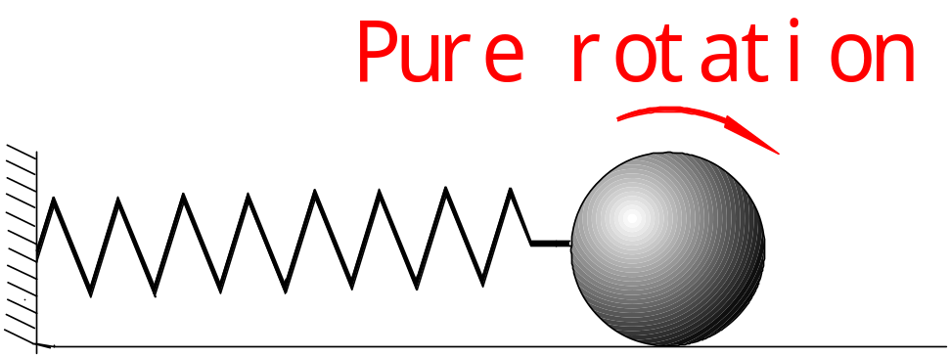

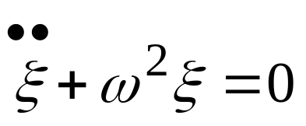
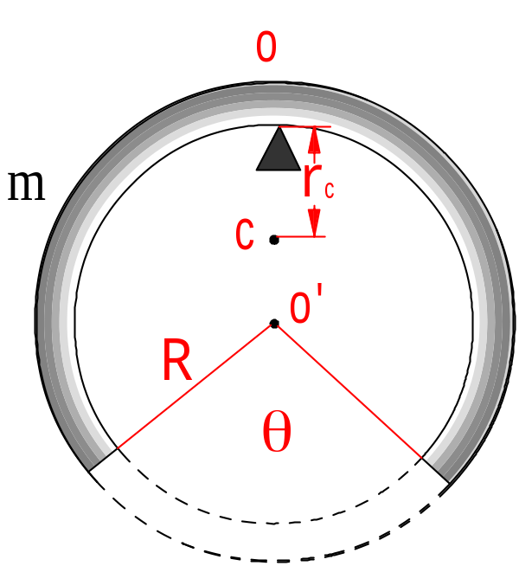
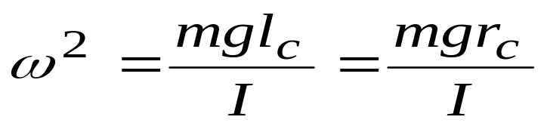
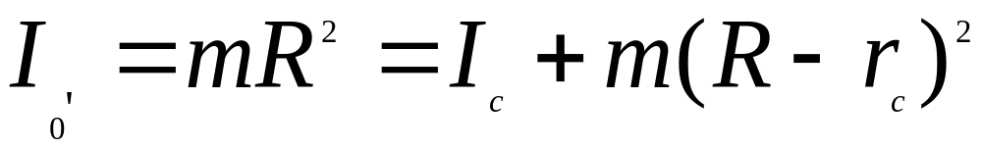

Definition.
Physical quantity:
Example:

Slide 6
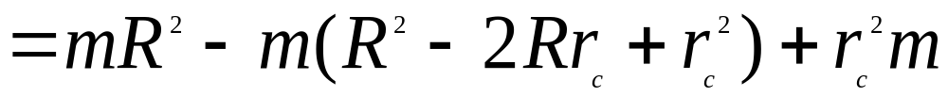


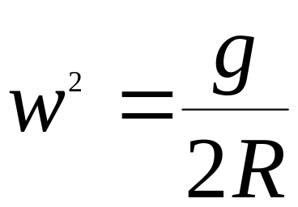
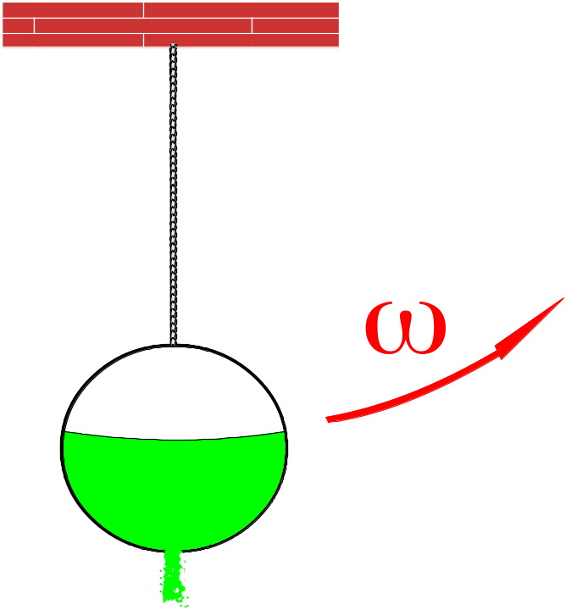

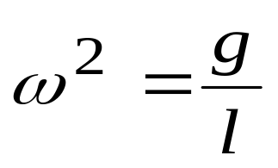

independent of
Another interesting
problem:
What is the behavior of
as water leak off?
Your classmates are
your good teacher!

Slide 7
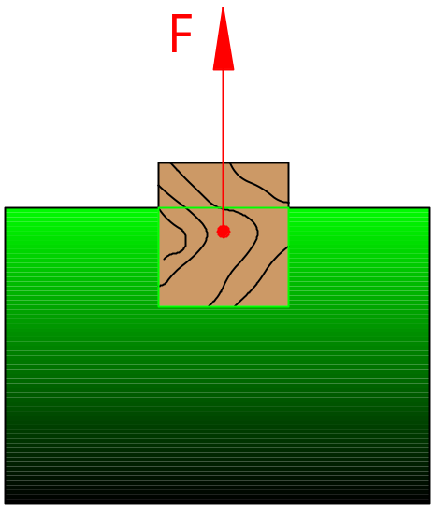
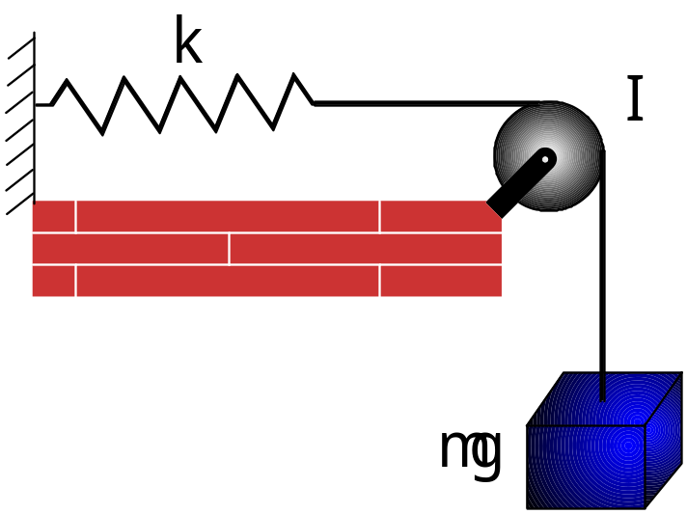
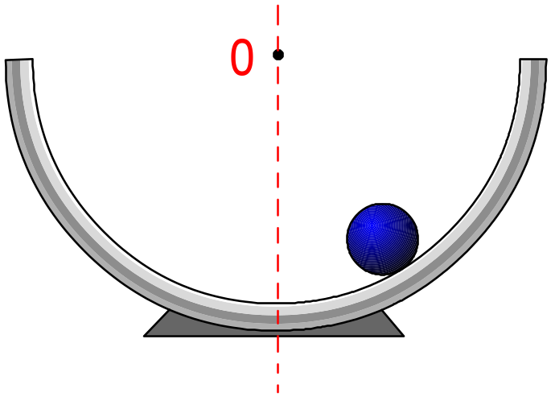
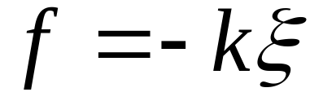
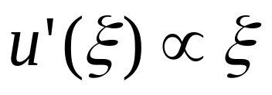
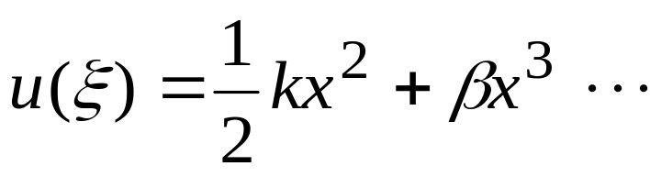
Related example about simple harmonic motion
(1).
(2).
Potential
(3).


Slide 8
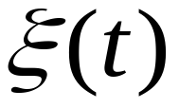
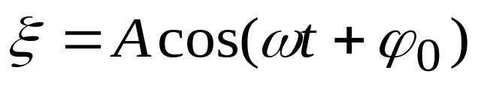
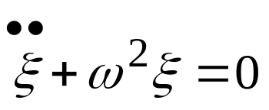
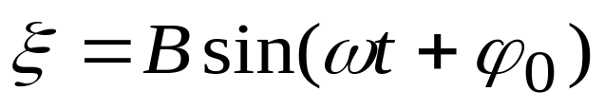
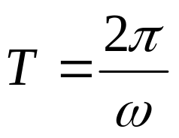
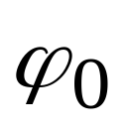
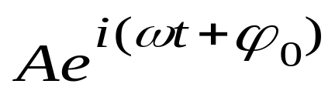
1-2 Solution
Guess!

A amplitude
(Period )
ω frequency
initial phase
Complex number:
real,imagine.
Not physical quantity.

Slide 9

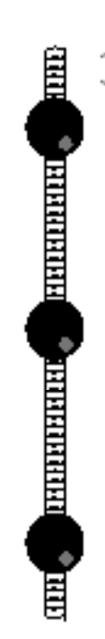
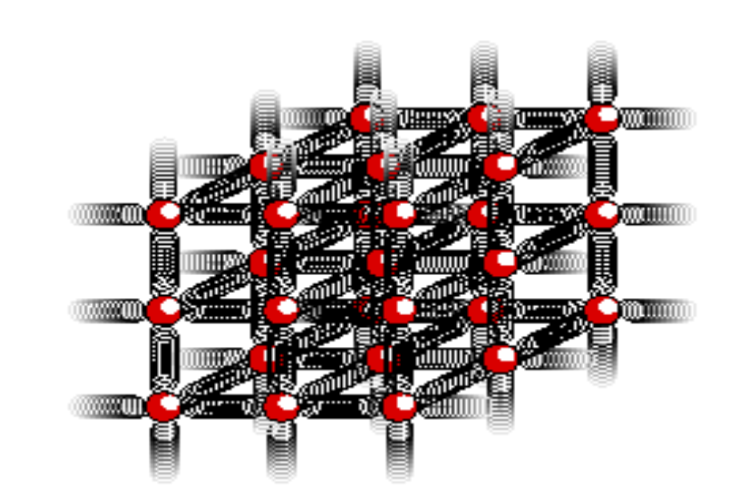
At beginning it was used for convenience in quantum mechanics ,it is necessary!
Normal mode:
(1).
(2).

Slide 10
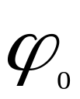
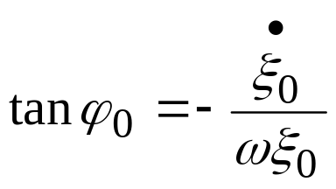
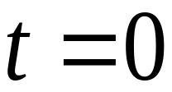
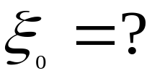
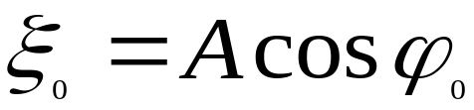
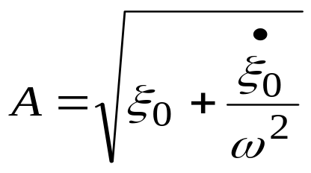
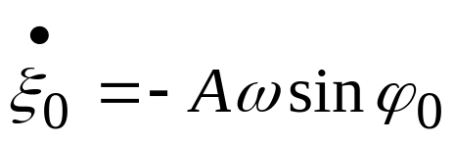
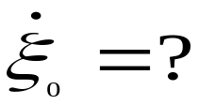
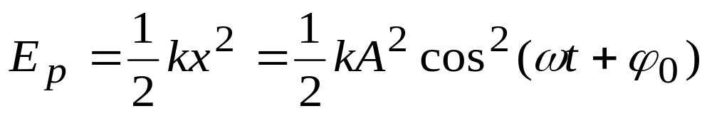
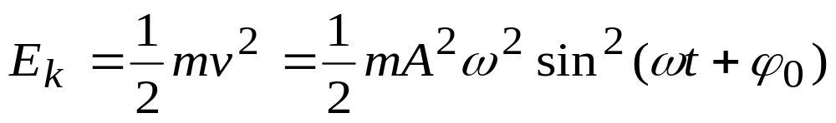
ω intrinsic.
A, alter mined by initial condition.
Energy:

Slide 11
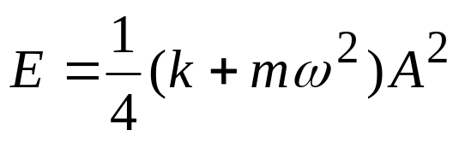













Average:
(conservative system)
How to judge?
①
Or is parabola.
②
③ Conservative system.
not only
Example:
Finding
,
And .

Slide 12












Slide 13










1-3 The damped harmonic oscillator
Friction
harmonic
resistance coefficient

damping constant.
Solution:
(1).

Slide 14







, are determined by initial.
Quasi-period:
slow down.
①
Lightly damped:
②
Heavily damped:

Slide 15









(2).
⇒
, initial condition.
(3).
faster
⇒ critical damping

Summary :
①Dynamical e.q.
Quasi-period
②
Solution behavior.

Slide 16







1-4 The forced Harmonic Oscillator
Driven Harmonic motion:

⇒
, initial condition.

Slide 17






After long time
steady state.

Velocity:

Slide 18






1-5 Resonance
has a maximum

should bear in mind!
Application:
① Mechanics
A
resonance
Electromagnetic v
② Soldier passing a bridge.
④ How to use “resonance”.
③ Warman vortex street .
⑤
How to avoid “resonance”.

Slide 19




§2. Superposition of two oscillators
2-1 Victorian representation
Harmonic motion:

Complex representation.
(example :Problem 6-1useful tool for further study)
2-2 1-D
⇒ Same frequency.

Slide 20




Analytical:
Principle of superposition.

Vectorial:


Slide 21







Remarks:
A depends on
Significant
interference

Slide 22

Notice:
(1).
The two circular patterns of ripples pass through each
Other. Unlike material objects,wave patterns can overlap
in space,and when this happens they combine by addition.

Slide 23



(2).
As the wave pattern passes the
rubber duck,the duck stays put.The
water isn’t moving with the wave.

Slide 24


(3).
Circular and linear wave patterns,with velocity vectors
shown at selected points.

Slide 25












2-3 2-D (orthogonal)
Locus:
Clockwise.
Anticlockwise

①


Slide 26










●
❍
Very important for Optics.
How to determine the clockwise or anticlockwise :
through the directions of and .
2-4 Simple examples
(1).
1-D Beat

Slide 27









Beat period:
(2). Lissajou figure

Slide 28






2-5 Fourier decomposition and harmonic
So far we discussed simple harmonic motion .
What we can do for complex vibration ?

In mathematics
one can prove
that for any

Slide 29


fundamental frequency
harmonic
Coordinate:
athorthgonal
⇒
Concept of space
completeness .
Basis {sinx,cosx}
scholar product.
Space of functions
important in modern
Physics.
⇒
Fration of fundamental frequency.

Slide 30


§3. Simple harmonic wave
3-1 wave

Longitudinal wave
is the transmission of the vibration
transversal wave.
Spherical wave

wave surface,
ray,
wave speed
Plane wave

Slide 31


Picture:
These pictures show the motion of wave pulses. To
Make a pulse,one end of the spring was shaken by hand.
(1).
A pulse travels to the left.

Slide 32


(2).
Superposition of two colliding positive pulses.

Slide 33


(3).
Superposition of two colliding pulses,one positive and
one negative.

Slide 34







3-2 Wave function
W.F. describes the motion at every point of the media.
1-D:

wave speed : c
Simple harmonic wave
wave length :λ
wave number (momentum)

Slide 35





3-3 Group velocity Phase velocity
Monochromatic wave:
monopole
Wave packet:

Wave packet
composition of many
monochromatic waves
Phase velocity

dispersion
Group velocity

Slide 36







Example: two wave

Slide 37




A. Einstein :Special Relativity
group velocity
Quantum De. Broglie wave
Particle Wave packet

Superluminality

Slide 38


backward mode
group velocity
Wang Lijun
transmit of opposite dir.
phase velocity
corgestion packet
Picture:
A series of imagines from a silent movie of the
bridge vibrating on the day it was to collapse ,taken
by an unknown amateur photographer.

Slide 39

The bridge immediately before the collapse,with the
sides vibrating 8.5 meters (28 feet )up and down .Note
that the bridge is over a mile long.

Slide 40

During and after the final collapse.The right-hand
picture gives a sense of the massive scale of construction.

Slide 41







§4. Standing wave
4-1 Standing wave
Consider two simple harmonic wave:
Question:
⇒
u=?
⇒
u=?

Slide 42





Loop:
or
Node:

half integer of

Slide 43


4-2 π-shift
How to make a standing wave in real world?
Characteristic impedance:
Z

Z
can be understand as n (refractive index).
Two special case:
(a). Free end
(b). Fixed end

Slide 44



Example:
(a). Fixed point
(b). Free point

Slide 45


4-3 Application
(i). Music instrument
(ii). Measurement of speed of sound

Slide 46









(iii). Advanced application
Potential well.
Bohr atom

Slide 47





§5. Doppler effect
Doppler shift
(sound,light)
travel through a air.
5-1 Principle
(1).Moving observer (detector)

Alternative way
to understand

Slide 48




(2).Moving source

C doesn’t change when sir moving.
⇒
Wave length
changes.
⇒
Another way:
the same

Slide 49






(3).Moving source and observer
5-2 Application
Car:

Slide 50





beat frequency
carrier frequency

Slide 51





Neotron scattering
measure the
chemical process.
Hubble law:
Light Doppler

C is independent.
Red shift
Three types of universe:

Laser cool:
1997 Nobel price.
vibration
Laser
light
amplification
by
stimulated
emission
of
radiation.

Slide 52




