Slide 1

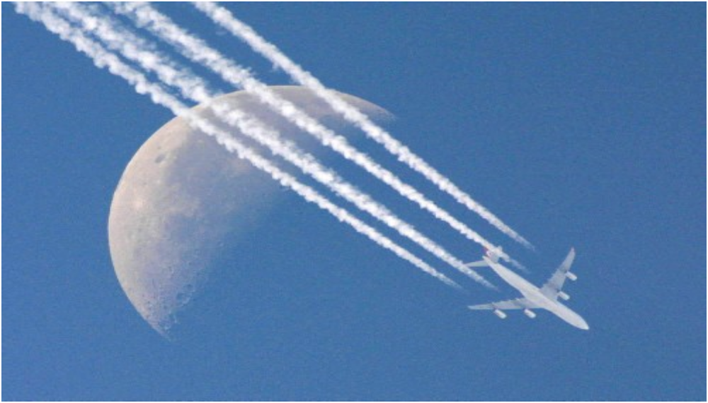
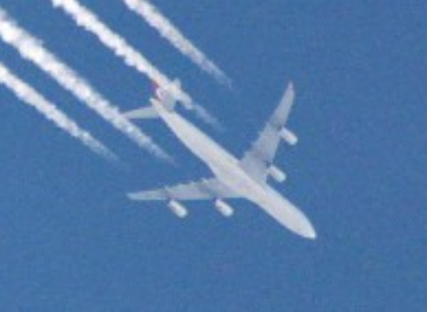
Chapter 1 Kinematics

Slide 2
1.Introduction
Kinematics Math (Definition & Description )
Dynamics Physics(Reason of motion )
Mechanics
Particle (mass point)
System of particles
Rigid body
Model
Space
Time
Frame of reference
coordinate
Cartesian coordinates
Plane polar coordinates
Natural coordinates
Space

Slide 3
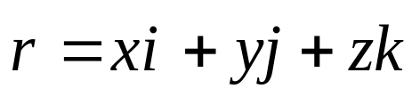
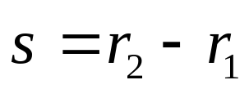

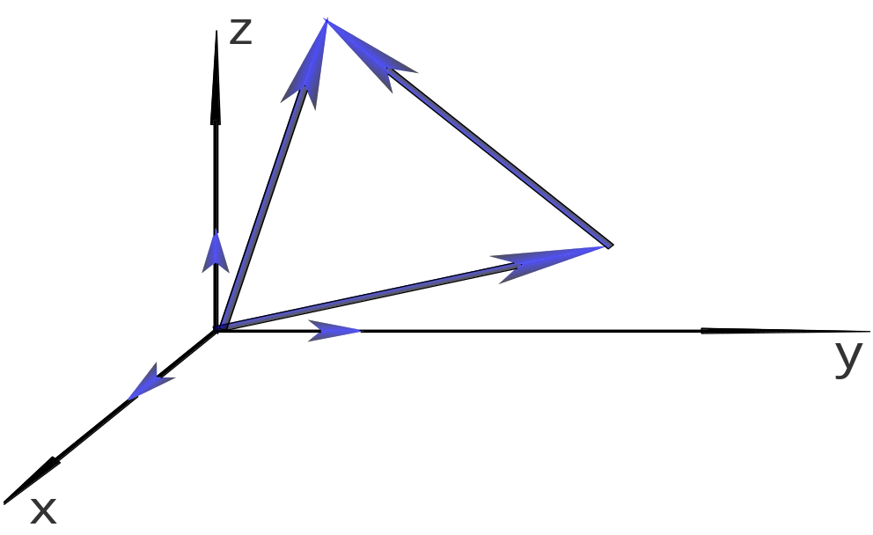




2.kinematical equations
2-1.Position vector and displacement
Position of a particle in 3-D
*Position vector:
*Displacement:
Abstract(Independent of coordinates)
In Rectangular coordinates

Slide 4
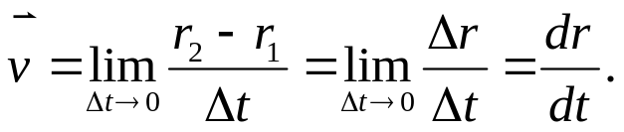
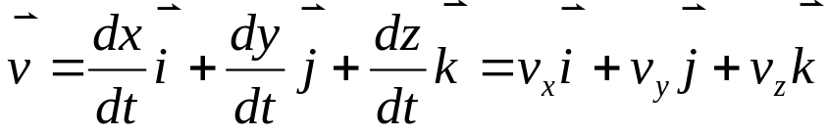


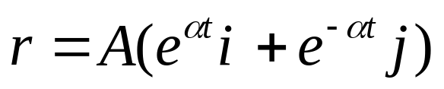
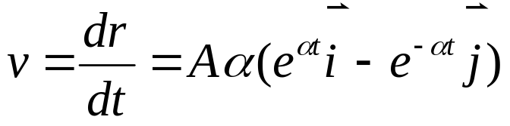
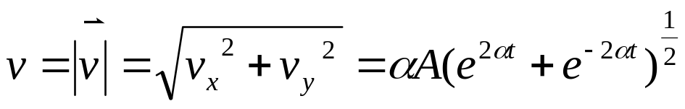
2-2.velocity and Acceleration
*Instantaneous velocity
In Rectangular coordinates
Example
Finding from , the position is given
Speed magnitude is

Slide 5
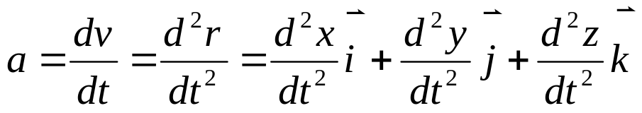
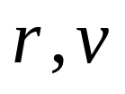

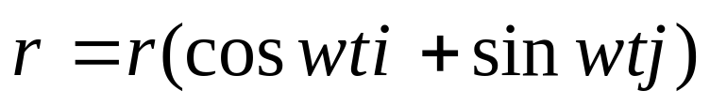
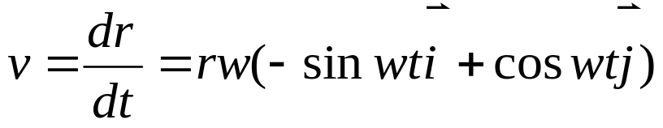
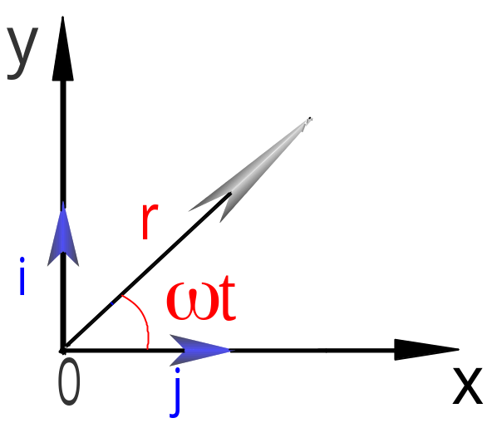

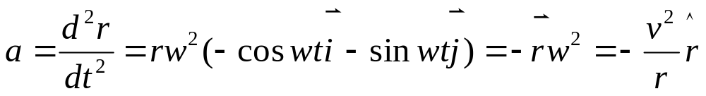
*Acceleration
We could continue to form mew vectors by taking higher derivatives
of .but we shall see in our study of dynamics that and are
of chief interest.
Centripetal acceleration
Example :Uniform circular motion

Slide 6
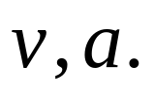
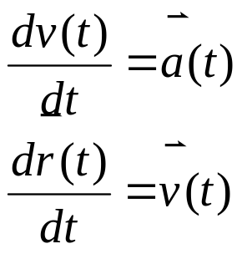
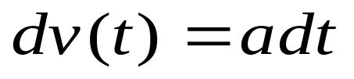
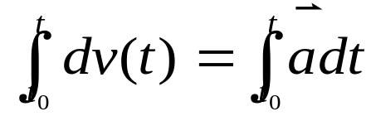
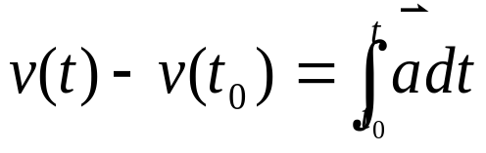
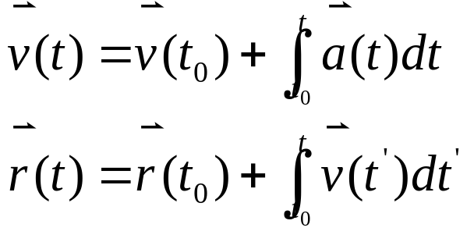
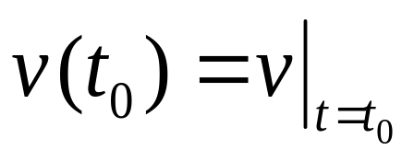
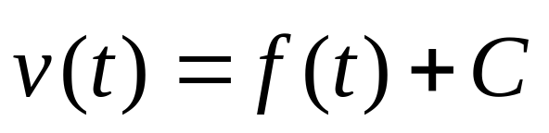
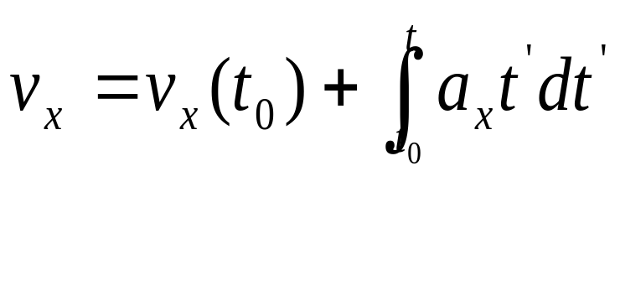
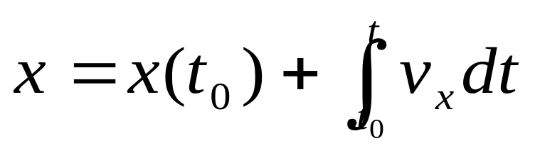
2-3 Kinematical equations
Definition of
Differential equations
Integral equations
Initial condition
Finding C.

Slide 7
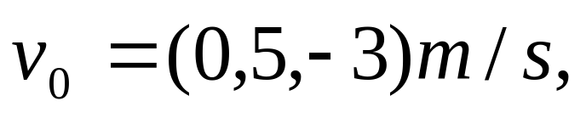
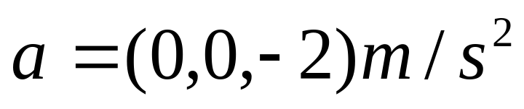
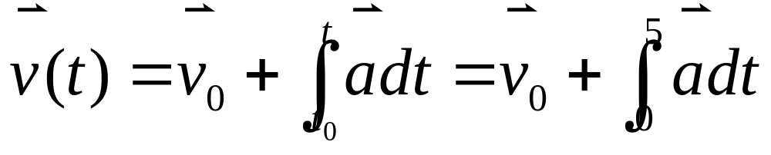
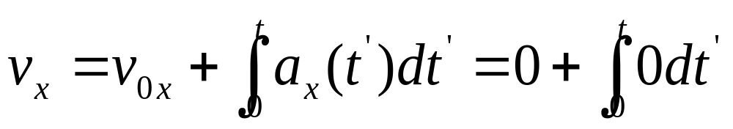
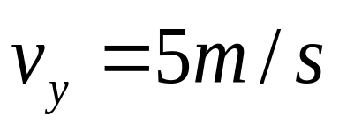
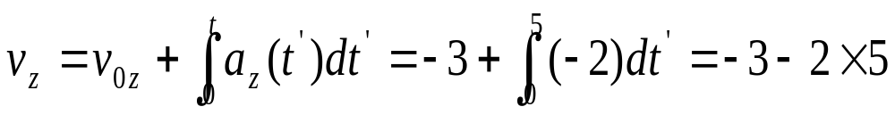
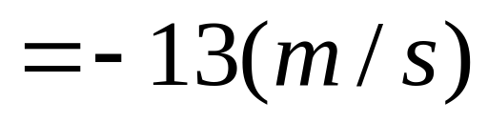
Example:
Finding velocity from Acceleration
Find its velocity after 5s.

Slide 8
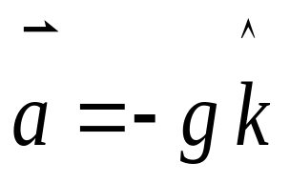
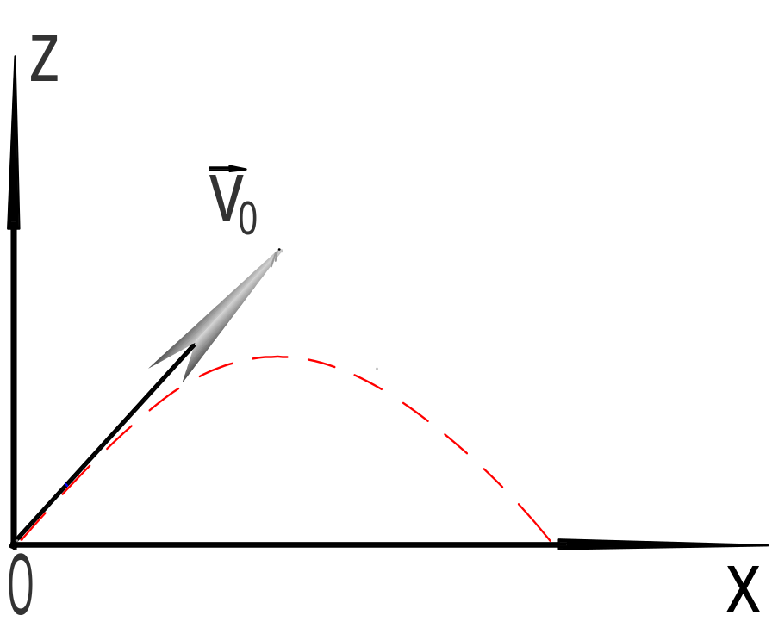
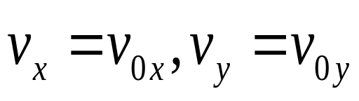
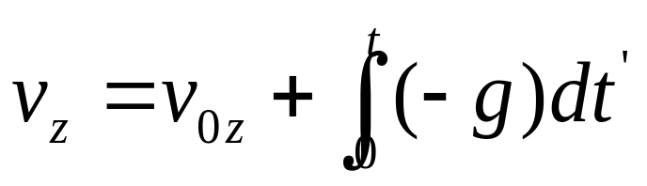
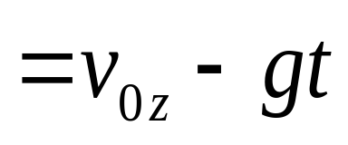
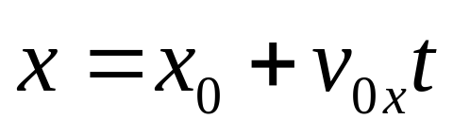
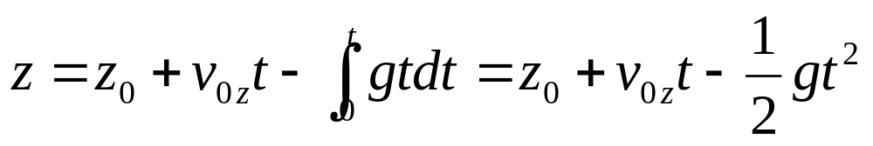
Example:
Motion in a uniform gravitational field.
<Projectile motion>.

Slide 9
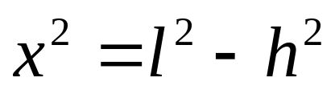
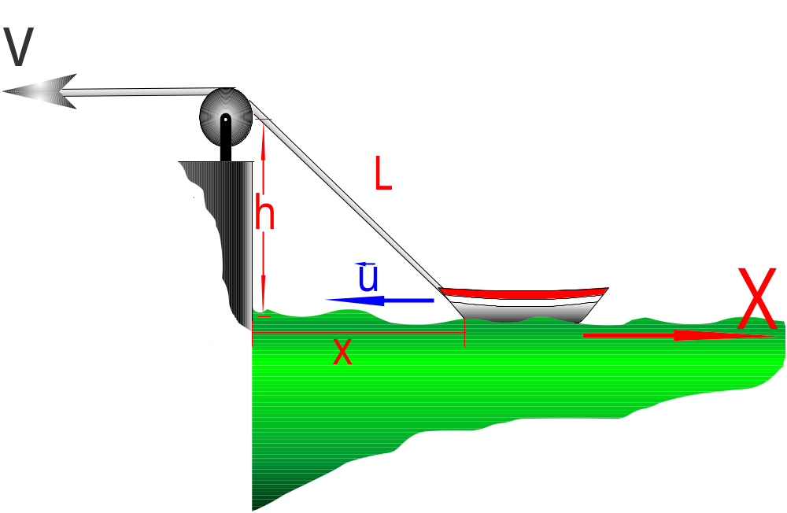
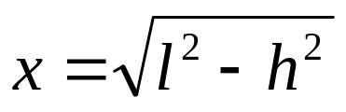
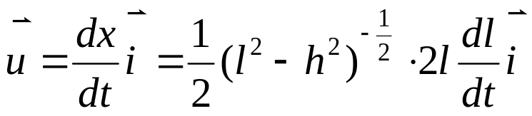
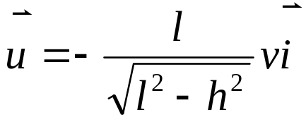
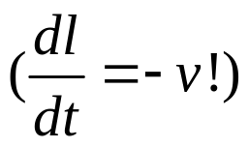
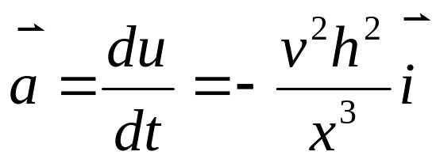
Example:
Finding u and a of that boat(v is uniform)

Slide 10


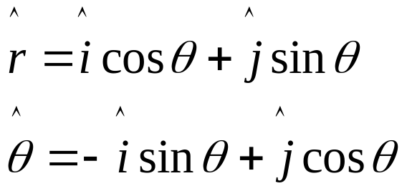
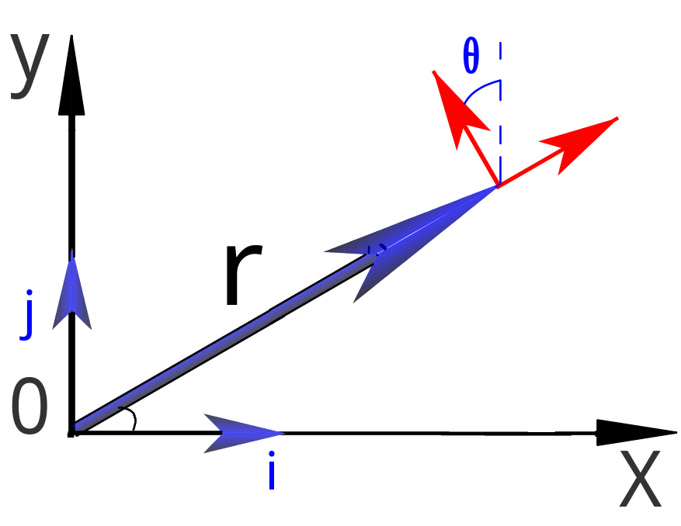
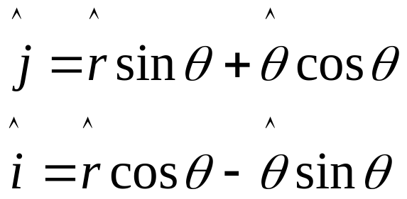

3.Motion in plane polar coordinates
3-1.Polar coordinates
Cartesian coordinates-----motion in a straight line
Polar coordinates----------circular motion
(cylindrical system, z is nonzero)
are orthogonal.
(perpendicular)
Position vector

Slide 11














3-2.velocity in polar coordinates

Slide 12





3-3.Acceleration in Polar Coordinates
Centripetal
acceleration
Coriolis acceleration---A fictitious act in a
Rotating coordinate system.
Linear acceleration in the tangential
direction
Linear acceleration
in the radial direction

Slide 13













Example:
1.Circular motion (radius r=b angular velocity a= )
2.Straight linear motion ( along y=2)

Slide 14









3.Motion of a bead on a spoke t=0 bead
along the x axis at the origin r=ut ,

Slide 15










In Cartesian Coordinates.
4.Radial Motion without acceleration
A particle moves with ,show that
for certain values of

Slide 16







4.Natural Coordinates
Path is fixed l=l(t)
=0
In mathematics :

Slide 17





Smooth curve is combined by many arcs of circles of
curvature

Slide 18










Example:
Find at

Slide 19













5. Relative Motion
Reference(Frame of reference) Coordinate
Proper choice is very important
Galileo’s transformation
In K1 system t=t’

Slide 20




In K2 system
Example:Monkey and Hunter
Hunter can always hit the monkey. Why?
Imply:General theory of Relativity

Slide 21








Quiz
1.Find out the derivative of the following functions.
（1）
（2）
（3）
（4）
2.Find out infinite integration.
(1) (2)
(3) (4)
Homework:
1-2,3,8,11,12,14

Slide 22




