Slide 1
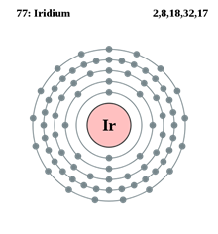
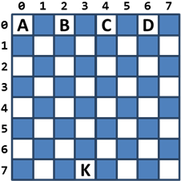
High – Quality Programming Code
Teamwork Assignment
‘King Survival’ project
Team Iridium
https://github.com/IridiumTeam
Telerik Software Academy
academy.telerik.com

Slide 2
Steps to the project completion
Renaming code members
Reformatting the code
Removing the comments
Conversion of few primitive members to class
Deletion of unused or useless members
Method level refactoring
Implementation of object-oriented design
Unit testing
Documentation

Slide 3
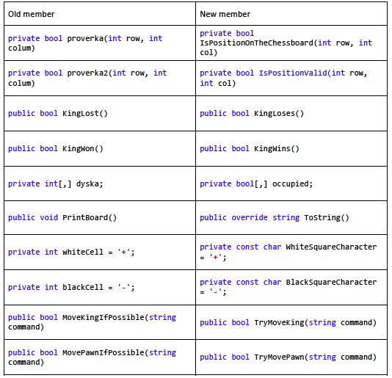
Data level refactoring examples

Slide 4
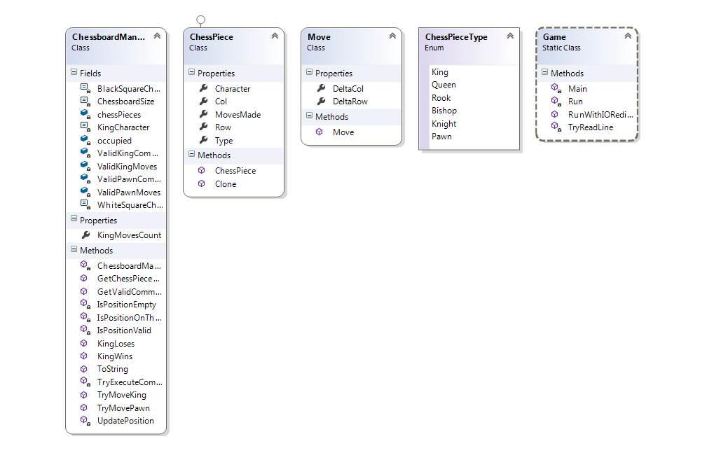
Class and method level refactoring showcase

Slide 5
Unit testing
Some interesting unit tests:
TestChessPieceClone() – cloning the figure before rendering it at the next screen
TestKingWins_PawnsCannotMoveAnyFurther() assert king wins if the pawns cannot move further
TestToString() of the ChessBoardManager class for the proper rendering of the board and figures
TestRunWithIORedirected() - console i/o redirection with sample input and expected output;

Slide 6
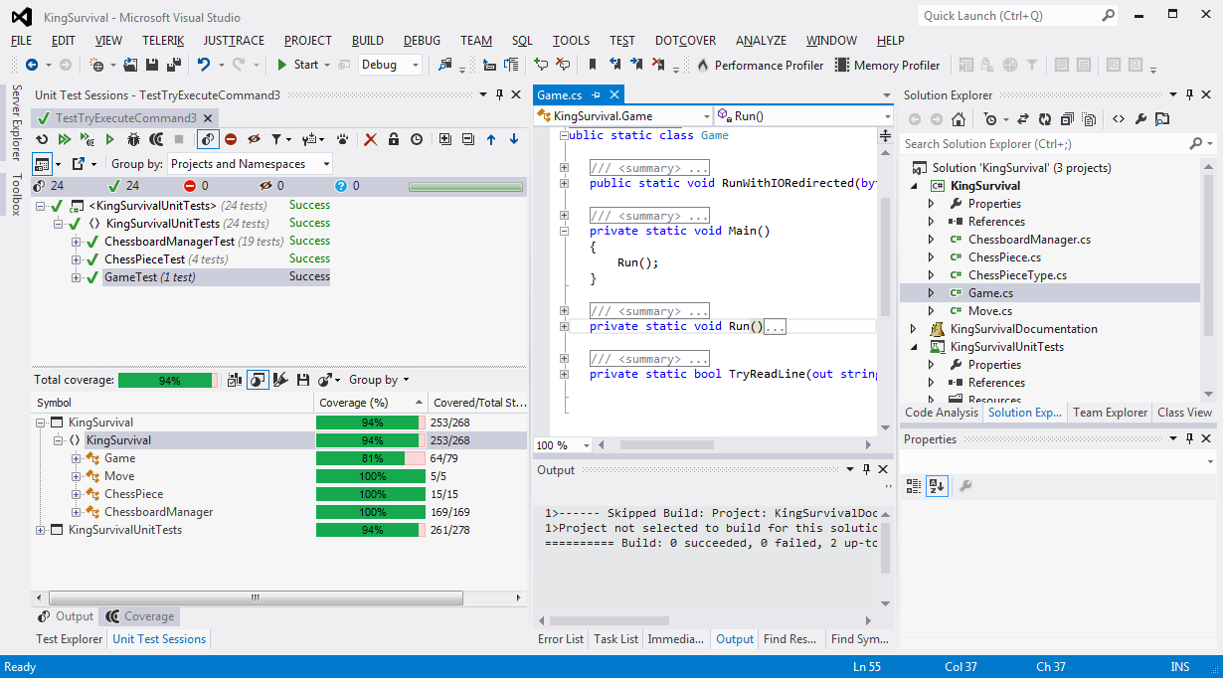
Unit testing coverage

Slide 7
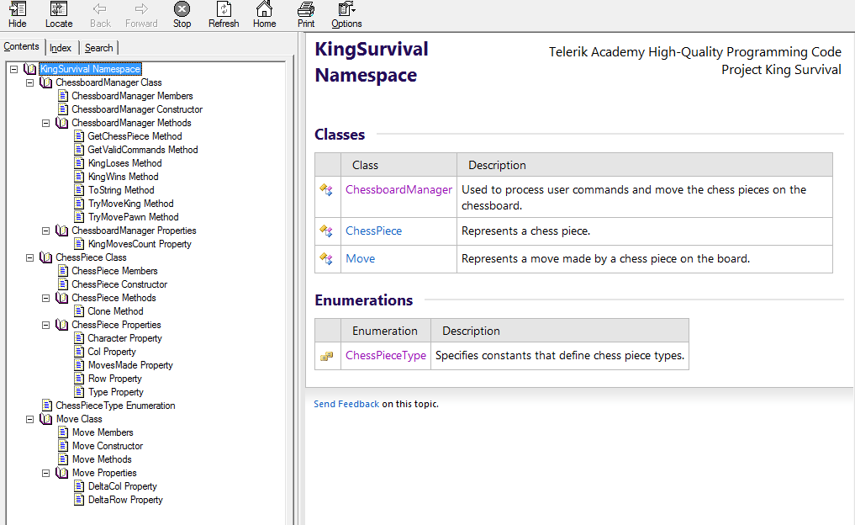
Documentation

Slide 8
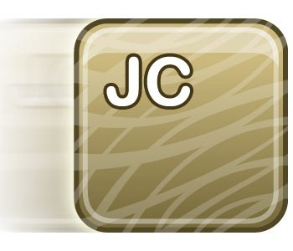



Weapons of choice
Microsoft Visual Studio 2012 Professional
StyleCop
Telerik JustCode
JetBrains dotCover
Sandcastle Help File Builder
GitHub repository and source control

Slide 9
Refactoring and commit logs
A log of the done refactoring is available at the documents folder of the team repository: https://github.com/IridiumTeam/KingSurvival/commits/master
More comprehensive and detailed log can be explored when browsing the commit history: https://github.com/IridiumTeam/KingSurvival/commits/master

Slide 10

Team Members
The members of Team Iridium:
Victor Alexiev
Anton Dobrev
Diana Koniarska
Boian Bianov
would like to say:

Slide 11

Team Members

