Slide 1

Prospects for Shale Gas Exploration in Europe by Iegor Riepin Chair of energy economics Brandenburg University of Technology
38th IAEE International Conference
25 – 27 May 2015 / Antalya, Turkey

Slide 2
Contents:
1. Background of the research
2. Data and assumptions
3. Mathematical modelling
4. Results & Conclusions

Slide 3
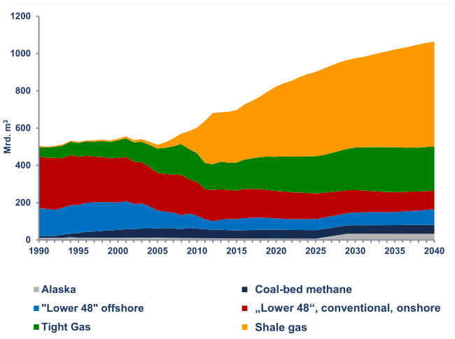
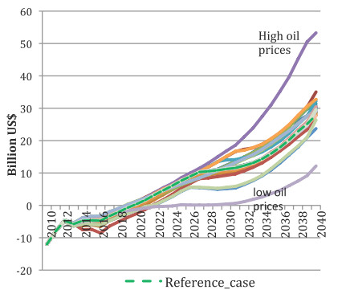
Unconventional wisdom
In 2012 US produced 290 bcm of unconventional natural gas
Wellhead prices for US natural gas had a sharp drop from 8 USD/Mbtu (2008) to 4 USD/Mbtu (2013)
In perspective US to become the biggest natural gas producer in the world and to change soon net status from “importer” to “exporter”
US natural gas trade balance forecasts (Spencer et al., 2013):

Slide 4
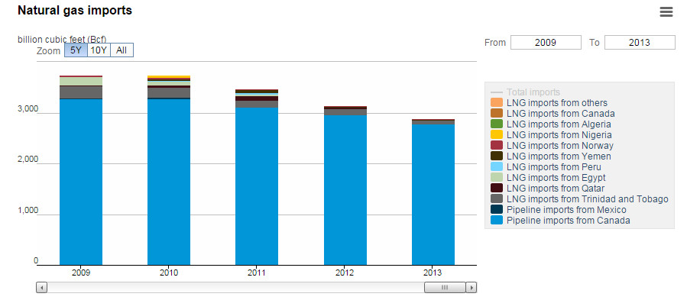
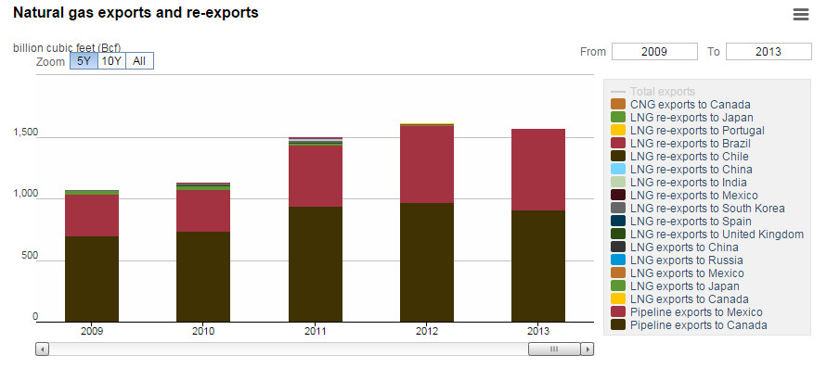
Unconventional wisdom
LNG imports decreased by 45% from the 2012 level to 97 Bcf in 2013, the lowest level since 1998
Pipeline exports to Mexico rose by 6% to 658 Bcf (a record level).
US EIA

Slide 5
Rising interest all around the world
The focus is on original estimates of OGIP, TRR or ERR
“Original estimate” is the one from a source that has either developed the estimate itself using recognized methodologies, or adapted the estimate from existing sources
Pearson et al., JRC EC (2012)

Slide 6

Objective and questions to answer
The objective of the study is to estimate a potential for shale gas exploration in Europe and consequent impact on natural gas market.
To what extent can shale gas production influence energy security concerns of EU (or certain member states) by
compensating the drop of European indigenous conventional gas production?
substituting natural gas imports?

Slide 7
Contents:
1. Background of the research
2. Data and assumptions
3. Mathematical modelling
4. Results & Conclusions

Slide 8
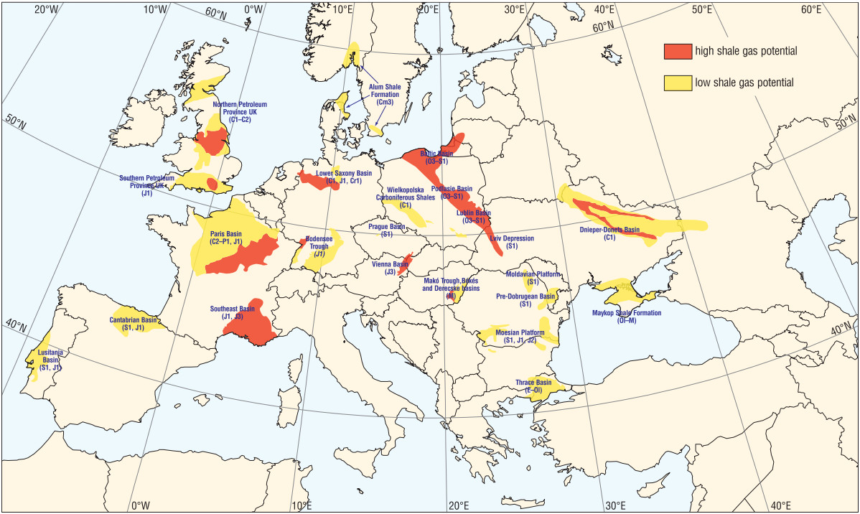
Major European sedimentary basins with shale gas potential
P. Karcz et al.: Compilation based on Szalay & Koncz (1993), Poprawa (2010b), Schulz et al. (2010), Kuuskraa et al. (2011), BGR (2012)

Slide 9
Resources and reserves
Reserves
 |  | Discovered |  |  | Undiscovered
Feasible with current technology | Commercial | Proved (1P; P90) | Possible (2P; P50) | Probable (3P; P10)
 | Sub-commercial
Infeasible with current technology
Not extractable at all
ERR - Economically recoverable resource
TRR - Technically recoverable resource
URR - Ultimately recoverable resource
GIP - Gas in place
‘McKelvey box’ Pearson et al. (2012)

Slide 10
Set of basic geological parameters characterizing European shale rocks
State | Basin | Depth (m) |  | TRR (TCM)
Poland | Baltic | 1000 - 4500 ¹'² | 1900 - 4800 ⁴ | 3,65 ¹ | 0,34 -0,76 ⁵ | 0 - 0,11 ² |  | 2,98 ⁴ | 0,0257 ⁶
 | Podlasie | 500 - 5000 ¹'² | 1820 - 4800 ⁴ | 0,4 ¹ |  |  |  | 0,29 ⁴
 | Lublin | 1000 - 4000 ¹'² | 3350 ⁴ | 1,25 ¹ |  |  |  | 0,26 ⁴
 | Fore Sudetic | 2400 - 4900 ⁴ |  | n.d. |  |  |  | 0,6 ⁴
Lithuania | Baltic | 1950 - 2120 ¹'² |  | 0,11 ¹
Ukraine | Lviv Depression | 1000 - 1500 ¹'² |  | 1,2 ¹ |  |  | n.d.
 | Dnieper-donets | 1000 - 5000 ⁴ |  |  |  |  | 2,15 ⁵
 | Maykop Shales | n.d. |  | n.d.
Romania | Pannonian | n.d. |  | 0,54 ¹ |  | n.d.
 | Moldavian/ Scythian Platform | n.d. |  |  |  | 0,1579 ⁴
 | Moesian Platform | 1800 - 4400 ¹'² | 1500 - 5000 ⁴ |  |  | 1,32 ⁴ |  | n.d.
Bulgaria | Moesian Platform |  |  |  |  |  |  | n.d.
Hungary | Pannonian | n.d. |  |  |  | n.d.
Austria | Vienna | 2000 - 8500 ¹'² |  | 0,425 ⁴
Turkey | Thrace | n.d. |  | 0,17 ¹
United Kingdom | North UK | 1500 - 4000 ⁴ |  | 0,71 ⁴
 | South UK | 1200 - 1830 ⁴ |  | 0,017 ⁴
Spain | Basque-Cantabrian | 2400 - 4420 ⁴ |  | 0,24 ⁴ |  |  | 1,084 ⁵
 | Others | n.d. |  | 0,893 ⁵
France | Paris | 1200 - 5000 ⁴ |  | 3,66 ⁴
 | South -East | 2500 - 5000 ⁴ |  | 0,21 ⁴
Germany | Lower Saxony | 1000 - 5000 ⁴ |  | 0,48 ⁴ |  |  | 1,3 ⁵
Netherlands | West Netherlands | 1000 - 5000 ⁴ |  | 0,73 ⁴ |  |  | 2,39 ⁵
Sweden | Alum Shale | 1000 - 2150 ⁴ |  | 0,28 ⁴
Denmark | Alum Shale | 3300 - 4600 ⁴ |  | 0,9 ⁴ |  |  | 0,2061 ⁵
1. P. Karcz et al. (2011); 2. Gautier et al. (2012); 3-4. ARI (2-11, 2013); 5. National Reports*; 6. U.S. Geological Survey (2012)

Slide 11
TRR by country: comparison
* Spain: ACIEP (2013), Germany: BGR (2012a), Netherlands: TNO (2009), Denmark: Gautier et al. (2013), Austria: OMV (2012), Poland: PIG-PIB (2012)

Slide 12
Countries included in a model and costs assumption
State | Basin | Depth (m) |  | Costs* ($/tcm)
 |  |  |  | Conservative | Reference | Optimistic
 |  |  |  | EUR 20 mcm | EUR 40 mcm | EUR 60 mcm
Poland | Baltic | 1000 - 4500 ¹'² | 1900 - 4800 ⁴ | 731 | 365 | 241
 | Podlasie | 500 - 5000 ¹'² | 1820 - 4800 ⁴
 | Lublin | 1000 - 4000 ¹'² | 3350 ⁴
 | Fore Sudetic | 2400 - 4900 ⁴
Ukraine | Lviv Depression | 1000 - 1500 ¹'² |  | 562 | 281 | 185
 | Dnieper-donets | 1000 - 5000 ⁴
 | Maykop Shales | n.d.
Romania | Pannonian | n.d. |  | 646 | 323 | 213
 | Moldavian Scythian Platform | n.d.
 | Moesian Platform | 1800 - 4400 ¹'² | 1500 - 5000 ⁴
Bulgaria | Moesian Platform |  |  | 646 | 323 | 213
United Kingdom | North UK | 1500 - 4000 ⁴ |  | 539 | 270 | 178
 | South UK | 1200 - 1830 ⁴
France | Paris | 1200 - 5000 ⁴ |  | 562 | 281 | 185
 | South -East | 2500 - 5000 ⁴
Germany | Lower Saxony | 1500 - 5000 ⁴ |  | 577 | 289 | 190
*G. Thonhauser, JRC EC (2012)

Slide 13
Contents:
1. Background of the research
2. Data and assumptions
3. Mathematical modelling
4. Results & Conclusions

Slide 14
Design of employed natural gas market model
Model focus
The model simulates operation and future developments of European gas sector for a middle- and long time periods
Model scope
European, FSU, North Africa and Middle East countries
Model output
Production&Consumption volumes
Model approach
Model formulated as a mixed complementarity problem (MCP)
Solved in GAMS
LNG liquefaction and regasification terminals
Storage facilities
Natural gas pipeline infrastructure
Seasonal storage dispatch
Gas traded volumes
Physical gas flow volumes
Price levels for natural gas

Slide 15
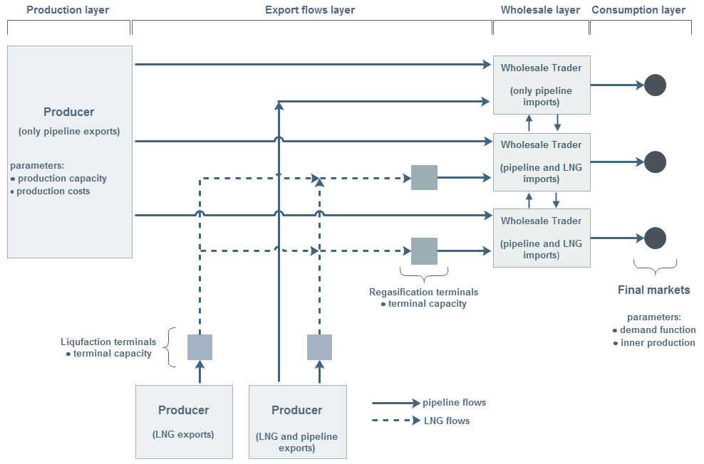
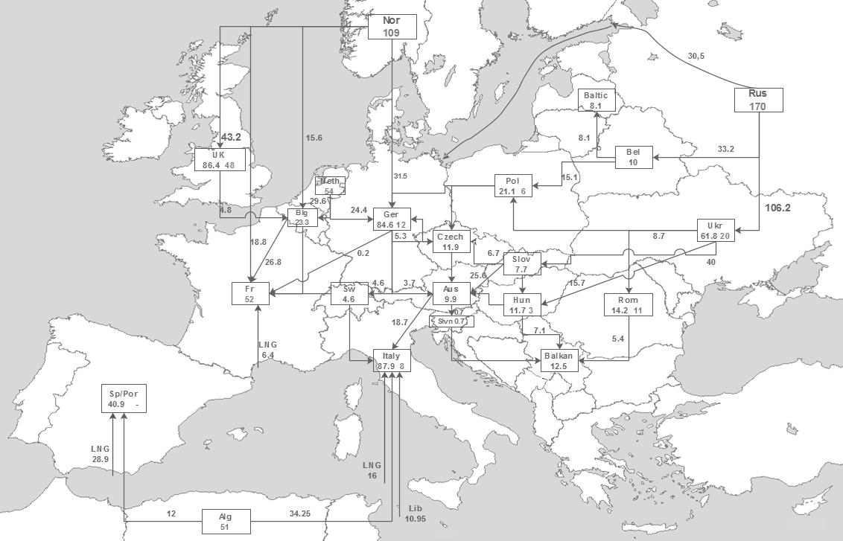
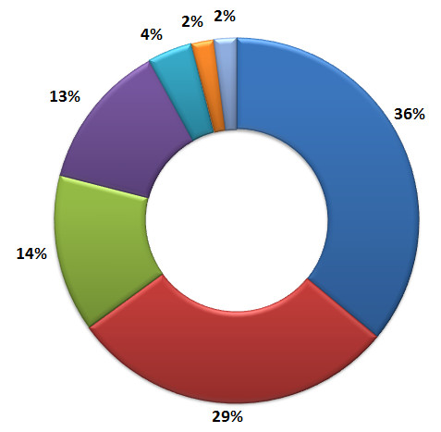
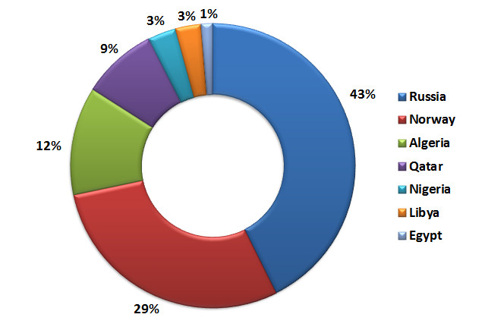
Design of employed natural gas market model
Left-top: Model scheme
Right-top: Model output data
Bottom: European imports mix validation
(Left – reference data for 2013;
Right – model output for 2013)

Slide 16
Contents:
1. Background of the research
2. Data and assumptions
3. Mathematical modelling
4. Results & Conclusions

Slide 17
Investments in shale gas

Slide 18
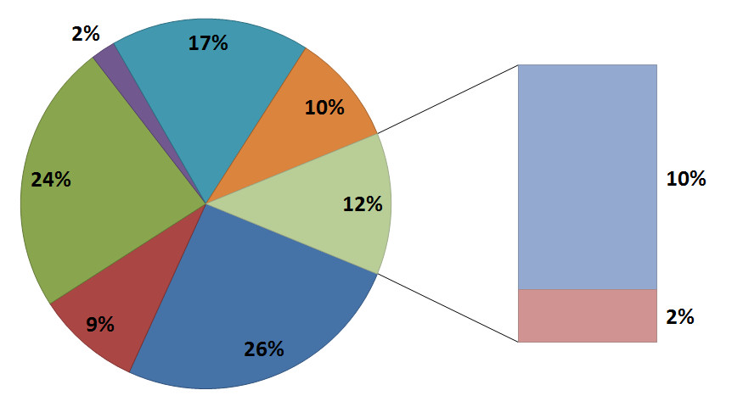
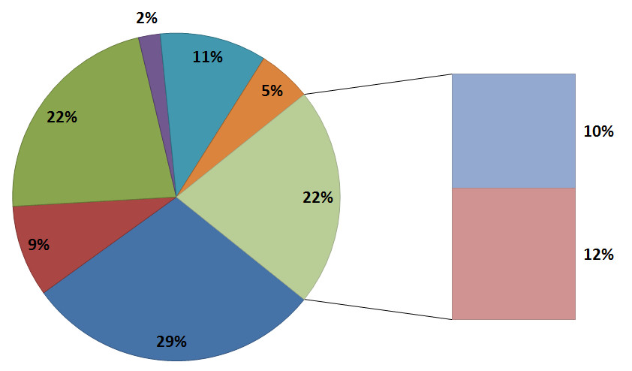
European supply mix for year 2030
Reference scenario:
Consumption: 526.2 BCM
Shale gas: 11.9 BCM*
Optimistic scenario:
Consumption: 530.4 BCM
Shale gas: 59.1 BCM*
*Excluding production in France

Slide 19
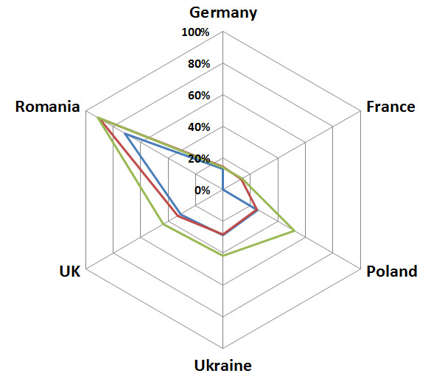
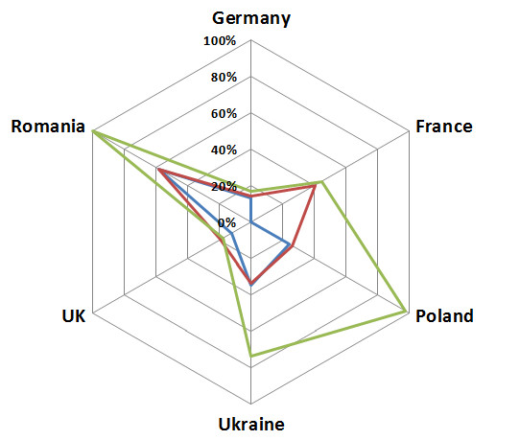
Natural gas self sufficiency for selected countries
Year 2020
Year 2030

Slide 20
Conclusions
Shale gas in itself should not be perceived as a solution to European energy security concerns
Under a reference scenario shale gas will not provide any significant contribution to European supply mix by 2030
The shale gas production, though, can have a positive influence on a market situation in particular European countries by reducing their import dependence.
The analysis examines only the economic potential of shale gas exploration and should be seen together with the associated reports addressing regulatory, environmental, technical and social issues.

Slide 21

0000 THANK YOU!
Iegor Riepin
Chair of energy economics
Brandenburg University of Technology
This presentation is based on a joined research with Felix Müsgens

Slide 22
Appendix A: Approaches used by reports providing country-level shale gas resource estimates
Bottom-up analysis of geological parameters
Literature review
Extrapolation of production experience
Expert judgement
Method not stated
Pearson et al., JRC EC (2012)

Slide 23
Appendix B: European shale gas potential estimates
Study | Cost Assumption | Projected EU shale gas production in 2035 | NG import dependence in 2035 (63% in 2011)
JRC 2012 | 5-12 USD/Mbtu | 1 to 2.1 tcm cumulatively to 2035 | 57% (high scen.) 72% (low scen.)
IEA WEO 2013 | - | 20 bcm in 2035 | 81%
Poryry and Cambridge Econometrics study for IA of Oil and Gas Producers, 2013) | 9 USD/Mbtu | 60 to 150 bcm in the high scenario | 63% (high scen.) 80% (low scen.)
BP WEO 2013 | - | 37 bcm in 2035 | C.a. 75%
EIA 2013 | - | 79 bcm in 2035 (figures for OECD Europe, not the EU) | 75%
T. Spencer et al. (2014)

Slide 24
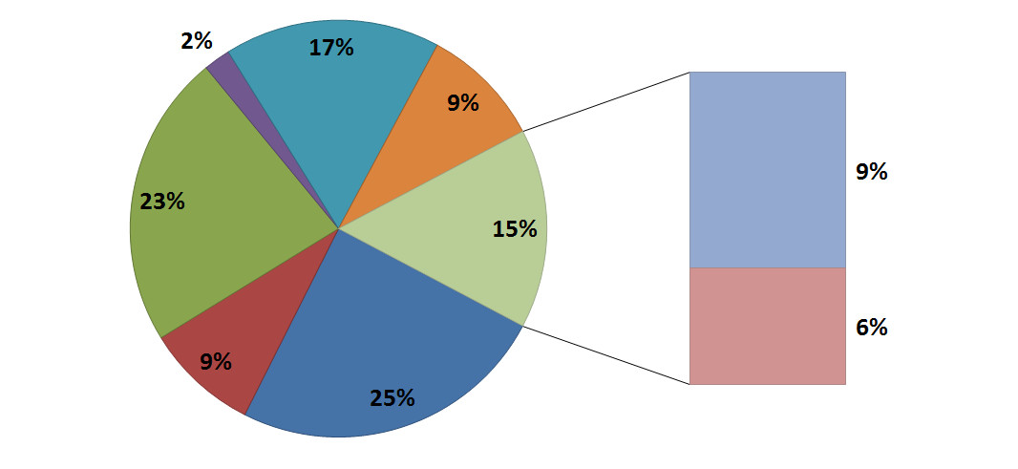
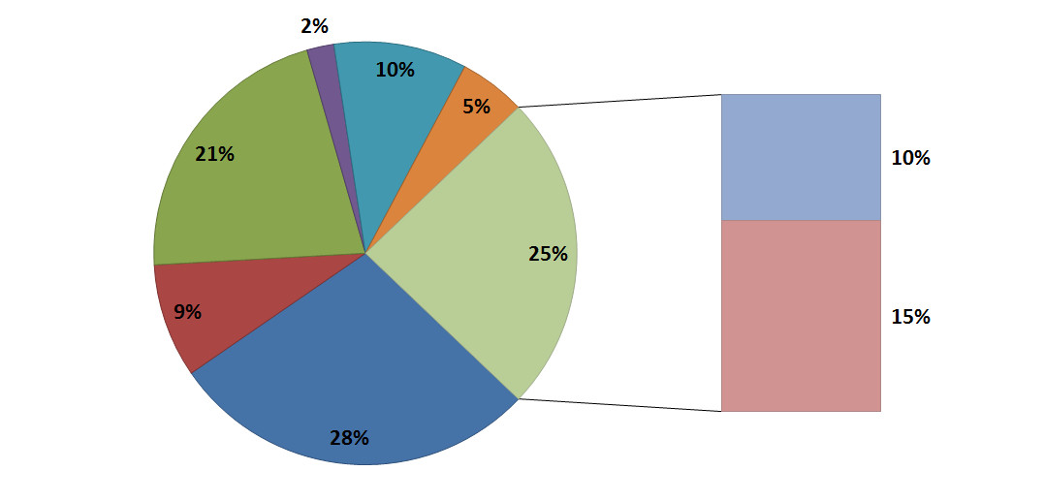
Appendix C: European supply mix (with France) 2030
Reference scenario:
Consumption: 526.2 BCM
Shale gas: 30.33 BCM*
Optimistic scenario:
Consumption: 530.4 BCM
Shale gas: 77.6 BCM*
*Including production in France

