Slide 1
Active Contour Model for Image Segmentation
Member: Yuyl; Chenmh

Slide 2
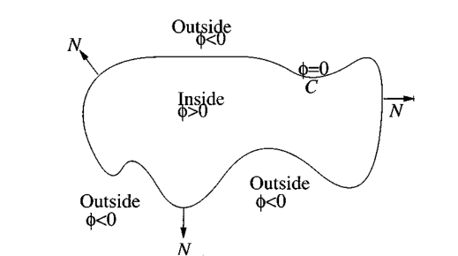
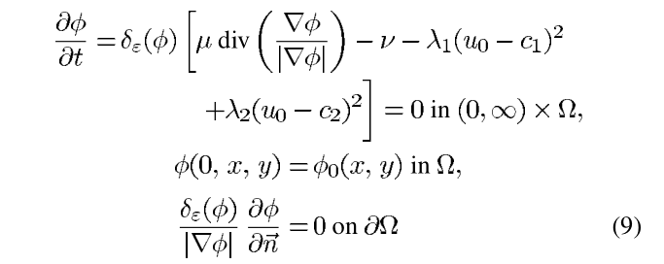
Concept
Basic idea comes from the paper: Active Contours Without Edges(2001) Tony F. Chan, Member, IEEE, and Luminita A. Vese
Mathematic description:

Slide 3
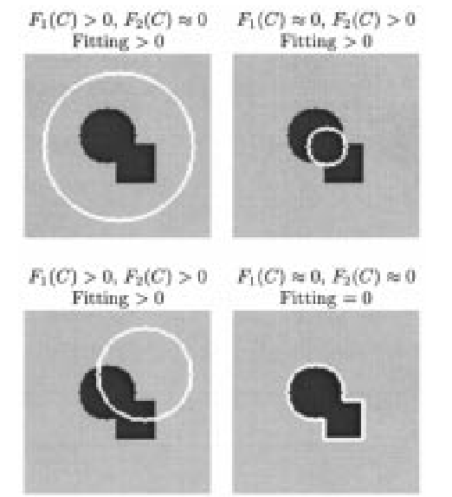
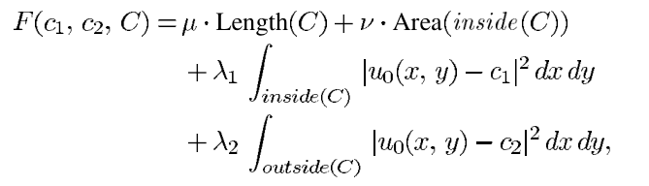
Concept: Average Intensity
The left-top image shows that the variance will be large due to
there decent amount of different intensity inside the curve.
The variance of right-down image will be low for the intensities
remain the same both inside and outside the curve.
Based on the idea above, we can get the formula. (1)
Fig 1: Examples of possible curve

Slide 4
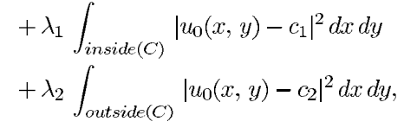
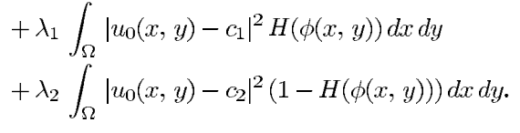
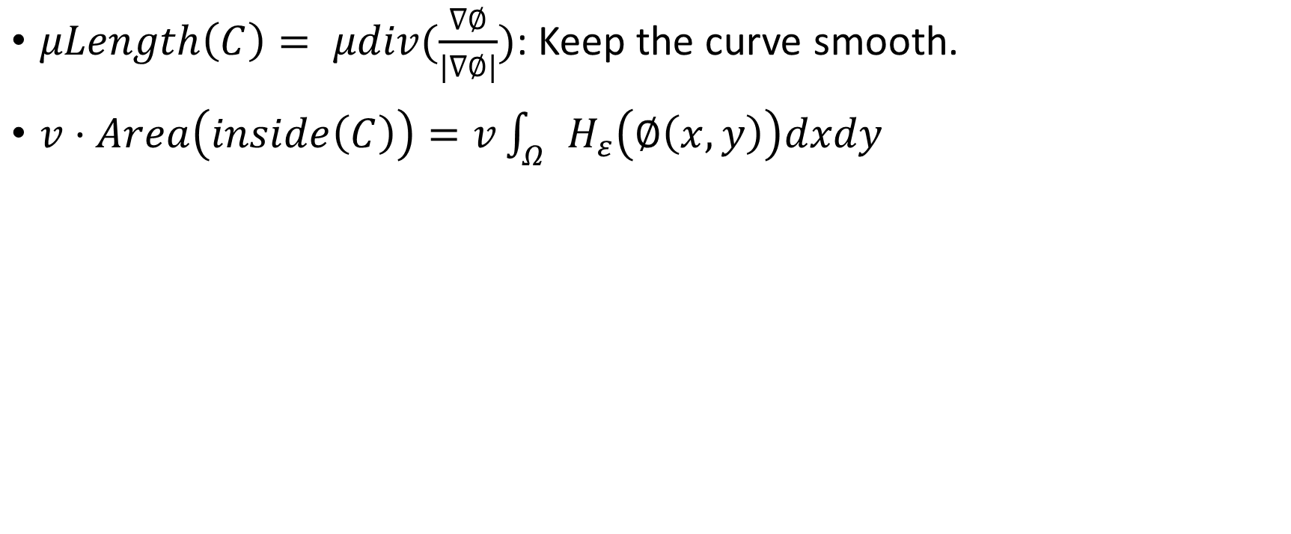
Rewrite the formula by level set
$μLength\left(C\right)= μdiv(\frac{∇∅}{|∇∅|})$: Keep the curve smooth.
$v·Area\left(inside\left(C\right)\right)=v\int_{Ω}{H_{ε}\left(∅\left(x,y\right)\right)dxdy}$
H(x) is Heaviside function.

Slide 5
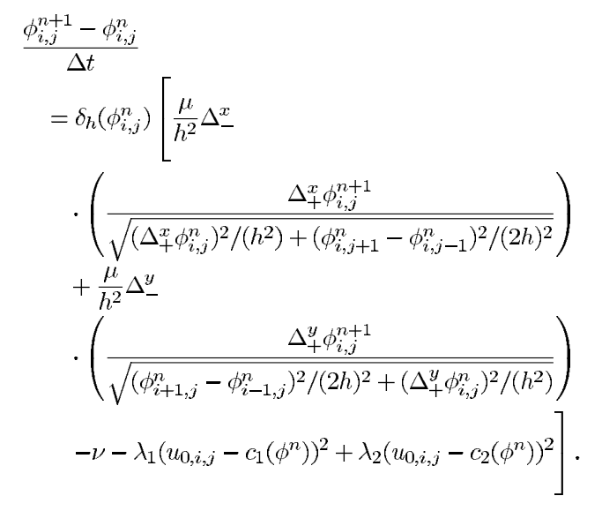
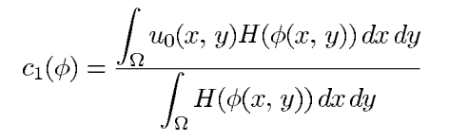
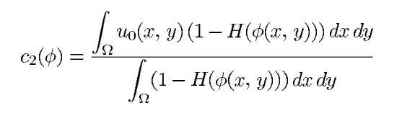
Discretization

Slide 6
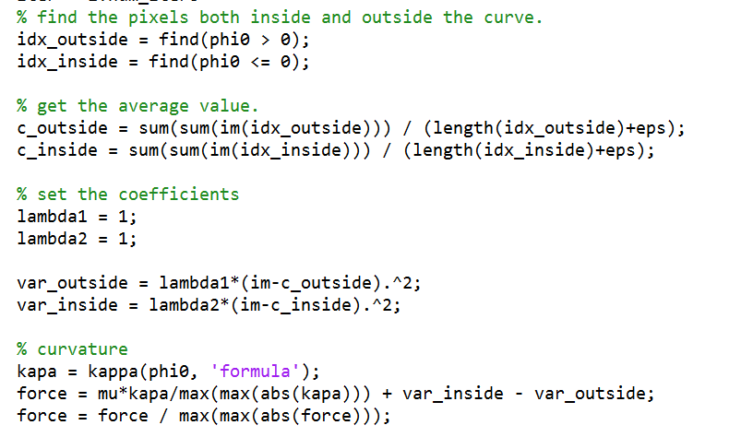
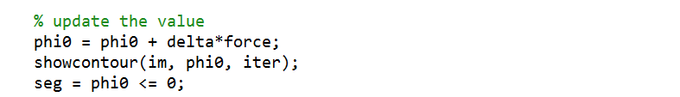
Solve the Equation(MATLAB)

