Slide 1


Global gene expression of NSCLC TIL
Students: Bogdanova Irina, Dilman Gleb
Supervisor: Esaulova Ekaterina

Slide 2

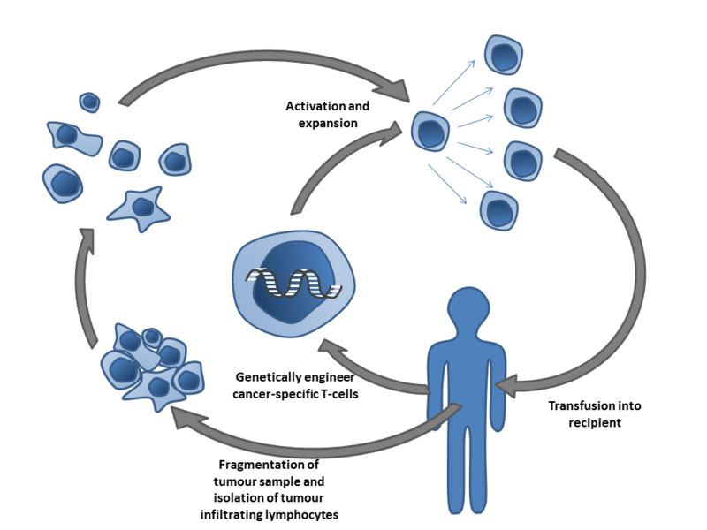

Introduction
Tumor-infiltrating lymphocytes (TIL) are white blood cells that have left the bloodstream and migrated towards a tumor.
TIL therapy is a type of cell-based immunotherapy that may be used to treat head and neck squamous cell carcinoma, melanoma, lung cancer, genitourinary cancers and a growing list of other malignancies.
It uses patient’s own immune cells from the microenvironment of the solid tumor to kill tumor cells.

Slide 3
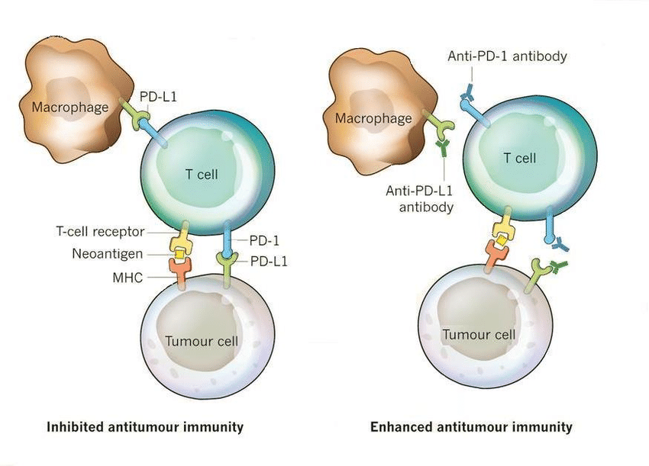
Introduction
PD-1 blockade unleashes CD8 T cells, but factors in the tumour microenvironment can inhibit these T cell responses.
Single-cell transcriptomics have revealed global T cell dysfunction programs TIL. The majority of TIL do not recognize tumour antigens, and little is known about transcriptional programs of TIL.
Authors of article which we study identify T cell clones using the functional expansion of specific T cells assay in neoadjuvant anti-PD-1-treated non-small cell lung cancers (NSCLC)

Slide 4
Objectives:
Reproduction of the study of the transcription profile of tumor-infiltrating lymphocytes (TIL) described in the article ‘Transcriptional programs of neoantigen-specific TIL in anti-PD-1-treated lung cancers' (doi: 10.1038/s41586-021-03752-4 ).

Slide 5
Tasks:
Downloading preprocessed data from GEO (single-cell RNA-seq) and annotations to them, understanding the data structure (3 count matrix files) Samples selection QC (genes number, mitochondrial and ribosomal genes counts, number of cells based filtration) Searching for variable genes, PCA, conducting UMAP Identification and annotation of T-cell clusters by expression of marker genes, results visualization TIL expression profile assessment

Slide 6
Methods
We used Scanpy (python toolkit for single cell analysis, analog of Seurat for R): https://scanpy.readthedocs.io/en/stable/
This pipeline is very suitable for out purposes:
https://scanpy-tutorials.readthedocs.io/en/latest/pbmc3k.html
Now we have our own pipeline for data we analyze:
https://colab.research.google.com/drive/14h3puI9-0yEthxm4DVQOPx4ffzs3ZJh4?usp=sharing
Let’s describe our pipeline step by step

Slide 7
Methods: what we start with?
We start with already preprocessed data published by authors on GEO:
https://www.ncbi.nlm.nih.gov/geo/query/acc.cgi?acc=GSE173351
Data by the authors with Cell Ranger:
https://support.10xgenomics.com/single-cell-gene-expression/software/pipelines/latest/what-is-cell-ranger

Slide 8
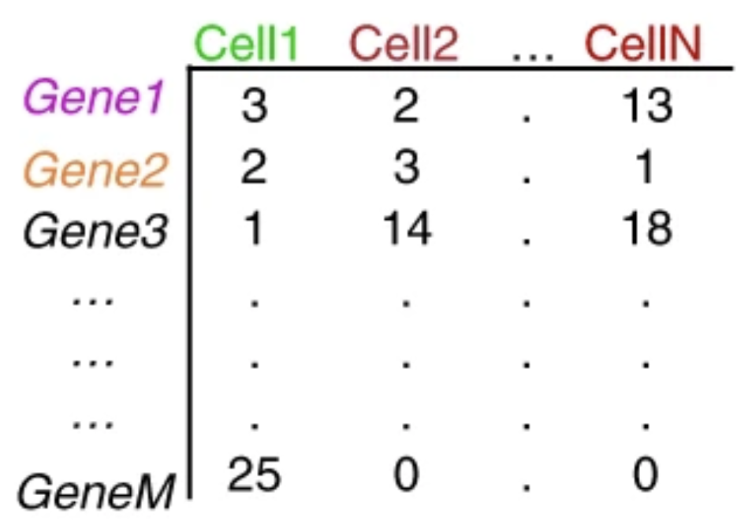
Methods: what we start with?
We start with already preprocessed data published by authors on GEO:
https://www.ncbi.nlm.nih.gov/geo/query/acc.cgi?acc=GSE173351
Data by the authors with Cell Ranger:
https://support.10xgenomics.com/single-cell-gene-expression/software/pipelines/latest/what-is-cell-ranger

Slide 9
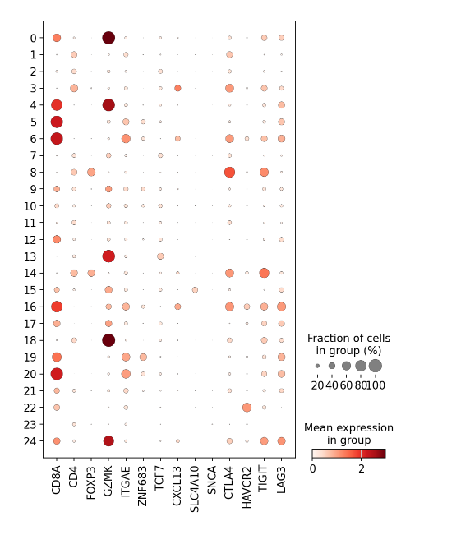
Results
Cells groups are clustered and annotated with cell types
Expression profile of marker genes

Slide 10
Github
https://github.com/Irina-Bogdanova-bioinformatician/Research_project_BIOINF_2023

