Slide 2
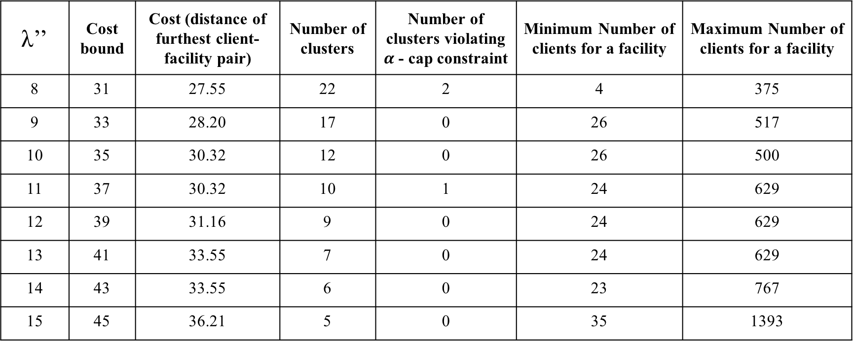
λ’’ | Cost bound | Cost (distance of furthest client-facility pair) | Number of clusters | Number of clusters violating $α$ - cap constraint | Minimum Number of clients for a facility | Maximum Number of clients for a facility
8 | 31 | 27.55 | 22 | 2 | 4 | 375
9 | 33 | 28.20 | 17 | 0 | 26 | 517
10 | 35 | 30.32 | 12 | 0 | 26 | 500
11 | 37 | 30.32 | 10 | 1 | 24 | 629
12 | 39 | 31.16 | 9 | 0 | 24 | 629
13 | 41 | 33.55 | 7 | 0 | 24 | 629
14 | 43 | 33.55 | 6 | 0 | 23 | 767
15 | 45 | 36.21 | 5 | 0 | 35 | 1393

Slide 3
λ’ | Number of clusters | Number of clusters violating constraint | Cost (distance of furthest client-facility pair) | Minimum Number of clients for a facility | Maximum Number of clients for a facility
8 | 22 | 2 | 27.55 | 4 | 375
9 | 17 | 0 | 28.20 | 26 | 517
10 | 12 | 0 | 30.32 | 26 | 500
11 | 10 | 1 | 30.32 | 24 | 629
12 | 9 | 0 | 31.16 | 24 | 629
13 | 7 | 0 | 33.55 | 24 | 629
14 | 6 | 0 | 33.55 | 23 | 767
15 | 5 | 0 | 36.21 | 35 | 1393

