Slide 1
Lyrics: authorship and emotion analysis
Anca Sotir, Florin Manghiuc, Irina Chitu

Slide 3
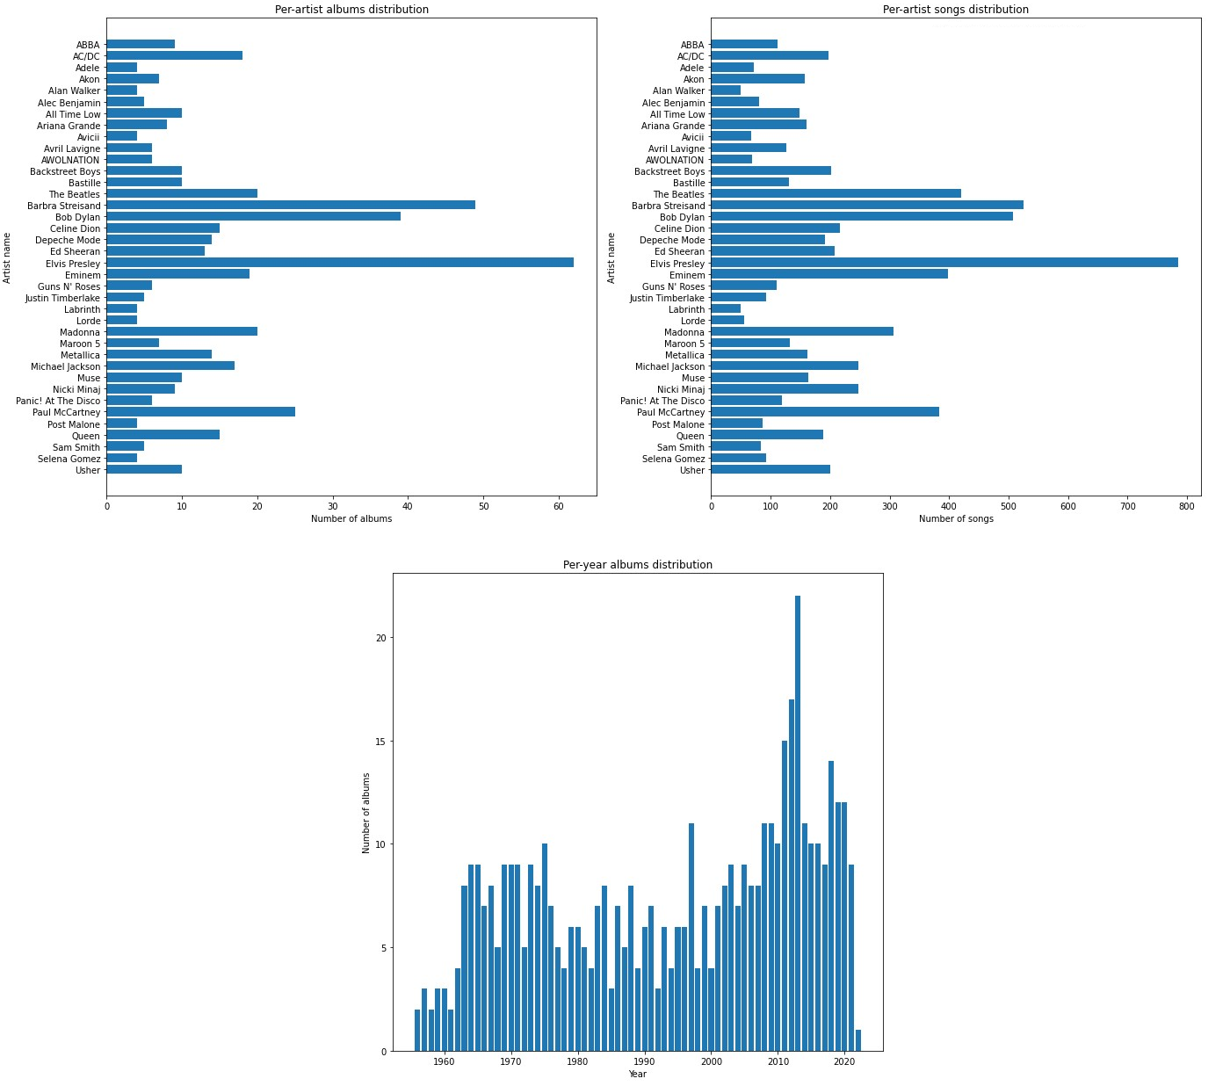
Dataset
Web scraping BeautifulSoup (AZLyrics)
Selected 38 artists
Dropped non-en songs

Slide 4
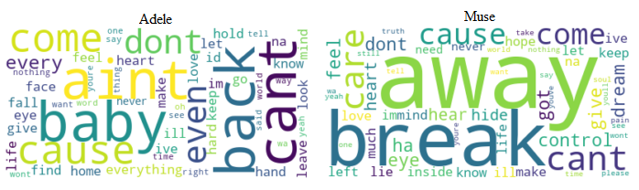
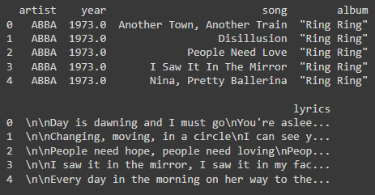
Dataset
Word clouds
CSV format

Slide 5
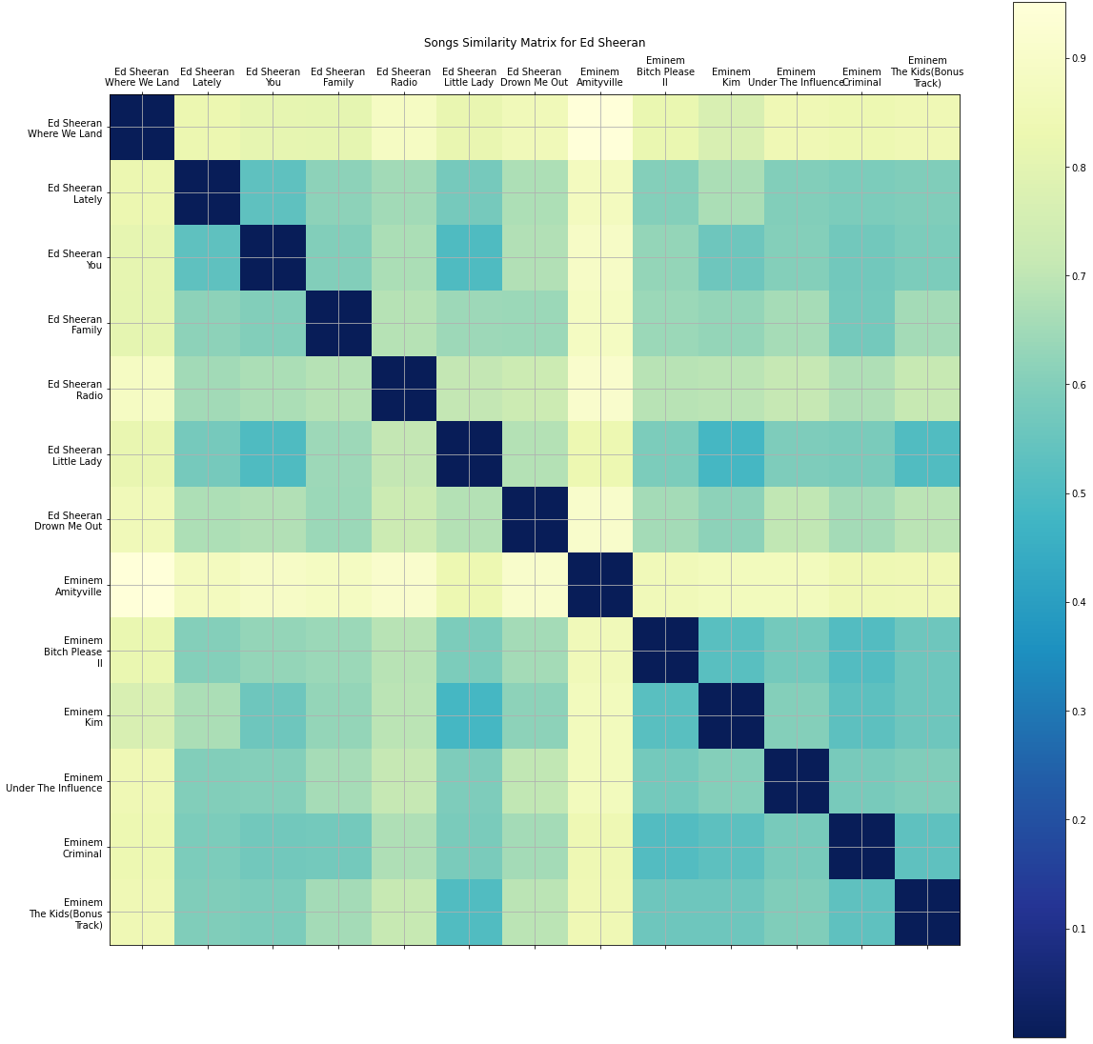
Song similarity
TFIDF
Pairwise similarity
Notes:
Top-left similarity between Ed Sheeran’s songs
Bottom-right similarity between Eminem’s songs
Top-right similarity between those two

Slide 6
Future work
Authorship
Emotion analysis
Similarity
doc2vec instead of TfidfVectorizer
try different similarity functions (e.g. cosine)

Slide 7
Thank
you for
your
attention!

