Slide 1
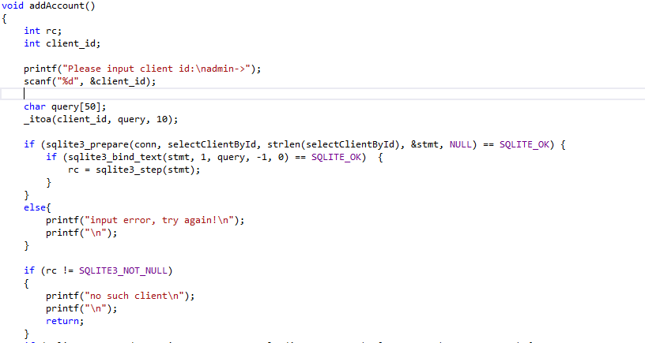
Add account

Slide 2

Add account

Slide 3
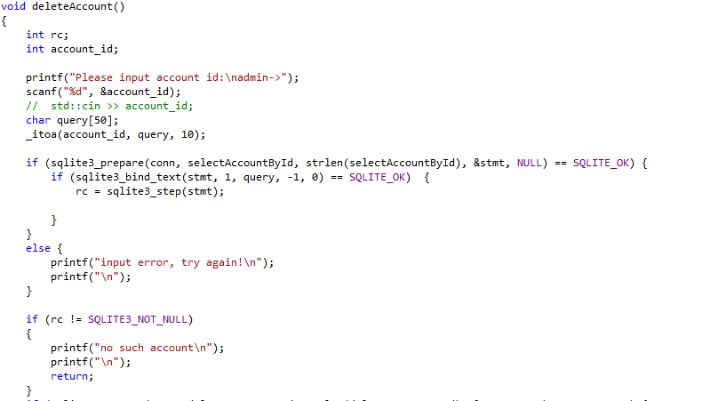
Delete account

Slide 4

Delete account

