Slide 1
Group 7 – ETL Proposal
Contributors – Clay, Irina

Slide 2
Introduction
Import Kaggle’s movies data set with 6820 movies
This data set contains movies from 5 countries:
US, Canada, UK, France and Germany
This data set contains numerous information for each of the movies, including company, director, genre, ratings, etc.
However this dataset only contains the domestic gross revenue, and does not include information on international revenue or DVD/BlueRay or streaming revenues.
To obtain this additional information we will be searching for an API or web scraping from www.the-numbers.com.

Slide 3
Challenges
The web scraping would involve using a for loop to iterate over thousands of movies, including search boxes and simulating user interactions.
Finding another data source which has required information

Slide 4
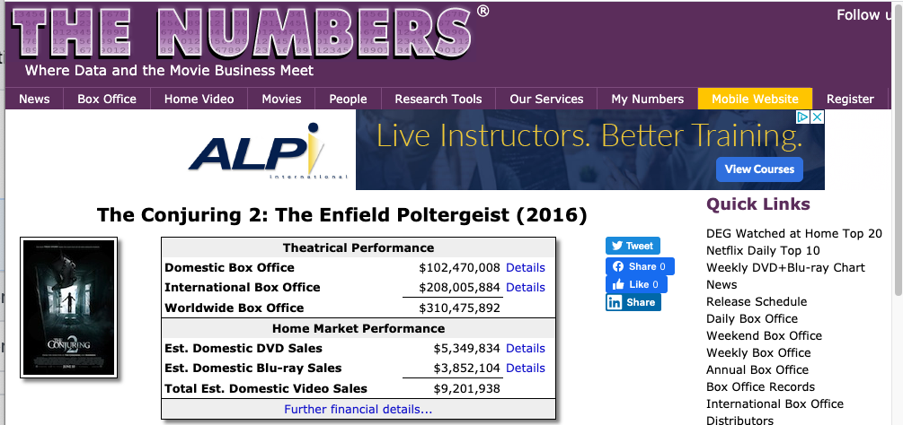
References
https://www.kaggle.com/danielgrijalvas/movies?select=movies.csv
https://www.the-numbers.com/movie/Conjuring-2-The-Enfield-Poltergeist-The#tab=summary

Slide 5
Relational database SQL
We chose relational database, because we are enhancing an existing movies dataset with additional information.
The original and additional data sets will be related
They will share a common column movie title
We will use a union on movie title to join them into one dataset

Slide 6
Database draft layout
Table from original Kaggle’s data set
The additional table with other revenue types
Merged table that includes gross domestic, international, other (DV/BlueRay, streaming, etc.), and total revenues.

