Slide 1

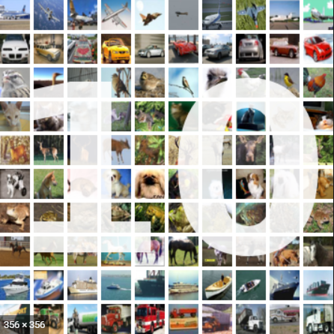
Machine Learning in Image Recognition: CIFAR10 Application
Rice University Data Camp
Project III, Team 6
Amy, Irina, mujgan & tunde
Oct 20, 2020

Slide 2
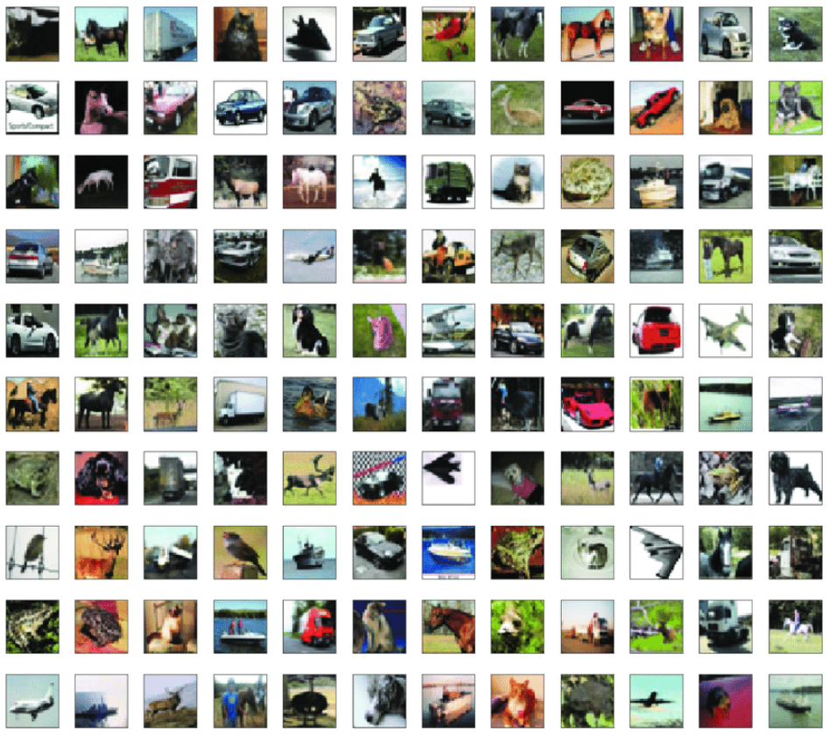
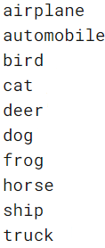
CIFAR10 Dataset Introduction
Rice University Data Camp
CIFAR stands for the Canadian Institute For Advanced Research and the CIFAR-10 dataset was developed along with the CIFAR-100 dataset by researchers at the CIFAR institute.
The CIFAR-10 dataset consists of 60,000 (50,000 dataset & 10,000 test dataset) 32×32 pixel color photographs of objects from 10 classes.
Homepage:
https://www.cs.toronto.edu/~kriz/cifar.html
Source code:
tfds.image_classification.Cifar10
Download size:
162.17MB
Dataset size:
162.17MB

Slide 3
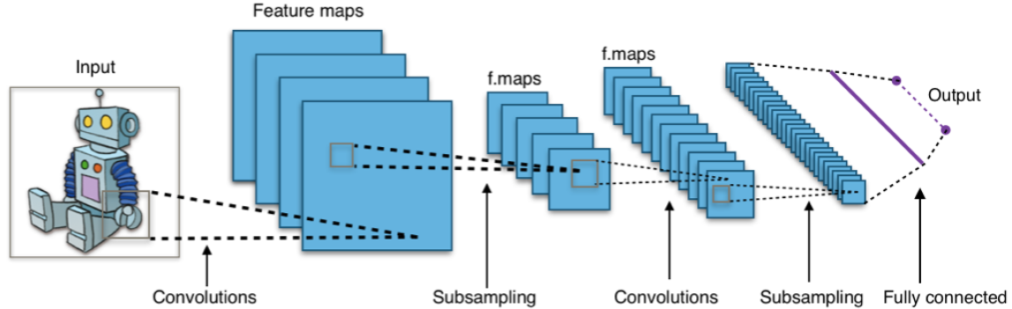
Overview: CNN Modeling Concept
Rice University Data Camp
Convolutional Neural Network (CNN) has been recognized as an effective image / object classification tool in the last 20 years;
A convolutional neural network consists of an input and an output layer, as well as multiple hidden layers;
Conceptually, convolution is technically a sliding dot product or cross-correlation to construct the feature maps.

Slide 4
Modeling Process
Rice University Data Camp
Shallow CNN
Hyperas Tuning of Shallow CNN
Deep CNN
VGG13

Slide 5
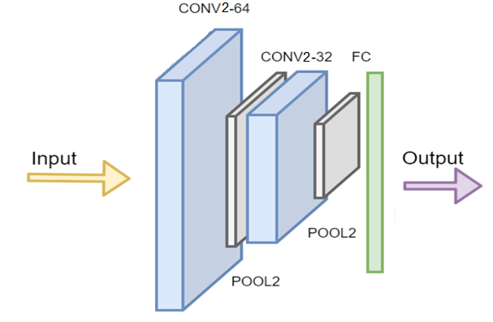
Shallow CNN
Rice University Data Camp
Started from the simplest with initial guess of parameters:
Two convolutional layers;
Two pooling layers;
One fully connected layer;
Added two more Convolutional layers;

Slide 6
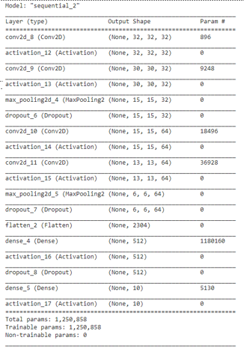
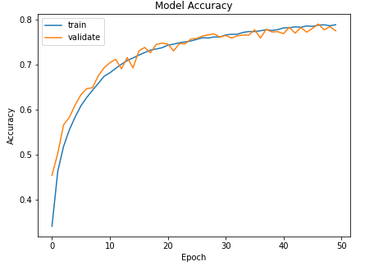

Hyperas Tuning of Shallow CNN
Rice University Data Camp
Batch size (32, 64, 128);
Epoch (20, 50, 100)
Conv layer depth (32, 64 or 128);
Kernel size (3x3, 5x5 or 7x7);
Pool size (2x2 or 4x4);
Dropout (uniform(0, 1));
Aviation (ReLu or Tanh);
Optimizer (adam, sgd or user defined RMSprop with learning_rate & decay)

Slide 7
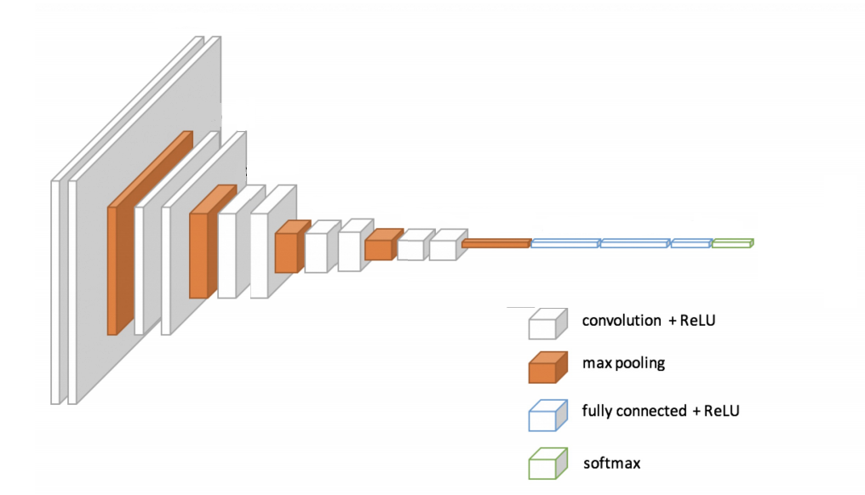
Deep CNN: VGG13
Rice University Data Camp
Notes:
A lot of comparative studies have demonstrated the undoubted advantage of deeper networks over the shallower version.

Slide 8
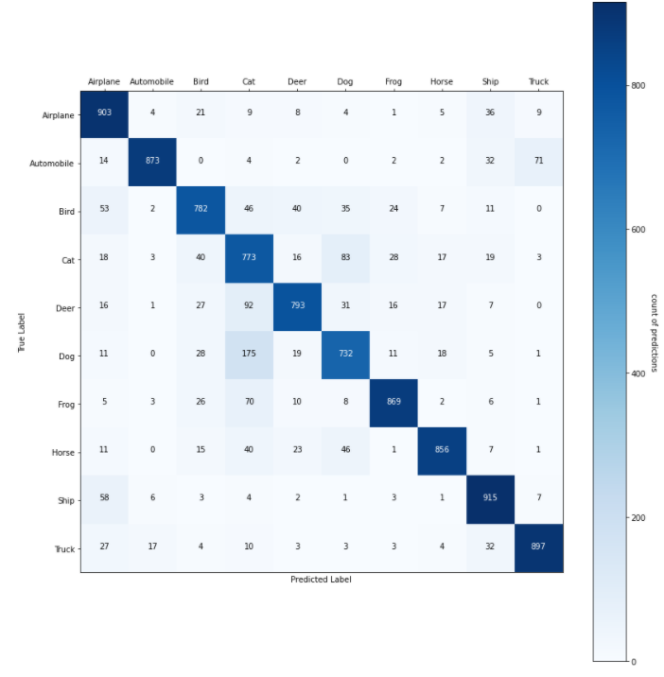
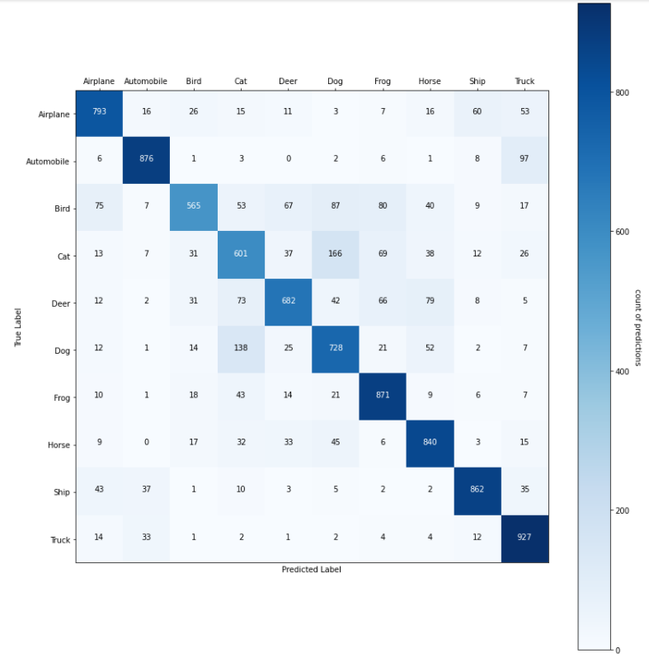
Heatmap of Test Set Result VGG13 vs. Optimized Shallow CNN
Rice University Data Camp

Slide 9
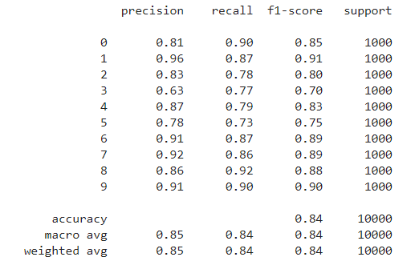
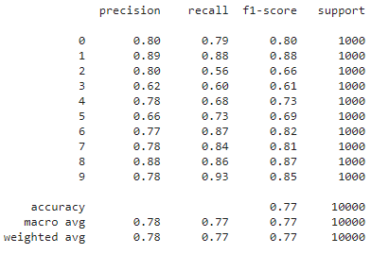
Rice University Data Camp
Classification Report VGG13 vs. Shallow CNN

Slide 10
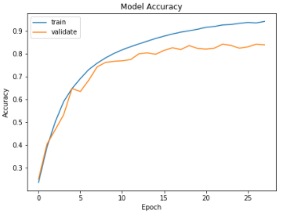

VGG13 Limitation & Next Steps
Rice University Data Camp
Regulation / Optimization already employed:
L2 Regularization has been employed to reduce overfitting;
Batch normalization implemented – prevent the abnormal values in the preceding layer to propagate into the next layer; allows layers to learn more independently
Limitation:
Accuracy in training set > validation set, -> overfitting;
Accuracy may be further improved.
Next Steps:
Hyperas tuning of VGG models
VGG16 & VGG19

