Slide 1
San Francisco Street Trees
Amy Steward
Ilya Slabodkin
Irina Kolesnik

Slide 2
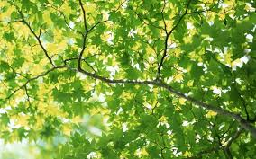
Trees for City’s ecosystem
“Trees are more than just beautiful additions to urban life. They are an essential component of the City's ecosystem and provide enormous environmental and social benefits. They help manage stormwater, reduce air pollution, sequester carbon, save energy, increase property values, provide wildlife habitat, calm traffic, provide a more pleasant pedestrian experience and benefit human health.” https://sfpublicworks.org/trees

Slide 3
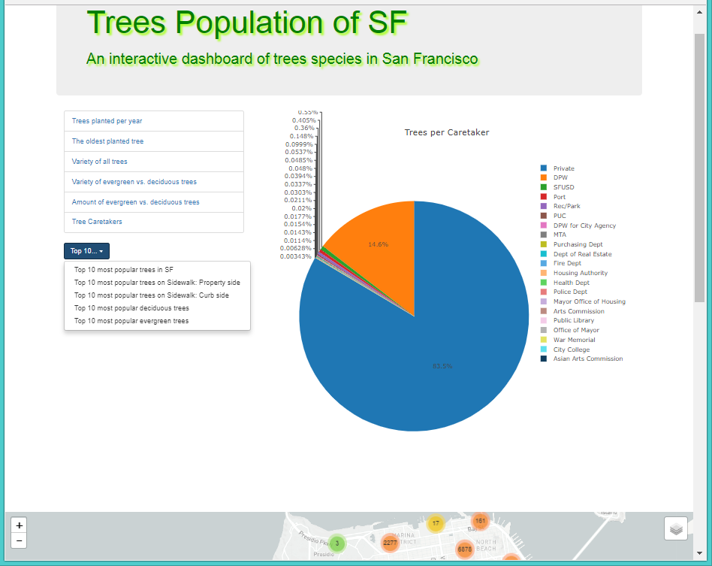
An interactive dashboard
Includes Facts, Top 10 stats, and Map:
Trees planted per year
The oldest planted tree
Variety of trees
Variety of evergreen vs deciduous trees
Amount of evergreen vs deciduous trees
Tree Caretakers
Top 10 most popular trees…
Interactive Map showing clusters/individual tree markers.

Slide 4
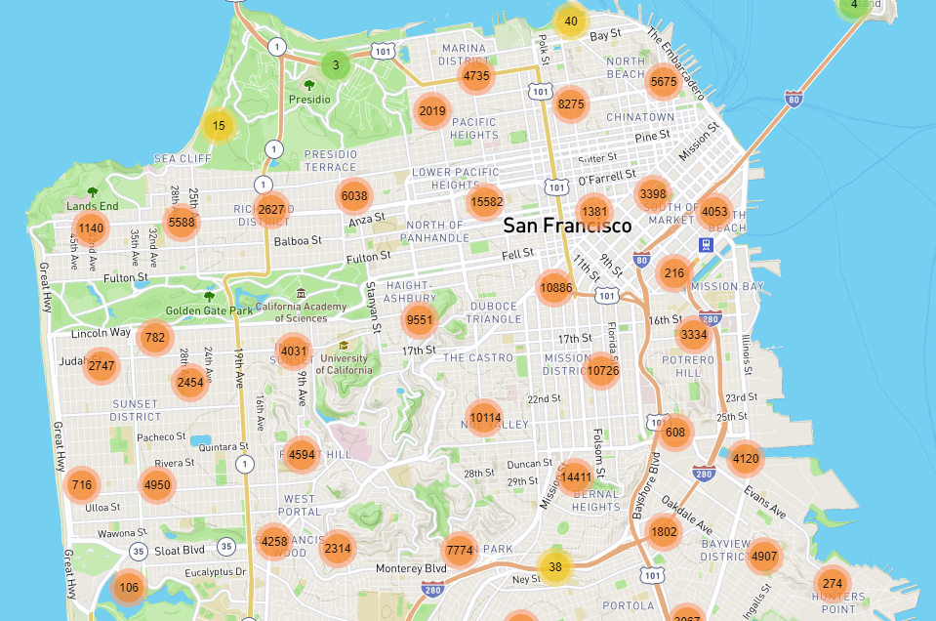
Trees Planted Around San Francisco
Two large concentrations around Lower Pacific Heights, the Mission District, and Bernal Heights

Slide 5
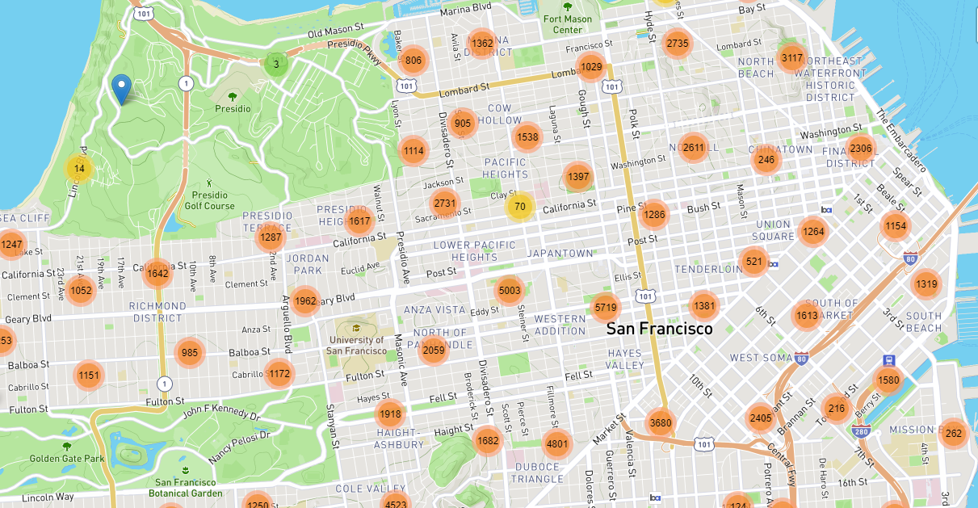
Pacific Heights
Zooming in to Pacific Heights, it’s clear that most of the planted trees are in the busy populated areas rather than places that are already parks
This makes sense with the fact that most of the trees planted are by private residents for their sidewalks, rather than trying to expand currently existing parks

Slide 6
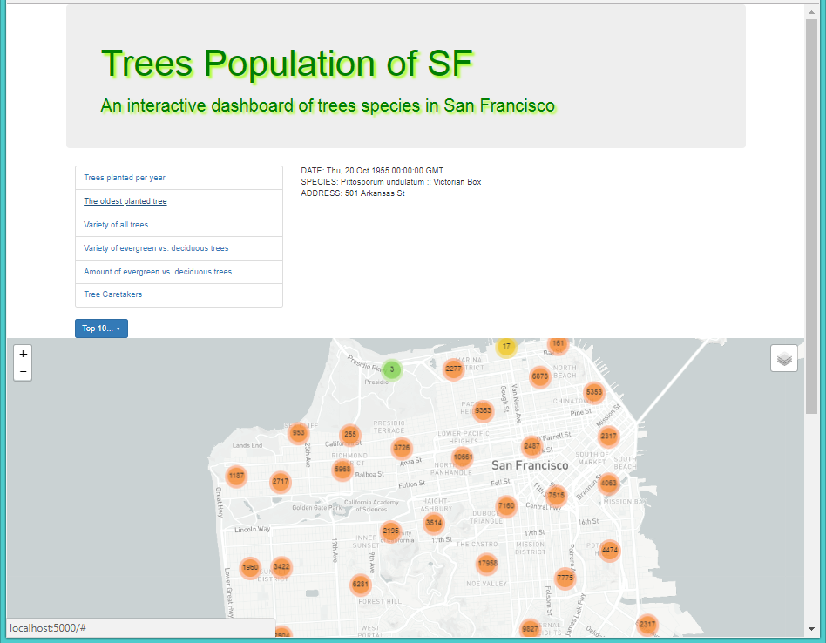
The oldest planted tree
The oldest planted tree:
DATE: Thu, 20 Oct 1955 00:00:00 GMT
SPECIES: Pittosporum undulatum :: Victorian Box
ADDRESS: 501 Arkansas St

Slide 7
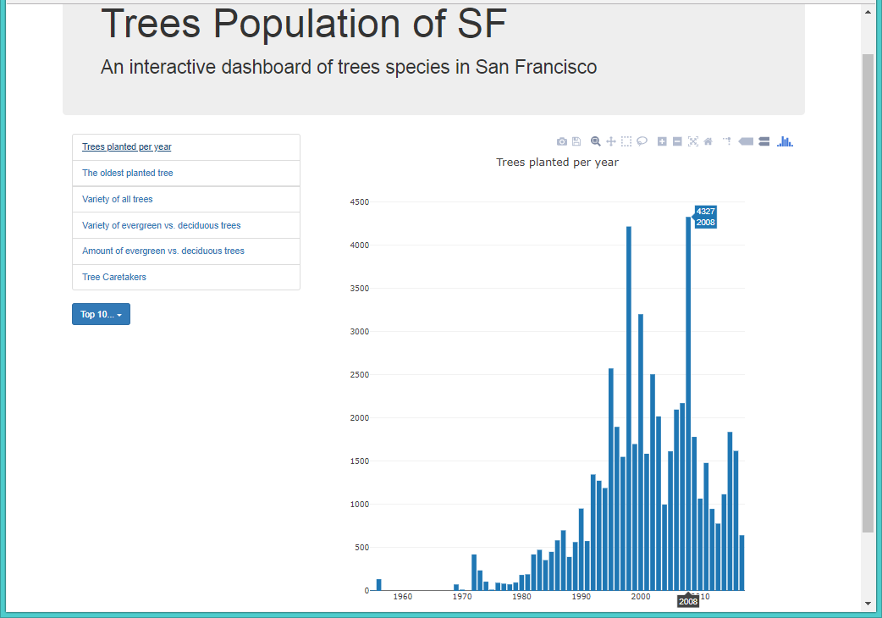
Trees planted per year
Visible peak of trees being planted around the years 2000 and 2010
Another slow rise in the mid to late 2010s, coinciding with the mayor’s initiative to plant over 2,000 more trees
Part of an initiative to become carbon neutral by 2050

Slide 8
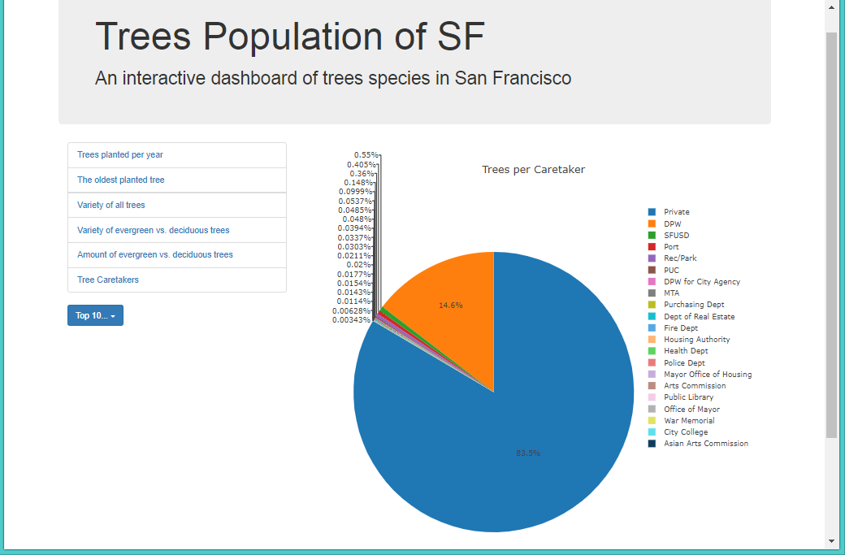
Trees per Caretaker
Majority of the trees are by private owners planting on their own property
Other large group is the DPW
DPW = Department of Public Works

Slide 9
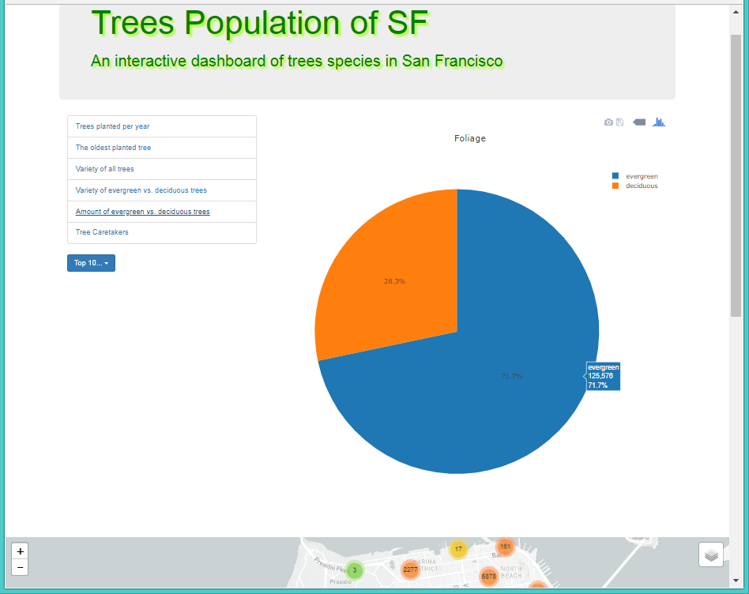
Trees: deciduous vs evergreen
The amount of deciduous vs evergreen: 49,578 vs 125,576
The variety of deciduous vs evergreen: 237 vs 339

Slide 10
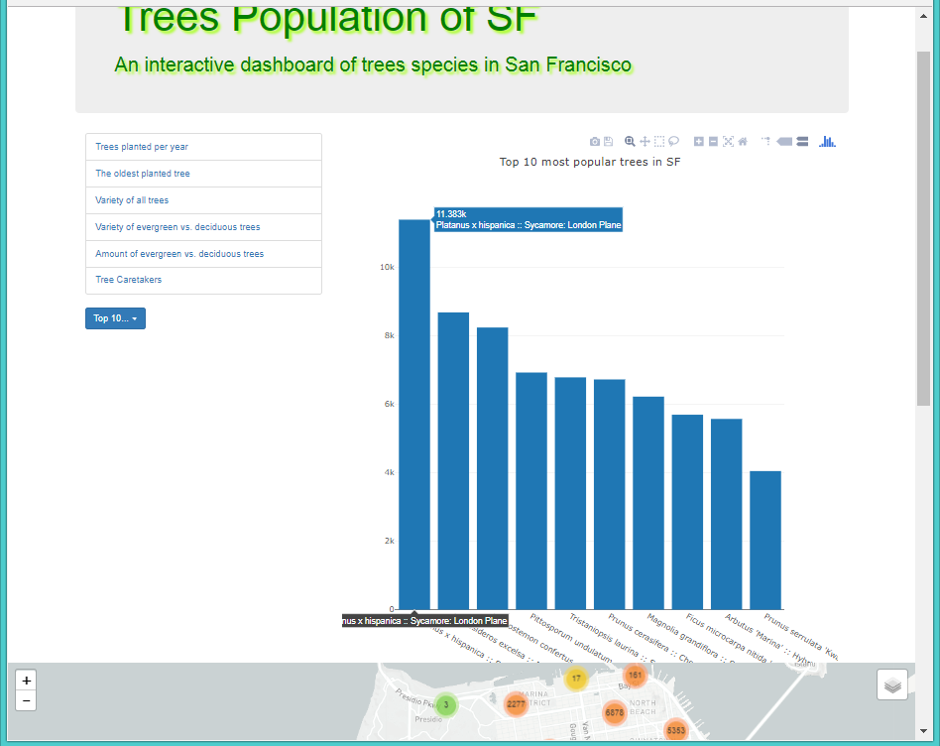
Top 10 most popular trees… statistics
Top 10 most popular planted trees in SF
The leader is Sycamore London Plane; deciduous, 11,383 species

Slide 11
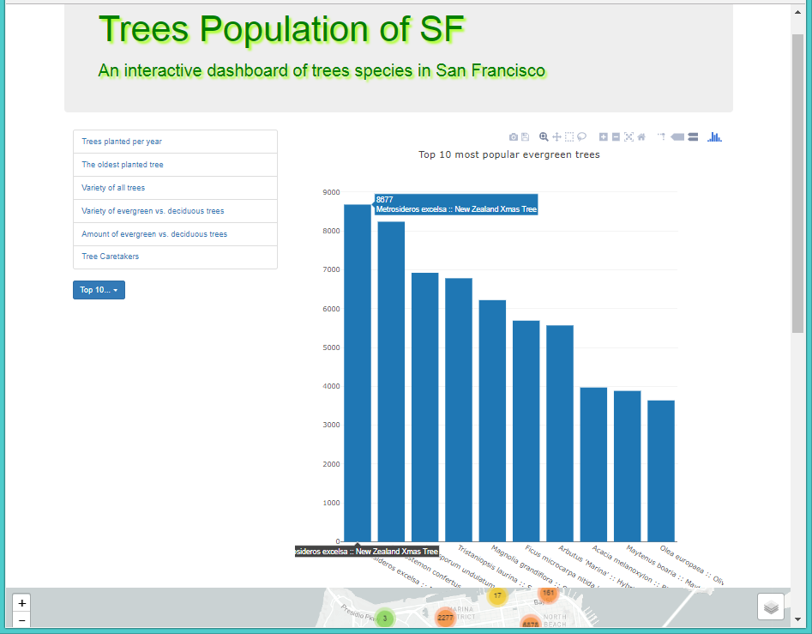
Top 10 most popular evergreen trees
Top 10 most popular planted trees in SF
The leader is New Zealand Xmas Tree; 8677 species

Slide 12
Conclusions & Possible Next Steps
In the last decade, San Francisco private citizens have planted a large number of trees on their personal property, sprucing up the more suburban areas
It would be worth re-pulling data in a few years as San Francisco executes its plan to become carbon neutral by 2050
We would also like to see if the proportion of private planters versus the DPW stays the same or changes; who would really be “taking ownership” of all these newly planted trees?

Slide 13
Tools used in this project
Python Flask powered RESTful API,
HTML/CSS,
JavaScript,
D3.js, SQLite & SOLAlchemy,
Plotly,
Leafleat,
Dataset: SF Street Trees from https://www.kaggle.com/jboysen/sf-street-trees/data

