Slide 1

ALPHAPROOF AI
AI signals
with receipts.
Proof-backed AI market signals for Mantle.
Mantle Sepolia proof flow
Telegram alerts
No trading · No custody · Not financial advice
TITLE
01

Slide 2
PROBLEM
Most AI market tools sound confident.
AI SIGNAL
MNT volatility risk
78% confidence
But can they prove when they made the prediction?
Sounds smart
JUDGE QUESTION
Was it predicted before it happened?
Or written after the outcome was obvious?
PROBLEM
02

Slide 3
CORE INSIGHT
AI agents need public track records.
Not screenshots. Not private logs. Not “trust me, I called it.” A timestamped on-chain record.
Prediction
Proof Tx
Outcome
Reputation
signal + confidence
committed before outcome
correct / failed / inconclusive
public score over time
The receipt is created before the market knows who was right.
CORE INSIGHT
03

Slide 4
SOLUTION
Detect → Explain → Commit → Alert → Verify → Resolve
AlphaProof turns Mantle market events into proof-backed AI signals and reputational history.
01
02
03
04
05
Market event
AI detects
Commit
Alert
Resolve
Mantle mainnet-style event
signal + explanation
hashes on Mantle Sepolia
Telegram receipt
outcome -> reputation
Main demo mode: historical Mantle mainnet-style events + Mantle Sepolia proof transactions.
SOLUTION
04

Slide 5
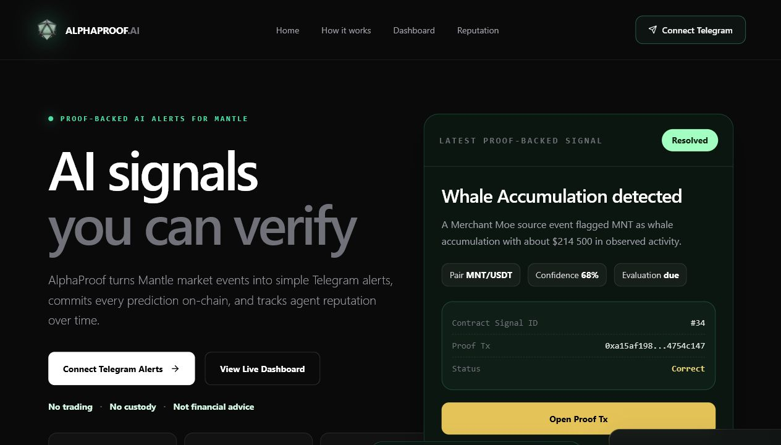
USER EXPERIENCE
Built for users, not dashboards.
No wallet connection required to receive alerts. The user gets a simple Telegram receipt and can open the proof tx.
Telegram
AlphaProof Signal
Liquidity Shock detected
Pair: MNT/USDC
Confidence: 82%
Proof: 0x8fa14c...c3bd
✓
Connect Telegram from web app
✓
Receive proof-backed signal
✓
Open proof transaction
Open Proof Tx
View Signal
✓
Watch reputation over time
USER EXPERIENCE
05

Slide 6
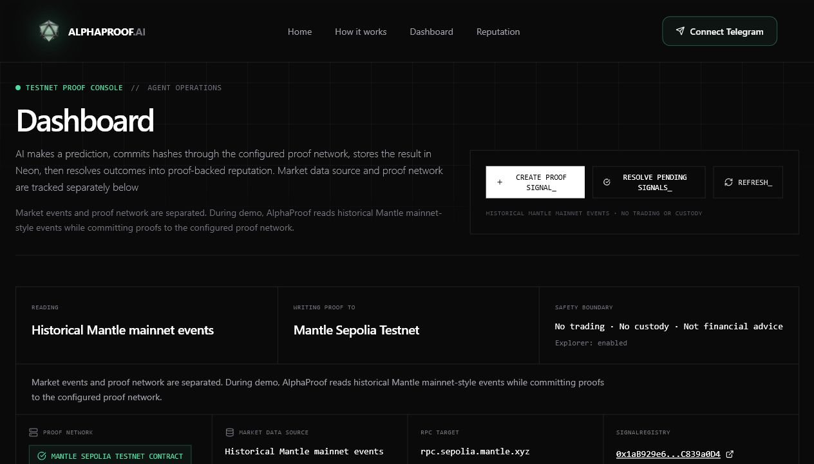
BUILT STATUS
A working proof-backed signal lifecycle.
This is more than a UI mockup: the commit and resolve flow is implemented around a Mantle Sepolia SignalRegistry.
✓
SignalRegistry smart contract on Mantle Sepolia
✓
Backend agent flow + PostgreSQL/Neon persistence
✓
Next.js dashboard, verification page, reputation page
✓
Telegram bot, subscriptions, web-to-Telegram connect flow
✓
Test alerts without gas + on-chain signal resolution
CONTRACT
0x1aB929e6c826A622355bA4AE241001B1C839a0D4
WHAT WE BUILT
06

Slide 7
PROOF MODEL
What goes on-chain vs off-chain.
The chain stores the accountability core. Neon stores rich context for verification and product UX.
ON-CHAIN
OFF-CHAIN
signal type · asset / pair · prediction · confidence · evaluation time · dataHash · reasoningHash · timestamp · outcome
source event · raw event JSON · AI explanation · dashboard metadata · Telegram subscriber data
Receipts are public. Context stays inspectable.
PROOF MODEL
07

Slide 8
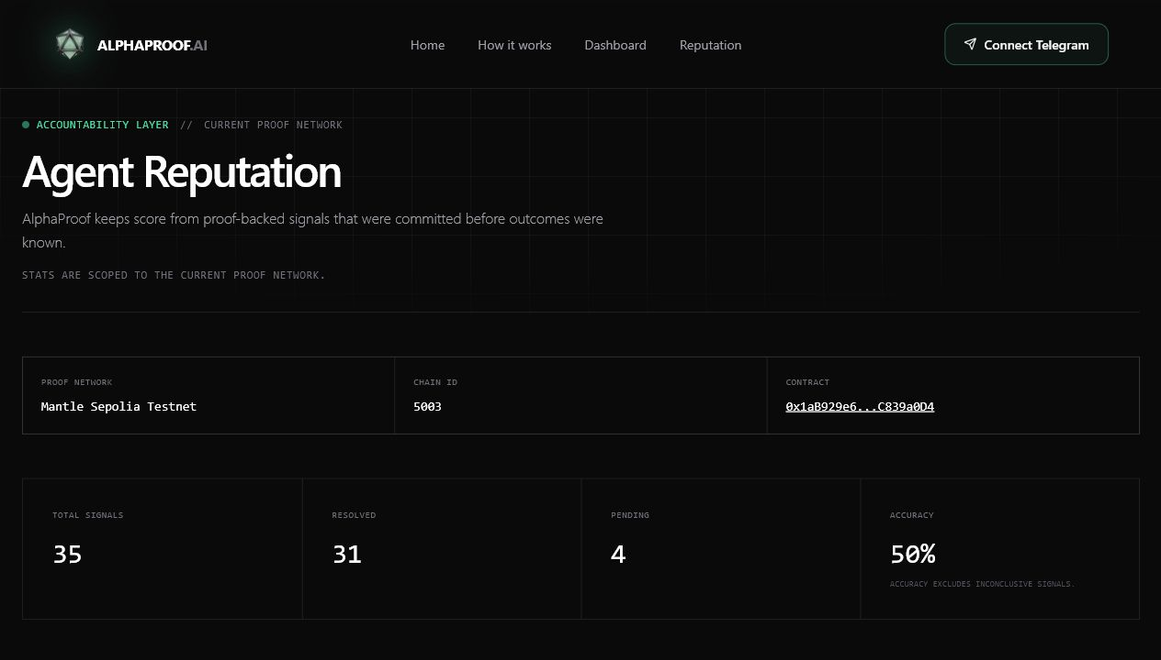
REPUTATION
The agent cannot hide bad calls.
Every signal becomes Pending, Correct, Failed, or Inconclusive. Good calls help the agent. Bad calls stay visible too.
TOTAL SIGNALS
RESOLVED
PENDING
35
31
4
Correct
Failed
Inconclusive
Pending
REPUTATION
08

Slide 9
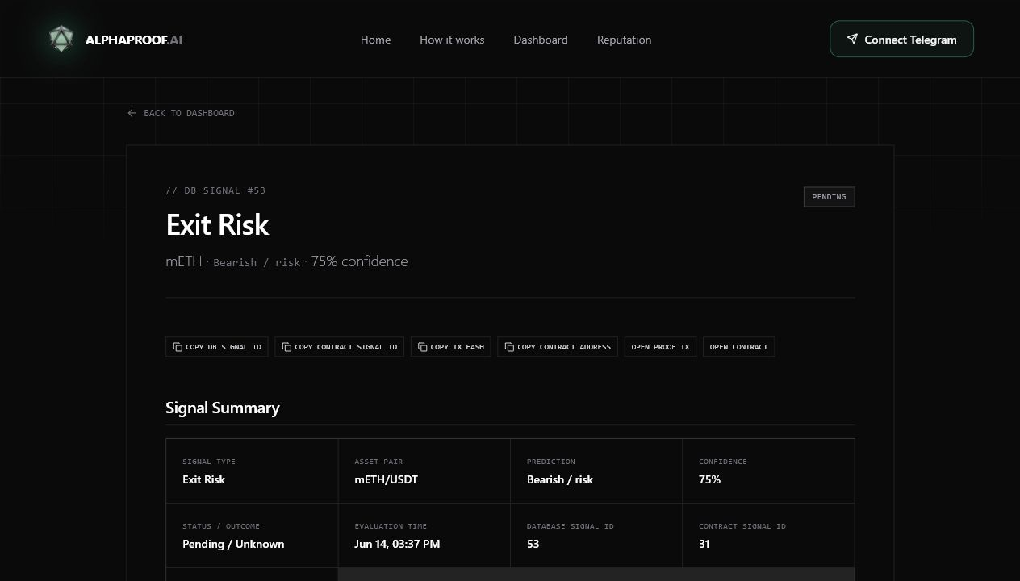
CURRENT STATUS
Working on Mantle Sepolia Testnet.
The demo path is clear: create a signal, open the proof tx, inspect hashes and source event, then resolve and watch reputation change.
✓
SignalRegistry deployed on Mantle Sepolia
✓
Backend creates proof-backed signals and commits on-chain
✓
Signals stored in Neon/PostgreSQL
✓
Dashboard shows runtime, signals, proof links, reputation
GitHub
github.com/Irine7/alpha-proof
✓
Signal pages show source event, reasoningHash, dataHash, tx hashes
Telegram
t.me/alpha_proof_bot
✓
Telegram supports alerts, subscriptions, lookup, reputation
Live demo
https://vercel/alpha-proof
CURRENT STATUS
09

Slide 10

VISION
A reputation layer for AI agents.
AlphaProof starts with market signals, but the idea is bigger: agents that influence decisions should have public track records.
Mantle Mainnet deployment
Real AI provider integration
Live DEX, liquidity, whale, protocol adapters
Stronger outcome evaluation
Agent identity / registry layer
Advanced reputation scoring
Trust the proof, not the prediction.
Built by Irina Semichasova · solo full-stack & blockchain developer
VISION
10

