Slide 1


Slide 2


SAP cloud search engine
Based on google-collab and Firebase DB

Slide 3
NFR
Flexibility
Auditability and Control
Response Time
Privacy
Security
Accessibility
Scalability
Backup
Usability

Slide 4









crawler
code
write to
Search data
write to
Index changes and statistics
Updates user history
Indx. table
Index management
search
information
statistics
admin
user
chatbot

Slide 5
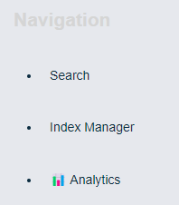
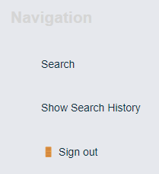
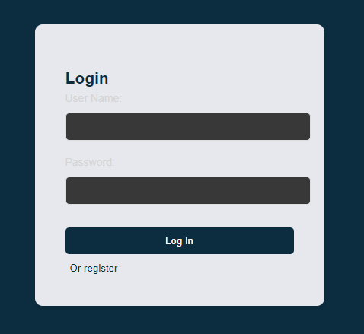
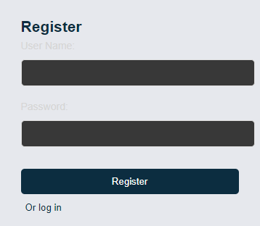
admin
user

Slide 6
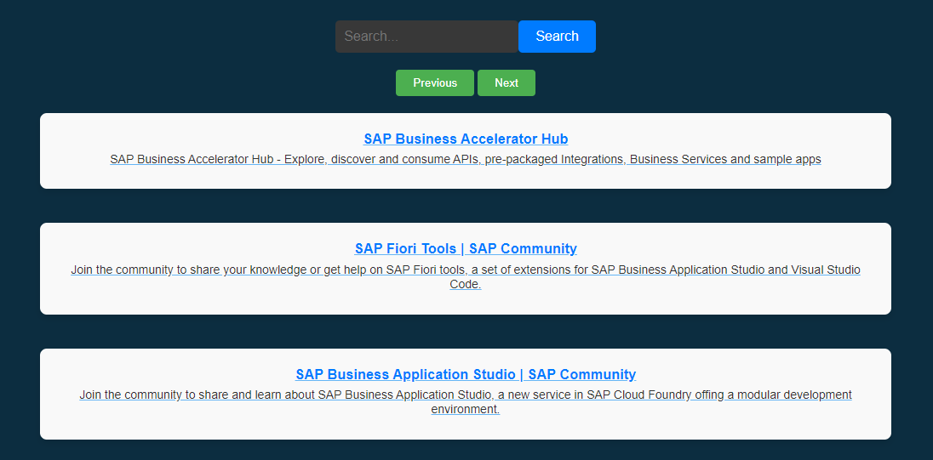
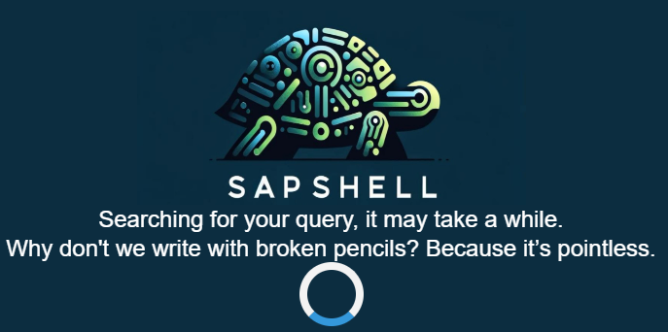
User search

Slide 7
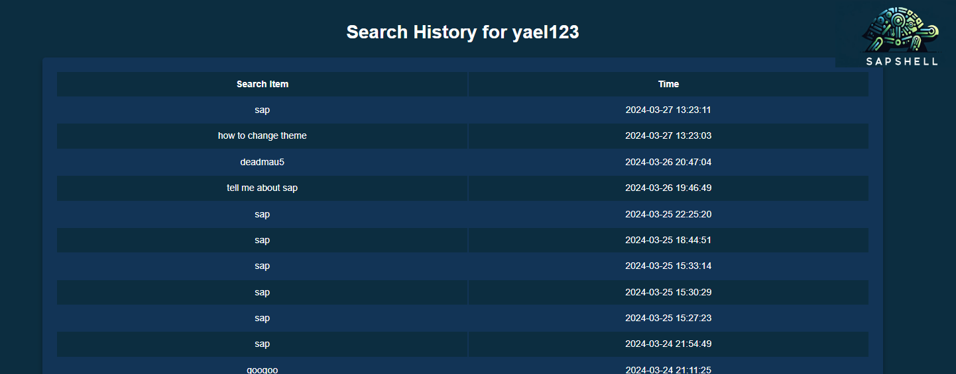
User history

Slide 8
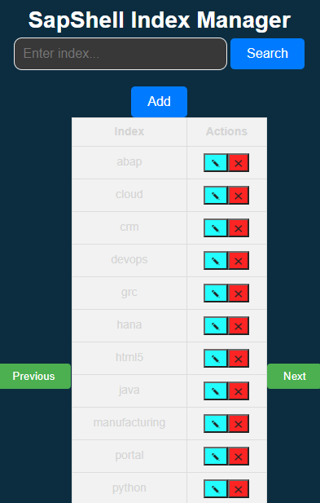
Index Manager

Slide 9
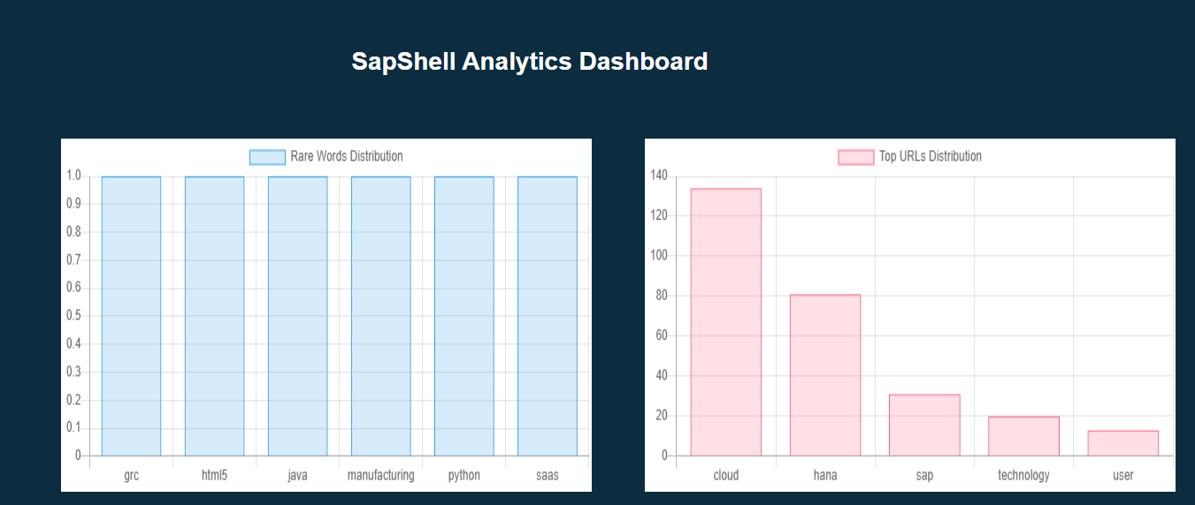
Index Statistics

Slide 10
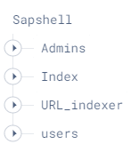

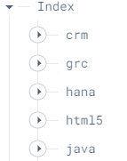
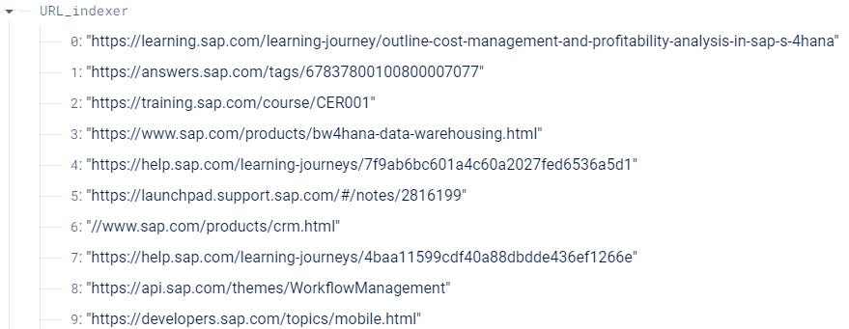
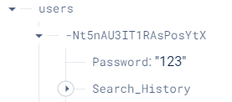
Firebase

