Slide 1


Slide 2


SAP cloud search engine
Based on google-collab and Firebase DB

Slide 3
NFR
Flexibility: filtering, key words
Auditability and Control: search history
Privacy: personal profile
Response Time: max. 3 seconds
Security: secure search
Accessibility: UX
Backup: firebase
Scalability
Usability

Slide 4









crawler
code
write to
Search data
write to
Index changes and statistics
Updates user history
Indx. table
Index management
search
information
statistics
admin
user
chatbot

Slide 5
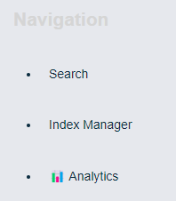
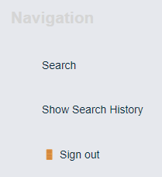
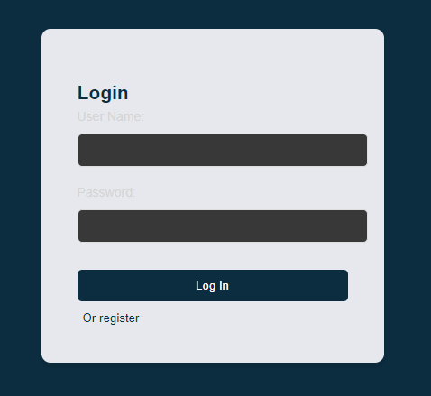
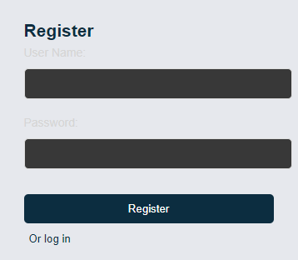
admin
user

Slide 6
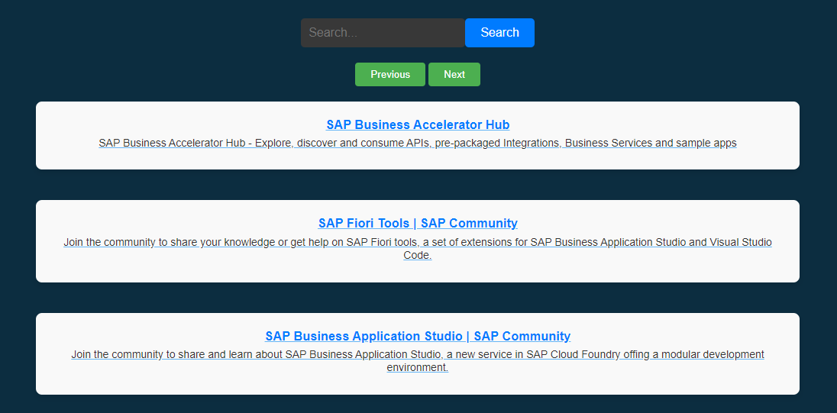
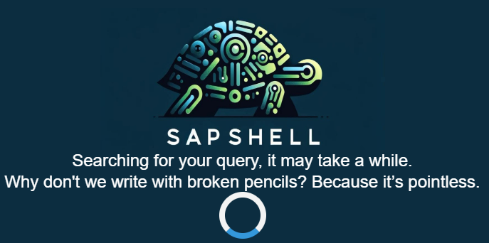
User search

Slide 7
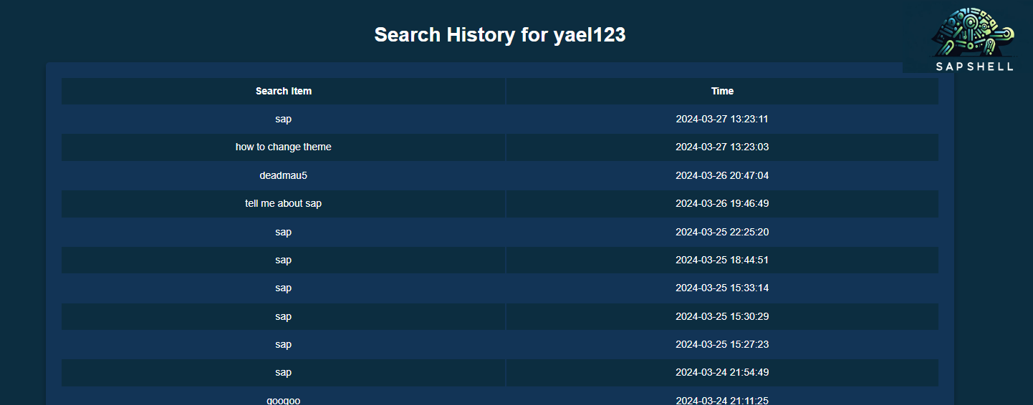
User history

Slide 8
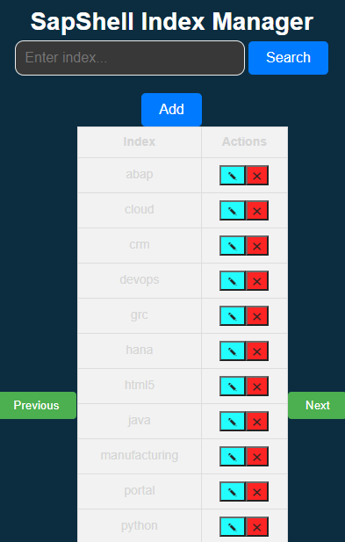
Index Manager

Slide 9
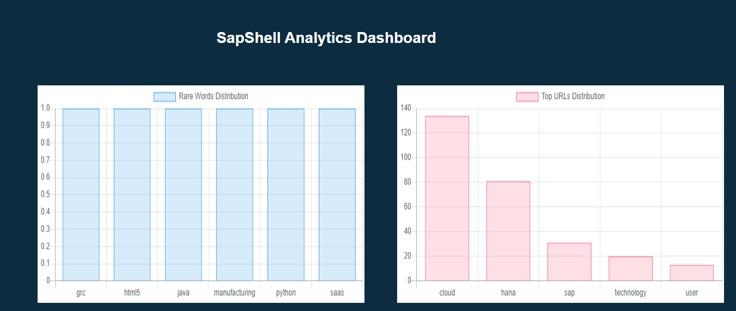
Index Statistics

Slide 10
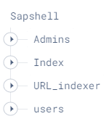

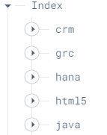
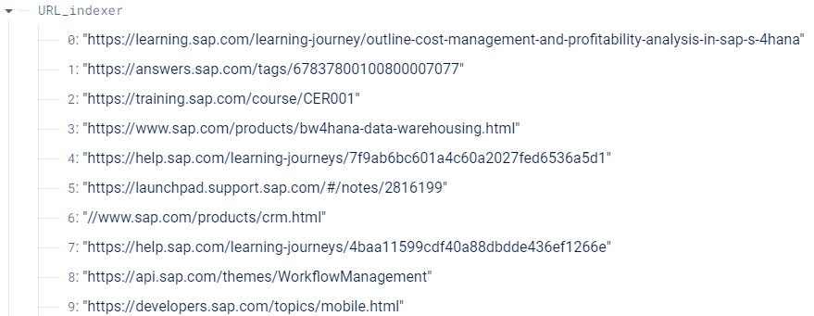
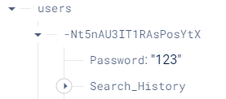
Firebase

