Slide 1

Company Pensions Submission Requirements
July 2013

Slide 2
Annuity Route
Send to Pension Claims if funds are being claimed from an Irish Life Retail Plan
Company Pension Retirement Claim form
Annuity Application form
A P60 or accountant's letter is required if the member is a proprietary director
Evidence of age - original or legible certified copy of the member's birth cert or passport
WWW.bline.ie/pensions/retirement-claims-information

Slide 3
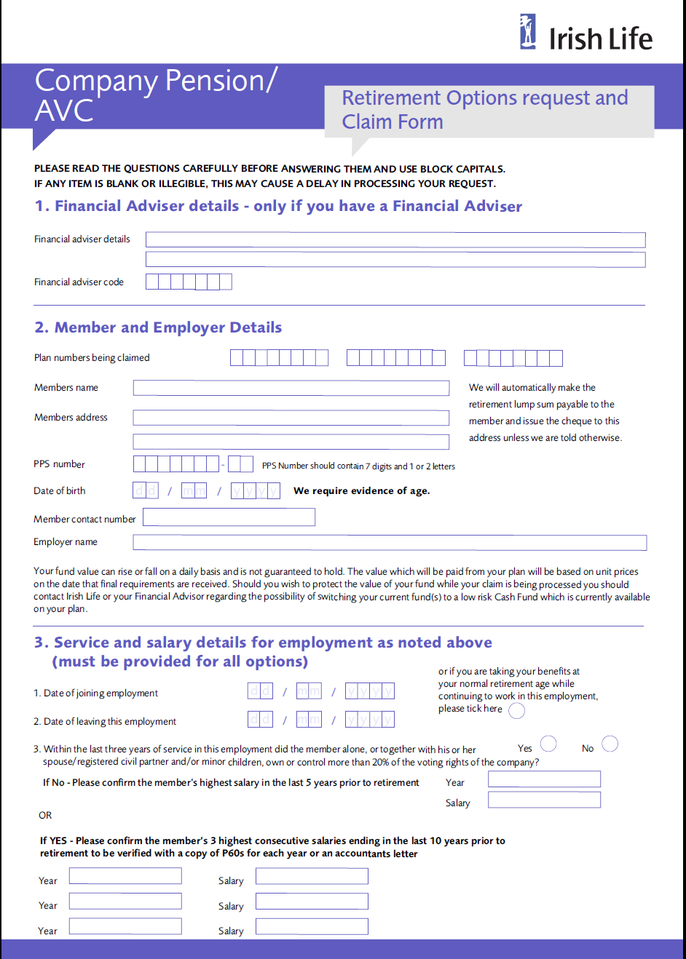
Claim Form (Key requirements)
Use 1 claim form per
employment
Evidence of Age
Marriage Cert if applicable
Salary & Service details iro
Employment being drawn down
- Not current empl.
P60’s for Directors
Full details of all other pension
Benefits both in-force
& previously drawn down
Trustee & Mbr Signature
(or person acting on behalf of
Trustee – eg liquidator)

Slide 4
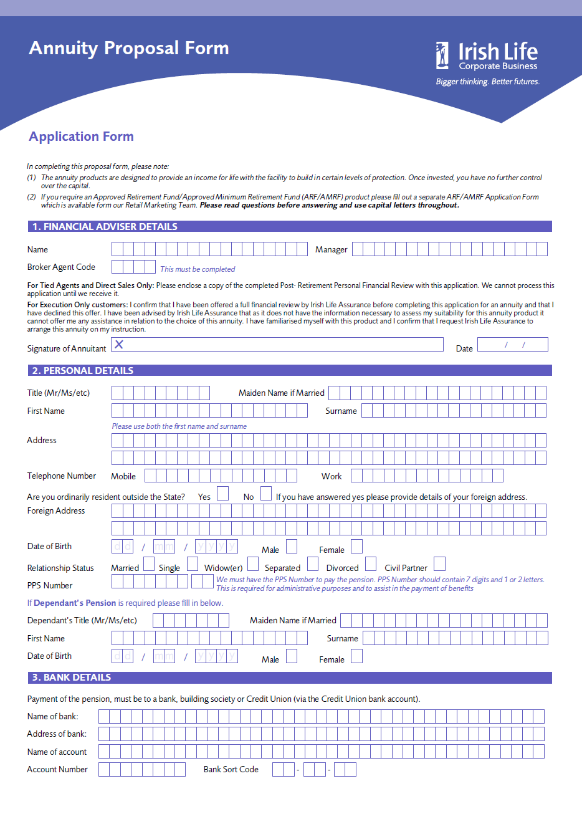
Annuity App Form (Key requirements)
Annuity App Form (Key requirements)
Evidence of Age
Marriage Cert if applicable
Quote if applicable (rates
Are guaranteed for 14 days –
Copy of the quote required)
Signed & Dated – Trustee
Signature required also
Commission – if non
Standard. Default is 2%.

Slide 5
A(M)RF Route
Send to Pension Claims if funds are being claimed from an Irish Life Retail Plan
Company Pension Retirement Claim form
A(M)RF application form
A P60 or accountant's letter is required if the member is a proprietary director
Evidence of age - original or legible certified copy of the member's birth cert or passport
Proof, by pay or remittance slip, of guaranteed pension income, where this income is greater than €12,700 p.a
WWW.bline.ie/pensions/retirement-claims-information

Slide 6
Claim Form (Key requirements)
Salary & service details are still required for the A(M)RF Route for funding calculation purposes
Use 1 claim form per
employment
Evidence of Age
Marriage Cert if applicable
Salary & Service details iro
Employment being drawn down
- Not current empl.
P60’s for Directors
Full details of all other pension
Benefits both in-force
& previously drawn down
Trustee & Mbr Signature
(or person acting on behalf of
Trustee – eg liquidator)

Slide 7
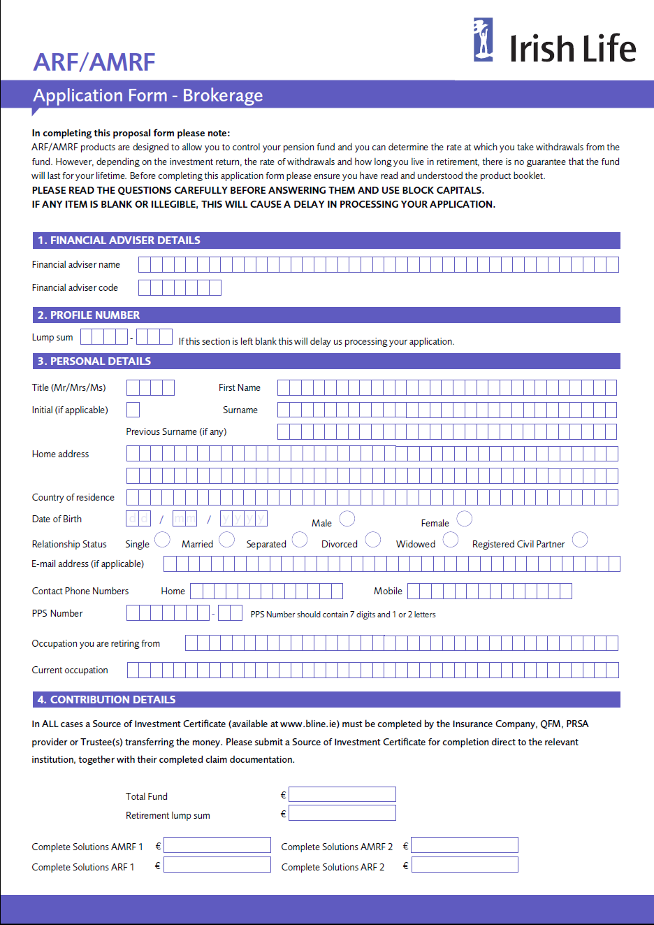
A(M)RF Form (Key requirements)
Commission Profile
Product Choice
Eligibility Evidence if ARF
IIF if SIF
Signed & Dated – by both
Trustee & Member
Source of Inv Cert if funds
coming from a non IL Retail
Plan.

