Slide 1


Slide 2


Slide 3

Talk to us about life insurance today.

Slide 4


Slide 5

Talk to us today about Life Cover.

Slide 6


Slide 7


Slide 8
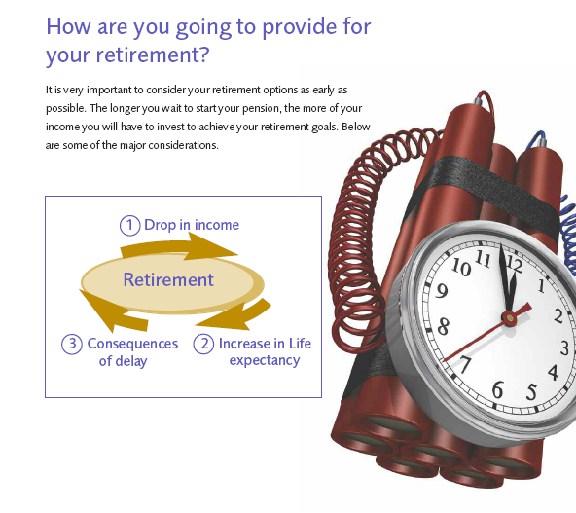

Slide 9


Slide 10


