Slide 1
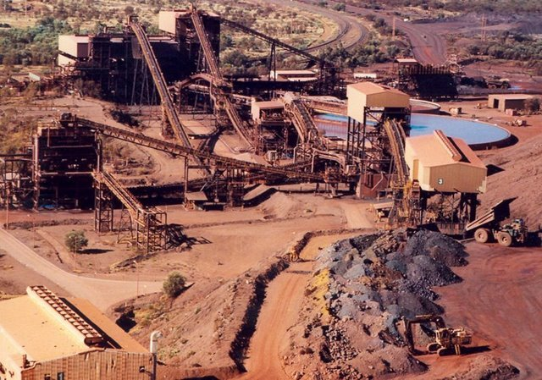

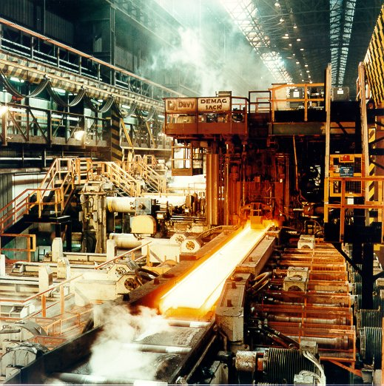

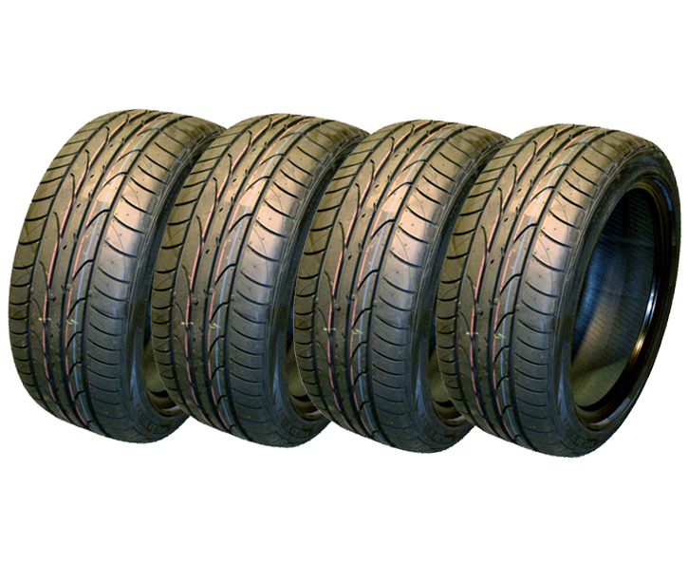








Looking for pricing power at different points in the cycle
Iron ore
mined
Iron ore
shipped
by dry bulk
Shipped to
mill to make
steel
Steel sold
to auto parts
producer
Rubber used to
manufacture
tyres
Car
assembled
Car
distributed &
sold globally
BHP
COSCO
US STEEL
HYUNDAI MOBIS
MICHELIN
DAIMLER
INCHCAPE

Slide 2
Relative Sector Positioning
Active management at the sector level
15.0
Dec-09
Mar-10
Jun-10
Sep-10
Dec-10
Mar-11
10.0
5.0
Relative % weighting
0.0
-5.0
-10.0
Industrials
Materials
Energy
Real Estate
Utilities
Source: FIL Limited, 31.03.2011

Slide 3
Relative Sector Positioning
Energy relative weighting (LHS)
Oil price (RHS)
12.0
120
10.0
8.0
110
6.0
100
4.0
Fund - Relative % Weighting
London Brent Crude Oil Price (US$/Barrel)
2.0
90
0.0
-2.0
80
-4.0
-6.0
70
Dec-09
Mar-10
Jun-10
Sep-10
Dec-10
Mar-11
Source: FIL Limited, 31.03.2011

Slide 4
Comparative performance against global indices
To 30 April 2011 | YTD | 6mths | 1 year | Since Launch
FF Global Real Asset Securities Fund | 10.2 | 20.4 | 25.7 | 58.5
MSCI AC World | 8.9 | 14.3 | 19.1 | 36.7
MSCI EM | 5.3 | 9.8 | 21.0 | 48.2
MSCI China | 4.6 | 1.3 | 11.7 | 24.8
MSCI India | -6.1 | -5.6 | 6.3 | 37.6
MSCI World Energy | 16.7 | 30.3 | 29.7 | 49.3
MSCI World Material | 7.1 | 19.0 | 29.4 | 54.7
Source: Fund data - FIL Limited/Morningstar, Nav to Nav, gross income reinvested, rounded off to one decimal place, all based in USD, as at 30.04.2011. Index data - Datastream, total return, all in USD, as at 30.04.2011. Fund launch – 02.02.2009.
FF Global Real Asset Secs outperformed – shaded green, Global Real Asset Secs underperformed – shaded red.

