Slide 1
The Economic and Public Finance Context for Pensions
Alan Barrett
ESRI, Trinity College and
Irish Fiscal Advisory Council
21 September 2001

Slide 2
Structure of the talk
Provide the broad medium-term macroeconomic context for pensions planning and policy
Look to the long-term: the growth in age-related spending
Internationally, how are countries planning to deal with the “pensions time-bomb”?
What do we know about the reaction of Irish people to announced policy changes?
Summing up – less scope for public support for age-related spending but do people know this?

Slide 3
Medium–term Macroeconomic Context
- EU forecasts from Sept
 | 2011 | 2012 | 2013 | 2014 | 2015
Real GDP (% change) | 0.6 | 1.9 | 2.4 | 3.0 | 3.0
Consumption | -2.4 | -1 | 0.5 | 1.8 | 1.7
Investment | -10.7 | 1.6 | 4.8 | 5.1 | 5.5
Government | -3 | -1.5 | -3 | -4.8 | -2.9
Exports | 6 | 5.2 | 4.9 | 4.9 | 4.9
Imports | 3.2 | 3.8 | 3.7 | 3.7 | 4.1
Unemployment rate | 14.3 | 13.8 | 13.3 | 12.6 | 11.5
General Govt. Bal. (% GDP) | -10.2 | -8.6 | -7.5 | -4.6 | -2.9
Debt Ratio (year end) | 109.9 | 116.2 | 119.4 | 117.6 | 113.9

Slide 4
What about the Long-Term?
- CSO population projections
2011
2021
2031
2041
Over 65
535,716
769,484
1,060,496
1,396,585
% of population
11.4%
14.1%
18.0%
22.4%
Over 80
130,598
189,051
311,312
457,962
% of population
2.8%
3.5%
5.3%
7.3%
Dependency ratio (popn 65+/popn 18-64)
0.18
0.23
0.30
0.38
Inverse of the dependency ratio
5.7
4.4
3.3
2.6

Slide 5
What about the Long-Term?
- Public spending
Estimates of possible spending increases in Ireland out to 2060 from the European Commission (2009):
    Pensions: 5.2% of GDP in 2007 to 11.3%
    Health: 5.8% to 7.6%
    Long-term care: 0.8% to 1.3%

Slide 6
Combining the medium-term and long-term outlooks
Debt levels are now high relative to GDP
Debt/GDP fell dramatically during the Celtic Tiger years due largely to an increase in GDP - such growth rates will not be repeated
National Pension Reserve Fund had been established as a pre-funding vehicle but it has been diverted
As a result, scope for significant public funding of increased pensions costs is limited

Slide 7
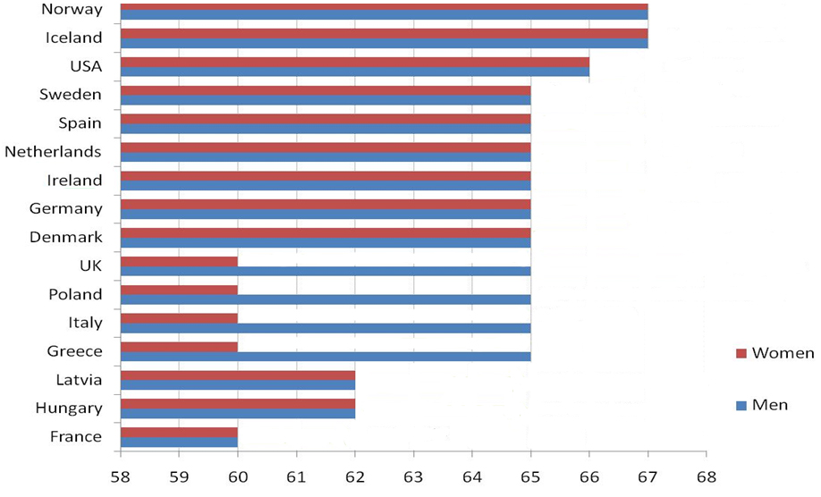
So how are countries planning to deal with this?

Slide 8
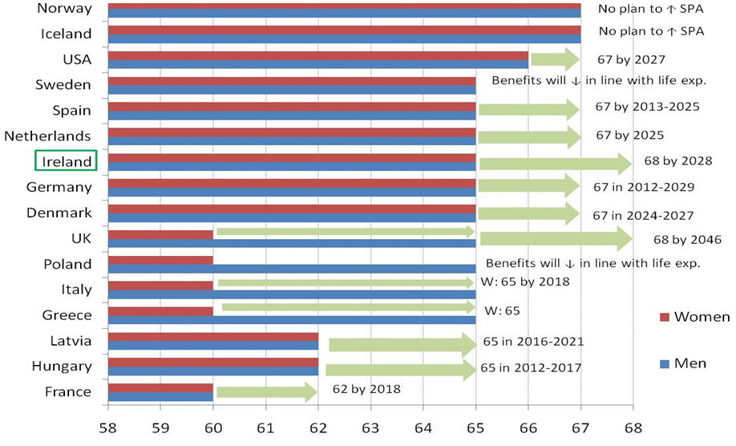
So how are countries planning to deal with this?

Slide 9
The Irish Solution
On 3 March 2010 the Irish Government announced an increase in the state pension age (SPA):
    from 65 to 66 in 2014
    to 67 in 2021 and
    to 68 in 2028
One reason for pre-announcing such a change is to provide time to adjust

Slide 10
How have people reacted?
We can get some sense of this using data from The Irish Longitudinal Study on Ageing (TILDA)
TILDA is a survey of over 8,000 people aged 50 and over, conducted from late 2009 to early 2011 (part-funded by Irish Life)
People have been questioned on a wide range of issues, including pension planning, and have undergone health assessments
They will be re-interviewed every two years until 5 waves of data exist

Slide 11
Fortunate timing of the data collection
The data was collected from late 2009 to early 2011
We interviewed people before and after the announcement of the pension age change
This period also covered the arrival of the EU, IMF, ECB troika
We can examine the following question:
    Did the expected age of retirement change in response to
  (a) policy or (b) the economic deterioration
Note: Research still in progress

Slide 12
Looking first at expected retirement ages in general
 | Outcome category: planning to retire at…
 | 50-64 | 65 | 66+ | Do not plan | Don’t Know
Male | 17% | 35% | 14% | 22% | 11%
Female | 26% | 34% | 10% | 17% | 13%
None/primary educ. | 9% | 37% | 14% | 24% | 16%
Secondary educ. | 20% | 34% | 13% | 21% | 13%
Third/higher educ. | 31% | 33% | 11% | 16% | 9%
Public sector worker | 36% | 38% | 10% | 9% | 8%
Not public sector worker | 15% | 33% | 13% | 24% | 14%
Has occupat./private pension | 28% | 38% | 11% | 14% | 9%
No occupat./private pension | 9% | 28% | 15% | 30% | 18%
Less than
Greater than

Slide 13
And what about policy v. recession?
 | 50-64 | 65 | 66+ | Do not plan | DK
 | (N=520) | (N=763) | (N=267) | (N=423) | (N=261)
Interviewed after pension reform | 20.2% | 33.4% | 12.6% | 20.9% | 13.0%
Interviewed before pension reform | 22.6% | 38.0% | 12.1% | 17.2% | 10.2%
Interviewed after late Sept | 19.1% | 28.9% | 10.7% | 23.6% | 17.6%
Interviewed before late Sept | 21.1% | 35.7% | 12.9% | 19.2% | 11.1%
Data suggest that the recession has had the bigger impact, with little reaction to the policy change in terms of a shift away from early or “standard” (i.e. at 65) retirement

Slide 14
Summing up
The medium term outlook sees Ireland’s public debt at above 100% of GDP in 2015
Age-related spending will tend to put upward pressure on the public budget
Policy will need to contain this
This is happening in Ireland already but little evidence of a reaction to the change in the state pension age

