Slide 1
Agenda
Elements of a funding rate or quotation
Evidence for equity risk premium
Volatility in equity returns
Balancing volatility and return

Slide 2
Question
Do you think that pension projections/funding rates are:
  1) About right
  2) Too optimistic
  3) Too pessimistic
  4) Pointless

Slide 3
Key elements of a Projection
Expenses charged by the life company
Investment return
Interest rate at retirement
Longevity/mortality
Inflation

Slide 4
The Easier Assumptions:
Expenses – company specific
Longevity
  Rules set by Society of Actuaries
  Allow reasonably for future improvements
  Will soon be gender neutral!
Inflation – linked with Investment Return
Interest Rate at Retirement
  Use 4% interest rate
  Higher than current risk free rates but lower than long term average
  Consistent with pre-retirement investment assumptions

Slide 5
Investment Return
This is where it gets hard
Guidance sets a cap of 6%
  Lower for bonds and cash
Set in the context of 3% inflation
So 3% real yield assumed
Is this realistic?

Slide 6
Analysis of history
There are many surveys of past performance of “equity risk premium”
Most detailed is from Dimpson, Marsh and Staunton
Updated annually to reflect latest position
Dates back to start of the 20th Century
Examines many different markets

Slide 7
Dimpson, Marsh, Staunton Conclusions
Historic average equity risk premium 5.5% per annum
Some of this attributed to falling bond yields
Likely to be a little lower in future
They predict 3.5% per annum as a reasonable assumption
Of course this is over the long term!

Slide 8
Typical Fund Mix
75% equity (say 6.5% return)
5% property (say 5.5%)
15% bond (4%-4.5%)
5% cash (2%-3%)
Just about delivers a return of 6% per annum

Slide 9
How long is long term?
110 years if you can wait that long!
Volatility is quite high over shorter durations
Even 20 year periods can show high levels of volatility

Slide 10
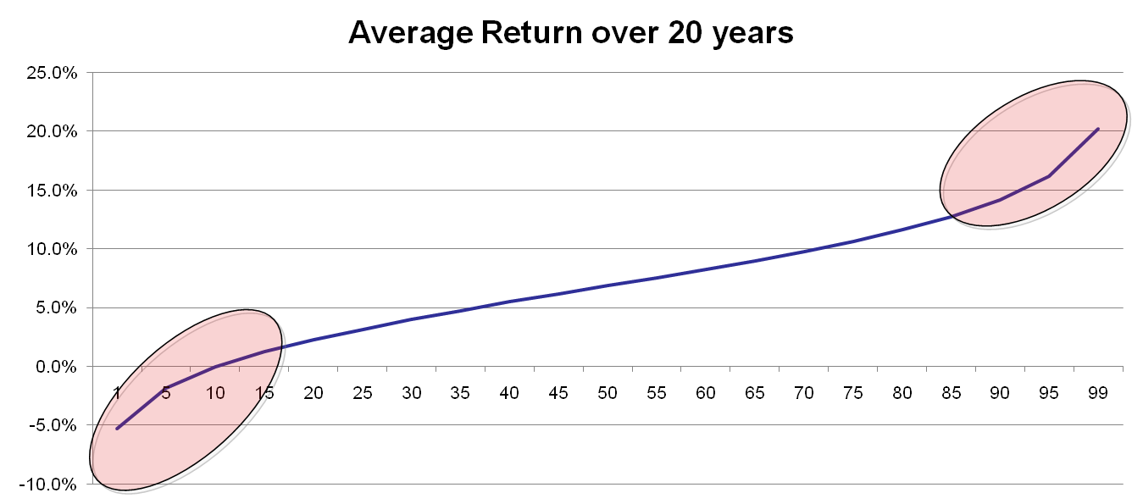
Variability of Equity Returns

Slide 11
Approach to planning
Determine contribution rates based on acceptable level of risk
  If risk profile is lower be prepared to pay a
  little more
If taking high risk be prepared to increase contributions if markets are poor
Do not take excessive exposure to equity markets in years prior retirement

Slide 12
Key Lessons
Understand the risk levels
Set expectations in light of the risk profile
Continually review the performance and amend accordingly
Ideally include some tools to balance risk
Perfect for the Independent Broker

Slide 13
Question?
You are 5 years from retirement. You are offered the following options. Which would you take:
  Guaranteed pension of €20,000
  An expected pension of €22,000 but with a possibility
  that it could fall to €15,000
  An expected pension of €24,000 but with a possibility
  that it could fall to €10,000
  A shot at a pension of €100,000 but with a 50/50
  chance of getting nothing

Slide 14
Thank you for your attention

