Slide 1


Recent research found…
planning to stop paying into their pension over the next 12 months
Source: Amárach Research, August 2011

Slide 2





Their Attitude towards Pensions
“I’ve other more important short-term
financial priorities”
“A lot of negatives and
not many of the benefits”
“Too complex to even consider”
“Uncertainty about the
Government support”

Slide 3



Three repeated reasons why consumers intend stopping paying into their pension
Can’t afford it
Lack of awareness
Uncertainty

Slide 4
Question 1
How much income do you think most people believe they will need to live on in retirement?
  1) over €40,000
  2) €30,000
  3) €20,000
  4) less than €20,000

Slide 5


Lack of Awareness
Expectations do not translate into actions to
achieve this income level…
State Pension –
don’t know
how much?
Pension -
never reviewed
Currently paying -
don’t know how much?
Expected
Pension –
don’t know
how much?

Slide 6
Uncertainty
Unsure about their
financial security
Negative press
Cynical about Government’s support for pensions

Slide 7

Supporting your conversations
Today’s conference
Launching today,
our new Pensions Guide for Pension Investors…

Slide 8
New Pensions Guide for Investors
Importance of continuing to plan
Dispels misconceptions
Answers questions clients are asking you
Urges people to seek advice from brokers
Jargon-free

Slide 9
Addressing the misconceptions…
“There’s no incentive to keep paying into my pension”
“I’ll worry about it later”
“I’m going to stop paying anything more in”
“I could put money into a savings plan instead”

Slide 10
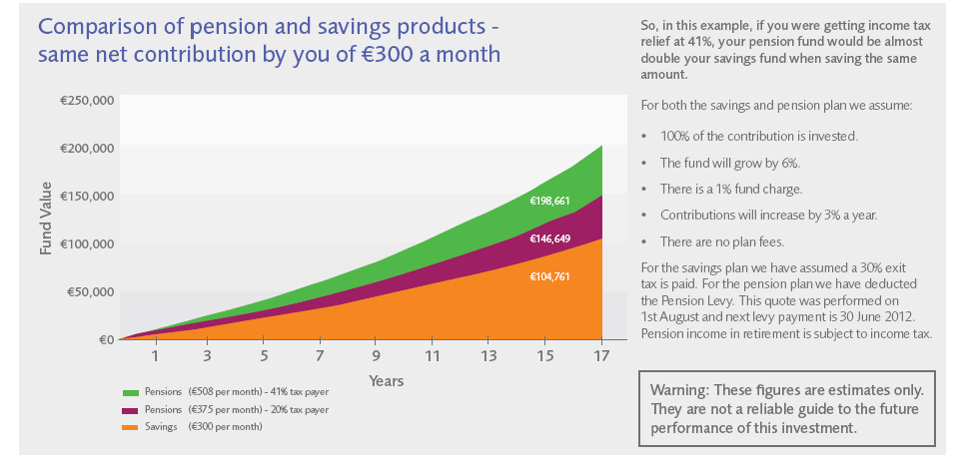
“I could put money into a savings plan instead”

Slide 11
Question
What % of people plan on maintaining or increasing current pension contributions
  1) 45%
  2) 55%
  3) 65%
  4) 75%

Slide 12



Lack of Awareness = Huge Need for Advice
GOOD
NEWS!
Maintaining
Increasing
Opportunity for pension brokers to review plans; assess circumstances and give independent advice

Slide 13

The Power of Planning
Never been more important
Those who have a pension plan feel most secure
HSBC 2011 global research reported hard financial benefits from…
  Planning Premium
  Advice Advantage
357%
Source: HSBC 2011 Global Report “The Future of Retirement”

Slide 14
Convincing your clients
Engagement and reducing the uncertainty is critical
We need to keep clients paying into their pension plan – reduce that 20% number
Hope that today’s conference and the new pensions guide support you in convincing clients that pensions absolutely still make sense

Slide 15
After all…
“Plan for the future because that’s where you are going to spend the rest of your life”
Mark Twain

