Slide 1

Do Private Pensions have a future?

Slide 2

Do Private Pensions have a future?

Slide 3

Pension Market Fundamentals

Slide 4


The need for good retirement planning advice

Slide 5




State Provision
Retirement
Health

Slide 6




State Provision
Private Provision
Retirement
Health
Retirement
Health

Slide 7

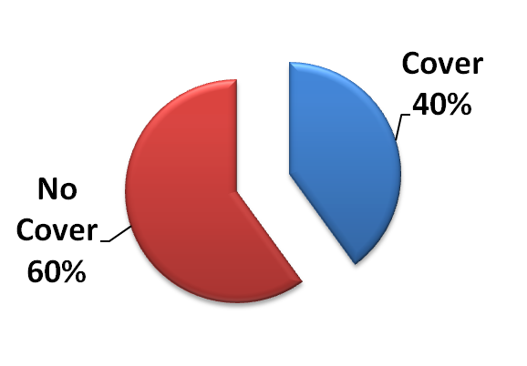
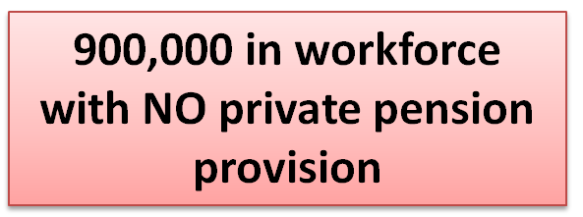
Private Pension Coverage ...two worlds
Public Sector
Private Sector

Slide 8
The traditional private pensions market
Accumulation
Retirement

Slide 9
Now there are two ‘pension’ markets
Drawdown
Accumulation
Retirement
Benefit options
Retirement

Slide 10

Drawdown market
Need for regular income
Longevity risk
Provision for Dependants?
Health?
Declining risk appetite
Tax?

Slide 11
Drawdown market
Power of attorney?
Sovereign annuities
PRSAs
Health insurance?
RACs
ARFs
Property
Deposits
Life assurance?
State Pensions
AMRF

Slide 12

“Pension savers have been urged to consider alternatives to buying an annuity with their retirement funds, after new figures showed annuity rates have suffered a huge fall.”
Charlie Weston, Irish Independent
15th September 2011

Slide 13
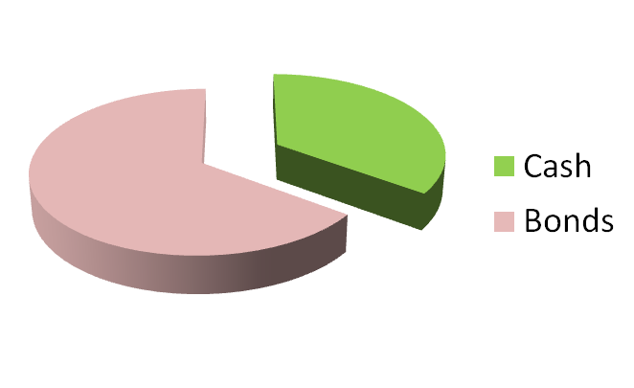
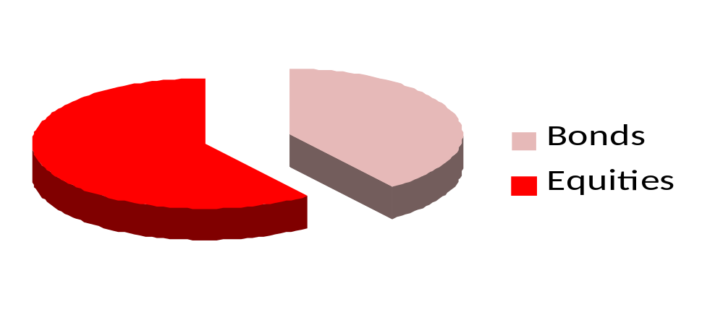
ARF imputed distribution
3% pa distribution
5% pa distribution

Slide 14
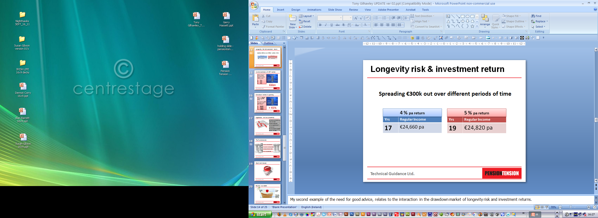
Longevity risk & investment return
Spreading €300k out over different periods of time

Slide 15
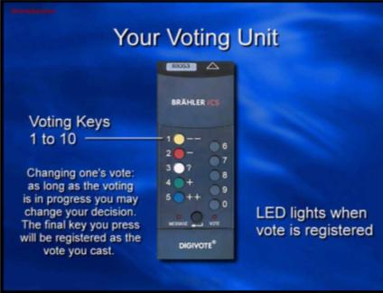

Current estimate of ARF market
What is the best estimate of the current size of the ARF market?
A €3bn
B €4bn
C €5bn
D €6bn

Slide 16


Drawdown market is growing
There are 536,000 people aged 65 + today.
How many people will be aged 65+ population in 10 years time?
A 600,000
B 675,000
C 725,000
D 775,000

Slide 17

Legislation and tax complexity
Reduction in pension tax reliefs
Fund Thresholds
Taxation of lump sums
Pension Adjustment Orders
Pension levy
Investment markets uncertainties
Will the Euro survive?

Slide 18


The Fundamentals of the private pensions market
Reduced State provision
Low private pension provision
Growing drawdown market
Increasing complexity

Slide 19

Short term issues

Slide 20


Pension tax reliefs
The tax relief!
The need for private pension provision

Slide 21
Incentives we still have ...
Marginal rate relief on personal contributions
Backdating of personal contributions
Employer contribution BIK exemption
Gross roll up
Tax free lump sum

Slide 22
The drawdown market ... lightly impacted
5% ARF imputed distribution
No pensions levy

Slide 23
Getting paid for advice?

Slide 24

Demonstrating to clients the value of your advice

Slide 25
The Fundamentals of the private pensions market
Reduced State provision
Low private pension provision
Growing drawdown market
Increasing complexity

Slide 26
Do Private Pensions have a future?

