Slide 1

LinkedIn for Brokers
Donal Wood
Manager Broker eBusiness Solutions
24/04/2012

Slide 2

Today’s content
A little background to LinkedIn
11 top tips to make the most of LinkedIn
5 things to do today
A bit about iCommunity and LinkedIn Club

Slide 3
Social stats and figures
50% of the world population is under 35
Years to reach 50M people
  Radio – 38 years
  TV – 13 years
  Internet – 4 years
  iPod – 3 years
  Facebook – 200M members in one year
  Linkedin 2 new members per second
  78% of consumers trust peer recommendation
  14% trust advertising

Slide 4

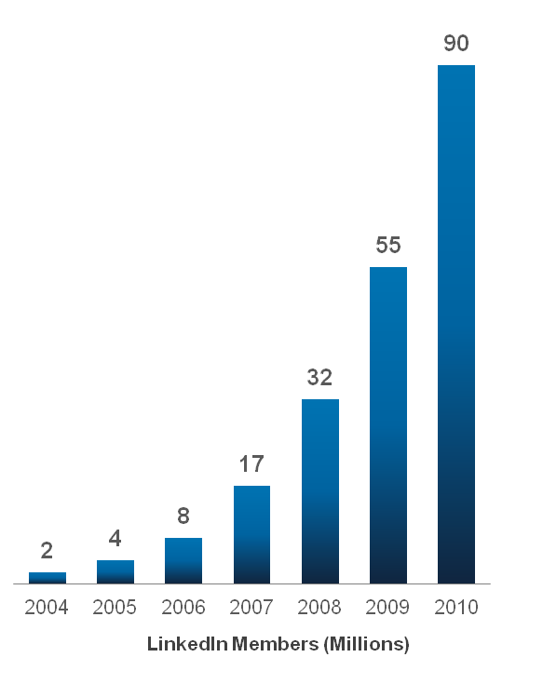




The world’s largest professional network
155M+
People searches in 2012
**
*
75%
Fortune 100 Companies
use LinkedIn to hire
**
>2M
Company Pages
**
~4B
*as of August 4, 2011
**as of June 30, 2011
Notes:
We’re making great strides toward our mission:
**As of August 4, 2011, LinkedIn has north of 120 million members, and we’re now adding more than two members every second. This is the fastest rate of absolute member growth in the company’s history. More than half of LinkedIn members are currently located outside of the United States.
As of June 30, 2011 (the end of the second quarter), LinkedIn counts executives from all 2011 Fortune 500 companies as members; its corporate hiring solutions are used by 75 of the Fortune 100 companies.
More than 2 million companies have LinkedIn Company Pages.
There were nearly two billion people searches on LinkedIn in 2010.
[See http://press.linkedin.com/about for a complete list of LinkedIn facts and stats]

Slide 5





The Professional Network
MISSION: Connect the world’s professionals
to make them more productive and successful
Turn relationships and information into business opportunity
Largest advertising platform for B2B
Notes:
On LinkedIn, you find professionals and professionals only.
And professionals acting professionally, showing their professional side. Only.
Not their dogs, not their moods. But their experience, their professional insights.
They’re not playing games, not sharing rants.
You can think of Facebook and Social Networks as the backyard BBQ or the pool party (for family or friends)
You can think of LinkedIn as a business lunch.

Slide 6
Linkedin
155 million members world wide
45% growth in 2011
2 new users join every second
2 million company pages
500,000 registered Irish users
Ireland 2nd only to US
9% daily, 11% every few days, 31% weekly
Average user is 35-44, employed, AB social

Slide 7

  11 Top Tips –
  Maximise your Exposure & Brand
Lets log in and see what we are taking about
Notes:
LinkedIn is all about connecting, but before we connect, we look for what we have in common.
That’s the key to putting together a profile that jump-starts conversation. Think of your profile
as a way to promote your brand—a professional permalink, a fixed point on the web to
promote your skills, your knowledge, your personality. Brands build trust by using an authentic
voice and telling a credible story. Here are ten tips to help you do the same:

Slide 8
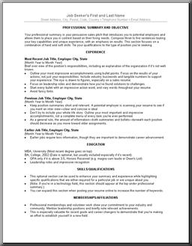
Tip 1: Don’t cut and paste your CV
LinkedIn hooks you into a network, not just a human resources department. You wouldn’t hand out your CV to people you are meeting in a business context, so don’t do it here. Instead, describe your experience and abilities as you would to someone you just met. And write for the internet and screen, in short blocks of copy with visual or textual signposts.

Slide 9
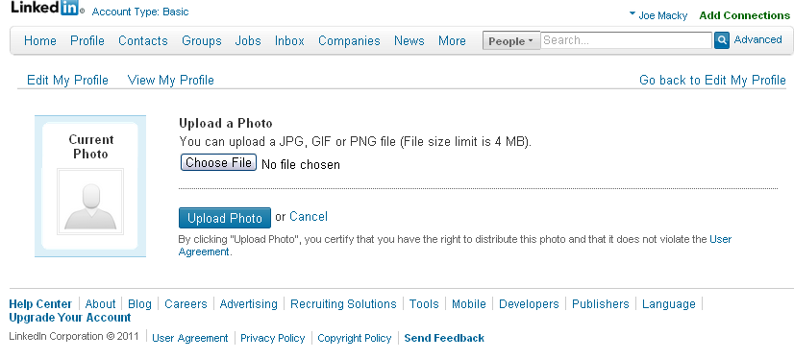
Tip 2: Upload a profile photo
Add a photo - Help people remember you by adding a professional-looking photo to your profile. It is harder for people to forget a face.

Slide 10
Tip 3: Reinforce your personal professional brand
Fill in your employment history -
Add your education –
By filling in correct informative information you will be able to maximise the power of LinkedIn better.

Slide 11
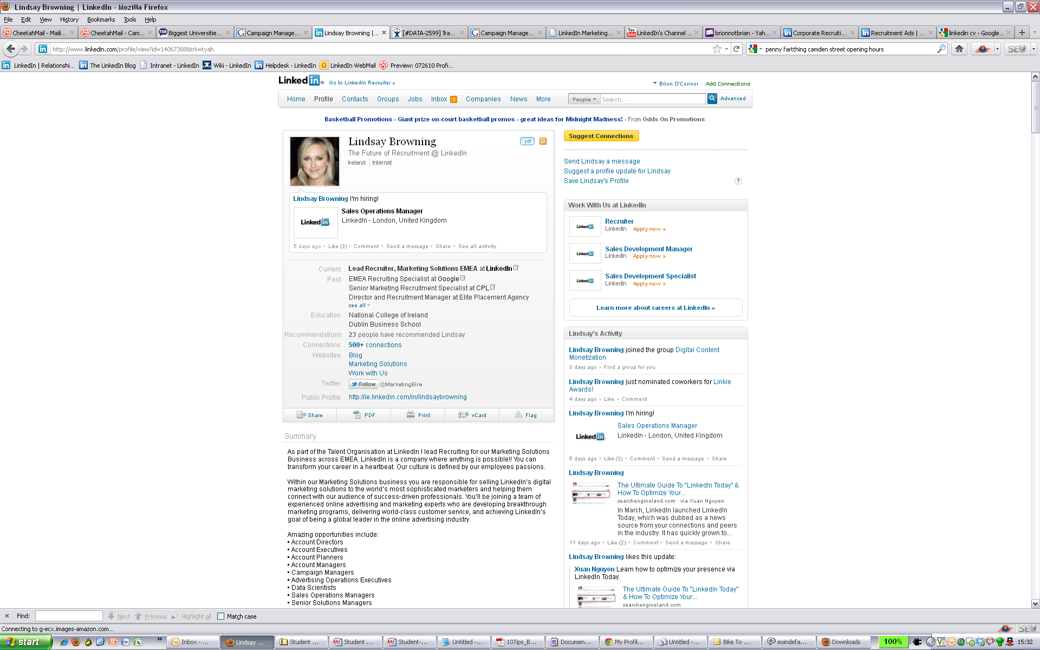
Tip 4: Write a personal tagline
That line of text under your name? It’s the first thing people see in your profile. It follows your name in search hit lists. It’s your brand!
N.B. User and Company specific
Your company’s brand might not be so strong that it and your title are sufficient. Or you might need to distil your professional personality into a more eye-catching phrase, something that at a glance describes who you are.

Slide 12
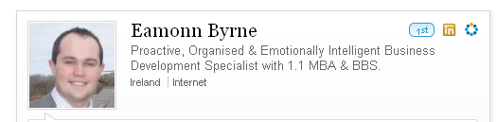
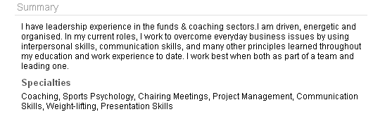
Tip 5: Sell yourself
Use the Summary section to engage readers. You’ve got 5–10 seconds to
capture their attention.
This is your “elevator pitch” – be conversational (talk in the first person)

Slide 13
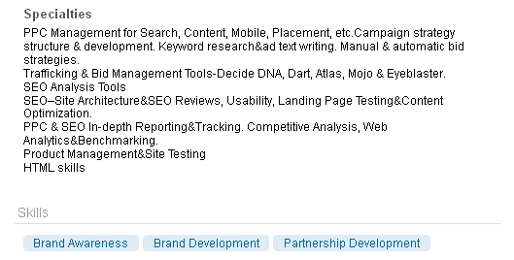
Point out your skills & specialities
Think of the Specialties and Skills fields as your personal search engine optimiser
Do some research on what the people you are aiming at will respond to add the skills and specialties that apply to you.

Slide 14

Tip 6: Be found
.
SEO (Search Engine Optimisation) is very important on LinkedIn so optimise your profile with keywords related to your expertise and proposition.
Life insurance, retirement advice, financial advice, pension etc.
If you would like a prospect to understand what you do, make sure they can do it 5 seconds or less!
Be specific. No vague descriptions and don’t lie ☺

Slide 15
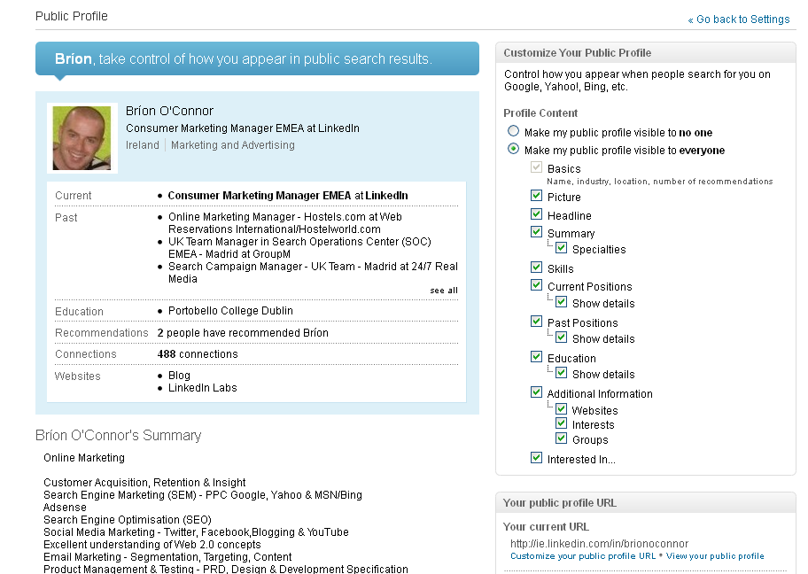
Tip 7: Make your profile public and Change Link

Slide 16
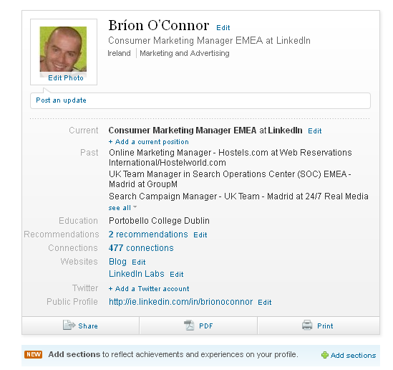
Tip 8: Check out the new Add Sections feature
Found on the Edit Profile page below the Print button

Slide 17
Tip 9: Build a network
Search and connect within LinkedIn for classmates, colleagues, friends and contacts that you know. Set goals for connecting. (Chanel College and Stats)
Spend just 30 minutes at least each week connecting and developing your network online – you’ll be surprised with your progress. The more you put in, the more you get out
NB - Personalize your connections and message. Explain why you want to connect – NO GENERIC INVITES ☺

Slide 18
Tip 10: Get recommended by people you’ve helped
Ask for meaningful recommendations
If you’ve added value to others, they’ll reciprocate
Request Specifics – remember those SEO keywords
‘78% 14% stat’!
Example of Ger Sheehy’s linked in page

Slide 19
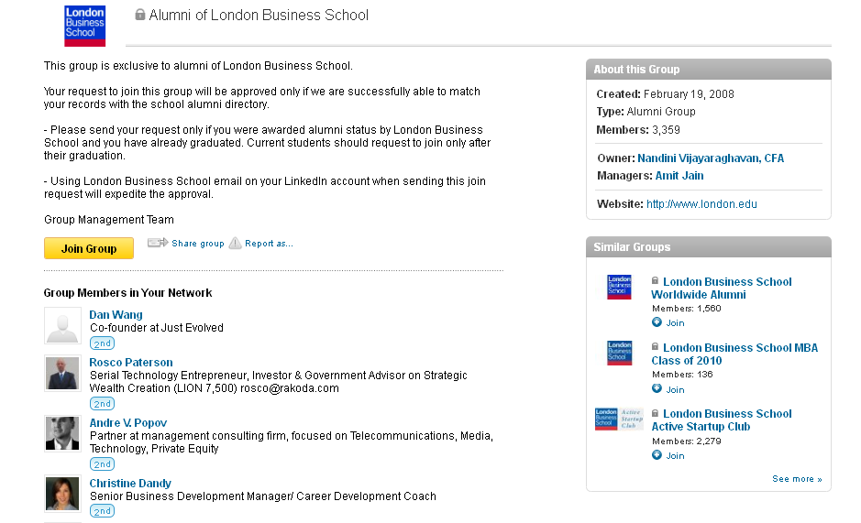
Tip 11: Create & administer a group

Slide 20




Groups
Join many
Participate in a few
Run one
800,000 +
.NET Developers
Design
Pros
Biotech & Pharma
Notes:
When it comes to Groups…
Join many. There are more than 800,000 groups on LinkedIn, and you can set up daily or weekly Group digests. Join recruiting groups to stay up to speed on your job, or join groups that are relevant to your key talent pools—whether they’re focused on industry, role or function. They’ll help you keep your finger on the pulse of the market.
Participate in a few. Get involved in a few select groups to brand yourself as an expert. Again, it’s all about building your personal brand as a recruiter. Don’t just post an open job or plug for your company here or there—when you participate, make sure it counts. Post thoughtful questions, articles the group might like, and unbiased responses to their conversations.
Run one. We’ve seen our customers create groups about their companies, their industries, functional areas or niches in which they’re particularly strong—and they use these groups for employment branding, pipeline building, and even sourcing. Figure out what’s best for your company and you recruiting strategy, and go for it. And don’t forget to promote and drive traffic to your group once you’ve created it—link to it from your career page and your profile, and encourage your recruiters to do the same.

Slide 21
5 things you should do in the next 24 hours
Enhance your personal profile & brand - Fill in your employment history & your education (100% profile)
Add a photo – it’s harder to forget a face
Add a public url
Add a company page
Join a school, college or networking group
Notes:
Just do it!

Slide 22
What will the LinkedIn Club do for my business?
www.icommunity.ie
Generate letters of authority (e.g. with business owners)
Develop a network of accountants to generate referrals
Host your own event
Build a LinkedIn Group of business owners
Notes:
Just do it!

Slide 23
Membership fees
Membership to the Irish Life LinkedIn Club:
Regular price is €145 per month (for 12 months)
Special offer is €75 per month (for 6 months)
Lmited places – please contact Donal Wood or www.icommunity.ie to arrange registration or find out more.
Notes:
Just do it!

