Slide 1
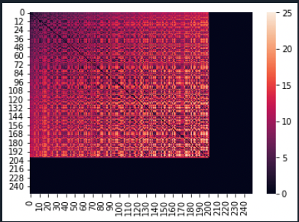
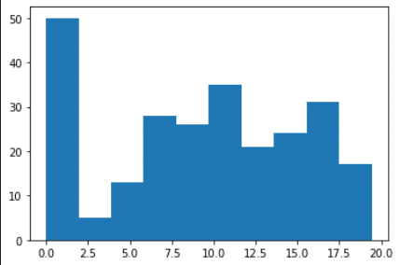
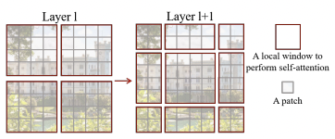
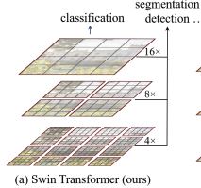
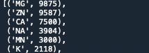
Plans
1. A simple model to compare with Unet
Train a simple model using Zn²⁺ (large data, one atom)
Several axial self-attention layers
Heatmap and distribution for visualization
2. Swin transformer
Hierarchical feature maps
Shifted window allows cross-window connection
3. Imbalanced data
Loss function

Slide 2
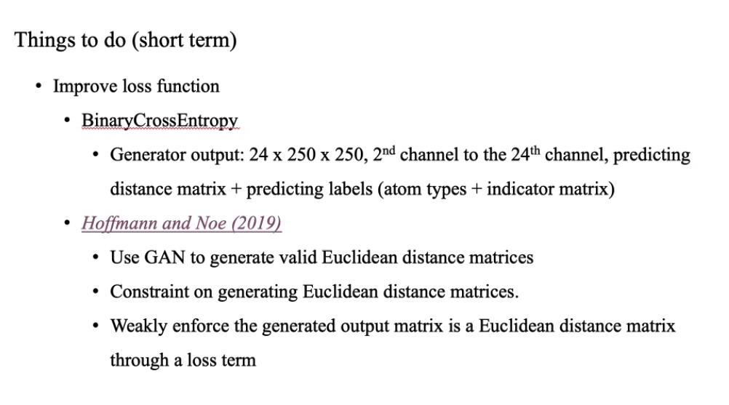

Slide 3
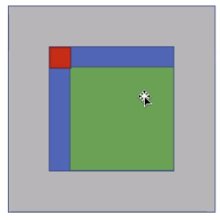
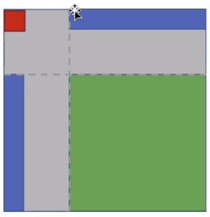
Input

Slide 4
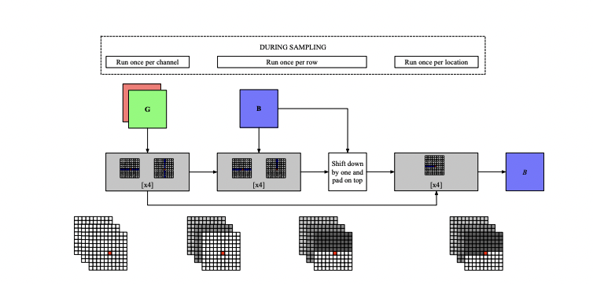
Simple network structure

Slide 5
0617 Task done
Data
Split ligands into groups by their charge
Padding
Model
Training
Charge | # kind | # sample
Positive | 27 | 38,826
Negative | 1 | 7
Neutral | 116 | 17,863
 | 144 | 56,696

Slide 6
0617 Comparison
Dataset | Starting position | Model | Test performance (mean/median/std) | Running time /epoch
Zn-ligand (9k+) | + | Simple (0.004 M) | 1.9/1.1/1.8 | ~3min
Cu-ligand (100+, aug 50k) | + | Pix2pix (#G:268M + #D) | 1.2/1/0.97 | ~8+min (Cu-ligand)
Ligands with positive charge
Dataset | Starting position | Model | Test performance | Running time /epoch
Positively charged | + | simple |  | ~90min
Positively charged | + | simple_generator (#G:268M) |  | ~120min

Slide 7
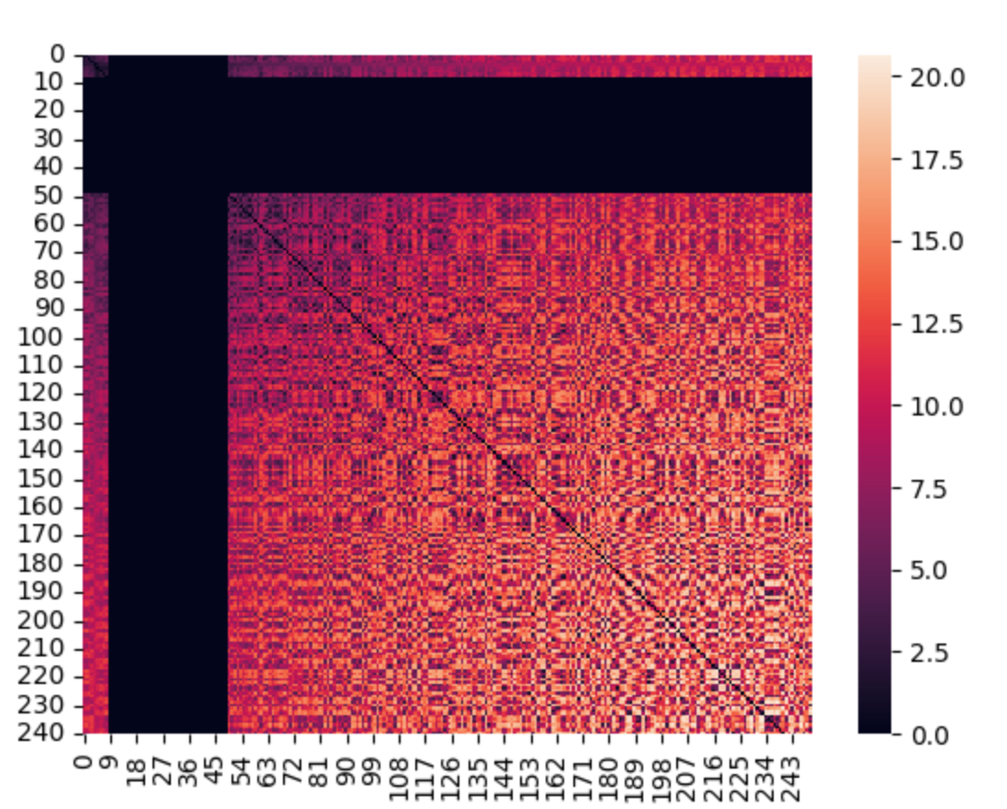
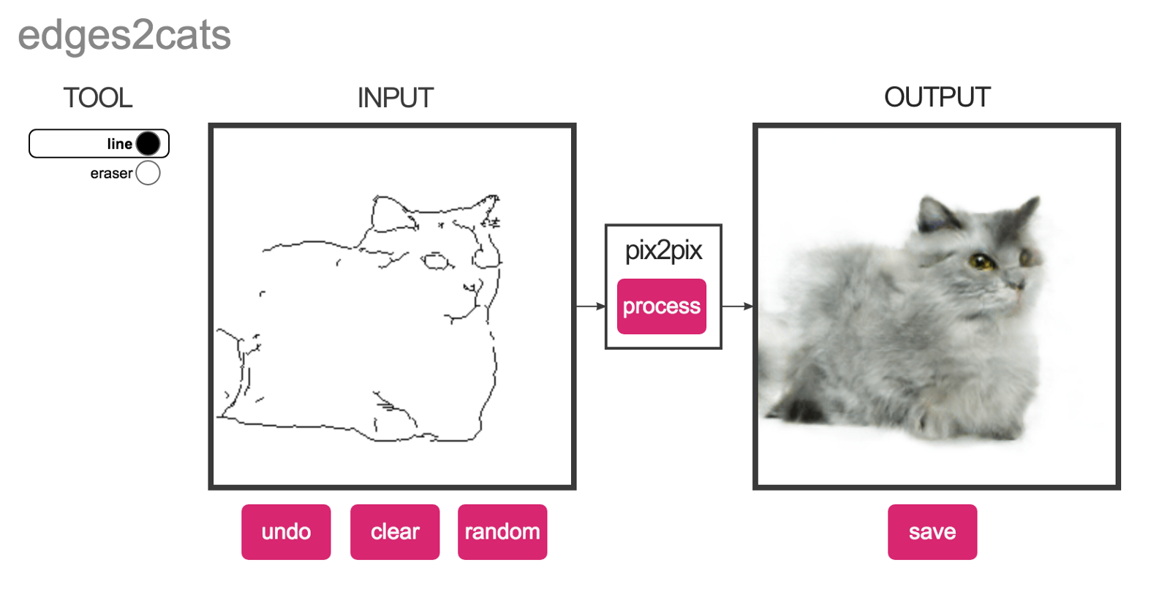
0617 Prob and To-do
Main issue: training time
Data
If exploring potential initial positions is needed?
Model
Analyze memory usage
Choose a suitable batch size?
OSError No space left on device
To-do
Generate and save
Fix model training issues
Fill out blanks in tables
Explore more model architectures

