Slide 1
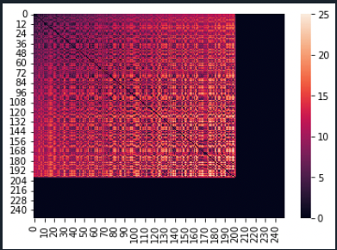
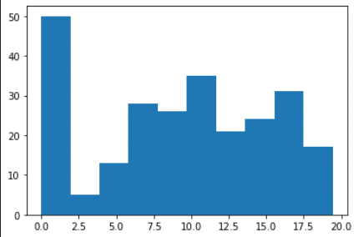
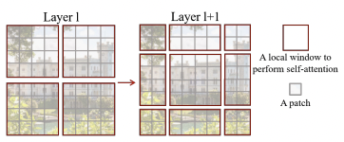
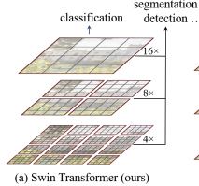
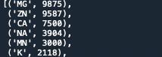
Plans
1. A simple model to compare with Unet
Train a simple model using Zn²⁺ (large data, one atom)
Several axial self-attention layers
Heatmap and distribution for visualization
2. Swin transformer
Hierarchical feature maps
Shifted window allows cross-window connection
3. Imbalanced data
Loss function

Slide 2
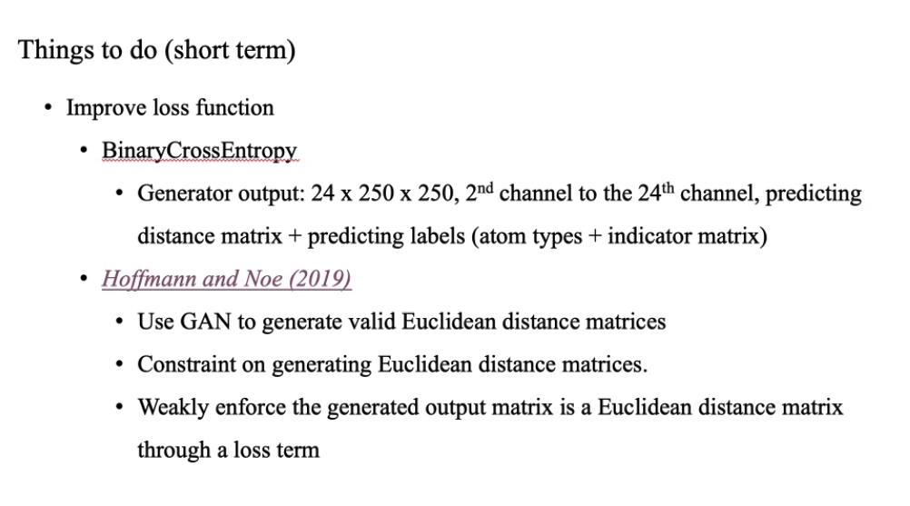

Slide 3
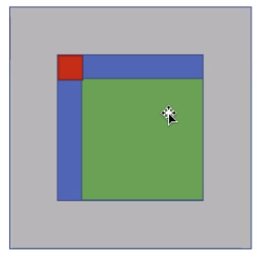
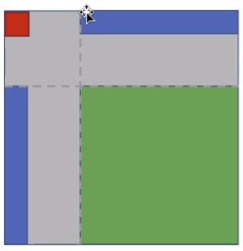
Input

Slide 4
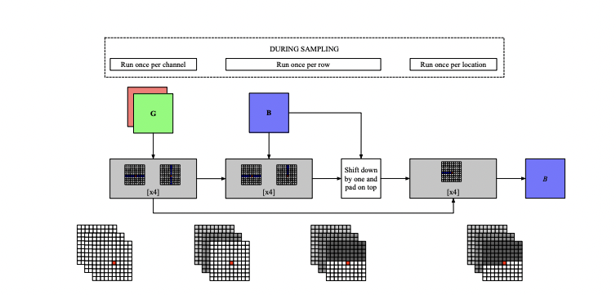
Simple network structure

