Slide 1
Model-Based API Fuzzing for the Java SAT Solving Library SAT4J
Iris Parruca

Slide 2
Table of contents
01
02
03
04
Background
Implementation
Results
Future Works

Slide 3

01
Background

Slide 4
SAT4J Library
Sat4j is an open-source Java library for solving Boolean satisfaction and optimization problems. It can solve SAT, MAXSAT, Pseudo-Boolean and Minimally Unsatisfiable Subset (MUS) problems
SAT4J provides pre-built SAT solvers but the library is designed for flexibility, so key components of the solver have been made configurable
Configurations include decision heuristics (order & phase), learning strategy, restart strategy, simplification, deletion strategy, and more
Notes:
The promise is not to be the fastest, a SAT solver in Java is about 3.25 times slower than its counterpart in C++
It includes unit and regression testing as well as static code analysis reports which are available in their website

Slide 5
Fuzzing & API Fuzzing
The original fuzzing approach tests programs with random but valid inputs to detect security bugs
API Fuzzing - randomly generates valid sequences of API calls
Allows testing additional functionalities not accessible with input fuzzing
Possible to test different solver configurations
In case of an error a trace is generated
Needs a trace interpreter to reproduce the failure
Often combined with delta debugging
Notes:
Randomly setting and combining configuration options

Slide 6
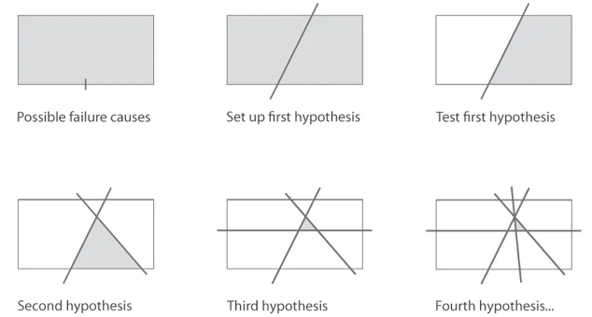
Delta Debugging
Delta Debugging techniques automatically simplify and isolate failure inducing inputs by using a divide-and-conquer strategy
A delta debugger repeatedly calls the program with simplified variants of the failure inducing input
Notes:
If the program shows the same observable behavior, then the delta-debugger continues with the simplified input or backtracks

Slide 7
IDRUP Proof
New incremental proof format
Extends DRUP proof (Reverse Unit Propagation with Deletion)
Includes input clauses (i), SAT queries (q), solver answers (s), models (m), unsatisfiable cores (u), learned clauses (l), deleted clauses (d), and weakened and restored clauses (w & r)
Needs accompanying incremental CNF file that records all user interactions with the solver (i, q, s, m, u)
IDRUP-CHECK proof-checker, implemented for CADICAL

Slide 8
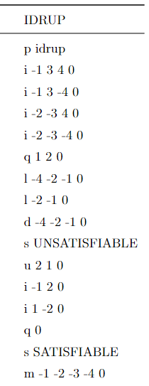
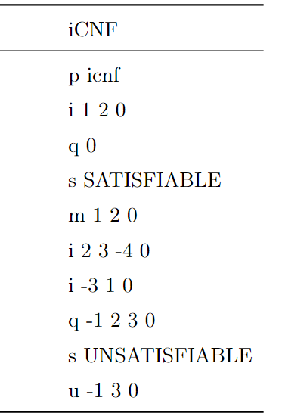

Slide 9
02
Implementation

Slide 10
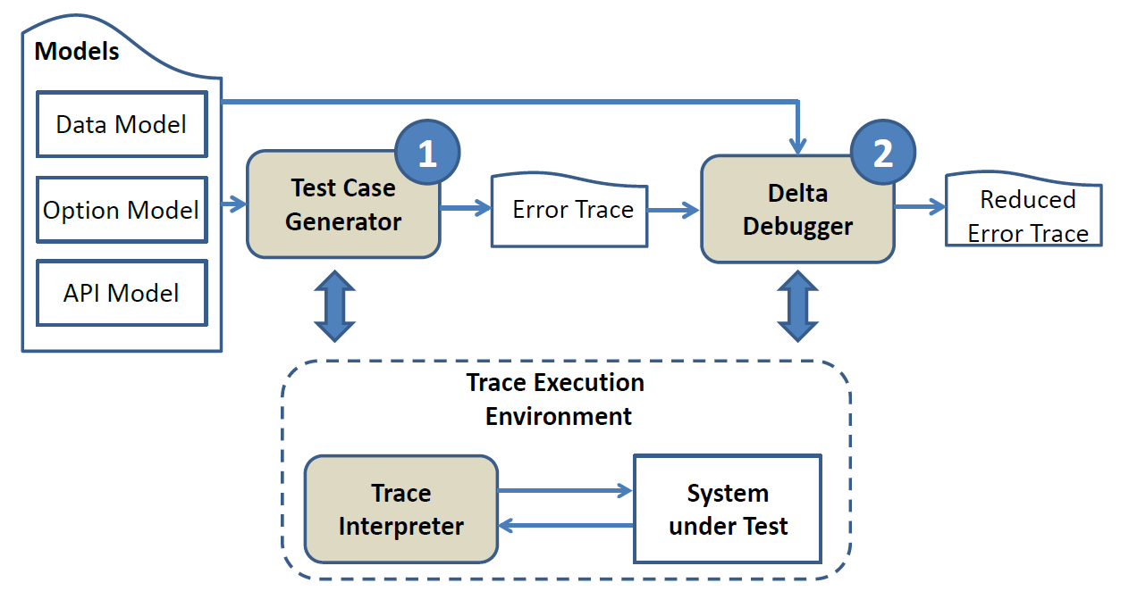

Slide 11
1. Test Case Generator
Trace class – contains ID (seed in HEX), List of API calls with add/remove methods as well as toFile() method
APIFuzzer class – generates Master seed (SecureRandom – 64bit) and calls TraceFactory
TraceFacotry class – uses Master seed to generate a number of Slave seeds (Random – 48bit) where each corresponds to one unique sequence of API calls
If an error is thrown a trace file is created
Can pass the Master seed, number of slave seeds to be generated, verbose flag and proof-checking flag via the command line

Slide 12
Option Model
Option fuzzing is done when the solver is initialized
It flips a coin if it should do option fuzzing or not and if yes then it flips a coin if it should fuzz all the options or only some of them
Pre-Defined Solvers – SAT4J has 33 pre-defined solvers from which it randomly picks one
Random Configuration – The fuzzer randomly selects different available configurations for data structures, order and phase selection, learning, restarts, Learnt constraints deletion, and conflict-clause minimization
Random Walk and Dependency-Based (DB) Simplification are fuzzed regardless if fuzzer is predefined or randomly configured
Notes:
The parameters of these configurations are fuzzed as well such as variable decay for order heuristic VSIDS, clause length or % for learning strategies, period and factor(Luby) for restart strategies

Slide 13
Data Model
Number of Variables – starts between 20 to 200 variables and each increment it increases by 20-200
Number of Clauses – calculated by multiplying the number of variables by a coefficient optimized to produce 50% SAT and 50% UNSAT formulas, during an increment it multiplies with the number of new variables
Clause Length – uniform (length 3) or power law by starting at length 3 and either reducing (1% unary - 10% binary clauses) or increasing (~ 17% chance to increase by 1) the length
Clause Literals – clause can have both positive and negative literals; checks if the literal is used before in the clause or if the literal is 0

Slide 14
Data Model
Assumptions – it is possible to solve the formula with certain literals assumed as true, while generating these literals it needs to check that these literal are used somewhere in the formula
Number of Assumptions – it applies power law to decide the number of literals that will be assumed which starts at 1/10 of total variables and it has a ~ 17% chance to increment by 1/10 of the total number of variables
Incremental Solving – continue adding clauses to a formula if it returns SAT, it can have 0 to 4 increments per trace

Slide 15
Enumeration
SAT4J provides Internal (SearchEnumeratorListener & SolutionFoundListener) and External (ModelIterator) Enumerators
Support for enumeration fuzzing was motivated by existing bug
Two solvers are created for both enumerators
Simplified Data Model – up to 20 variables
Internal enumerator returns the number of models based on the used variables
External enumerator takes into consideration the unused variables as well

Slide 16
Proof Checking
A new listener was created to generate IDRUP proofs
The fuzzer generates the iCNF files
Once incremental solving has finished the IDRUP and iCNF files are passed to IDRUP-CHECK
If the checker exits with code 0 then the iCNF and IDRUP files are deleted
Proof-checking is skipped if:
An error is thrown from the solver
Enumerating
MinOne solver is used
A Parallel solver is used
Notes:
Mobical gets a lot more tests through in the same amount time. I think that is due to a combination of: - the JVM launches multiple threads and sat4j too. So we probably reach the maximum amount of possible threads - Sat4j is slower than cadical - we restart the solver and the JVM each time, unlike mobical - the solved problem is more complication (enumerating solution is more complication than finding only one) - here I am not sure: does the JVM compile and optimize the tests or does it only interpret the bytecode without optimizing it.

Slide 17
2. Trace Interpreter
TraceRunner class – accepts 2 types of arguments : trace seed or trace file
Trace Seed – if you pass a trace seed then it will call the TraceFactory with that seed as Slave seed
Trace File – if you pass a trace file then it will parse the lines of the file and execute those API calls one by one

Slide 18
3. Delta Debugger
DeltaDebugger class - gets the name of the file to be reduced from the command line
Runs the whole trace to get the error type
Uses the TraceRunner to run the reduced traces
Compares the error of the reduced file with the error of the original file to decide if it should reduce or not
Removes Lines
Removes Literals
Renames Literals

Slide 19
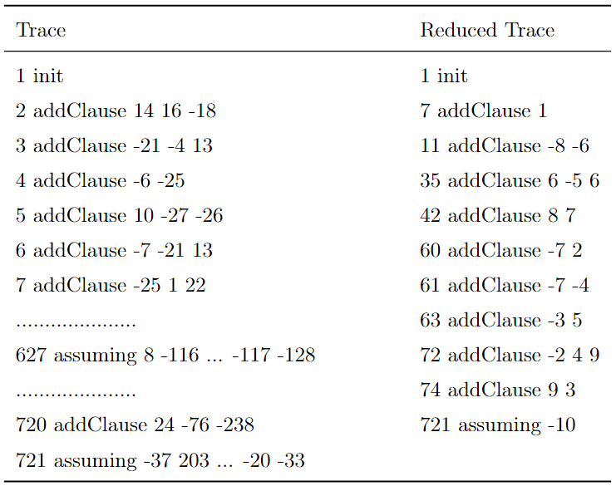

Slide 20
03
Results

Slide 21
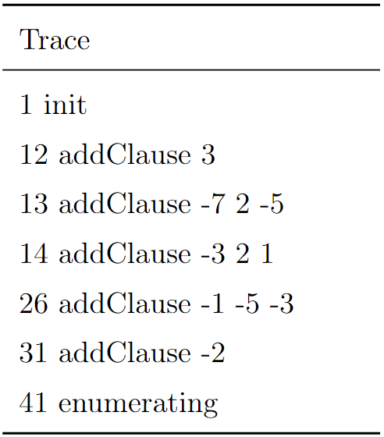
Internal Enumerator
The reduced file produced 65 models from the internal enumerator and 2 from the external enumerator
The models are 1 −2 3 −5 −7 and 1 −2 3 −5 7
Unit clauses were being forgotten after a backjump
It was needed to backtrack to the decision level 0 and since the solver did not store that information a hack was used to look at the trail and backtrack to the place where it met the first propagated literal
Notes:
As mentioned, the motivation behind adding support for internal and external enumerators in the fuzzer was the existing bug reported by users regarding incorrect results from the internal enumerator
The internal enumerator did not work properly for the example because there was a unit propagation at decision level 0

Slide 22
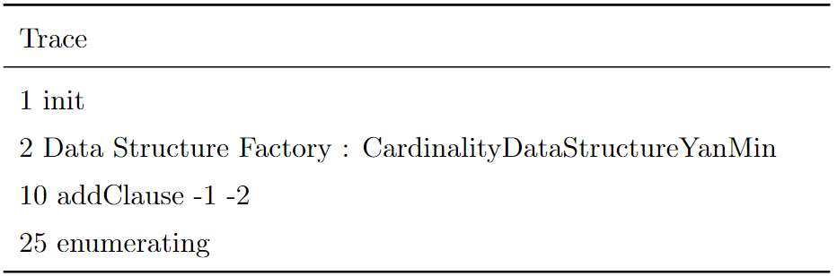
Head/Tail Data Structures
Another issue was discovered due to enumeration fuzzing when learning an empty clause.
Creating an empty clause using the Head/Tail data structures should not be possible.
The models found from the internal enumerator are 1 2, 1 −2, and −1. When trying to add −1 to the formula an “Assertion Error” is thrown from the solver
Notes:
If the empty clause is not added to the formula, the enumeration process can not end with an UNSAT answer.
Though in the trace the CardinalityDataStructureYanMin data structure is used, the error is also present for CardinalityDataStructureYanMax, CardinalityDataStructure, ClausalDataStructureWL, MixedDataStructureDanielHT, and MixedDataStructureSingleWL data structures

Slide 23
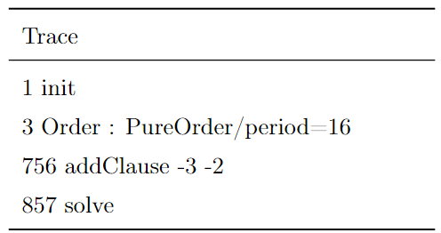
PureOrder Heuristic
The fuzzer detected a “Null Pointer Exception” in PureOrder heuristic when checking that there is a watch connected to the literal being analyzed
The original literals were −264 and −171 but were manually renamed to −3 and −2 because the renaming done by the DeltaDebugger to −2 and −1 did not preserve the error
Notes:
The variables did not belong to the formula, so the watches were not initialized

Slide 24
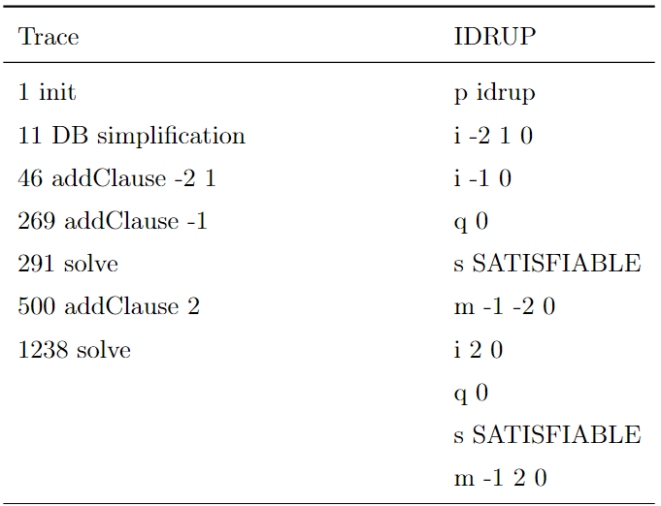
DB Simplification
When DB simplification is allowed the solver would sometimes provide wrong results
The underlying issue was due to a missing check when enqueuing learned literals, so unsatisfiability with unit clauses was not detected
Notes:
After adding the unit clause 2 the solver returns an incorrect model −1 2 instead of the correct UNSAT answer
DB simplification also caused an enumeration bug where internal and external enumerators would differ by one.

Slide 25
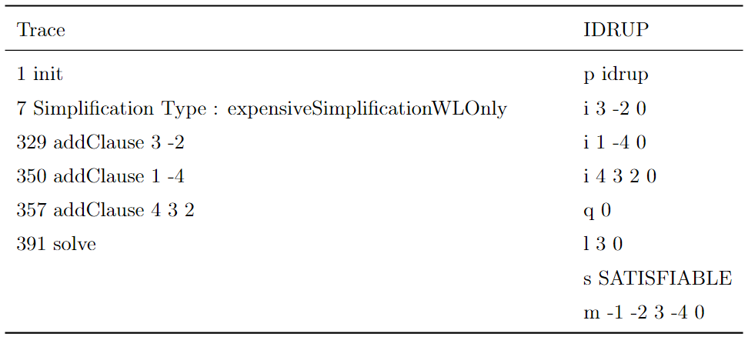
ExpensiveSimplificationWLOnly Learned Clauses
An issue was found when expensiveSimplificationWLOnly
The trace threw “Lemma Implication Check Failed Exception”
This simplification technique was supposed to be used only with the watched literal data structures
Notes:
l 3 0 threw an error
The correct learned clause should have been l 3 4 0
where the first literal is satisfied when the clause is a reason. In binary clause data structures, this is not enforced
asking the constraint the index to use for probing the first literal (0 by default, 1 for watched literals data structures)

Slide 26
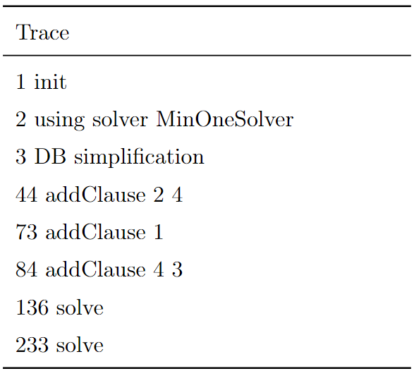
MinOne Solver
The fuzzer found a bug when applying MinOneDecorator DB simplification
“Array Index Out Of Bounds Exception” and “No Such Element Exception”
If the solver allows for constraints to be removed, then there are cases where the constraints added for minimizing the model could also b removed
Notes:
There were clauses added to the formula between the solve calls made to the solver but they did not affect the bug.

Slide 27
MinOne Solver 2
It took too long for TraceRunner to finish executing
A new problem was found when looking at the generated IDRUP proof
The first search found a minimal model, but the second search kept repeating the first found model
The IDRUP proof would reach 80,000+ lines before finishing with a SAT answer and there was only one model found during the second iteration
There are two loops when using an iterator on MinOne
Execution finishes successfully when satisfied clause deletion is disabled
Notes:
(sometimes up to 200,000)
one to get a model with a minimal number of ones and one to iterate over those models
Once the first loop is applied, the minimization finishes with a cardinality constraint which propagates unit clauses. Those unit clauses then remove some satisfied clauses from the original formula
If the goal is to find only one minimal model then this is correct. However, if an additional loop is added to iterate over all models, some clauses have disappeared so the solver can no longer find the right models.

Slide 28
04
Future Works

Slide 29
Possible Extensions
Parallel Solvers – fuzzer and proof-checker
Input Generation Techniques
Machine Learning-Based Fuzzing

Slide 30
Thank you!

