Slide 1
API Fuzzing for SAT4J Library
Iris Parruca

Slide 2
Table of contents
01
02
03
04
Background Information
Milestones
Demo
Future Work

Slide 3

01
Background Information

Slide 4
Fuzzing & API Fuzzing
The original fuzzing approach tests programs with random but valid inputs in order to detect bugs
Blackbox Fuzzing - does not require knowledge of the program source code
Whitebox Fuzzing - creates test cases taking into consideration the target program's logical constraints and data structure
API Fuzzing - randomly generates valid sequences of API calls
Allows to test all possible valid system configurations
In case of an error an API trace is generated
Needs a trace interpreter to reproduce the failure
Notes:
Randomly setting and combining configuration options

Slide 5

Delta-Debugging
Delta-Debugging techniques automatically simplify and isolate failure inducing inputs by using a divide-and-conquer strategy
A delta-debugger repeatedly calls the program with simplified variants of the failure inducing input.
Notes:
If the program shows the same observable behavior, then the delta-debugger continues with the simplified input or backtracks

Slide 6
SAT4J Library
Sat4j is an open-source Java library for solving boolean satisfaction and optimization problems. It can solve SAT, MAXSAT, Pseudo-Boolean and Minimally Unsatisfiable Subset (MUS) problems
It is full featured, robust, user friendly, and follows Java design guidelines and code conventions
The library is designed for flexibility using the decorator and strategy design patterns
SAT4J provides pre-configured SAT solvers depending your needs
It can be built with ANT as a standalone SAT solver or integrated in your Java Software
Notes:
The promise is not to be the fastest, a SAT solver in Java is about 3.25 times slower than its counterpart in C++
It includes unit and regression testing as well as static code analysis reports which are available in their website

Slide 7
02
Milestones

Slide 8
1. API Fuzzing for SAT4J modules
Trace class – contains ID (seed in HEX), List of API calls with add/remove methods as well as toFile() method
APIFuzzer class – generates Master seed (SecureRandom – 64bit) and calls TraceFactory, you can also pass the Master seed via the command line
TraceFacotry class – uses Master seed to generate a number of Slave seeds (Random – 48bit) where each corresponds to one unique sequence of API calls
All API calls made are inside try/catch blocks where the error is caught and the trace file is created

Slide 9
Design Choices
Increments – add more clauses to a formula if it returns SAT, it can have no increments or 1 to 4 increments per trace
Number of Variables – it can start with anything between 20 to 200 variables and each increment we increase the number by 20-200
Number of Clauses – is calculated by multiplying the number of variables by a coefficient optimized to produce 50% SAT and 50% UNSAT formulas, during an increment it multiplies with the number of new variables
Clause Length – uniform (length 3) or power law by starting at length 3 and either reducing (1% unary - 10% binary clauses) or increasing (~ 17% chance to increase by 1) the length

Slide 10
Design Choices
Clause Literals – clause can have both positive and negative literals; it checks if the literal is used before in the clause or if the literal is 0
Assumptions – it is possible to try to solve the formula with certain literals assumed as true, while generating these literals it need to check that this literal is used somewhere in the formula
Number of Assumptions – it applies power law to decide the number of literals that will be assumed which starts at 1/10 of total variables and it has a ~ 17% chance to increment by 1/10 of the total number of variables
Solution & Proof – if the generated instance is SAT it provides the valid assignment of variables or if it is UNSAT then the solver provides a proof

Slide 11
Design Choices
Slave Seed – It is possible to pass a Slave seed to the TraceFactory instead of a Master seed and it will generate API calls with that seed and then terminate
Statistics – at the end of APIFuzzer it prints some statistics about the execution such as number of SAT/UNSAT instances and avg. solver runtime which are calculated during execution and avg. learned clauses and avg. number of conflicts which are provided by the solver
Verbose – if this is set to true when calling TraceFactory then all decisions made are printed out in the console
Timeout – for testing purposes I set solver timeout to 10 minutes

Slide 12
Solution Enumerator
Tries to solve cnf file passed as argument on the command line
If it finds a solution it prints it to the console, negates the literals and adds it as a new constraint to the solver
Repeats as long as it returns SAT
c Solution 1 : -1 -2 -3
c Solution 2 : -1 2 3
c Solution 3 : 1 -2 3
c Solution 4 : 1 2 3
No other solution
Notes:
OR.cnf file results

Slide 13
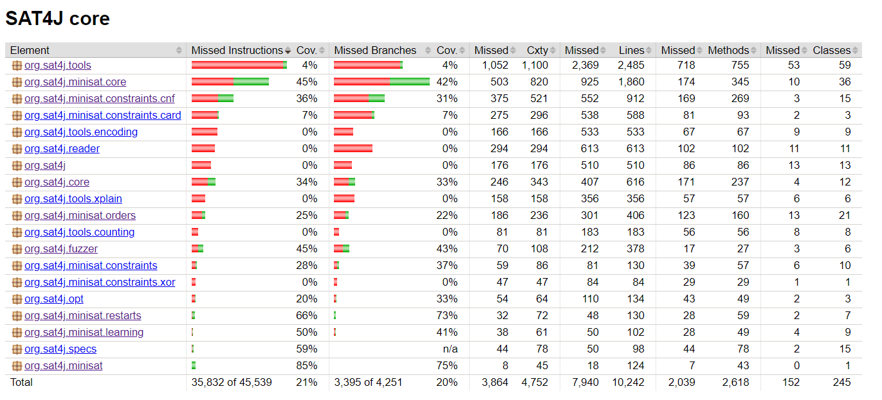
Code Coverage
Used JaCoCo plugin to generate a code coverage report by executing a test method that calls the APIFuzzer

Slide 14
2. Controlled Execution - Record & Replay
TraceRunner class – accepts 2 types of arguments : trace seed or trace file
Trace Seed – if you pass a trace seed then it will call the TraceFactory with that seed as Slave seed
Trace File – if you pass a trace file then it will parse the lines of the file and execute those API calls one by one and print the stack trace in the console if it throws an error

Slide 15
3. Delta Debugger
DeltaDebugger class – main method that gets the name of the file to be reduced from the command line and createFile() method to save the new reduced file
Runs the whole trace to get the error type
Uses the inner runTrace() method from TraceRunner to run the selected API calls
Compares the error of the reduced file with the error of the original file to decide if it should reduce or not

Slide 16
4. Option Fuzzing
Option fuzzing is done when the solver is initialized
It flips a coin if it should do option fuzzing or not and if yes then it flips a coin if it should fuzz all the options or only some of them
Solver Configurations – SAT4J has 33 pre-defined solver configurations such as Glucose21, Backjumping, RandomSolver, MiniLearningHeap, Parallel and so on from which it randomly picks one
Dependency-Based (DS) Simplification – if all options are being fuzzed it is set to true or otherwise it flips a coin
Notes:
Another option was timeout but it did not make sense to fuzz it

Slide 17
03
Demo

Slide 18
04
Future Work

Slide 19
Possible Extensions
String Configuration Option Fuzzing – You can specify different properties of the solver via a string in the command line, e.g:
-S RESTARTS=LubyRestarts/factor:512,LEARNING=MiniSATLearning
Possible building blocks are DSF, LEARNING, ORDERS, PHASE, RESTARTS, SIMP,
PARAMS, CLEANING
MaxSAT module – ‘opt’ comandline option
Notes:
DSF – Data Structure Factory
LEARNING – Learning Strategy
ORDERS – Order of traversing – includes random walk
PHASE – Phase Selection Strategy
RESTARTS – Restart Strategy
SIMP – Simplifier
PARAMS – Search Parameters
CLEANING – Learned Constraints Deletion Strategy

Slide 20
References
Le Berre, D. and Parrain, A. (2010). The Sat4j library, release 2.2. Journal on Satisfiability, Boolean Modeling and Computation, 7(2-3), pp.59–64. doi: https://doi.org/10.3233/sat190075.
Godefroid, P. (n.d.). Random Testing for Security: Blackbox vs. Whitebox Fuzzing Invited Talk. [online] Available at: https://patricegodefroid.github.io/public_psfiles/abstract-rt2007.pdf.
‌
Cyrille Valentin Artho, Biere, A., Masami Hagiya, Platon, E., Seidl, M., Tanabe, Y. and Yamamoto, M. (2013). Modbat: A Model-Based API Tester for Event-Driven Systems. Lecture Notes in Computer Science, [online] pp.112–128. doi: https://doi.org/10.1007/978-3-319-03077-7_8.
‌Niemetz, A., Preiner, M. and Biere, A. (n.d.). Model-Based API Testing for SMT Solvers *. [online] Available at: https://ceur-ws.org/Vol-1889/paper1.pdf.
‌Artho, C., Biere, A. and Seidl, M. (2013). Model-Based Testing for Verification Back-Ends. Lecture Notes in Computer Science, [online] pp.39–55. doi: https://doi.org/10.1007/978-3-642-38916-0_3.

Slide 21
References
‌Aina Niemetz, Preiner, M. and Barrett, C. (2022). Murxla: A Modular and Highly Extensible API Fuzzer for SMT Solvers. Lecture Notes in Computer Science, [online] pp.92–106. doi: https://doi.org/10.1007/978-3-031-13188-2_5.
Debuggingbook.org. (2023). The Debugging Book. [online] Available at: https://www.debuggingbook.org/.
ACM Other conferences. (2021). Fuzzing and delta-debugging SMT solvers | Proceedings of the 7th International Workshop on Satisfiability Modulo Theories. [online] Available at: https://dl.acm.org/doi/abs/10.1145/1670412.1670413.

