Slide 1

FINAL PROJECT · PHASE A · SOFTWARE ENGINEERING DEPARTMENT
Network Stability using Hyperbolic Geometric Latent Diffusion Model
By: Rotem Maravent · Irit Kogan
Advisors: Dr. Renata Avros · Prof. Zeev Volkovich
Project 26-2-R-5
01
Notes:
Irit: Good afternoon, my name is Irit and together with my partner Rotem, we will be presenting our research on evaluating 'Network Stability using a Hyperbolic Geometric Latent Diffusion Model, supervised by our advisors, Dr. Renata Avros and Prof. Zeev Volkovich.

Slide 2
AGENDA
Presentation Outline
1
Motivation & Background
8
Graph Perturbation Module
2
Problem Statement
9
Generative Recovery Module
3
Mathematical Background
10
Probabilistic Stability Scoring Module
4
HypDiff – Hyperbolic Autoencoding
11
Datasets
5
HypDiff – Anisotropic Diffusion Process
12
Validation & Evaluation
Our Solution
Summary & Conclusion
6
13
7
High-Level Architecture
02
Notes:
Irit: Let's start with a quick look at where we're going.
First, we'll explain why this problem matters and why current tools can't solve it.
Then we will cover the mathematical framework and the specific model we build upon, known as HypDiff.
The core of our presentation will detail our custom pipeline, which consists of three modules.
And finally, we'll review our datasets, our validation methods, and close with a summary.

Slide 3



OVERVIEW
Motivation & Background
Complex Networks Are Everywhere
The Reality
The Need
From power grids to biological systems and social networks.
Networks are rarely static.
They are constantly exposed to environmental stress and targeted structural failures.
Early detection of vulnerabilities within the network structure is essential to prevent systemic collapse.
03
Notes:
Irit: Complex networks are not a theoretical abstraction - they're the backbone of every critical system we depend on. Power grids, biological systems, social platforms - all controlled by the same underlying mathematical structures. The challenge is that these topologies are almost never static. They're constantly exposed to environmental stress, heavy dynamic loads, and even targeted structural failures such as a power grid losing connections, or a biological network changing under disease conditions. Because these systems are so critical, identifying their structural vulnerabilities early is essential to prevent catastrophic collapse. The key insight: stability isn't just about measuring the current graph - it's about understanding how that graph behaves under damage, and whether its important structural properties can still be recovered.

Slide 4




OVERVIEW
Problem Statement
The Challenge
The Gap
The Flaw
Classical metrics treat networks as static, rigid structures, ignoring the probability of multiple structural states.
Standard Graph Neural Networks (GNNs) force non-Euclidean graphs into flat Euclidean spaces, causing massive geometric distortion.
Standard diffusion models inject isotropic Gaussian noise, which destroys delicate topological information.
The Result Unreliable assessment of true system resilience.
04
Notes:
Irit: You might assume that network stability is a solved problem, but it is far from it. There are three fundamental reasons why current approaches fall short.
First, classical metrics treat a network as a single, static structure, ignoring the fact that a damaged network has many potential structural states.
Second, standard graph neural networks suffer from significant geometric distortion because they attempt to embed hierarchical, tree-like structures into Euclidean space. Since these networks grow exponentially while Euclidean space only expands polynomially, the underlying structure is compressed and misrepresented.
Finally, standard diffusion models inject uniform noise in every direction, which destroys the very topological structure we are trying to measure.
Together, these issues mean that current resilience scores simply cannot be trusted.
Now, Rotem will explain the mathematics that allow us to overcome these limitations.

Slide 5
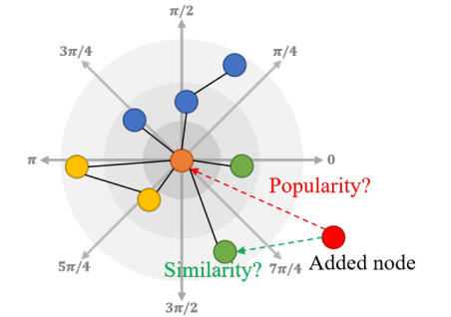
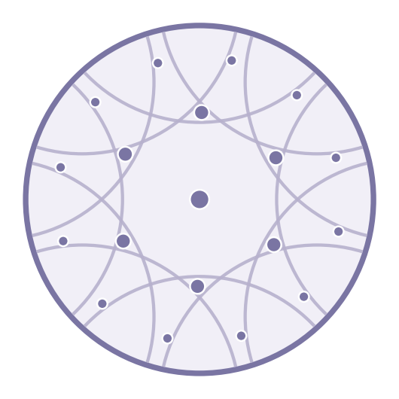
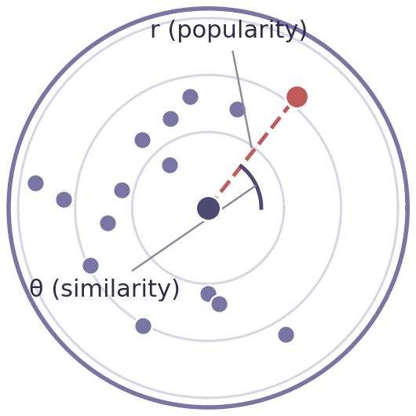
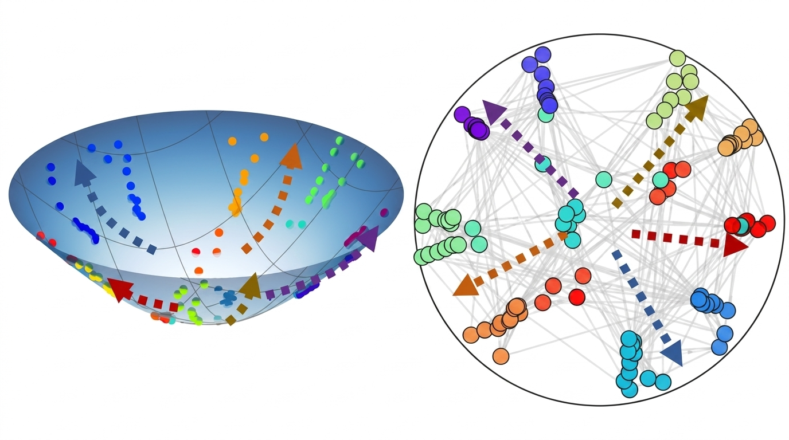
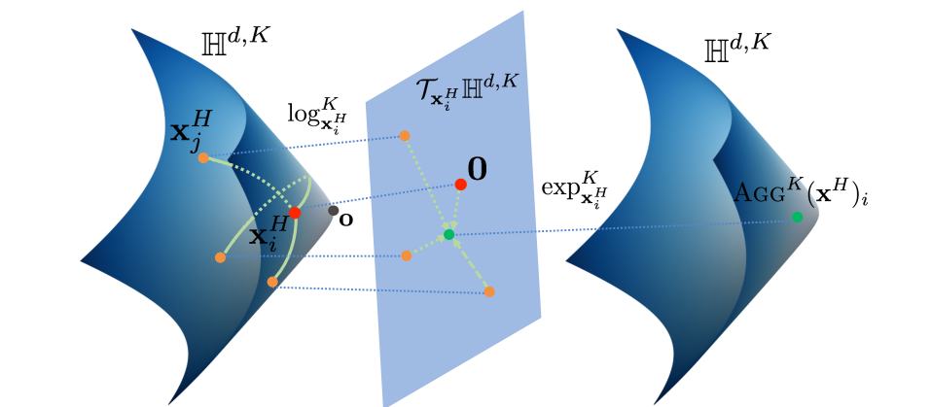
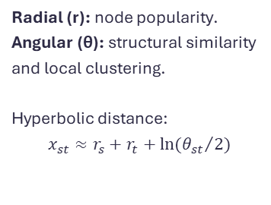
FOUNDATIONS
Mathematical Background
Hyperbolic Geometry
Exponential & Logarithmic Maps
Popularity-Similarity Optimization (PSO)
Non-Euclidean space with constant negative curvature naturally models continuous hierarchical structures without distortion.
Log map: projects a point from the manifold onto the tangent space.
Exp map: projects a tangent vector back onto the manifold.
Enable Euclidean computation while preserving hyperbolic structure.
Radial (r): node popularity.
Angular (θ): structural similarity and local clustering.
Hyperbolic distance: $$x_{st}≈r_{s}+r_{t}+\ln{({θ_{st}}/2)}$$
05
Notes:
Rotem: To address the problems we just outlined, we rely on three mathematical foundations.
The first is Hyperbolic geometry – a space with constant negative curvature that expands exponentially as you move outward from the center. This is exactly the right property for representing complex structures.
Now, hyperbolic space has no linear structure, so operations like adding points or adding Gaussian noise — which diffusion models rely on — aren't even defined. This is where the second foundation steps in. At any point on the manifold, we attach a tangent space, which is locally Euclidean. The log map projects a point from the manifold into that tangent space. The exp map does the reverse.
The last foundation is the Popularity-Similarity Optimization framework, or PSO. Each node is mapped to a polar coordinates on the hyperbolic disk. The radial coordinate encodes popularity – a smaller radius means the node is more central and attracts more connections. The angular coordinate encodes structural similarity, so nodes at close angles cluster into local communities.

Slide 6
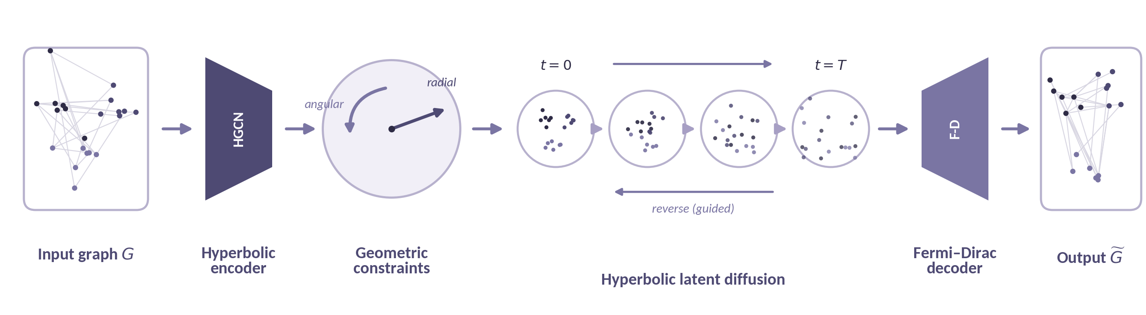
PRIOR WORK · FU ET AL., 2024
HypDiff – Hyperbolic Autoencoding
HypDiff (Fu et al., 2024) is a state-of-the-art latent diffusion model for graph generation that operates in a hyperbolic latent space, avoiding the distortion Euclidean models introduce on hierarchical graphs.
Hyperbolic Encoder (HGCN)
Aggregates node features in the tangent space via log/exp maps, producing a hierarchy-preserving hyperbolic latent.
Fermi-Dirac Decoder
Converts hyperbolic distances between nodes into edge probabilities, reconstructing the discrete graph topology.
06
Notes:
Rotem: This brings us to HypDiff, the state-of-the-art model our project builds on.
HypDiff is a latent diffusion model for graph generation — but unlike standard diffusion models, its latent space is hyperbolic.
The encoder is a hyperbolic version of a standard GCN. It uses log and exp maps to move features into the tangent space, aggregate there, and map back. The result is a node embedding that preserves the graph's hierarchical structure.
The decoder is Fermi-Dirac. It takes the hyperbolic distance between two nodes and converts it into a probability of an edge existing between them, which is used to reconstruct the discrete graph.
Irit will now cover the anisotropic diffusion process.

Slide 7
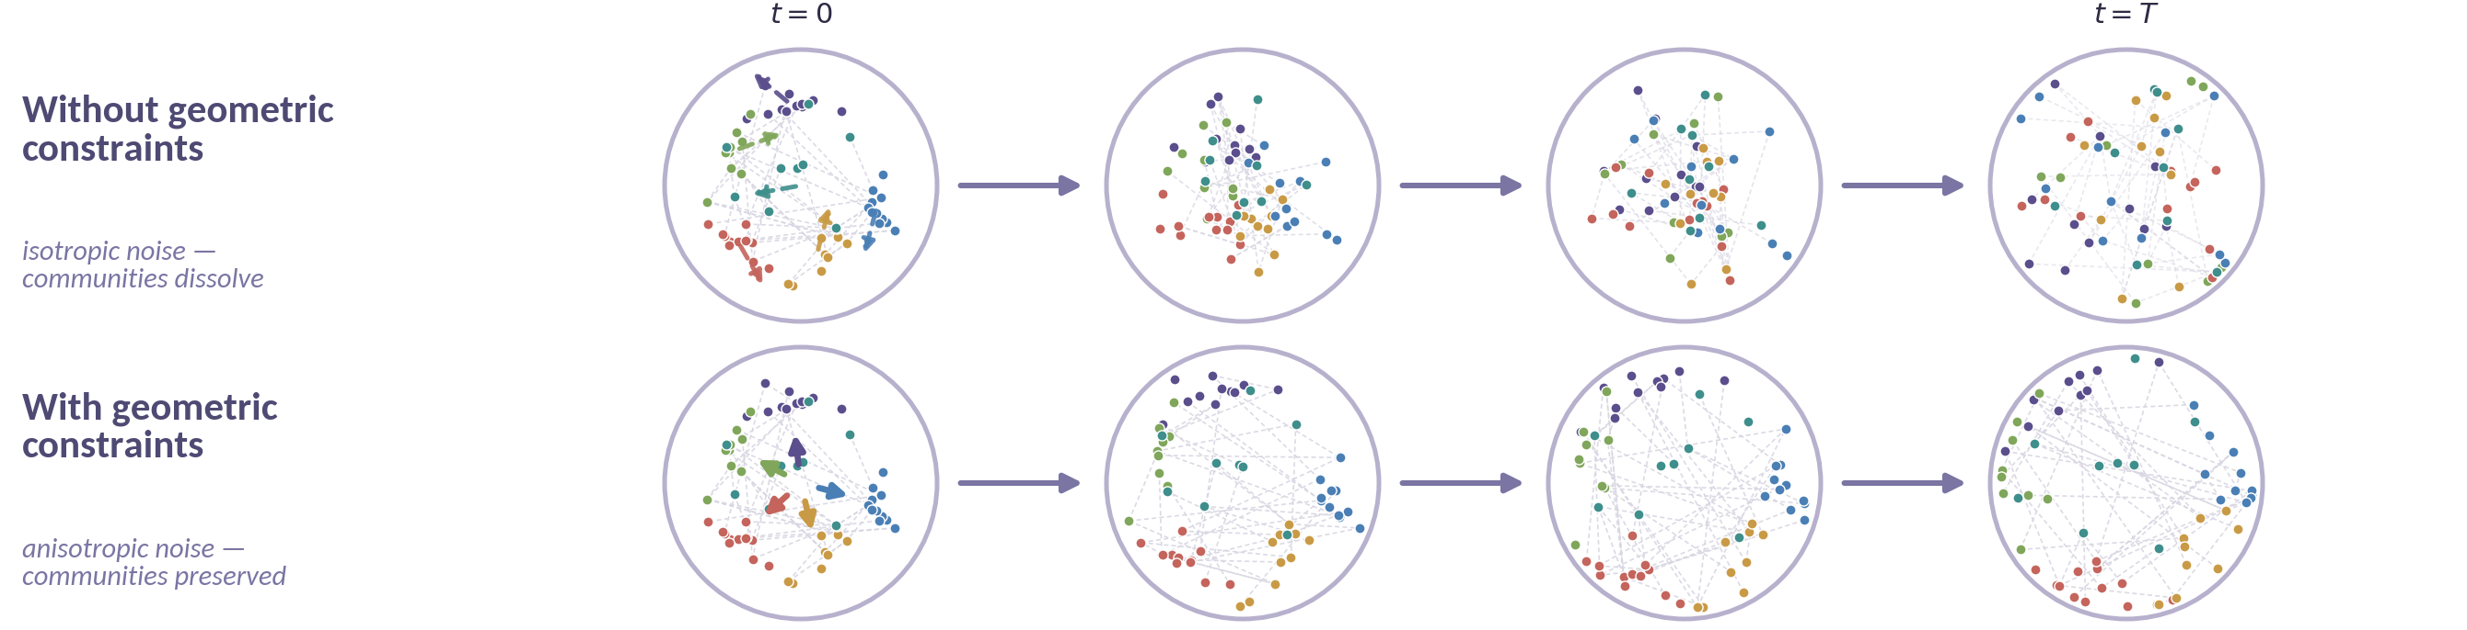
PRIOR WORK · FU ET AL., 2024
HypDiff – Anisotropic Diffusion Process
Forward Process – Directional Noise
Reverse Process – Guided Denoising
Instead of uniform noise, injects noise along two geometric constraints:
Angular: aligned with local community structure.
Radial: preserves node popularity/hierarchy.
A neural network iteratively removes noise along these same constraints, reconstructing the graph structure step-by-step.
07
Notes:
Irit: The autoencoder is only half the story; the second component is what makes HypDiff truly effective — its anisotropic diffusion process.
Instead of uniform noise, the forward process injects directional noise along two geometric constraints defined by the Popularity-Similarity model: the angular direction, aligned with local community structure, and the radial direction, which preserves node popularity and hierarchy.
As you can see, while unconstrained isotropic noise completely dissolves community structures, constrained anisotropic noise preserves them throughout the process.
The reverse process then denoises along those same directions, rebuilding the graph step by step.

Slide 8




CONTRIBUTION
Our Solution
Bridging continuous geometry with structural resilience by repurposing HypDiff for stability evaluation.
Core Idea
The Gap
Representing networks as probability distributions over potential structural states, rather than fixed points.
HypDiff was designed purely for graph generation and not for measuring resilience under stress.
Our Adaptation
Outcome
Wrapping the pretrained HypDiff model in a dedicated pipeline that turns its generative reconstructions into a measurable stability signal.
A precise, geometry-derived score that quantifies structural robustness using HypDiff's probabilistic reconstructions.
08
Notes:
Rotem: That was HypDiff. Now — our solution.
The gap is simple. HypDiff was built purely for graph generation — not for measuring how a network holds up under stress.
Our core idea is a reframing: instead of representing a network as a single fixed point —we represent it as a probability distribution over the many structural states a damaged network can have.
In practice, we take the pretrained HypDiff and wrap it in a dedicated pipeline that takes in damaged graphs and produces a measurable stability signal.

Slide 9
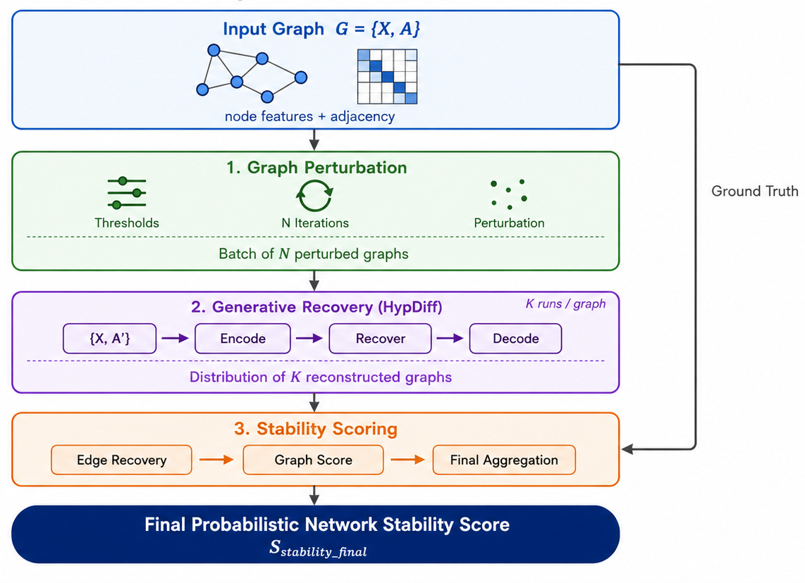
SYSTEM DESIGN
High-Level Architecture
This entire pipeline is executed once per damage threshold (e.g., 10%–50%), tracing how stability degrades as damage increases.
09
Notes:
Irit: With that foundation in place, we can now look at how our system is built.
Our system architecture consists of three sequential modules. First, Module One damages the graph systematically. Module Two then passes that damaged graph into HypDiff to perform generative recovery. Finally, Module Three compares the recovered graph against the original ground-truth to produce a stability score.
We execute the entire pipeline once per damage level — from ten percent up to fifty percent. Consequently, our final output is not just a single number, but a performance curve that shows exactly how stability degrades as damage increases.
Let's zoom in on Module One to see exactly how we simulate these structural attacks.

Slide 10
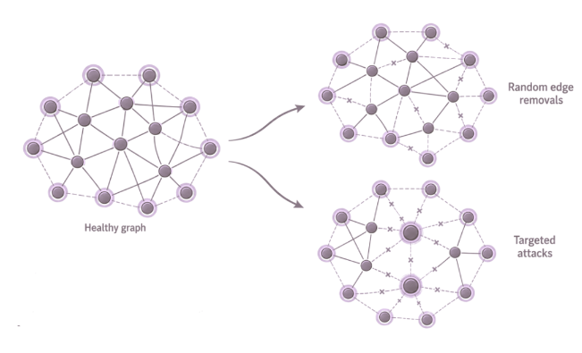




MODULE 1
Graph Perturbation Module
Goal Systematically removes edges to simulate dynamic structural disruptions.
Random Edge Removals
Targeted Attacks
Iterative Batch Generation
Deletes connections uniformly based on a predefined fraction.
Removes the highest-impact connections based on Degree Centrality.
Repeats the removal process N independent times, producing a batch of N perturbed matrices for statistical reliability.
10
Notes:
Irit: Starting with Module One, we systematically disrupt the graph using two methods. First, we apply random edge removal, deleting a fixed fraction of edges uniformly.
Next, we execute targeted attacks by ranking edges according to the combined degree of their endpoints, to disable the network’s most critical hubs.
Relying on a single damaged graph doesn’t give us a reliable statistical picture. To fix this, we use iterative batch generation: we repeat the removal process N independent times to create a statistically robust batch.

Slide 11


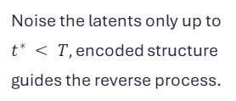
MODULE 2
Generative Recovery Module
Goal Reuse pretrained HypDiff to sample K reconstructions per perturbed graph
Hyperbolic Encoding
Partial Forward Diffusion
Anisotropic Reverse Denoising
Fermi-Dirac Decoding
HGCN embeds the perturbed graph into latent space, keeping the surviving structure.
Noise the latents only up to $t^{∗} < T,$encoded structure guides the reverse process.
Denoise along angular & radial constraints, reusing community centres from the original graph. Run K times per perturbed graph.
A reconstructed adjacency matrix per run — K reconstructed graphs for every perturbed graph.
11
Notes:
Rotem: In this module, we adapt the HypDiff framework.
We start by encoding the damaged graph into hyperbolic latent, which captures the structure that survived the edge removals.
Then, instead of starting from pure noise like standard HypDiff, we inject noise only partway — enough to let the model recover missing edges, but not so much that it erases the surviving structure.
From there, the network runs the guided denoising process.
We repeat this K times, and each cleaned embedding is decoded by Fermi-Dirac into a reconstructed adjacency matrix — giving us K samples per damaged graph, ready for Module 3.

Slide 12
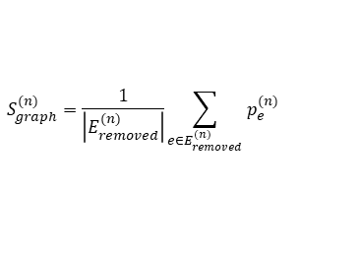




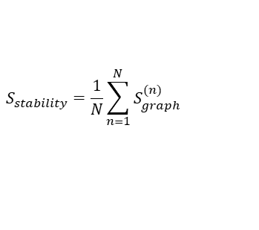
MODULE 3
Probabilistic Stability Scoring Module
Goal: Turn K stochastic reconstructions of each of the N perturbed graphs into a single stability score for the network.
Step 1
Step 2
Step 3
Step 4
Identify Target Edges
Edge-Level Recovery
Graph-Level Stability
Final Stability Score
For each perturbed graph $n$, isolate the set of removed edges $E_{removed}^{(n)},$For every reconstruction ${\hat{A}}_{rec,n}^{(k)},$record which of these edges reappear.
For each removed edge $e$, compute its recovery frequency across the K reconstructions
Average the edge-level probabilities to score each perturbed graph:
Average across all $N$ perturbed graphs to obtain the final Probabilistic Network Stability Score
$$p_{e}^{(n)}=\frac{1}{K}\sum_{k=1}^{K}{1\left\{e∈{\hat{A}}_{rec,n}^{(k)}\right\}}$$
$$S_{graph}^{(n)}=\frac{1}{\left|E_{removed}^{(n)}\right|}\sum_{e∈E_{removed}^{(n)}}{p_{e}^{(n)}}$$
$$S_{stability}=\frac{1}{N}\sum_{n=1}^{N}{S_{graph}^{(n)}}$$
12
Notes:
Rotem: This is the final module of our pipeline, and it's where the reconstructions get turned into a concrete stability score.
We do this in four steps.
Step 1 — for each damaged graph, we identify the edges that were removed. Those are our target edges — the ones we want to see restored.
Step 2 — for each of those removed edges, we ask a simple question: across the K reconstructions of this graph, in how many of them did the edge reappear? That frequency is the edge's recovery probability.
Step 3 — we average those edge-level probabilities to get a single stability score for that damaged graph.
Step 4 — finally, we average across all N damaged graphs to get the overall Probabilistic Network Stability Score.

Slide 13
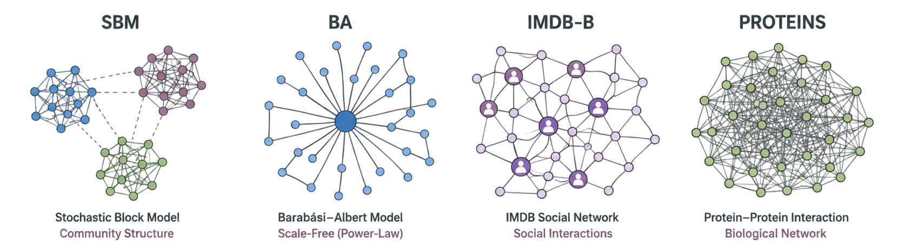
EVALUATION DATA
Evaluation Datasets
Synthetic Datasets
Real-World Datasets
SBM: Modular community structure. Stress-tests the Angular constraint's ability to preserve local structure under perturbation.
BA: Scale-free hub topology. Stress-tests the Radial constraint's ability to protect high-degree nodes under targeted attacks.
IMDB-B (Social): Co-starring network with dense local cliques. Validates the framework on naturally clustered social topologies.
PROTEINS (Biological): Amino-acid contact network with edges within 6 Å. Validates performance on spatially dense, non-hierarchical topologies.
13
Notes:
Rotem: We evaluate on four datasets, each with a purpose.
The synthetic ones isolate the diffusion constraints: SBM has modular Communities, testing the angular constraint under damage. BA is scale-free with dominant hubs, testing the radial constraint under direct attack.
The real-world ones add realism.
IMDB-B capture actors co-staring links. PROTEINS links amino acids by physical proximity, a structure with no clean hierarchy.

Slide 14

VERIFICATION
Validation & Evaluation
Generative Consistency
Robustness Degradation
Comparison to Classical Metrics
Evaluates structural fidelity of reconstructions using MMD (distributional similarity) and F1 Score (edge-level precision/recall).
Stress-tests across damage thresholds (10%–50%) under both random and targeted deletion.
Benchmarks proposed probabilistic metric against traditional deterministic measures (e.g., algebraic connectivity).
Future Work Comparison against alternative graph generation baselines, to isolate the contribution of hyperbolic geometry specifically.
14
Notes:
Irit:
To evaluate our framework, we focus on three key aspects.
First, we verify the generative consistency of our results; we use MMD to ensure distributional similarity, and we check that the generated graphs aren't collapsing into repetitive, unrealistic samples by using precision-recall and density-coverage scores.
Second, we analyze the system’s performance under increasing stress, in both random and targeted deletion to produce a clear, reliable degradation curve rather than noise.
Additionally, we compare our approach with classical metrics, to highlight the unique insights our probabilistic score provides compared to deterministic measures.

Slide 15
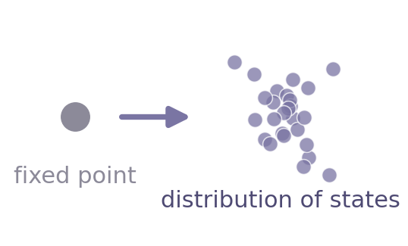
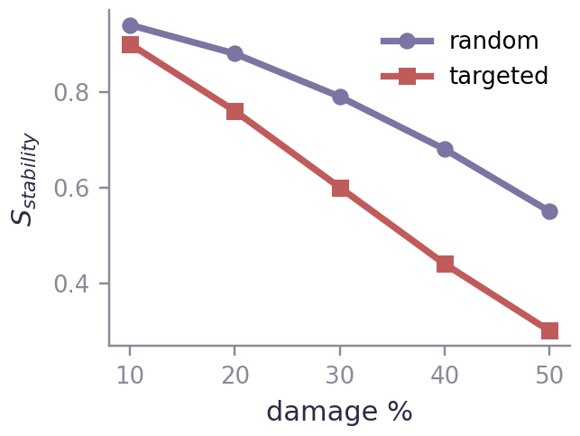
CLOSING
Summary & Conclusion
The Shift
The Innovation
The Impact
Transitioning from deterministic metrics to an uncertainty-aware, probabilistic framework for network evaluation.
Repurposing HypDiff, a generative model built only for graph generation, into a stability-evaluation pipeline via guided partial recovery.
The dynamic score provides a precise, geometry-derived measurement of true structural resilience under dynamic stress.
15
Notes:
Rotem: To conclude, our project represents a shift - from static, deterministic metrics to a probabilistic, uncertainty-aware way of measuring stability.
The core innovation is our adaptation of the HypDiff framework from graph generation into a stability evaluation pipeline.
The result is a dynamic, stress tested score that reflects a network’s true resilience.

Slide 16

Thank You
Questions?
Rotem Maravent · Irit Kogan | Advisors: Dr. Renata Avros · Prof. Zeev Volkovich

