Slide 1
Coelogyne Orchid Species Classification
14 Jul 2026
Deep Learning for Botanical Species Identification

Slide 2
Research Context and Botanical Relevance
Objective: classify five Coelogyne taxa from floral imagery using deep learning.
Use case: support preliminary identification workflow before expert morphological confirmation.
Scope in this report: current computational performance from logged experiments.
Taxa: Asperata, Dayana, Pandurata, Rumphii, Swaniana.
Notes:
Framing intentionally positions the model as decision support, not taxonomic replacement.

Slide 3
Data and Experimental Workflow
Image dataset organized by taxon directory (supervised 5-class setup).
Exploratory analysis used unsupervised methods to inspect discriminative regions.
Methods included variance mapping, gradient mapping, PCA, patch clustering, and t-SNE embedding.
Model training used train/validation monitoring with TensorBoard event logs.

Slide 4
Model Families Evaluated
MobileNetV2 (transfer learning): head training and fine-tuning.
EfficientNetV2S (transfer learning): head training and fine-tuning.
EfficientNetV2S dedicated experiment: dropout=0.3, top-15 unfreezing, label smoothing=0.1.
CSPDarknet53 (from-scratch custom CNN baseline).
ViT-Tiny (transformer baseline).

Slide 5
Validation Performance Summary (Current Logs)
Model Stage | Best Validation Accuracy | Best Validation Loss | Interpretive Note
EfficientNetV2S Fine-tune | 0.8158 | 0.7566 | Best overall result in available logs
EfficientNetV2S Head | 0.8026 | 0.6602 | Strong pre-fine-tune baseline
EffNet Dedicated R1 Fine-tune | 0.7895 | 1.1064 | Stable but below peak main run
EffNet Dedicated R1 Head | 0.7500 | 0.9605 | Good early transfer signal
MobileNetV2 Head | 0.6974 | 1.3217 | Moderate lightweight baseline
MobileNetV2 Fine-tune | 0.6842 | 1.9504 | No clear improvement in best run
CSPDarknet53 | 0.4868 | 11.1342 | Optimization/generalization issues
ViT-Tiny | 0.2763 | 1.9591 | Insufficient under current setup
Notes:
Metrics are best-observed values from current logged runs; not averaged across repeated seeds.

Slide 6
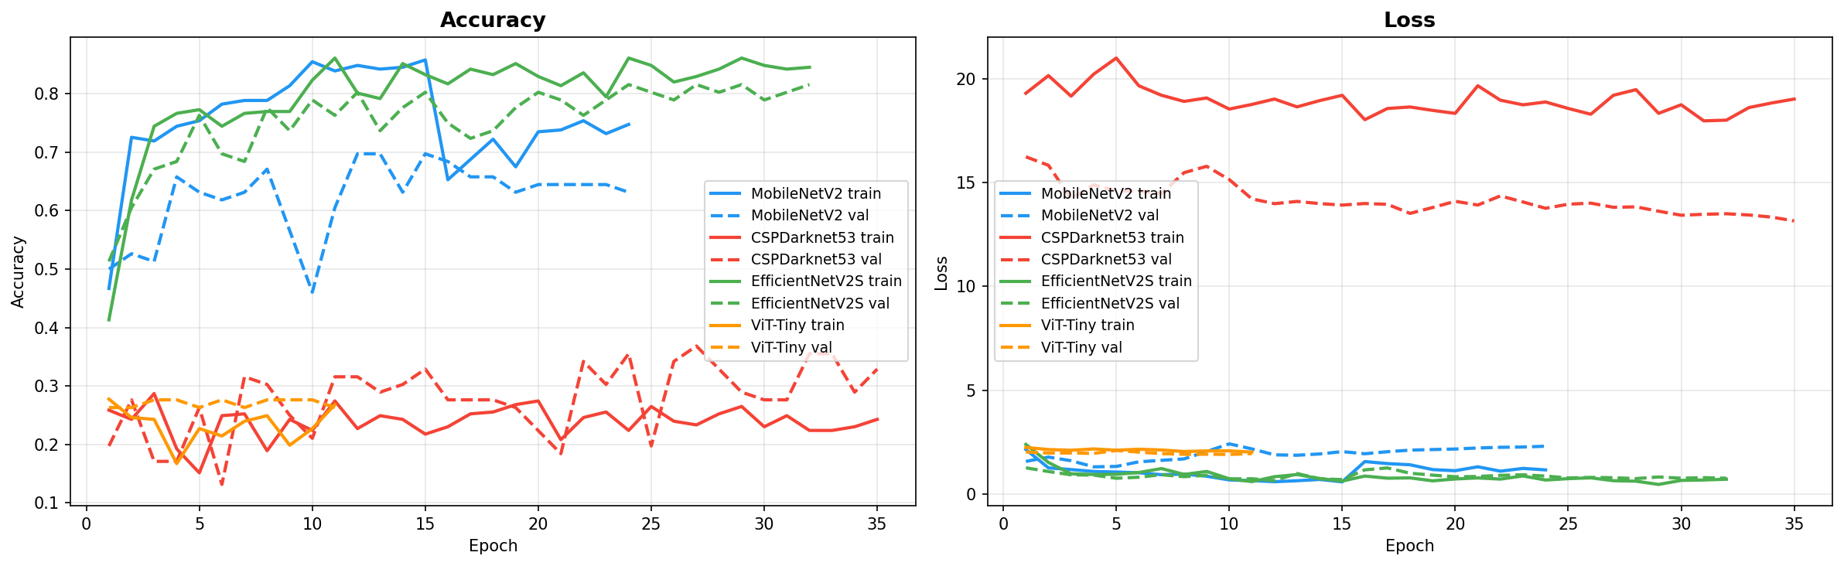
Training and Validation Curves
Accuracy and loss over epochs across model training runs. EfficientNetV2S converges highest and most stably; CSPDarknet53 and ViT-Tiny plateau well below 40%.

Slide 7
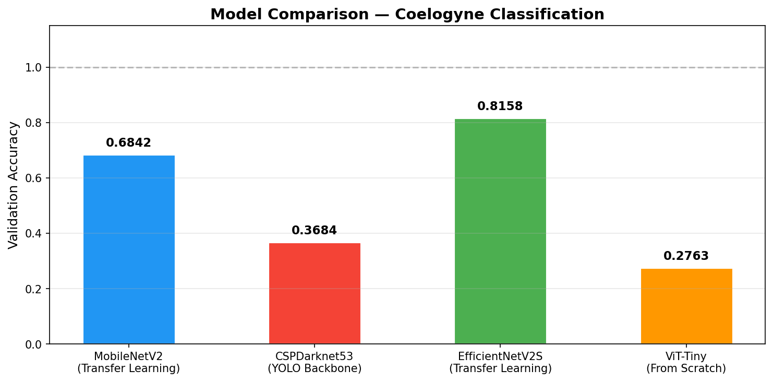
Model Comparison — Validation Accuracy
Best validation accuracy by model family. EfficientNetV2S leads at 0.8158, more than double CSPDarknet53 and ViT-Tiny.

Slide 8
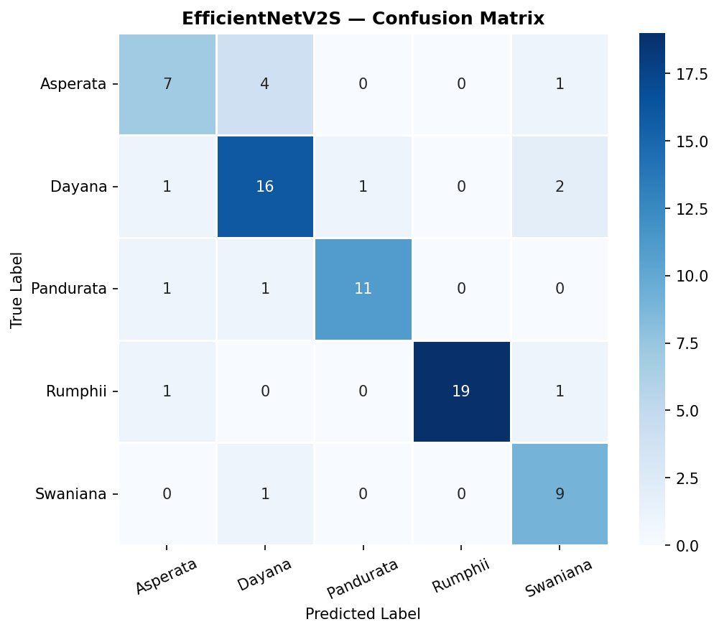
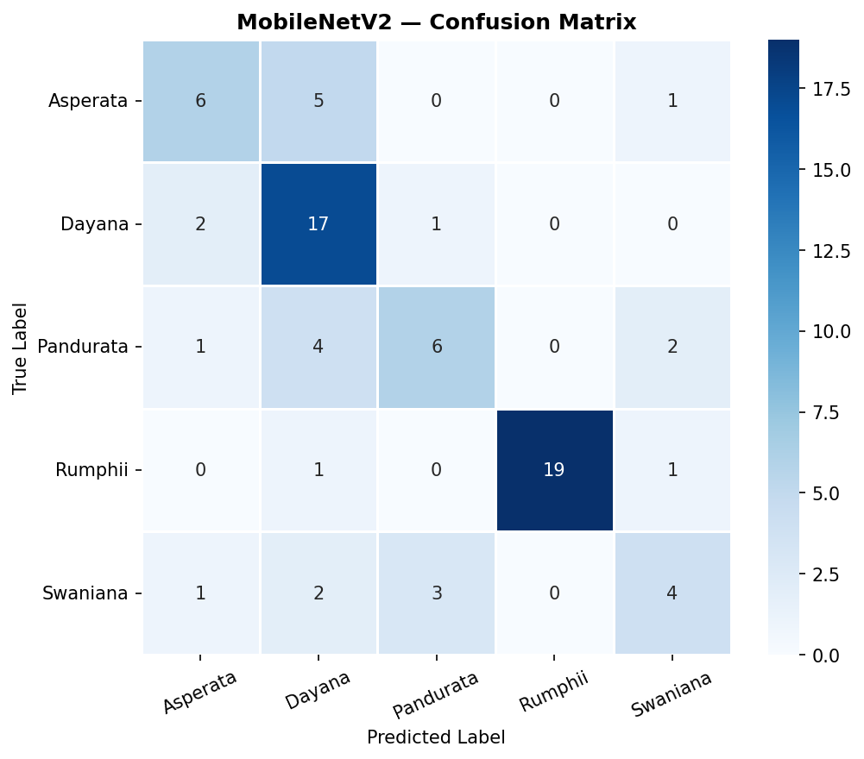
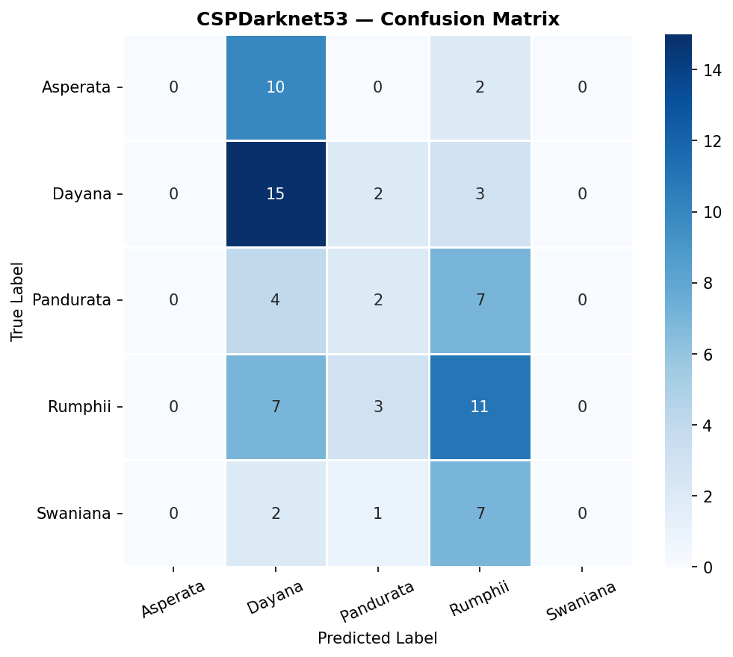
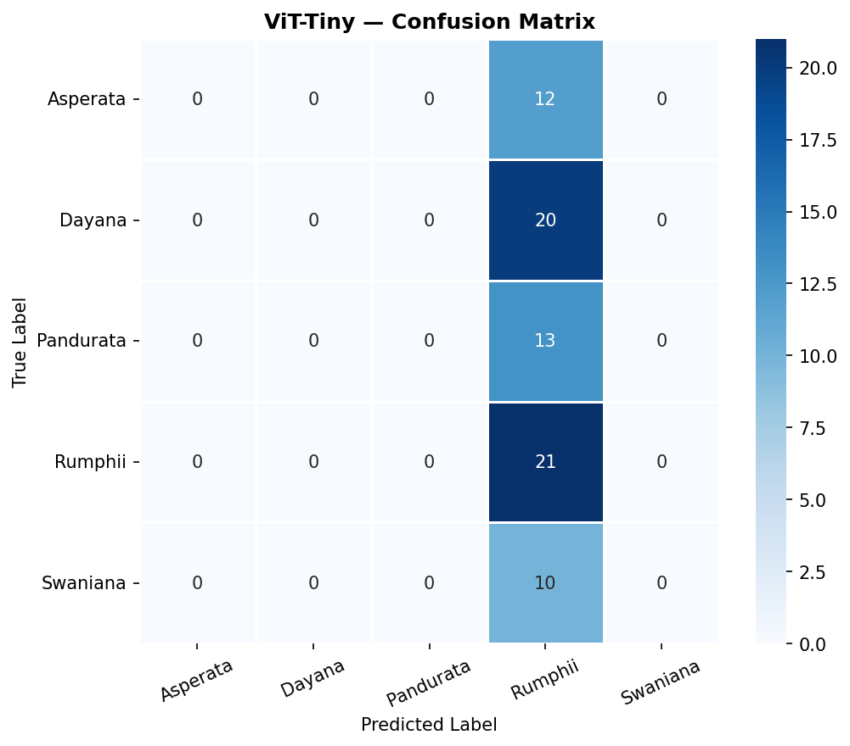
Confusion Matrices by Model
EfficientNetV2S
MobileNetV2
CSPDarknet53
ViT-Tiny

Slide 9
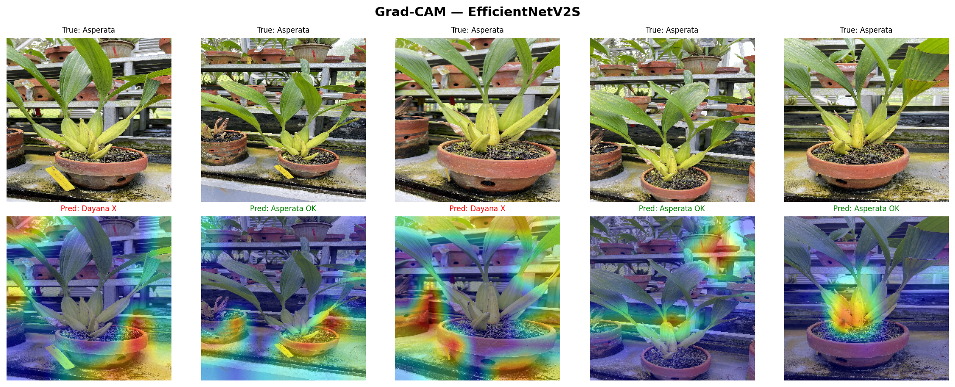
Grad-CAM Attention — Where Each Model Looks
Highlighted regions show the image areas most influential to each model's prediction.

Slide 10
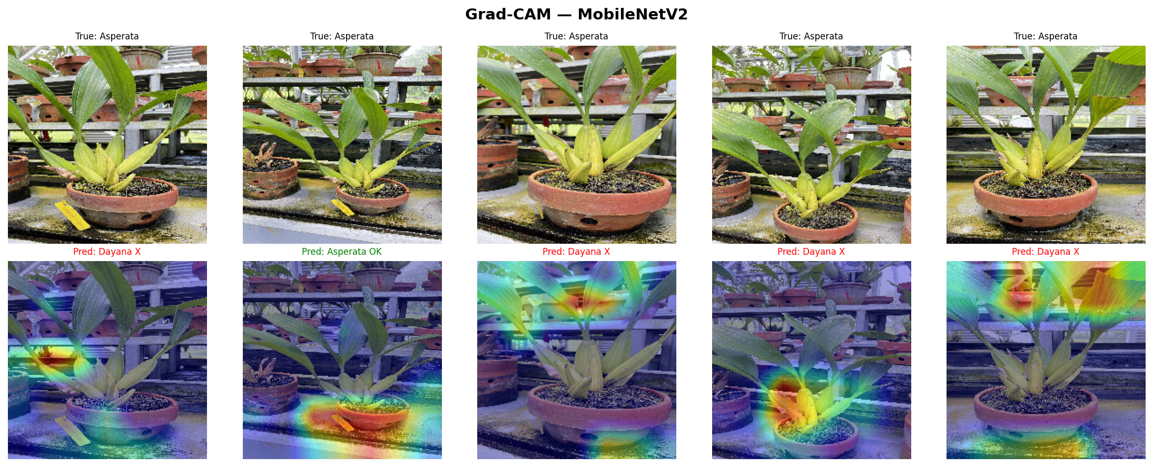
Grad-CAM Attention — Where Each Model Looks
Highlighted regions show the image areas most influential to each model's prediction.

Slide 11
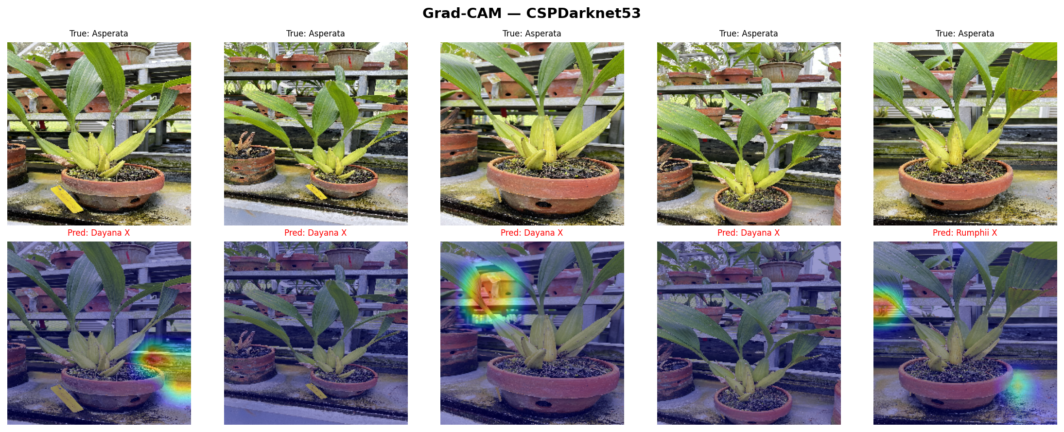
Grad-CAM Attention — Where Each Model Looks
Highlighted regions show the image areas most influential to each model's prediction.

Slide 12
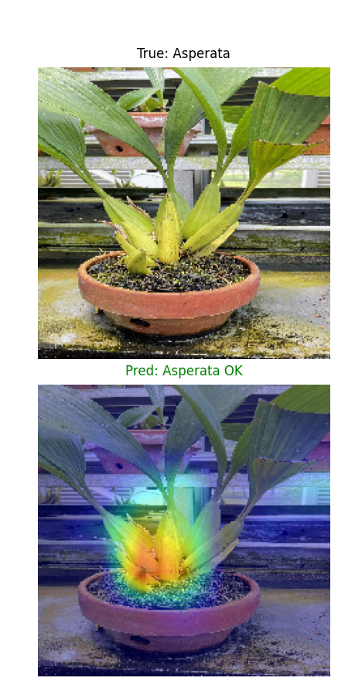
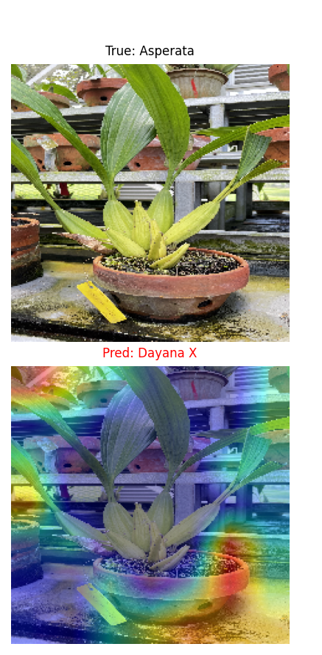
Key Finding: Attention Lands on the Pseudobulb Base
Correct: Asperata
Misread: Asperata to Dayana
What this means
Correct predictions activate on the pseudobulb/stem base — the character botanists already use for ID.
Misclassifications happen when attention leaks onto pots, shelving, or neighboring plants.
This is an actionable error driver, ahead of collecting more data.
Next Phase: Region-of-Interest (ROI) Modeling
Detect and crop to the pseudobulb/base region before classification, so the model learns from diagnostic plant structure instead of background context.
Heat concentrates on the pseudobulb / stem base
Heat drifts to the pot rim and background clutter

Slide 13
Botany-Oriented Interpretation
Model can accelerate preliminary sorting of specimens into likely taxa.
Most reliable current candidate is EfficientNetV2S for decision support pipelines.
Predictions should be interpreted alongside key morphological characters and expert review.
Potential utility: curation triage, field-photo pre-screening, and educational collections.

Slide 14
Current Limitations (Academic Transparency)
Reported values are validation-log based; external hold-out botanical survey is pending.
Multiple runs exist; best-run reporting can obscure variance between training repeats.
Per-class precision/recall and confusion behavior need consolidated reporting.
Potential dataset bias (lighting, angle, phenological stage) remains to be quantified.

Slide 15
Recommended Next Experiments
Priority: build an ROI stage that detects/crops the pseudobulb-base region before classification (see prior finding).
Perform repeated-seed experiments and report mean ± SD for robust comparison.
Add class-wise metrics and confusion analysis for morphologically similar taxa.
Evaluate calibration (confidence reliability) before practical deployment.
Test external image sets from varied habitats, devices, and flowering conditions.
Document reproducible protocol for the selected final checkpoint.

Slide 16
Deployment Position
Primary candidate: EfficientNetV2S fine-tuned model.
Fallback for constrained environments: MobileNetV2.
TFLite artifacts are already available, enabling pilot deployment studies.
Next milestone before wider pilot: retrain with an ROI-focused crop on the pseudobulb/base region to reduce background-driven errors.
Recommendation: release as assistive tool with expert-in-the-loop validation.

Slide 17
Conclusion
Current evidence supports EfficientNetV2S as the strongest direction for Coelogyne image classification.
For academic botany use, the model is best positioned as a complementary identification aid.
Next value gain will come from external validation and taxon-level error characterization.
Immediate next step: ROI-focused retraining on the pseudobulb/base region to cut background-driven misclassifications.

