Slide 1
ORd 2011
Preparing hardware and software requirements
Get computational cell model in C
Apply GPU memory optimization and offsetting
Apply ODE solvers in each code of cell model type
ORd 2017
ToR-ORd
Simulation Validation
Under-drug
Drug-free
Drug: bepridil (33, 66, 132 mMol)
Concentration: 0 mMol
Run GPU Simulation for 1000 cycles
Save initial states for GPU simulation
Run and record GPU Simulation for 1 cycles
Validate GPU action potential to CPU result
Record computing time
Run CPU Simulation for 1000 cycles
Save initial states for CPU simulation
Run and record CPU Simulation for 1 cycles
Computational time advancement
Computational time advancement
Compare action potential shape and MAE
Compare action potential for under drug and drug free

Slide 2
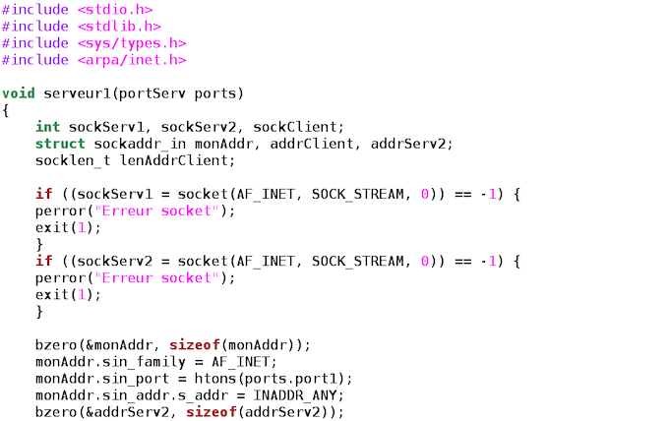
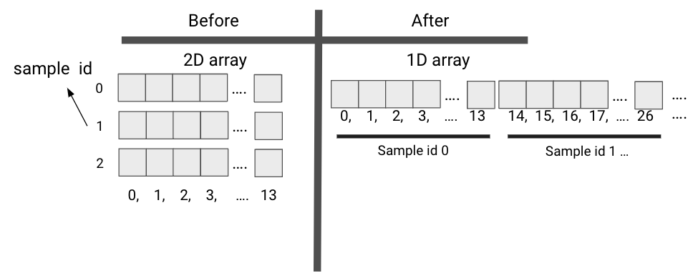
Simulation Validation
Under-drug
Drug-free
Drug: bepridil (33, 66, 132 mMol)
Concentration: 0 mMol
Run GPU Simulation for 1000 cycles
Save initial states for GPU simulation
Run and record GPU Simulation for 1 cycles
Validate GPU action potential to CPU result
Record computing time
Run CPU Simulation for 1000 cycles
Save initial states for CPU simulation
Run and record CPU Simulation for 1 cycles
Computational time advancement
Computational time advancement
Compare action potential shape and MAE
Compare action potential for under drug and drug free

Slide 3
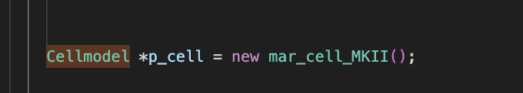
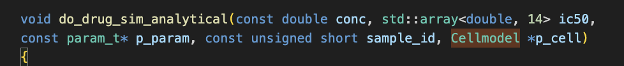
Before
After
Simplify class-based into function-based
Before
After
CONSTANTS[5] = 8314;
CONSTANTS[(sample_id * 163) + 5] = 8314;
Add offset to every array
Adjust 2D array into 1D to simplify parallelization management

