Slide 1
ORd 2011
Preparing hardware and software requirements
Get computational cell model in C
Apply GPU memory optimization and offsetting
Apply ODE solvers in each code of cell model type
ORd 2017
ToR-ORd
Simulation scenarios:
Under drug : bepridil ( concentration: 33, 66, 132 mMol)
Drug free (concentration: 0 mMol)
Compare action potential shape of GPU and CPU result
Run GPU simulation for 1000 cycles
Save initial states for GPU simulation
Run and record GPU simulation for 1 cycle
Record computing time
Save simulation result
Run CPU simulation for 1000 cycles
Save initial states for CPU simulation
Run and record CPU simulation for 1 cycle
Calculate difference between GPU and CPU simulation result using MAE
Compare CPU and GPU computing time
Calculate computing time advancement
Check how drug affect the simulation
Compare action potential shape in different concentrations

Slide 2
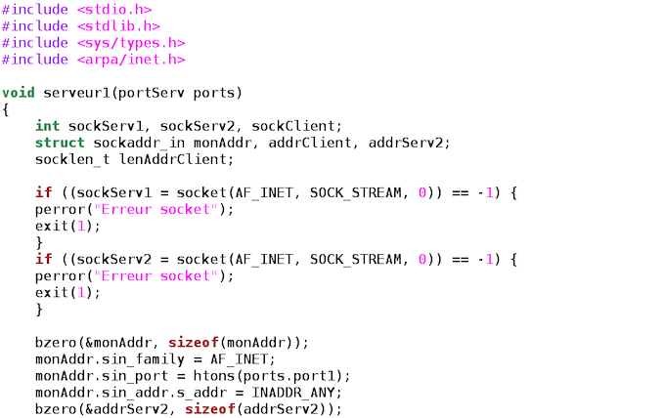
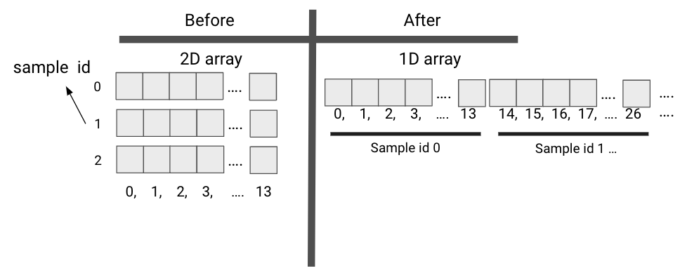
Simulation Validation
Under-drug
Drug-free
Drug: bepridil (33, 66, 132 mMol)
Concentration: 0 mMol
Run GPU Simulation for 1000 cycles
Save initial states for GPU simulation
Run and record GPU Simulation for 1 cycles
Validate GPU action potential to CPU result
Record computing time
Run CPU Simulation for 1000 cycles
Save initial states for CPU simulation
Run and record CPU Simulation for 1 cycles
Computational time advancement
Computational time advancement
Compare action potential shape and MAE
Compare action potential for under drug and drug free

Slide 3
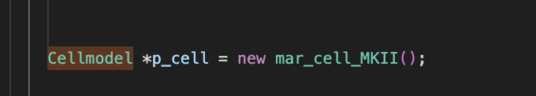
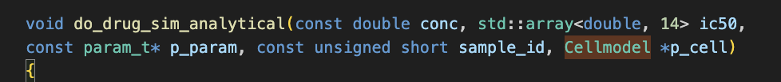
Before
After
Simplify class-based into function-based
Before
After
CONSTANTS[5] = 8314;
CONSTANTS[(sample_id * 163) + 5] = 8314;
Add offset to every array
Adjust 2D array into 1D to simplify parallelization management

