Slide 1
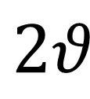
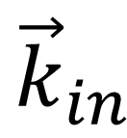
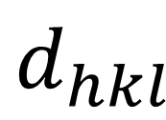

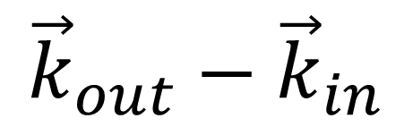
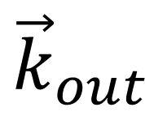
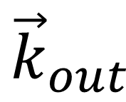
$${\vec{k}}_{out}$$
$${\vec{k}}_{out}−{\vec{k}}_{in}$$
$${\vec{k}}_{in}$$
$${\vec{k}}_{out}$$
$$θ$$
$$2θ$$
$$d_{hkl}$$

