Slide 1


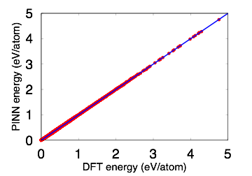
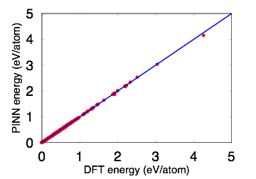
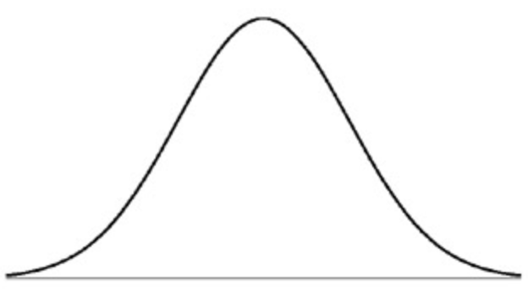
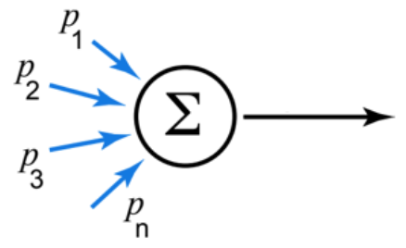
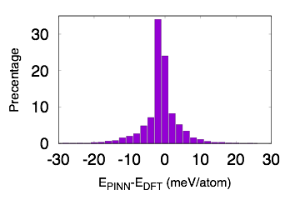
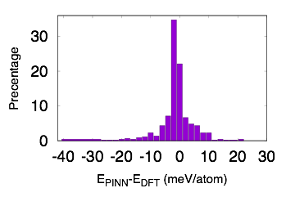
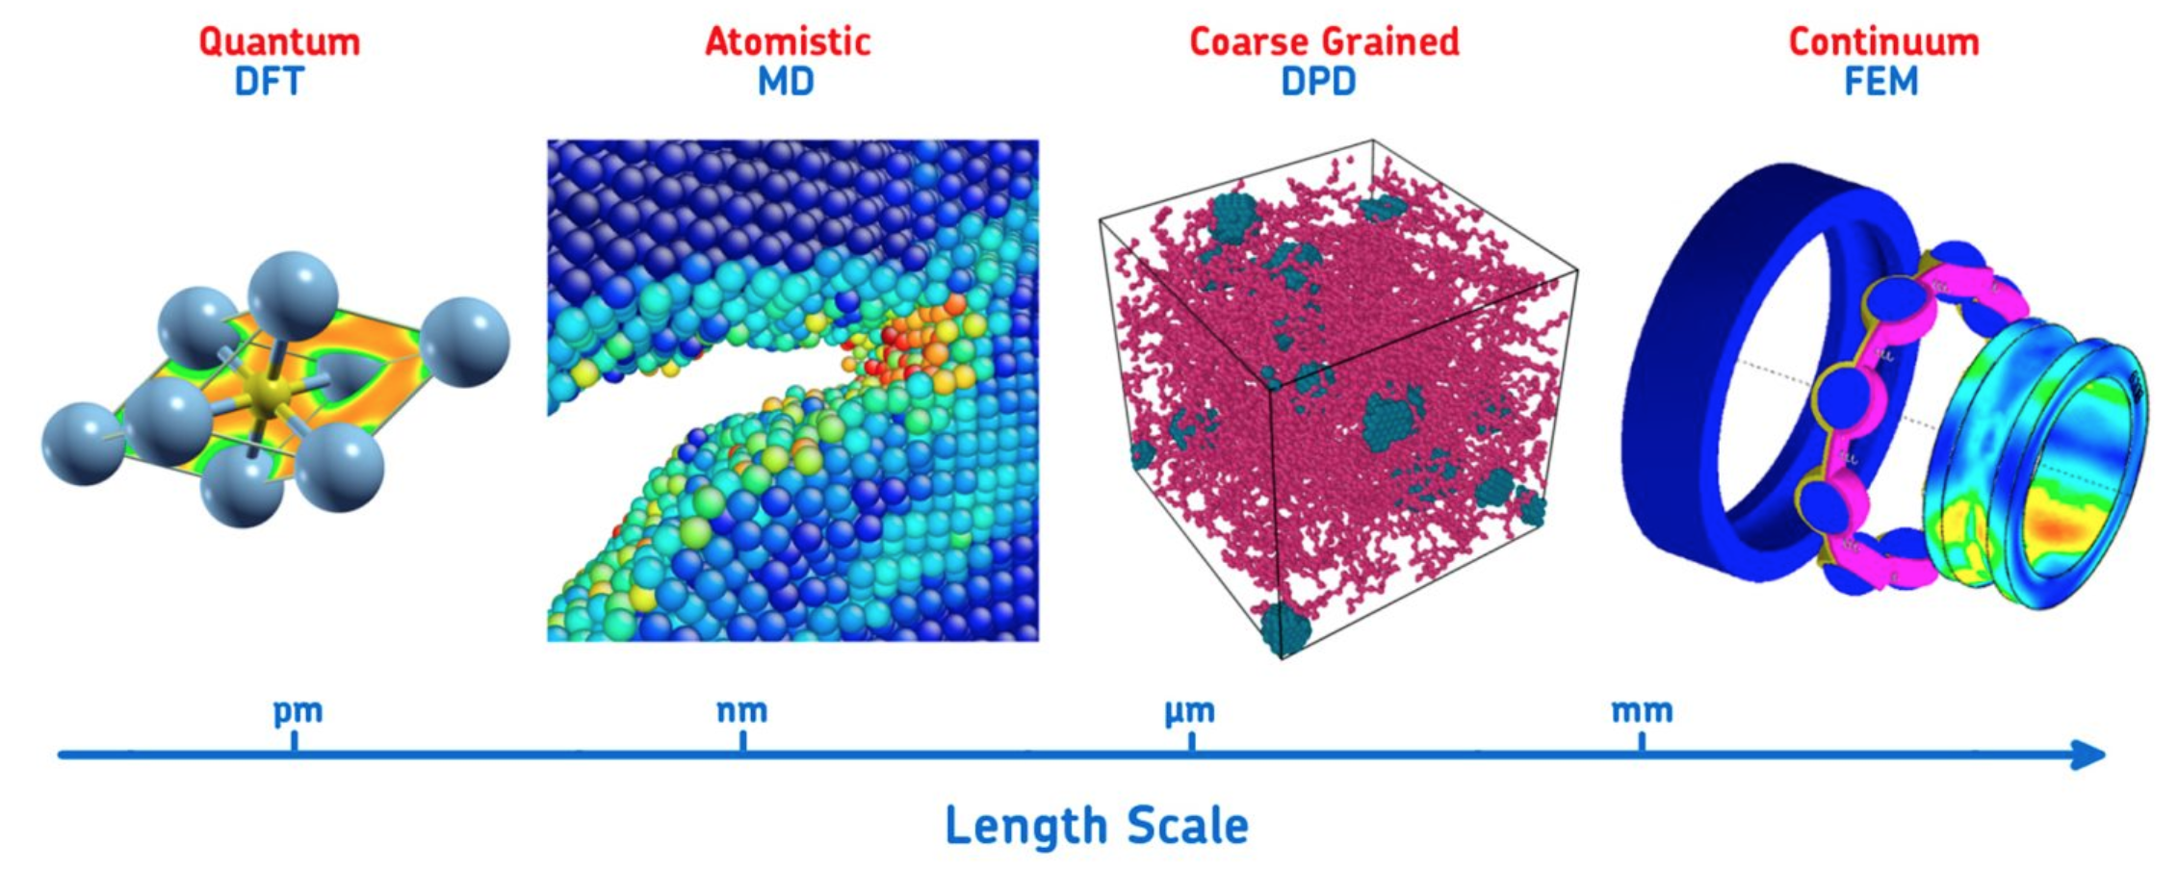



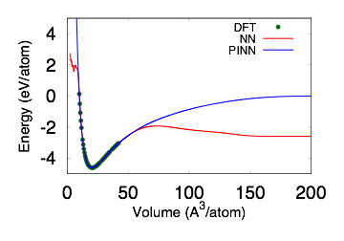
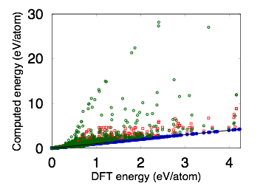
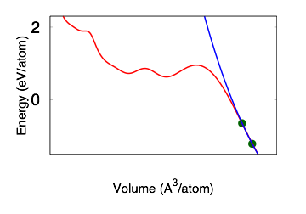


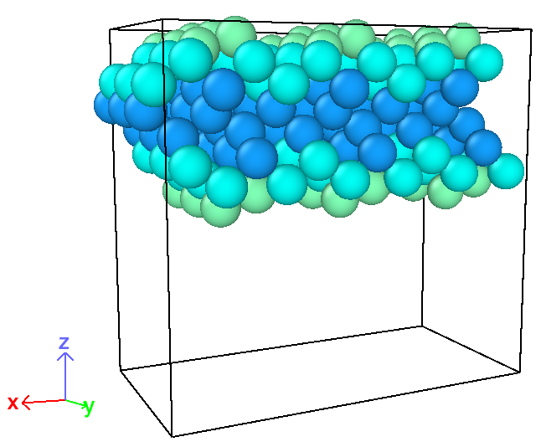
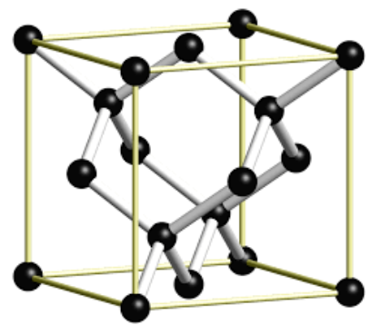
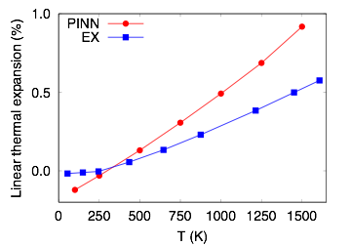
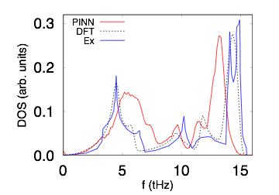
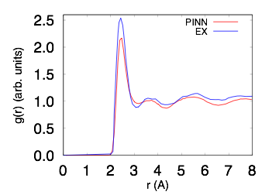
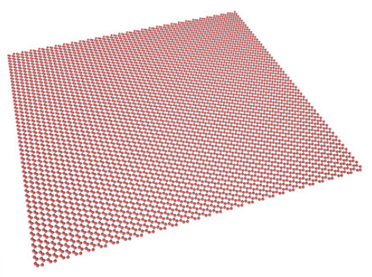
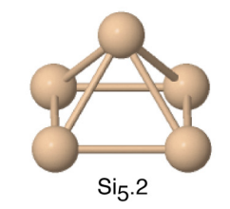
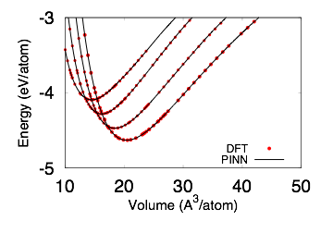
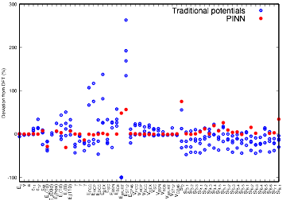
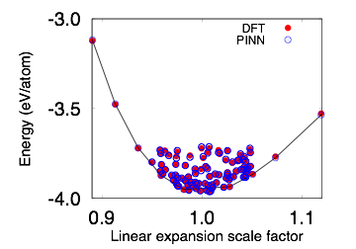
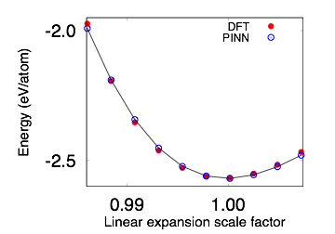

Development and testing of a physically-informed artificial neural network potential for the silicon system
James Hickman*, Ganga Purja Pun**, Francesca Tavazza*, Yuri Mishin**
*National Institute of Standards and Technology: Materials Measurement Laboratory (MML). ** George Mason University: Department of Physics
Introduction
Physically informed neural network potentials
Results
The present work focuses on the development of a new type of classical interatomic potential known as a “physically-informed neural network” (PINN) potential. This novel format combines the high level of accuracy and flexibility associated with artificial neural networks (ANNs) with the transferability inherent to physical analytic potential models. We focus on silicon as a test case, however, the PINN model can generally be applied to any multicomponent metallic or covalently bonded material.
In the present work we utilize the PINN interatomic potential formalism [4]. This model can be broken into three separate parts as summarized below.
Training data
Validation data (untrained)
Local Structural “Finger-printing”
RMSE= 4.95 meV
j
$$(r_{1},r_{2}...r_{n})$$
$$G_{i}^{m}=\underset{j,k}{∑}P_{m}(cos(θ_{ijk}))f(r_{ij})f(r_{ik})$$
(neural network input)
i
k
form neighbor
list
$$(G_{1},G_{2}...G_{M})$$
$$M=60$$
Radial term
Angular term
(Legendre polynomials)
Motivation
$$f(r)=\frac{1}{σ^{3}}e^{-\frac{(r-r_{o})^{2}}{σ^{2}}}f_{c}(r)$$
$$P_{m}(cos(θ))m=0,1,2,4,6$$
y=x equality with DFT
RMSE= 5.58 meV
Cutoff function
Computational material science spans a wide range of length and time scales ranging from the sub-atomic to the macroscopic. In the present work we focus on the atomistic domain, particularly, density functional theory (DFT) and classical methods such as molecular dynamics (MD) or Monte Carlo (MC).
$$r_{min}$$
$$r_{o1}$$
$$r_{o2}$$
$$r_{o3}$$
$$r_{c}$$
$$r$$
$$f_{c}(r)=\frac{(r-r_{c})^{4}}{d^{4}+(r-r_{c})^{4}}r<r_{c}$$
Artificial neuron
(nodes or perceptrons)
Neural network evaluation
final layer has no
transfer function
Distribution of training error
Distribution of validation error
$$s_{1}$$
$$w_{1}$$
weighted and
biased signal
$$G_{1}$$
$$w_{11}$$
$$w_{12}$$
$$b_{1}$$
$$p_{1}$$
Quantum
DFT
Classical
MD/MC
Coarse Grained
Continuum
FEM
$$s_{2}$$
$$w_{2}$$
$$s=Σ_{i}w_{i}s_{i}+b$$
$$G_{2}$$
$$⋮$$
$$w_{13}$$
$$b_{2}$$
$$p_{2}$$
input signals
$$⋮$$
$$⋮$$
$$s_{3}$$
$$w_{3}$$
$$b$$
neuron
output
$$⋮$$
$$⋮$$
$$s_{n}$$
$$w_{n}$$
transfer
function
$$f(s)=\frac{1}{1+e^{-s}}$$
$$f(s)$$
$$w_{M1}$$
$$b_{k}$$
output
layer
$$p_{8}$$
The weights and bias are the NN’s fitting parameters
$$G_{M}$$
input layer
hidden layers
$$(w,b)$$
NN Architecture: 60x32x8
Physical model evaluation
$$2216fittingparam$$
SL
interface
8 Adjustable terms which are controlled by the outputs of the NN
Comparison with NN potentials
Comparison with Traditional potentials
Reference [1]
GB
$$(p_{1},p_{2}...p_{8})=(A,B,α,β,a,h,λ,σ)$$
physical extrapolation
RMSE (meV/atom)
Compromises
Classical (MD/MC)
$$E_{i}=\frac{1}{2}\left(Σ_{j≠i}e^{A-αr_{ij}}-S_{ij}b_{ij}e^{B-βr_{ij}}\right)f_{c}(r_{ij})+E_{p}$$
Modified Tersoff
1281
[7]
Ab-initio/DFT
Computationally Fast [5]
Larger systems (N~ )
Kinetic phenomena/long simulations
Accuracy depends on approximation of the potential energy surface (PES)
vacancy
catastrophic
extrapolation!!
Stillinger-Weber
2591
Slow
Size limited (N~ )
0K or short timescales
Very accurate
Speed
Accuracy
Scalability
Transferability
repulsive term
attractive term
promotional energy
PINN
5
$${10}^{2}$$
$${10}^{7}$$
bulk
liquid
bond order parameter
$$b_{ij}=(1+z_{ij})^{-\frac{1}{2}}$$
$$E_{p}=-σ_{i}{\left(Σ_{j≠i}S_{ij}b_{ij}f_{c}(r_{ij})\right)}^{\frac{1}{2}}$$
zoom
physical extrapolation
$$S_{ijk}=1-f_{c}(r_{ik}+r_{jk}-r_{ij})e^{-λ^{2}(r_{ik}+r_{jk}-r_{ij})}$$
screening factor
$$z_{ij}=a^{2}Σ_{k≠i,j}S_{ik}(cos(θ_{ijk}+h)^{2}f_{c}(r_{ik})$$
catastrophic
extrapolation!!
$$E=E(r_{1},r_{2}...r_{N})$$
$$S_{ij}=\underset{k≠i,j}{∏}S_{ijk}$$
All computational methods have associated limitations and compromises. Therefore, models which mitigate these compromises open up new avenues of exploration and enable the discovery of novel phenomena.
number of chemical bonds
Neural Network training
Training region
Types of interatomic potentials
DFT training set generation:
2D Silicene allotropes
Bulk phase
Atomic clusters
Surfaces
Interstitials, vacancies, stacking faults
Thermal expansion
Phonon density of states
Liquid RDF
Many methods for approximating the potential energy surface exist; collectively these methods are known as interatomic potentials. Typically such methods predict the energy of each atom and sum these individual contributions to get the total structural energy. Below are three commonly used schemes.
VASP:
Functional/PP: PBE/PAW
ENCUT=600 eV
~4300 structures
block size 1-96 atoms
k-point convergence
[7]
(https://jarvis.nist.gov/)
[7]
[7]
Traditional Potentials: (physical model)+(parameterization)
Training process:
“Training set”
Model error
$$RMSE={\left(\frac{Σ_{i}(E_{i}-{\overset{˜}{E}}_{i})^{2}}{N}\right)}^{\frac{1}{2}}=f(w,b)$$
Note: From Previous PINN version
Neighbor list
interatomic
potential
model
atomic energy
Structures
DFT energies
Model energies
Atom-i
$$(r_{1},r_{2}...r_{n})$$
$$e_{i}$$
structure-1
$$E_{1}$$
$${\overset{˜}{E}}_{1}$$
parameterization
structure-2
$$E_{2}$$
$${\overset{˜}{E}}_{2}$$
Fit the NN weights and bias’s
to minimize the RMSE
Conclusions
Pro’s
$$(p_{1},p_{2},..p_{m})$$
Con’s
$$⋮$$
$$⋮$$
$$⋮$$
computationally fast
Decent extrapolation
Potential models derived from physics
Difficult to train/fit
Hard to improve upon once finalized
Accuracy limitations
structure-N
$$E_{N}$$
$${\overset{˜}{E}}_{N}$$
We developed a new silicon interatomic potential using the PINN potential format
Even in preliminary stage we are obtaining excellent agreement with the DFT energies
Current potential reproduces DFT data around 300x better than current traditional potentials
Reference [2]
Results
Mathematical neural network potentials: [3]
Pro’s
Select equations of state
Property comparison:
local structure
parameters for atom-i
Fast relative to DFT
DFT level accuracy (~1-5 mEv) within training set
Relatively straight forward and routine to train/fit
Systematic improvement (add more data)
FCC
BC8
$$(G_{1},G_{2}...G_{M})$$
NN
$$e_{i}$$
SC
Con’s
Slow relative to traditional potentials
Bad extrapolation
diamond
References
Atom-i
Deviation from DFT(%)
Physically informed neural network (PINN) potentials: [4]
Bulk phases:
[1] Image source: http://evolution.skf.com/us/bearing-research-going-to-the-atomic-scale
[2] Image source: https://glossary.periodni.com/glossary.php?en=Lennard-Jones+potential
[3]. Behler, Jörg, and Michele Parrinello. "Generalized neural-network representation of high-dimensional potential-energy surfaces." Physical review letters 98.14 (2007): 146401
[4] Pun, G. P., Batra, R., Ramprasad, R., & Mishin, Y. (2018). Physically-informed artificial neural networks for atomistic modeling of materials. arXiv preprint arXiv:1808.01696.
[5] Plimpton, Steve. "Fast parallel algorithms for short-range molecular dynamics." Journal of computational physics 117.1 (1995): 1-19.
[6] Kresse, G., and J. Furthmüller. "Software VASP, (1999).” Phys. Rev. B 54.11 (1996): 169.
[7] Pun, GP Purja Physical Review B 95.22 (2017): 224103.
local structure
parameters for atom-i
NN
parameterization
$$(G_{1},G_{2}...G_{M})$$
$$(p_{1},p_{2},..p_{m})$$
Silicene
Tetrameter
Atom-i
Neighbor list
interatomic
potential
$$e_{i}$$
atomic energy
$$(r_{1},r_{2}...r_{n})$$
Pro’s
Same benefits as straight NN
Decent extrapolation
Potential models derived from physics
Con’s
Slow relative to traditional potentials
structure
contact: james.hickman@nist.gov
Notes:
Behavioral results: make bar graphs of RT?
fMRI results: labels, figure caption, make blues in graph the same color
References: add marcel 2004, add numbers, rearrange

