Slide 1
Quantum speedup with quantum machine learning
Saleh Naghdi
Supervised by Prof. Michelle Simmons and Dr. Casey Myers

Slide 2
1. Classifying Data points

Slide 3



$$x_{2}$$
?
?
?
$$x_{1}$$
Notes:
Begin with concrete example to help with motivation and REFERENCES

Slide 4

How did we decide

Slide 5
$$x_{2}$$
$$x_{1}$$

Slide 6
$$x_{2}$$
$$x_{1}$$
Notes:
Don’t use the word deduce, instead use intuit
That separates greens from reds

Slide 7
$$x_{2}$$
$$x_{1}$$

Slide 8
What makes for a BETTER line
?

Slide 9
$$x_{2}$$
$$x_{1}$$

Slide 10
$$x_{2}$$
$$x_{1}$$

Slide 11
$$x_{2}$$
$$x_{1}$$

Slide 12


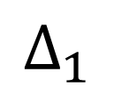
$$x_{2}$$
$$Δ_{2}$$
$$Δ_{1}$$
$$x_{1}$$

Slide 13



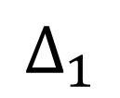
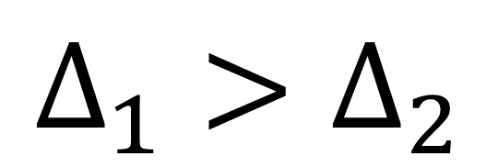

$$x_{2}$$
$$Δ_{1}>Δ_{2}$$
$$Δ_{2}$$
OPTIMAL BOUNDARY
$⇒$ GREATEST SEPARATION
$⇒$ WIDEST MARGIN
$$Δ_{1}$$
$$x_{1}$$

Slide 14
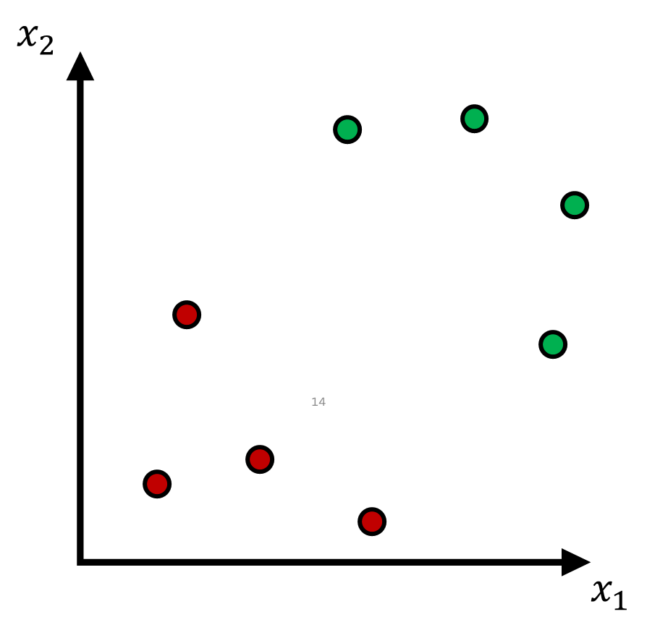
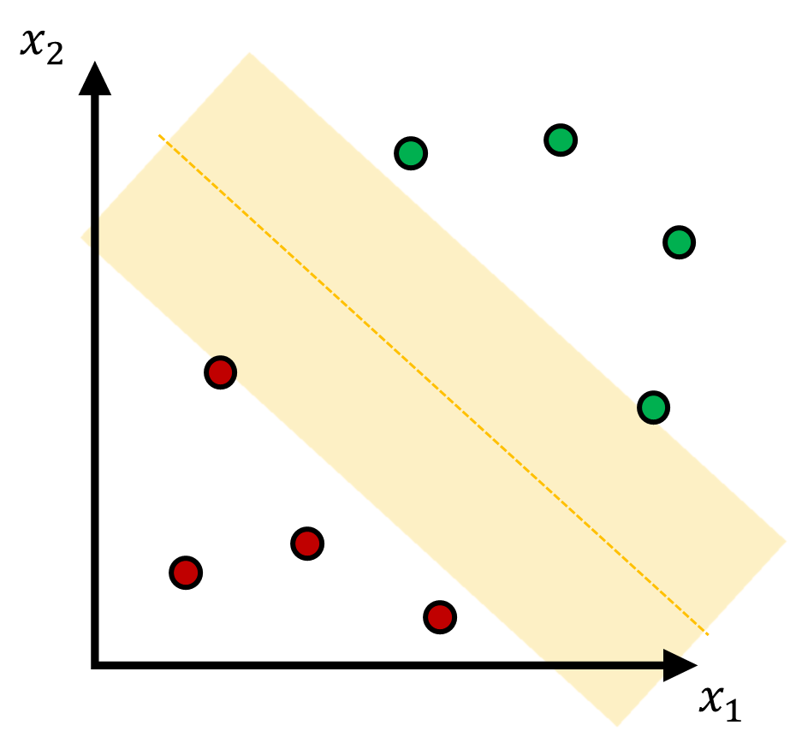
SUPPORT VECTOR MACHINE^{[1]} (SVM) SOLVES THIS
SVM
Notes:
ADD REFERENCE TO LITERATURE
Don’t abbreviate SVM

Slide 15
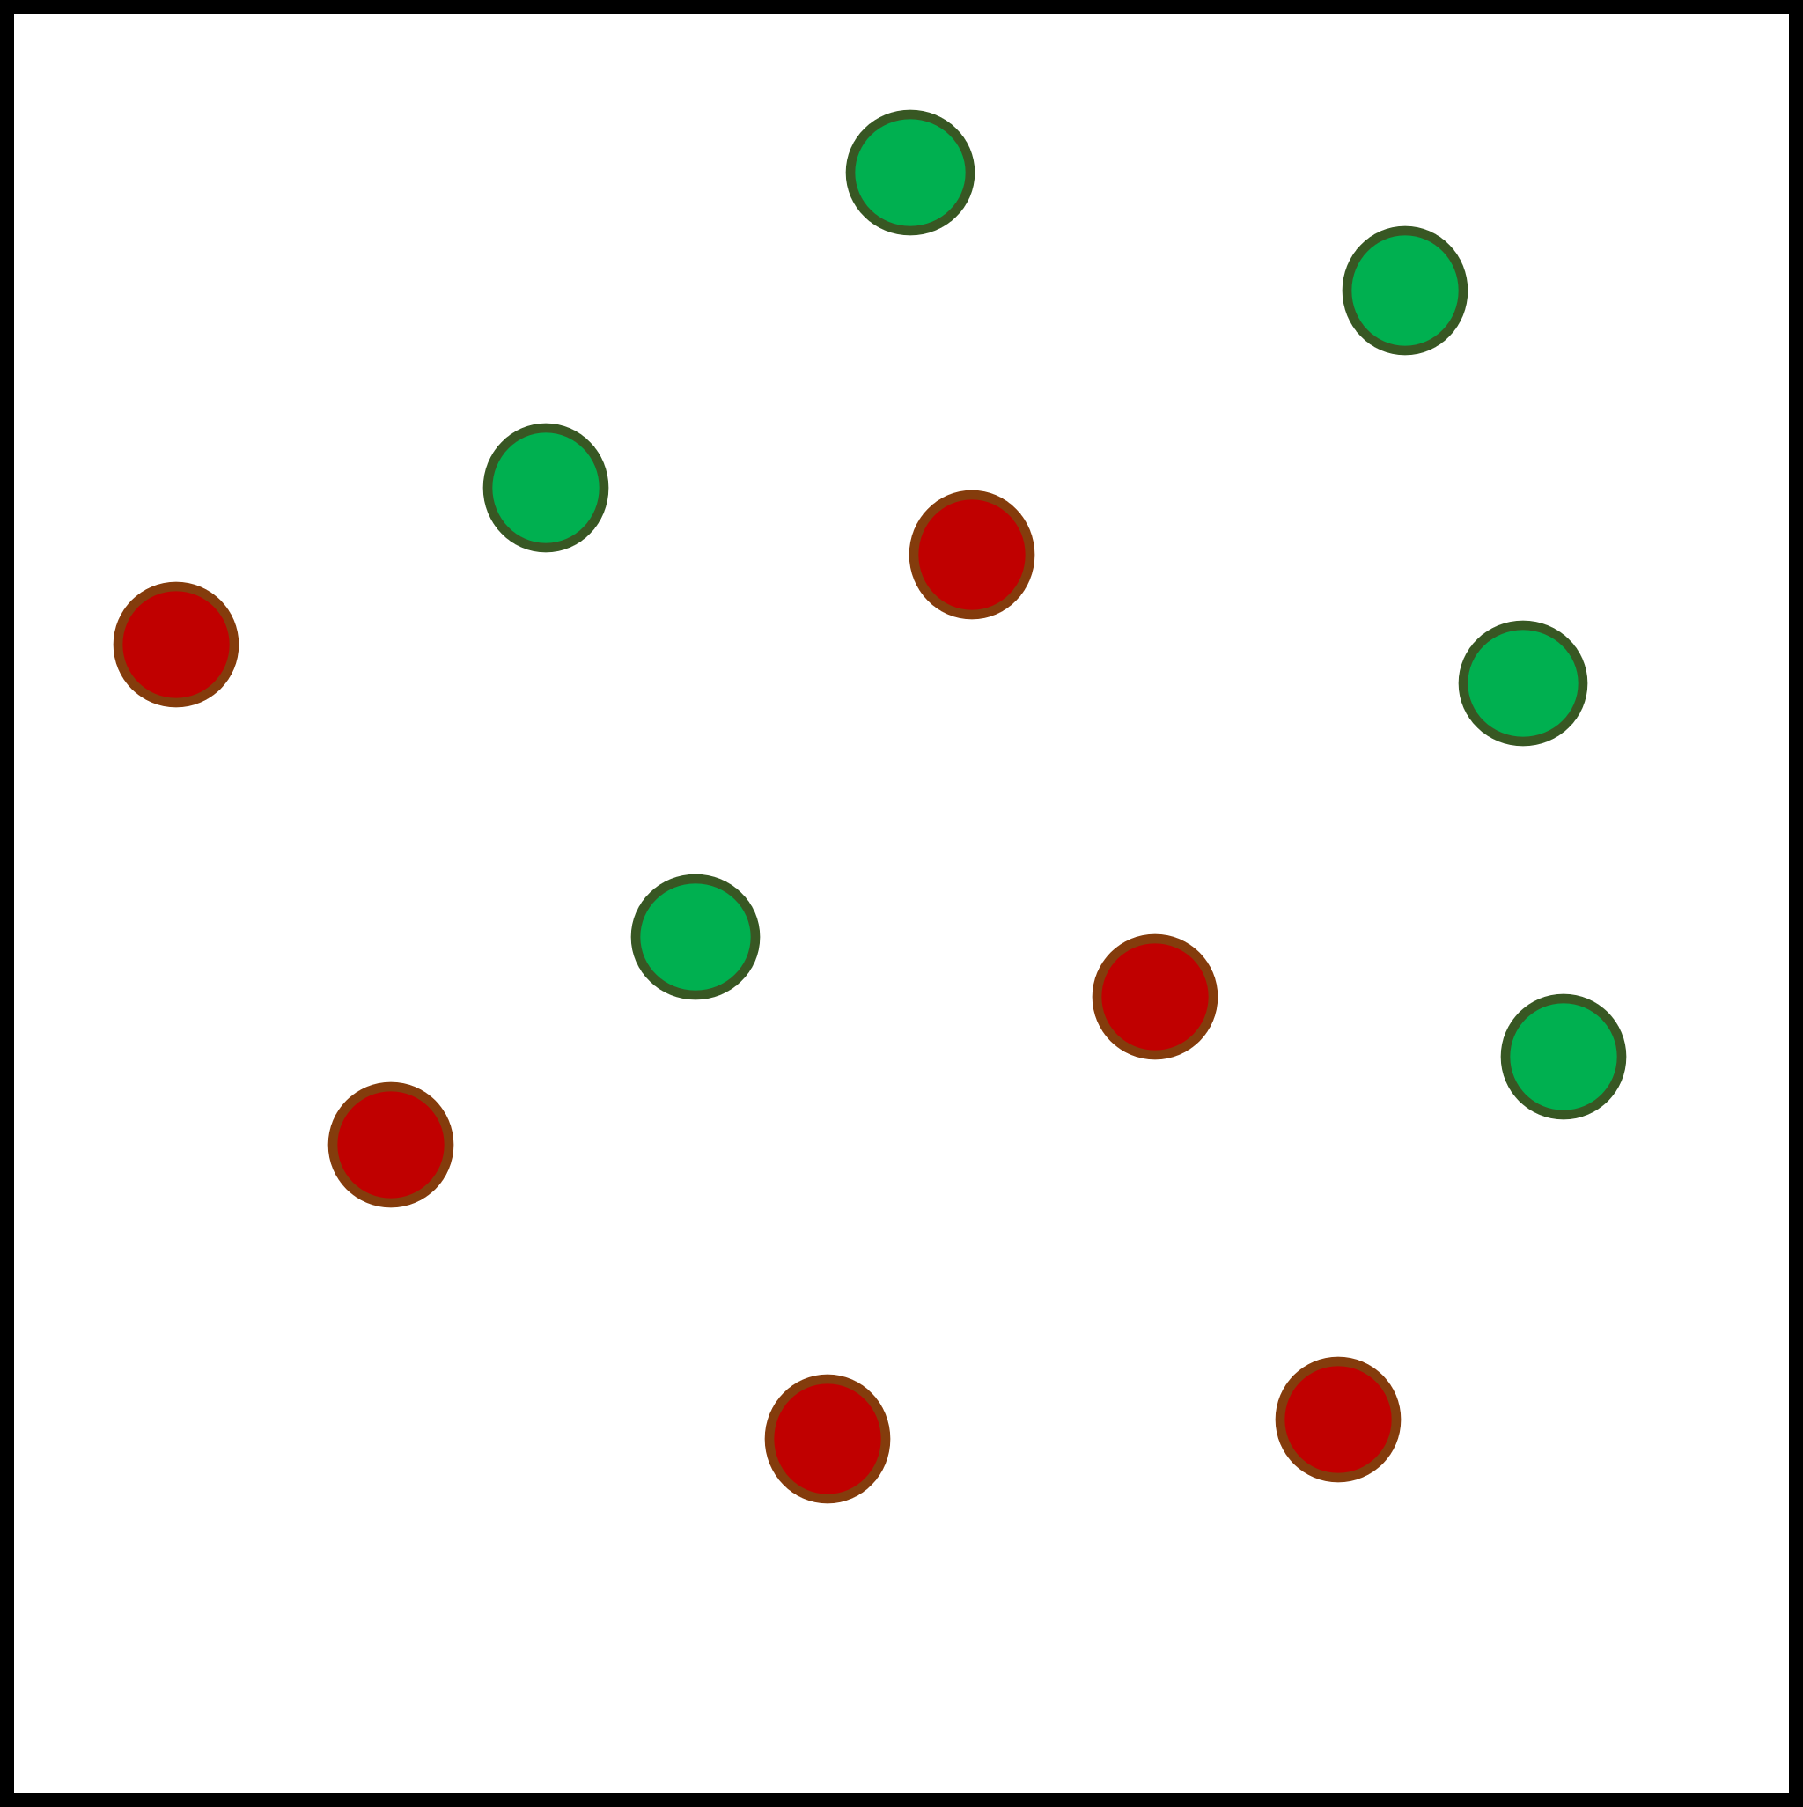
SUPPORT VECTOR MACHINE^{[1]} (SVM) SOLVES THIS
SVM

Slide 16
SO WHAT ABOUT NONLINEARLY SEPARABLE DATASETS?
Notes:
You can still separated nonlinearly separable datasets so long as your dataset becomes packaged with some specific phi

Slide 17
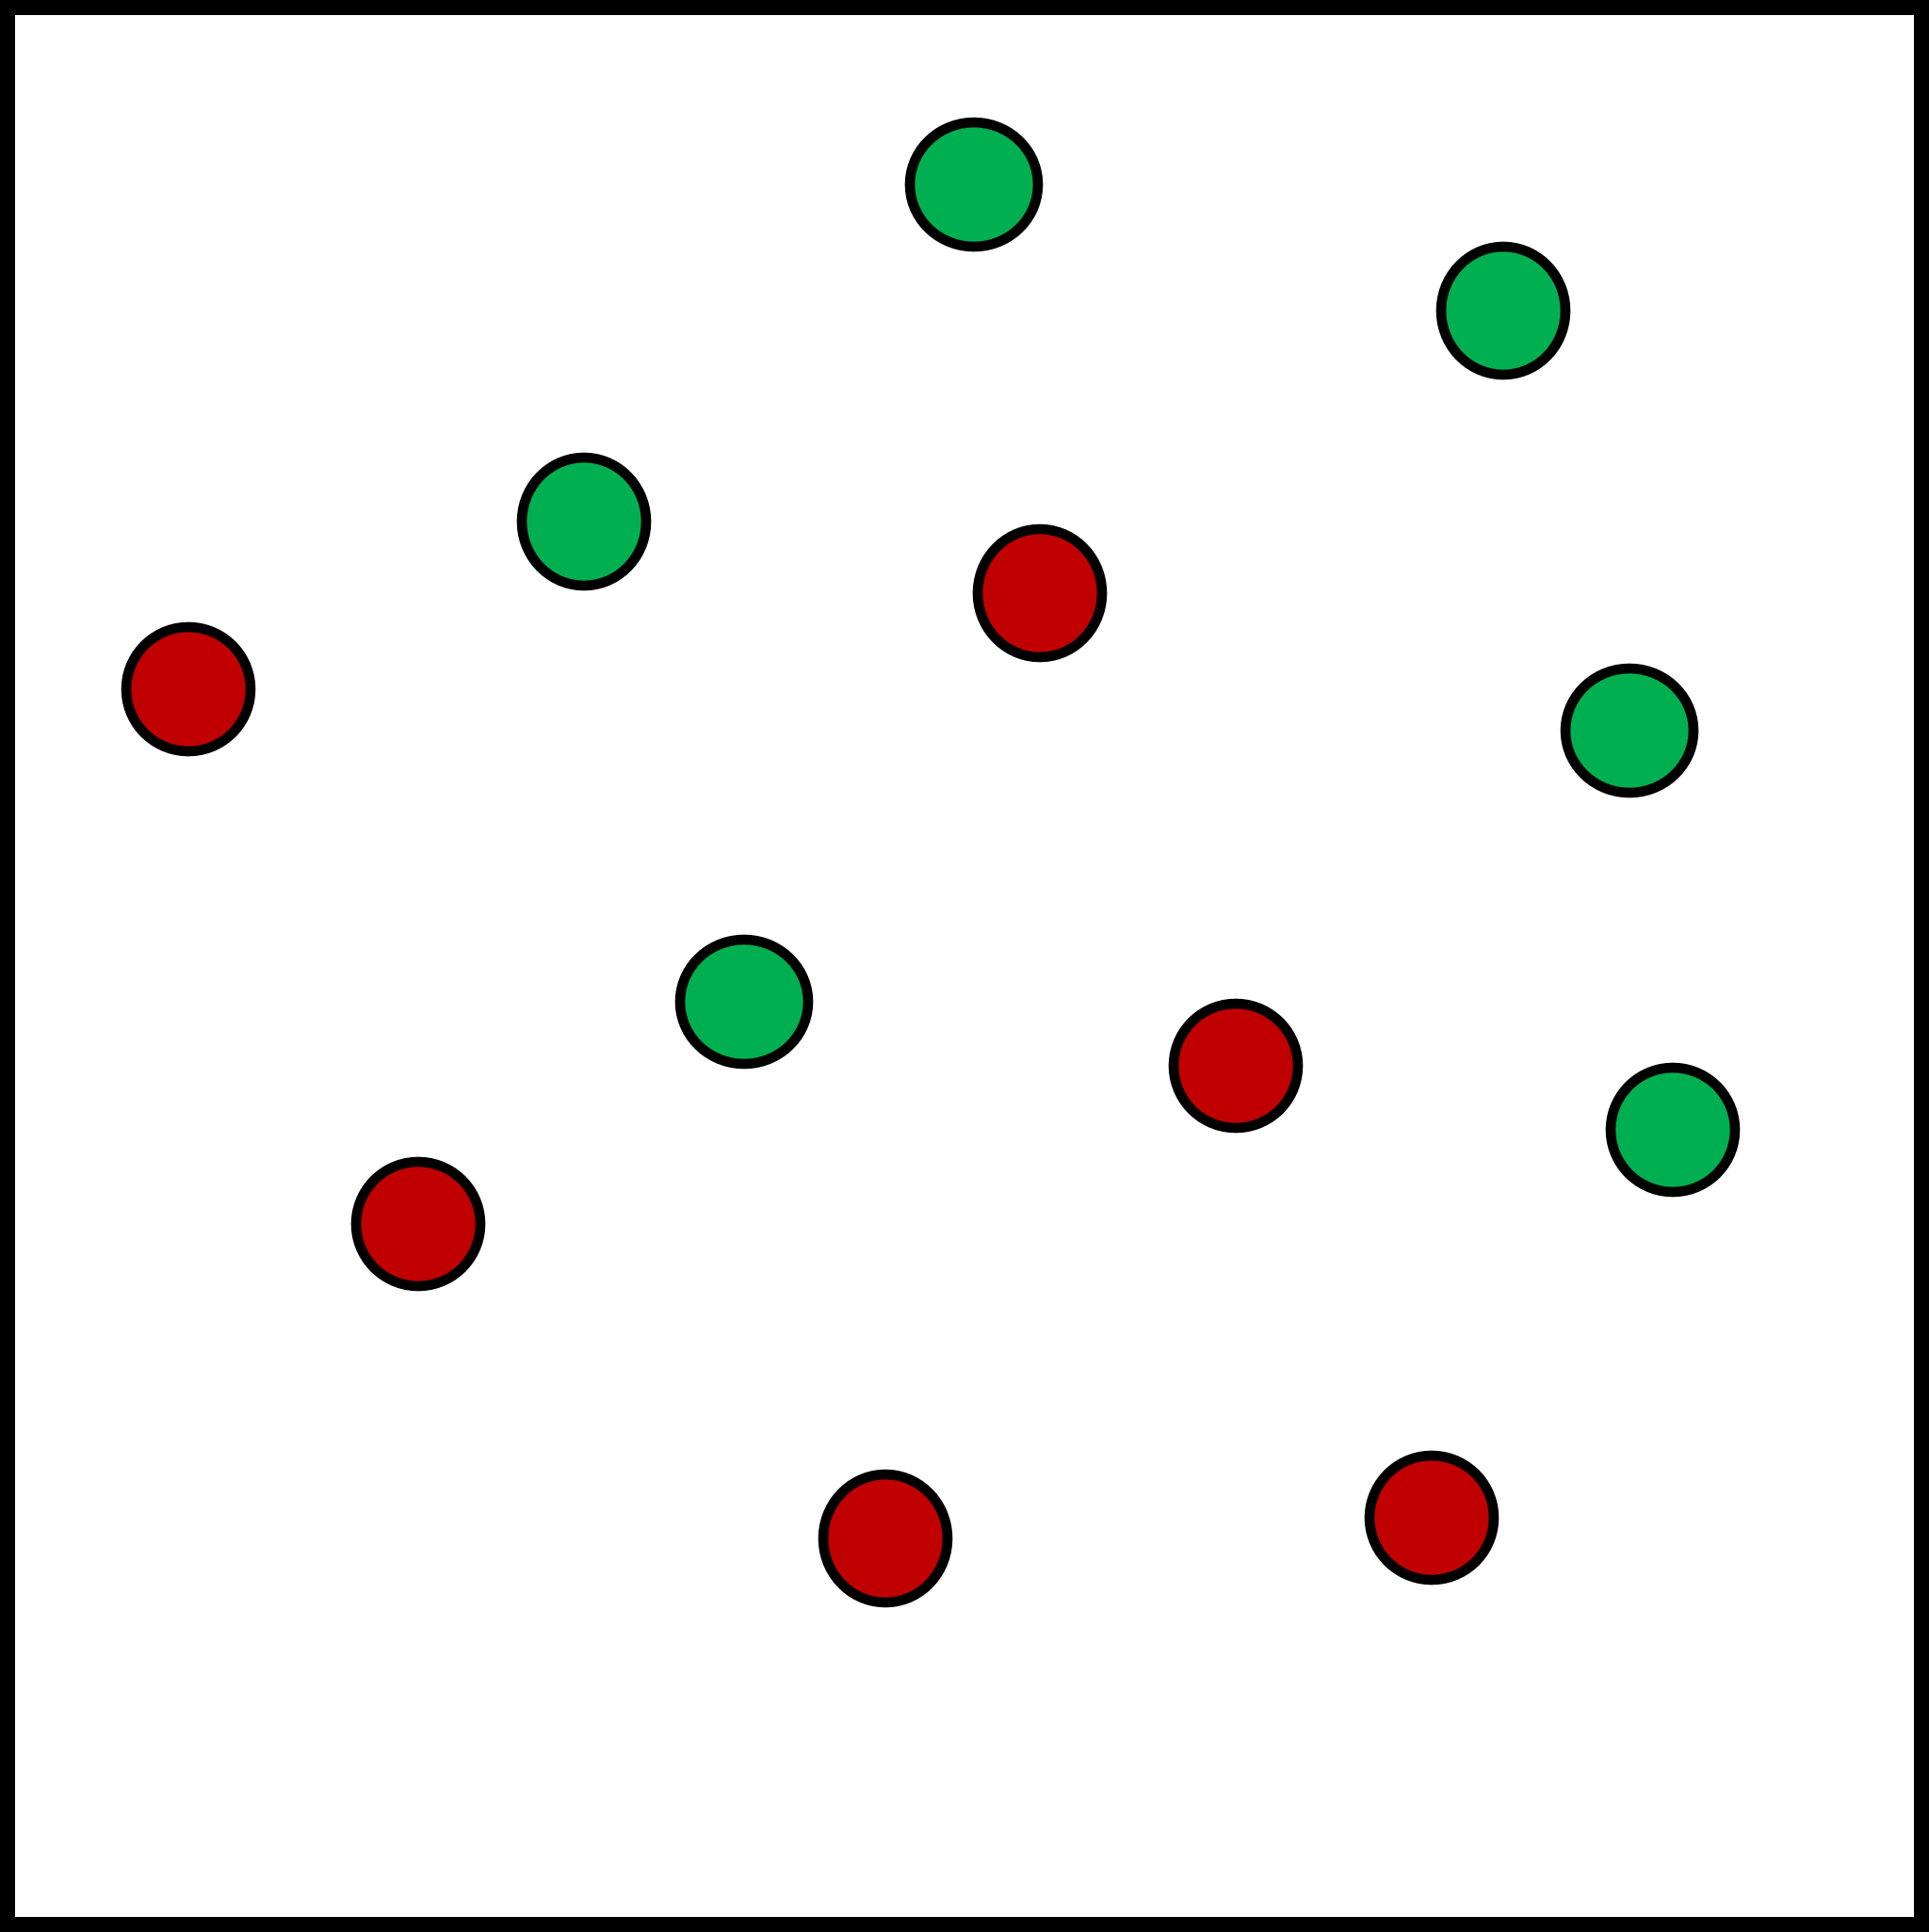

$$( , φ)$$

Slide 18


$$φ$$
Notes:
Explicity instance of varphi
Too cartoonish

Slide 19
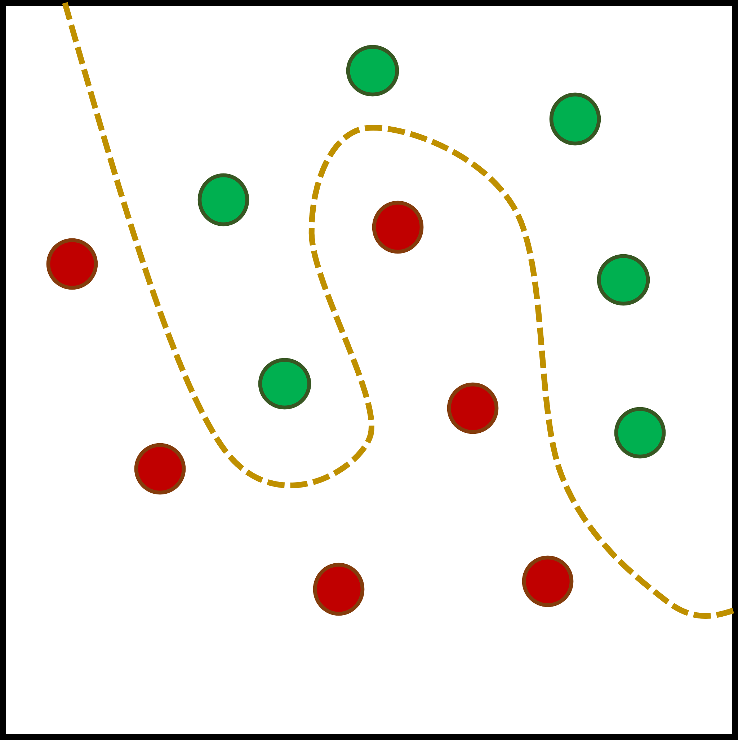

$$φ$$
SVM

Slide 20
WHERE DOES QUANTUM Enter THE PICTURE?

Slide 21
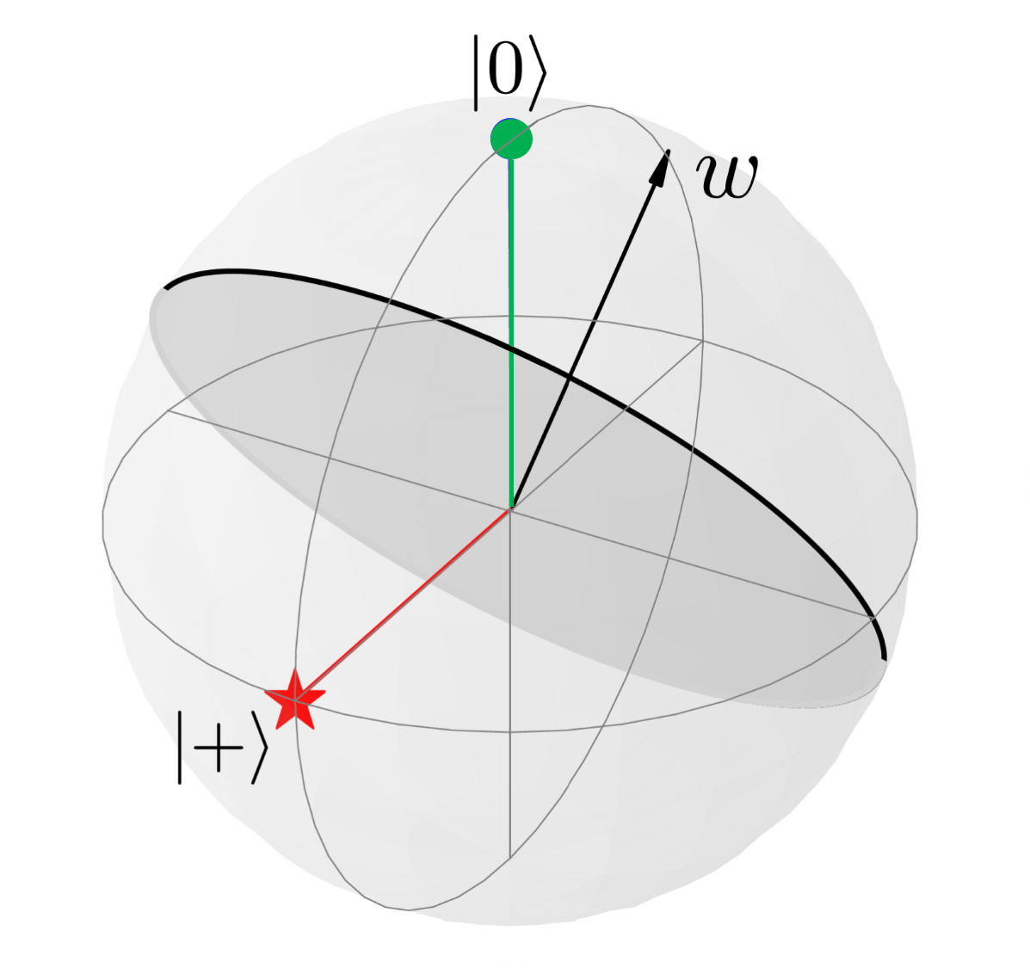

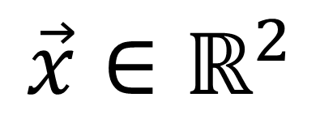
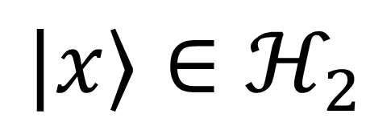
$$\vec{x}∈ℝ^{2}$$
$$|x⟩∈ℋ_{2}$$
$$φ$$
[2]
Notes:
Scales unfeasibly exponentially and large cases cannot be simulated on a classical computer (not this puny instance)
“Mathematically formulated as above (2D space). Point physicallt to each space and then outline matehamtical label
Quantum comptuers needed to map into large hilbert spaces

Slide 22
SIGNIFICANCE?

Slide 23

$$\vec{x}∈ℝ^{2}$$
$$|x⟩∈ℋ_{2}$$
$$φ$$
[3]

Slide 24

$$\vec{x}∈ℝ^{2}$$
$$|x⟩∈ℋ_{2}$$
$$φ$$
[3]
Notes:
NEW SLIDES indicating that for every dataset there’s a phi
A dataset that cannot be separated unless you map into a quantum feature space

Slide 25
2. DATASETS ONLY LINEARLY SEPARABLE WITH A QUANTUM COMPUTER

Slide 26

THE $DLP_{P}$ DATASET Based on the discrete logarithm
[3]

Slide 27
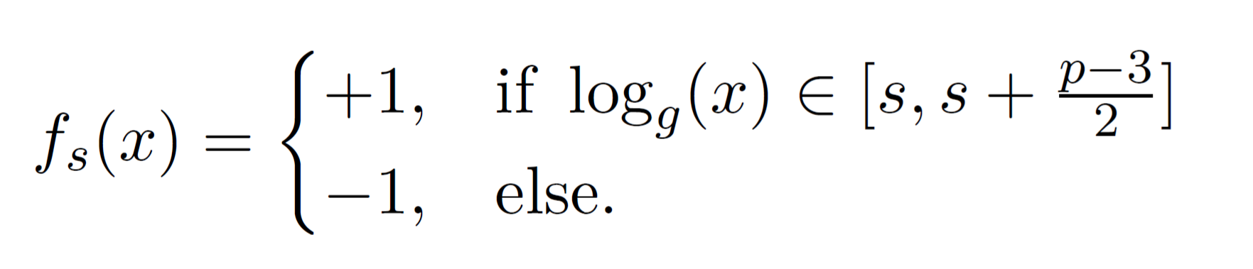
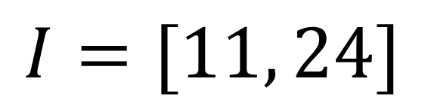
$$I=[11, 24]$$

Slide 28
$$I=[11, 24]$$

Slide 29
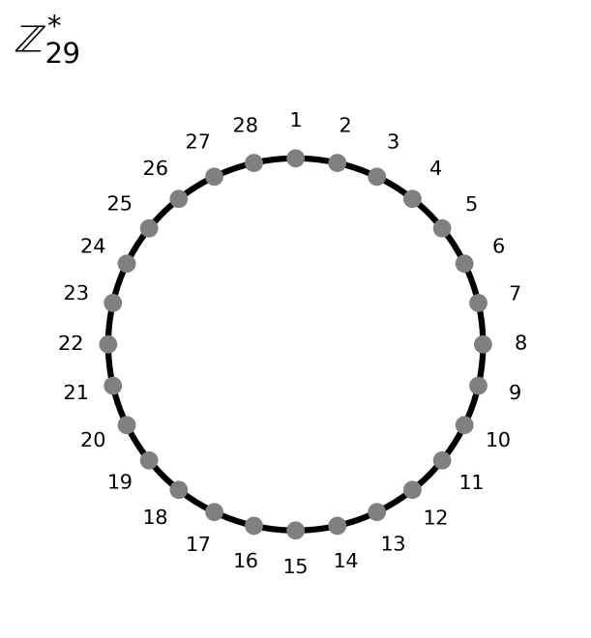
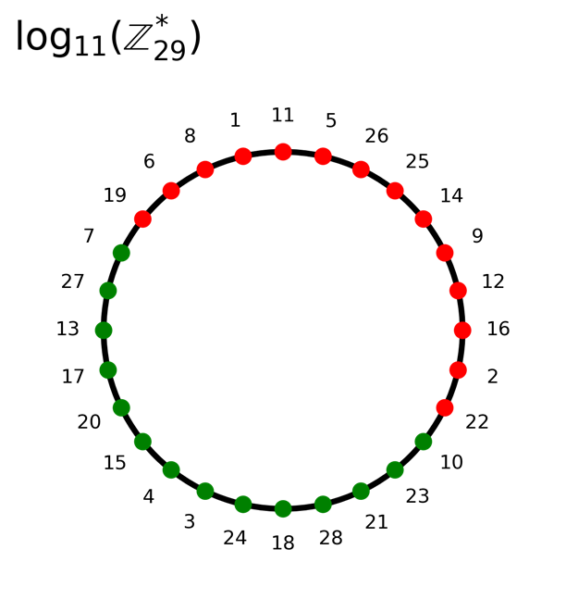
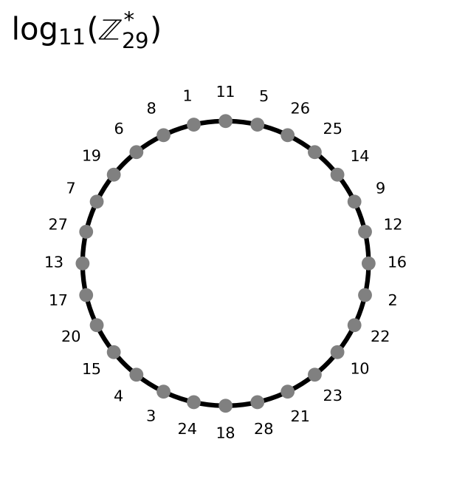
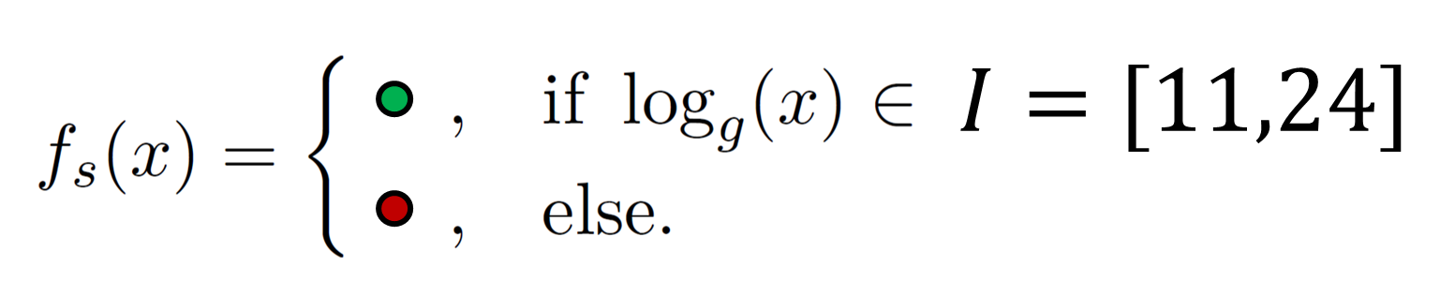
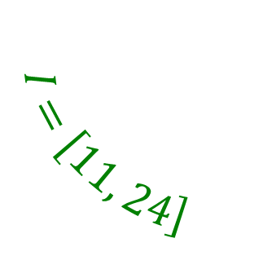
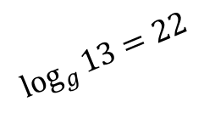
$$I=\left[11, 24\right]$$
$$\log_{g}{13=22}$$
Notes:
Small datasets trivial, but large ones nontrivial/unfeasible.
Include all elements of set but fade out those not in datasets

Slide 30
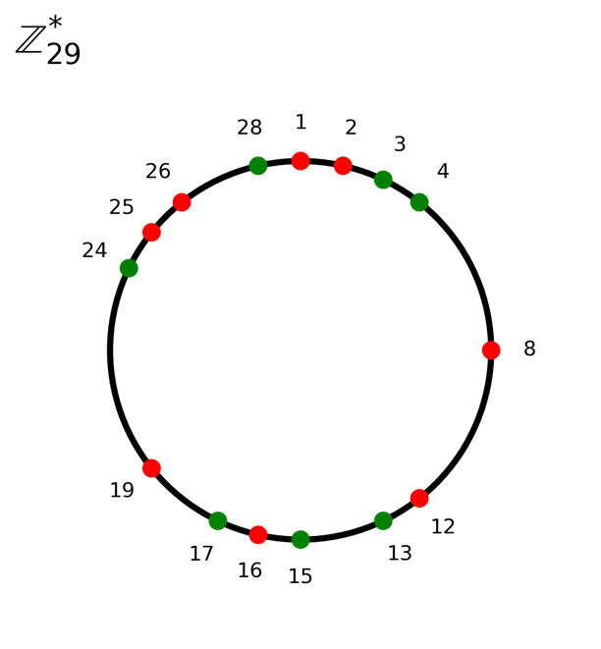
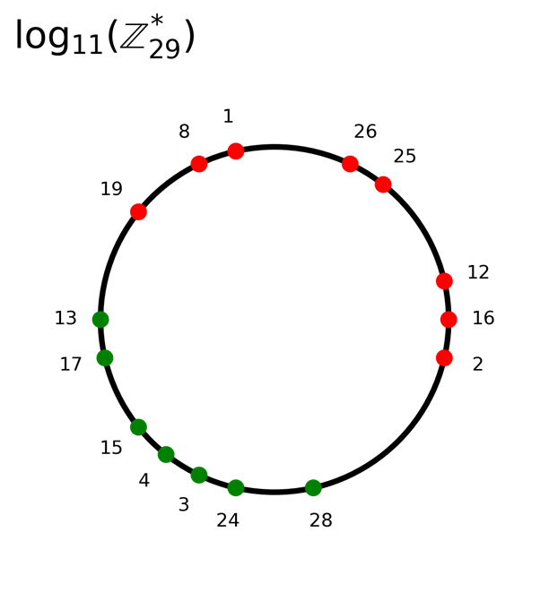
?
Notes:
Small datasets trivial, but large ones nontrivial/unfeasible.
22 is misleading
Clarify that while this whole time I’ve been using a classical computer anyway, it’s for larger datasets that the task becomes exponentially more difficult.

Slide 31




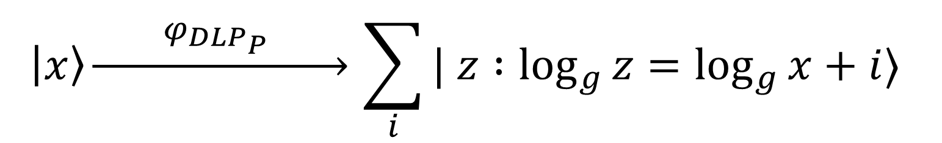
$$I$$
$$I$$
$$\left|x\right\rangle \underset{→}{ φ_{DLP_{P}} } \sum_{i}{| z :\log_{g}{z}=\log_{g}{x}+i⟩}$$
$$:$$

Slide 32
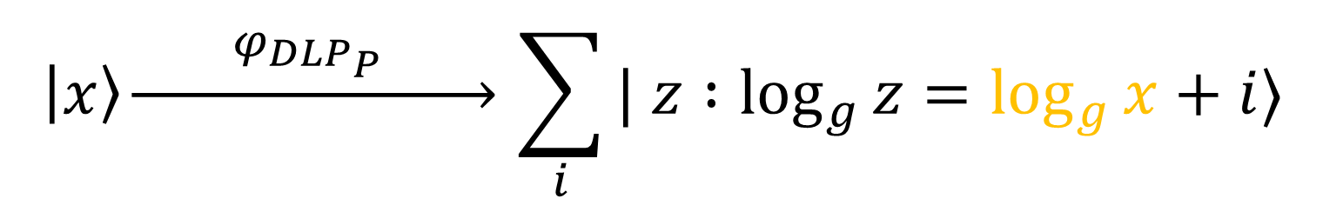
$$I$$
$$I$$
$$\left|x\right\rangle \underset{→}{ φ_{DLP_{P}} } \sum_{i}{| z :\log_{g}{z}=\log_{g}{x}+i⟩}$$
$$:$$
Notes:
Now we’re going to isually illustrate this mapping IN A QUANTUM COMPUTEr (in terms of arcs)

Slide 33
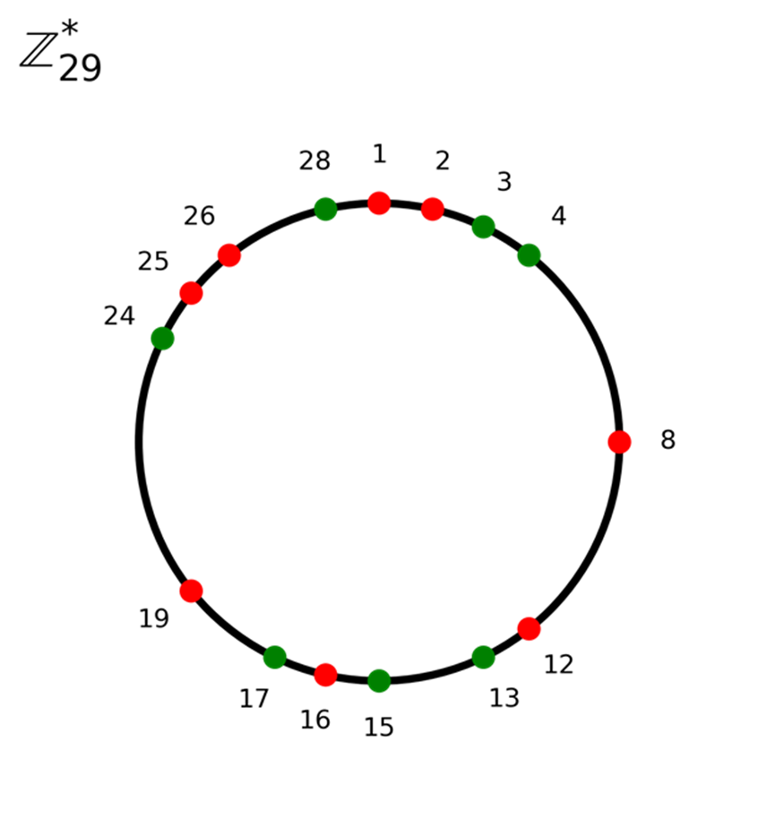

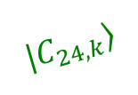


$$\left|φ_{11}\right\rangle$$
$$|C_{8,k}⟩$$
$$|C_{24,k}⟩$$
Notes:
Calculating inner products is JUST AS important as the mapping to arcs from data points
Link back to the goal of classification

Slide 34


$$\left|φ_{11}\right\rangle$$
$$\log_{g}{21=10}$$
$$\left|C_{21}\right\rangle$$
Notes:
Calculating inner products is JUST AS important as the mapping to arcs from data points
Link back to the goal of classification

Slide 35

$$\left|φ_{11}\right\rangle$$
$$\log_{g}{21=10}$$
$$\left|C_{21}\right\rangle$$
Notes:
Calculating inner products is JUST AS important as the mapping to arcs from data points
Link back to the goal of classification

Slide 36
1. Building a framework

Slide 37
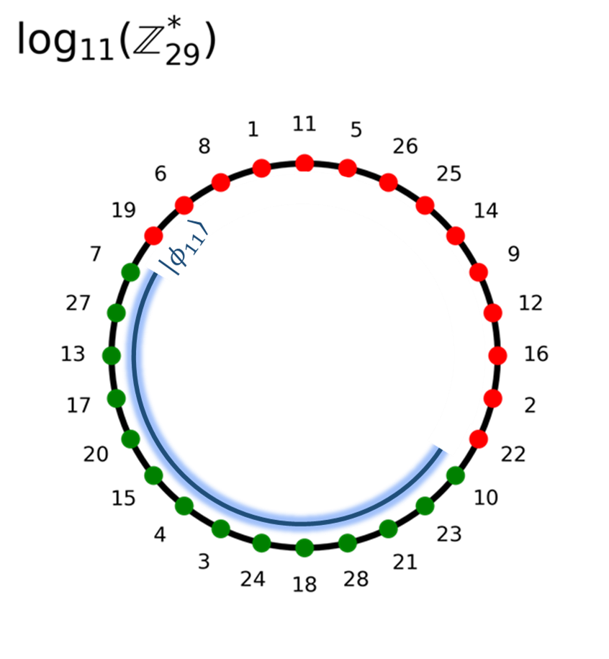



Equivalence to Abelian Hidden Subgroup Problem (AHSP)
1.
The problem was classically intractable
Belongs to Statistical Zero Knowledge
2.
There was a Hilbert space in which the problem became linearly separable
Map is only as difficult as an Abelian Hidden Subgroup Problem (AHSP)
3.
$$φ$$
The map $φ$ into the Hilbert space was efficiently implementable with a quantum computer
WHAT MADE THE $DLP_{P}$ WORK?
Notes:
One of the first outcomes was that each corresponds to property

Slide 38
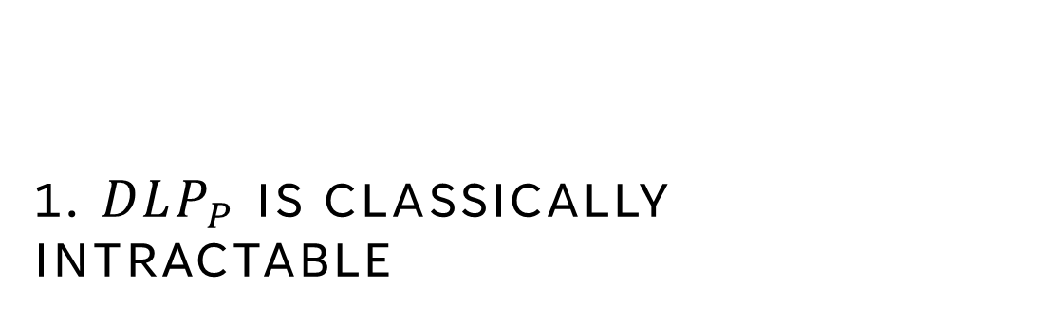
1. $DLP_{P}$ IS CLASSICALLY INTRACTABLE

Slide 39
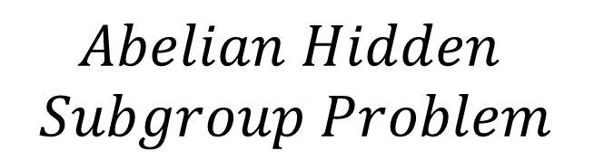

$$Abelian Hidden$$
$$Subgroup Problem$$
HARD WITH CLASSICAL
EASY WITH QUANTUM
$$DLP_{P}$$
[4]

Slide 40

2. $DLP_{P}$ IS LINEARLY SEPARABLE IN SOME HILBERT SPACE

Slide 41
$$Abelian Hidden$$
$$Subgroup Problem$$
$$DLP_{P}$$

Slide 42




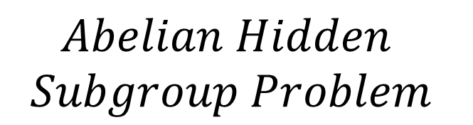

$$φ_{DLP_{P}}$$
$$⇒$$
$$Abelian Hidden$$
$$Subgroup Problem$$
$$Quantum$$
$$Sampling$$
$$Statistical Zero$$
$$Knowledge$$
$$DLP_{P}$$
[5]

Slide 43

3. Quantum computers can efficiently MAP data points into that HILBERT SPACE
$$φ$$

Slide 44
$$φ_{DLP_{P}}$$
$$⇒$$
$$Abelian Hidden$$
$$Subgroup Problem$$
$$Quantum$$
$$Sampling$$
$$Statistical Zero$$
$$Knowledge$$
$$DLP_{P}$$

Slide 45


$$:$$
$$QSampling Instance$$
$$Abelian Hidden$$
$$Subgroup Problem$$
$$Statistical Zero$$
$$Knowledge$$
$$DLP_{P}$$

Slide 46



$$:$$
$$QSampling Instance$$
$$:$$
$$Abelian Hidden$$
$$Subgroup Problem$$
$$Statistical Zero Knowledge Instance$$
$$DLP_{P}$$

Slide 47
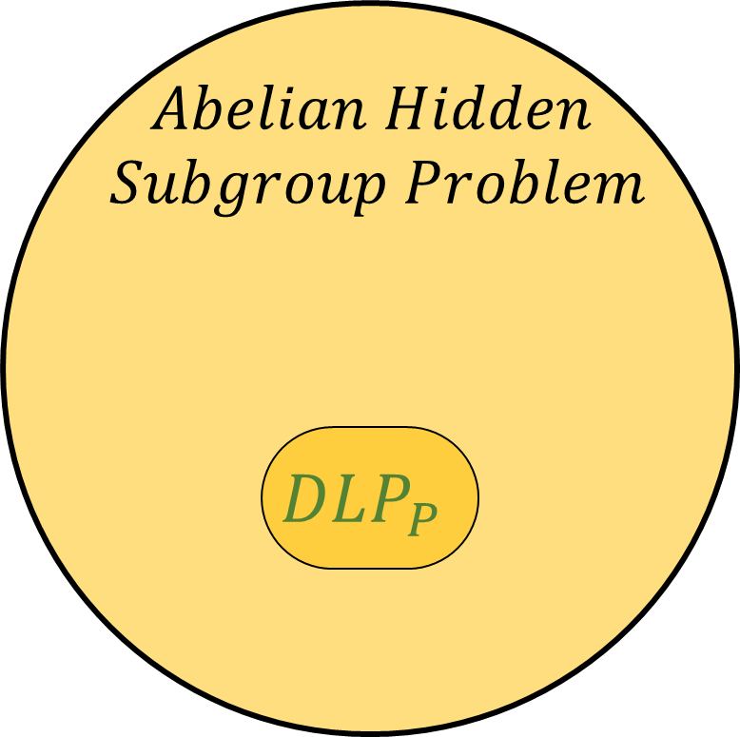

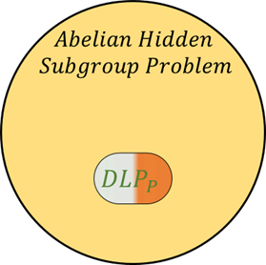

DIFFICULT FOR CLASSICAL COMPUTERS
LINEARLY SEPARABLE IN SOME
QUANTUM HILBERT SPACE
$$DLP_{P}$$
QUANTUM COMPUTERS CAN EFFICIENTLY IMPLEMENT MAP INTO THAT HILBERT SPACE

Slide 48
2. USING FRAMEWORK TO GENERATE TWO NEW DATASETS

Slide 49

Dataset 1: Quadratic residues $QR_{P}$

Slide 50
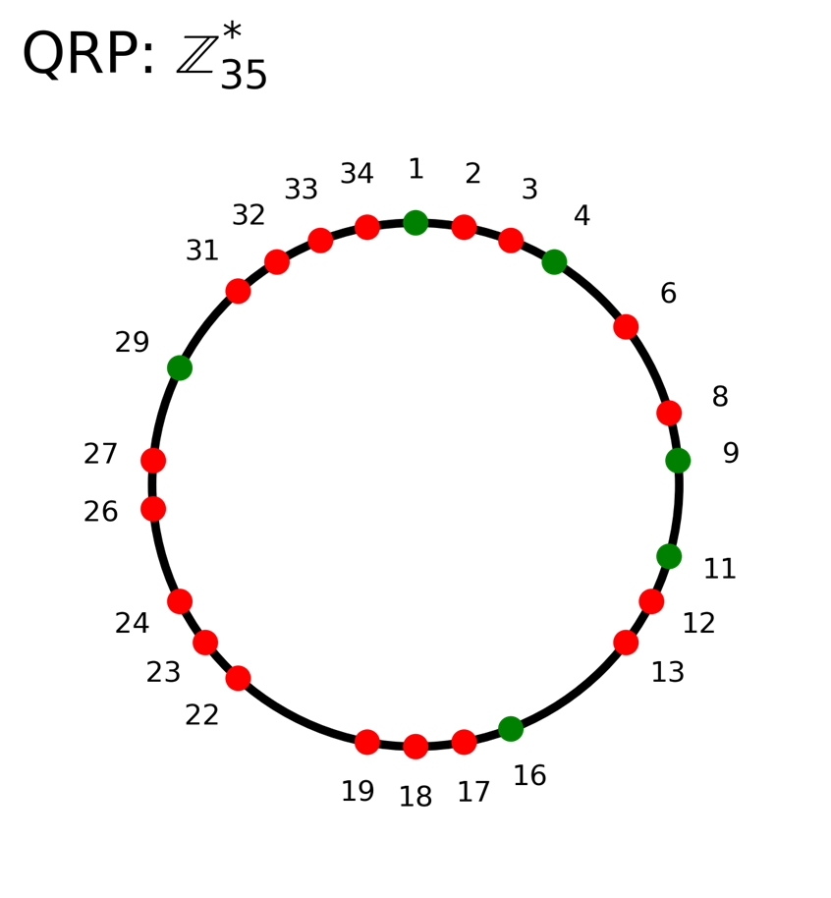
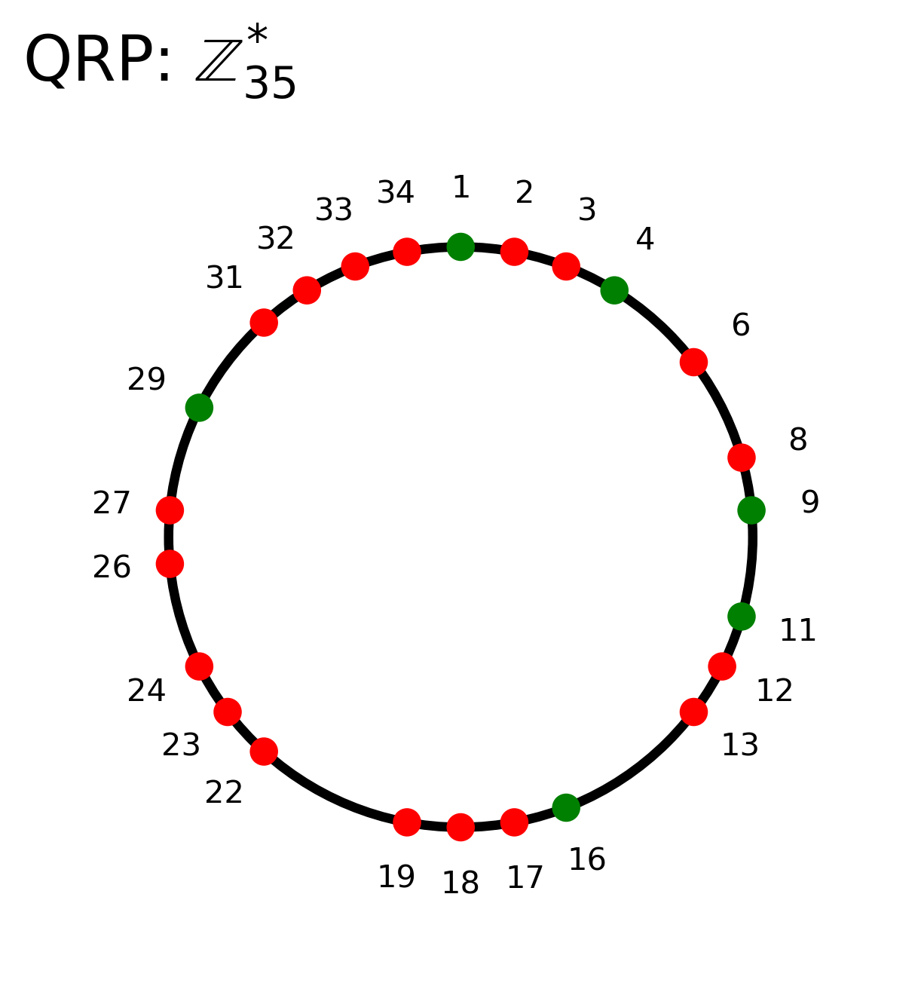





$$φ_{QR_{P}}$$
$$\left|C_{1}\right\rangle$$
$$|C_{33}⟩$$
$$|C_{4}⟩$$
$$φ_{QR_{P}}$$

Slide 51




$$:$$
$$QSampling Instance$$
$$:$$
$$Abelian Hidden$$
$$Subgroup Problem$$
$$Statistical Zero Knowledge Instance$$
$$QR_{P}$$
$$DLP_{P}$$
$φ_{QR_{P}}$with Quadratic Speedup!

Slide 52

Dataset 2: ORDER FINDING $OF_{P}^{1}$

Slide 53
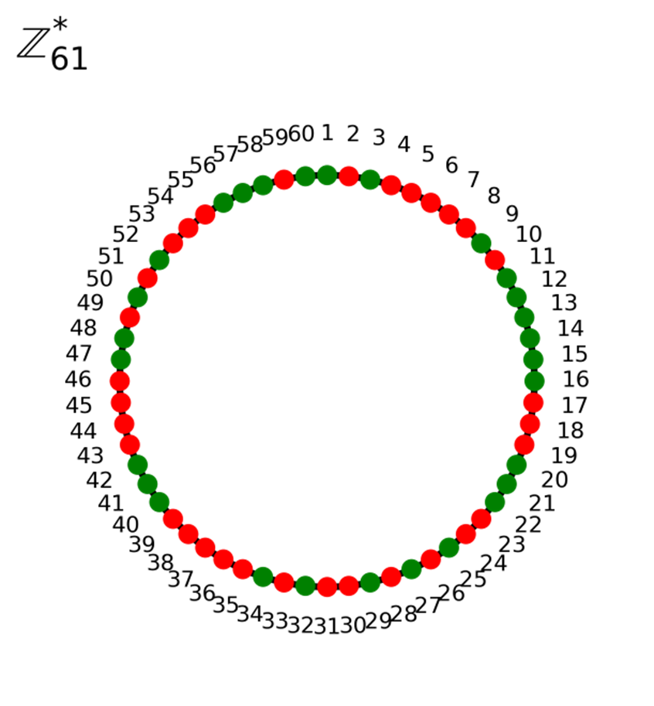
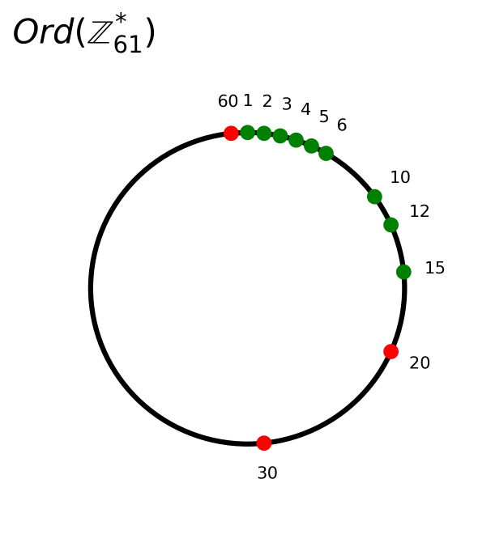





$$φ_{OF_{P}^{1}}$$
$$|O_{60,k}⟩$$
$$|O_{24,k}⟩$$
$$φ_{OF_{P}^{1}}$$
$$\left|O_{1,\log{19}} \right\rangle$$

Slide 54

$$:$$
$$QSampling Instance$$
$$:$$
$$Abelian Hidden$$
$$Subgroup Problem$$
$$Statistical Zero Knowledge Instance$$
$$QR_{P}$$
$$DLP_{P}$$
$$OF_{P}^{1}$$

Slide 55
3. COMBINING DATASETS To GET Efficiently Implementable MAP

Slide 56

Dataset 3: ORDER FINDING 2.0 $OF_{P}^{2}$

Slide 57


$$:$$
$$QSampling Instance$$
$$:$$
$$Abelian Hidden$$
$$Subgroup Problem$$
$$Statistical Zero Knowledge Instance$$
$$QR_{P}$$
$$DLP_{P}$$
$$OF_{P}^{1}$$
$$OF_{P}^{2}$$

Slide 58
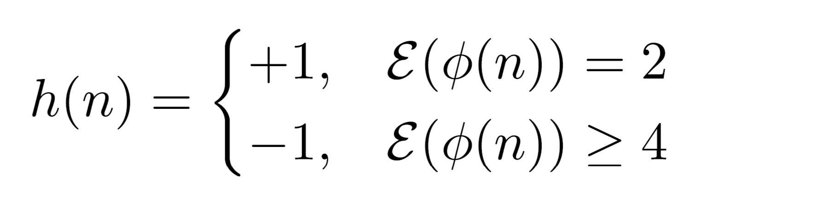

Slide 59

SIMULATING QUANTUM VS CLASSICAL ON $OF_{P}^{2}$

Slide 60
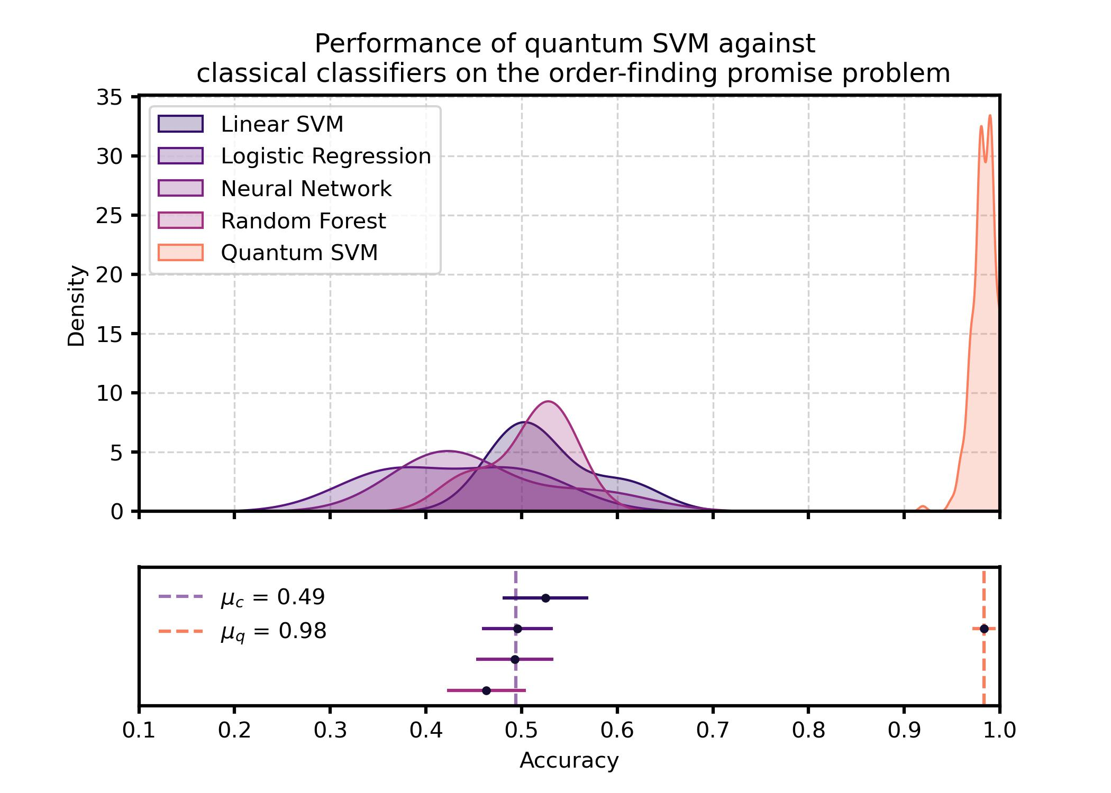
Notes:
Find a way to shorten our own contributions (at the 5 minute mark)
5 minute contributions
Clearer about why third dataset is efficiently implementation
Communicate clearly what your original work is (motivated by the liu results)
Number the results (1. Establish framework, 2. Two datasets, 3. The third implementable
Footnotes
Beef the venn diagrams up with references. Explain AHSP. Acronyms, label yes
Shrink down the figures, key below figure
STATE YOUR FINDINGS EXPLICITLY

Slide 61

Outcomes
Obtained general framework for constructing datasets learnable by quantum computers but not classical computers.
Constructed two null datasets, $OF_{P}^{1}$ and $QR_{P}$ that do not conform to framework.
Nevertheless, designed algorithm featuring quadratic speedup
Constructed a third dataset, $OF_{P}^{2},$satisfying the framework above. This marks the only other classically intractable learning problem learnable by quantum computers, second to the $DLP_{P}$
Takeaway: Use our framework to find classically intractable datasets learnable only by a quantum computer
Notes:
Number the result

Slide 62
Thank you

Slide 63
References
Mohri, M., Rostamizadeh, A., & Talwalkar, A. (2018). Foundations of machine learning. MIT press.
Havlíček, V., Córcoles, A. D., Temme, K., Harrow, A. W., Kandala, A., Chow, J. M., & Gambetta, J. M. (2019). Supervised learning with quantum-enhanced feature spaces. Nature, 567(7747), 209-212.
Liu, Y., Arunachalam, S., & Temme, K. (2021). A rigorous and robust quantum speed-up in supervised machine learning. Nature Physics, 17(9), 1013-1017.
Nielsen, M. A., & Chuang, I. (2002). Quantum computation and quantum information.
Aharonov, D., & Ta-Shma, A. (2003, June). Adiabatic quantum state generation and statistical zero knowledge. In Proceedings of the thirty-fifth annual ACM symposium on Theory of computing (pp. 20-29).

