Slide 1

Quantum Boltzmann Machines: An Investigation Saleh Naghdi Supervised by Charles Hill and Thomas Quella The University of Melbourne
Vacation Research Scholarships are funded jointly by
Notes:
QBMs a

Slide 2

Machine Learning in a Word:
Approximating Probability Distributions
Notes:
20 seconds

Slide 3
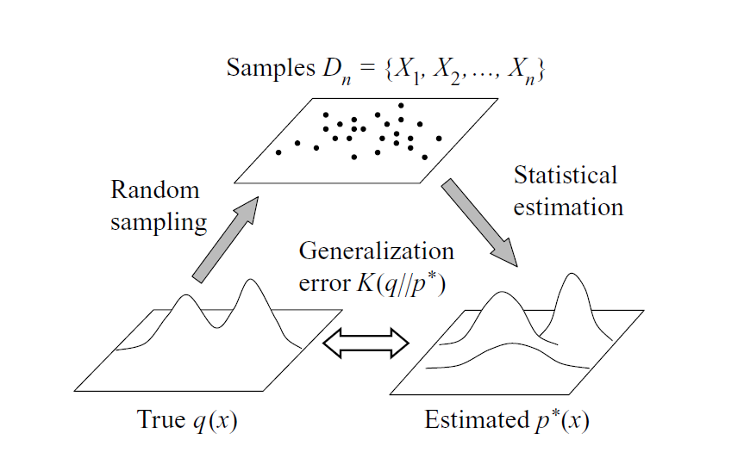
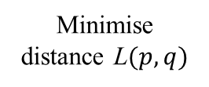

Mathematically…
Parameter tuning
Minimise distance L$(p,q)$
To find $θ_{best}$ such that $p\left(x | θ_{best}\right)≈q\left(x\right)$
(Watanabe, 2009)
Notes:
48 seconds

Slide 4
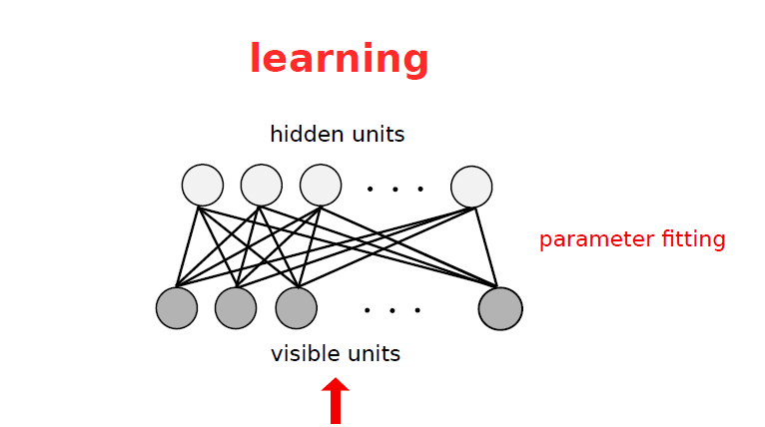
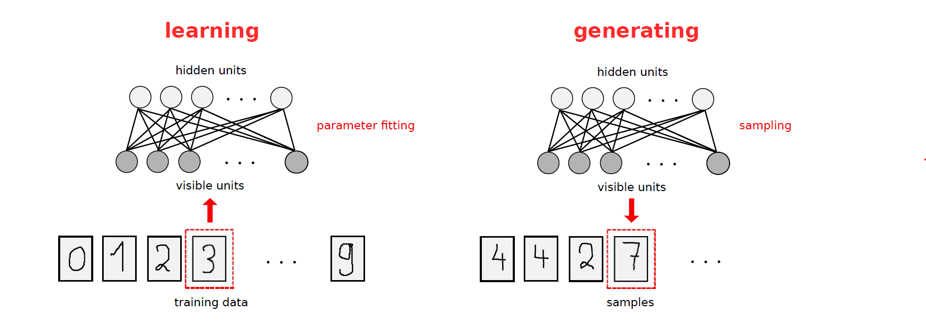
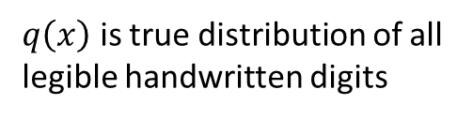
Sample
$q\left(x\right)$ is true distribution of all
legible handwritten digits
(Fischer and Igel, 2014)
Notes:
1:30

Slide 5
The Classical Boltzmann Machine
Notes:
Build from ground up

Slide 6
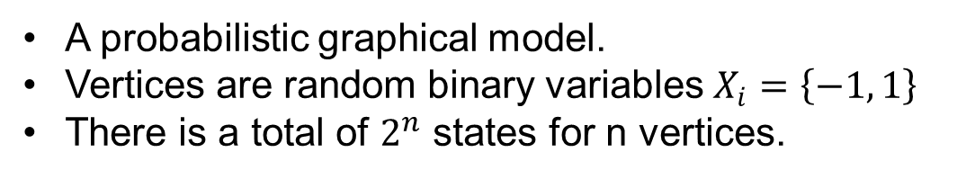
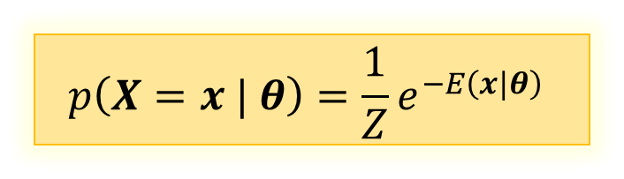


Markov Random Fields (MRFs)
A probabilistic graphical model.
Vertices are random binary variables $X_{i}=\left\{−1, 1\right\}$
There is a total of $2^{n}$ states for n vertices.
States follow Gibbs distribution:
Where:
$Z$is normalization constant
$E\left(x, θ\right)$ is an energy function
$θ$ are model parameters
$$p\left(X=x | θ\right)=\frac{1}{Z}e^{−E\left(x|θ\right)}$$
-1
1
-1
1
1
-1
-1
$$x=\{1,−1,−1,−1,1,1,−1\}$$
Notes:
Great! Have framework that has expression for p() – but we still need an energy function that gives energy of states
3

Slide 7
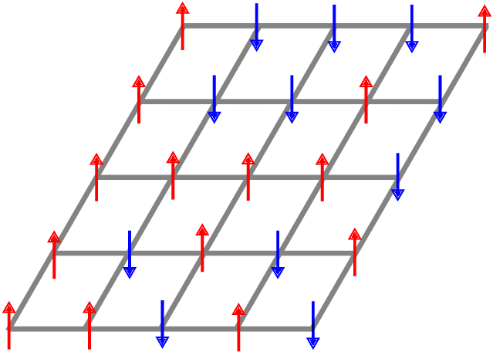





The Ising Model: One Energy Function
Describes energy of spin (dipolar) configurations of a graph of dipoles in a magnetic field:
$$E\left(x |b, w\right)=−\sum{b_{i}x_{i} −\sum{\sum{w_{ij}x_{i}x_{j}}}}$$
$$j$$
$$−1$$
$$b_{i}$$
$$i$$
$$+1$$
$$w_{ij}$$
Notes:
4

Slide 8
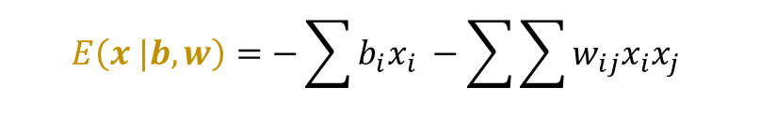
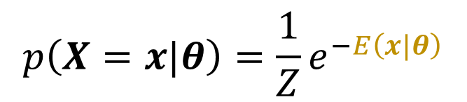
MRF
+
Ising Model
$$p\left(X=x|θ\right)=\frac{1}{Z}e^{−E\left(x|θ\right)}$$
$$E\left(x |b, w\right)=−\sum{b_{i}x_{i} −\sum{\sum{w_{ij}x_{i}x_{j}}}}$$
=
Classical Boltzmann Machine
Notes:
4:20

Slide 9
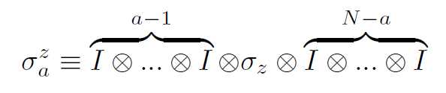
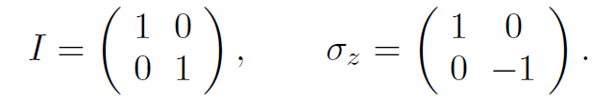
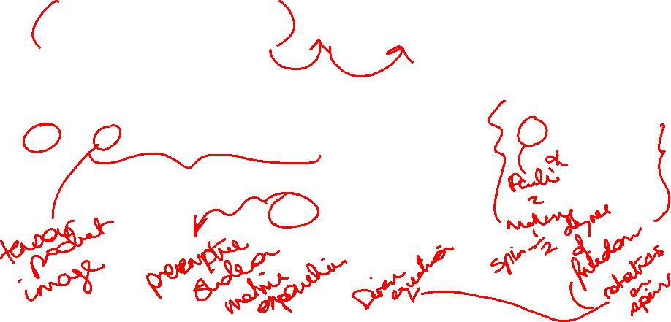
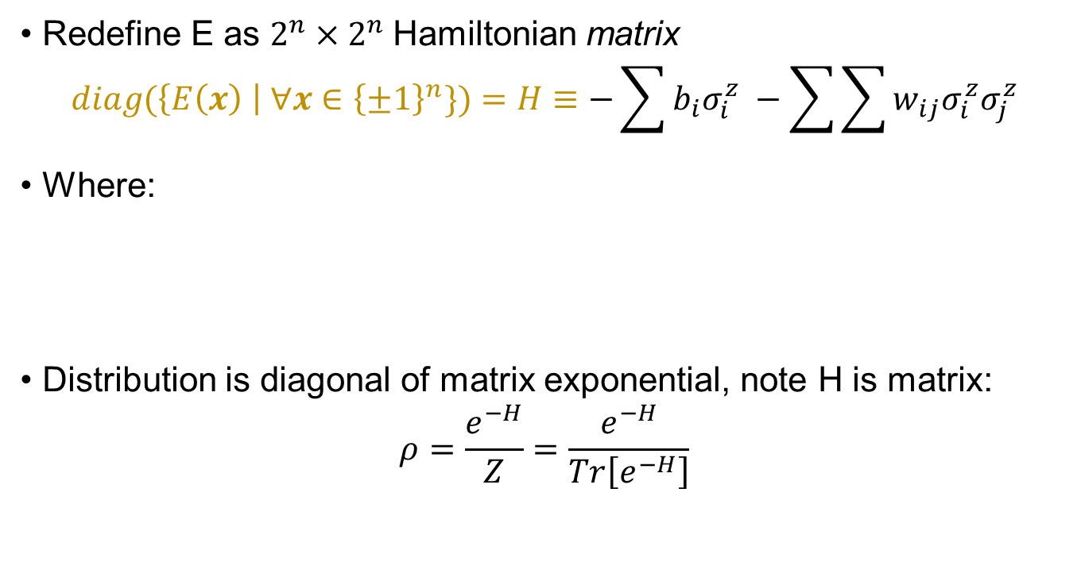
Quantum Boltzmann Machines (QBMs)
Redefine E as $2^{n}×2^{n}$Hamiltonian matrix
$$diag(\left\{E\left(x\right) \right| ∀x∈{\left\{±1\right\}}^{n}\})=H≡−\sum{b_{i}σ_{i}^{z} −\sum{\sum{w_{ij}σ_{i}^{z}σ_{j}^{z}}}}$$
Where:
Distribution is diagonal of matrix exponential, note H is matrix:
$$ρ=\frac{e^{−H}}{Z}=\frac{e^{−H}}{Tr\left[e^{−H}\right]}$$
Notes:
5:20

Slide 10
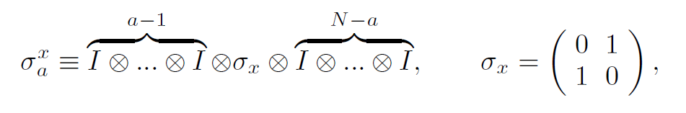






What’s quantum about the QBM?
Unlocked new model parameter: transverse field $Γ_{i}$
$$H≡−\sum{Γ_{i}σ_{i}^{x} }−\sum{b_{i}σ_{i}^{z} −\sum{\sum{w_{ij}σ_{i}^{z}σ_{j}^{z}}}}$$
Where:
$$j$$
$$−1$$
$$b_{i}$$
$$i$$
$$+1$$
$$w_{ij}$$
$$Γ_{i}$$
(Amin et al., 2016)
Notes:
6

Slide 11

Effect of Model Parameters on Distribution

Slide 12
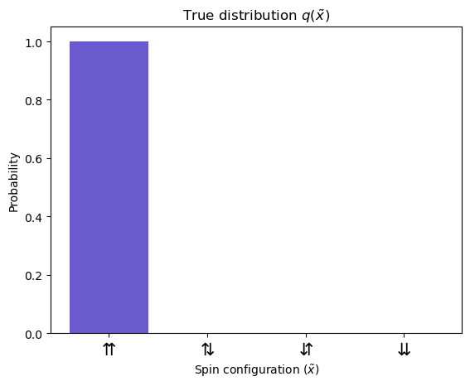
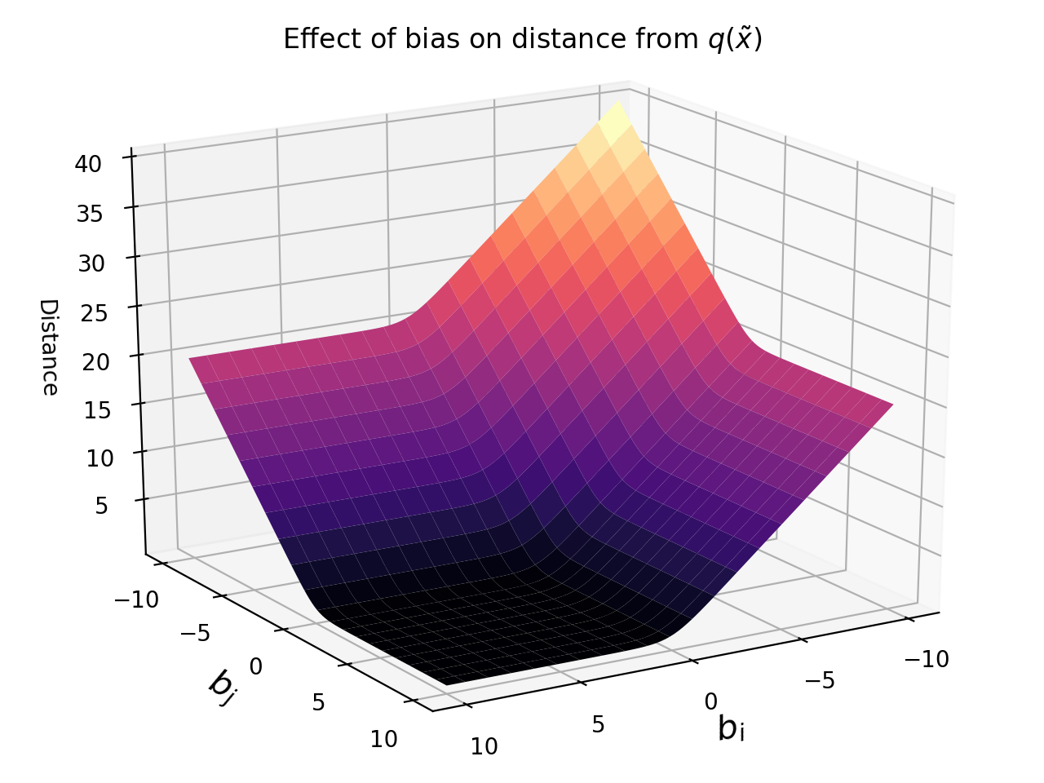
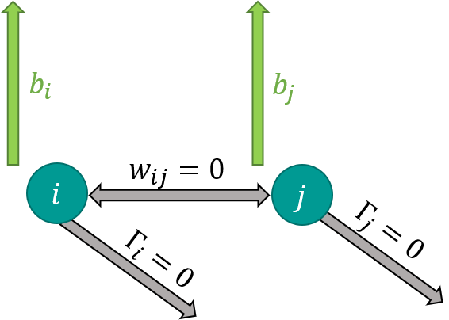
Effect of Bias
Notes:
1:30

Slide 13
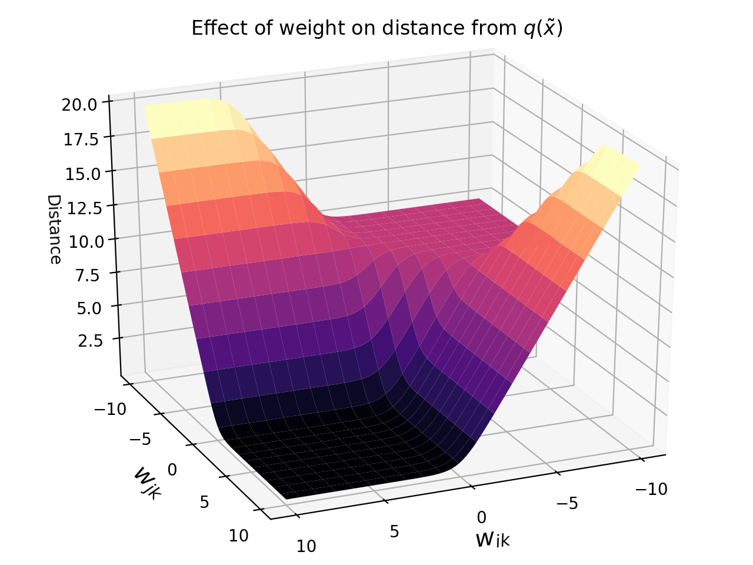
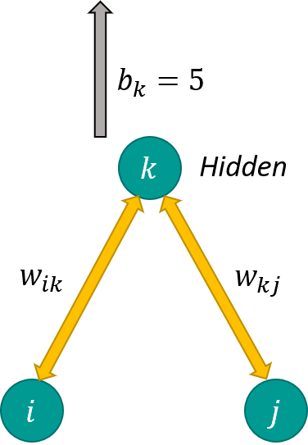
Effect of Weight
Notes:
2

Slide 14
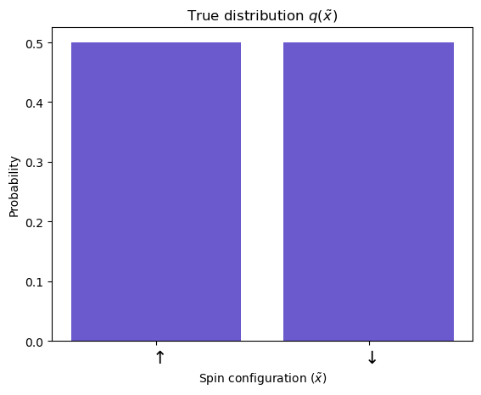
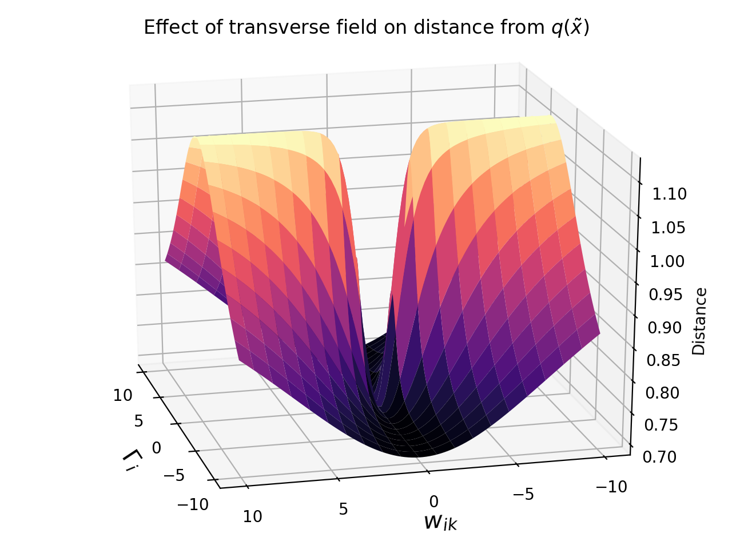
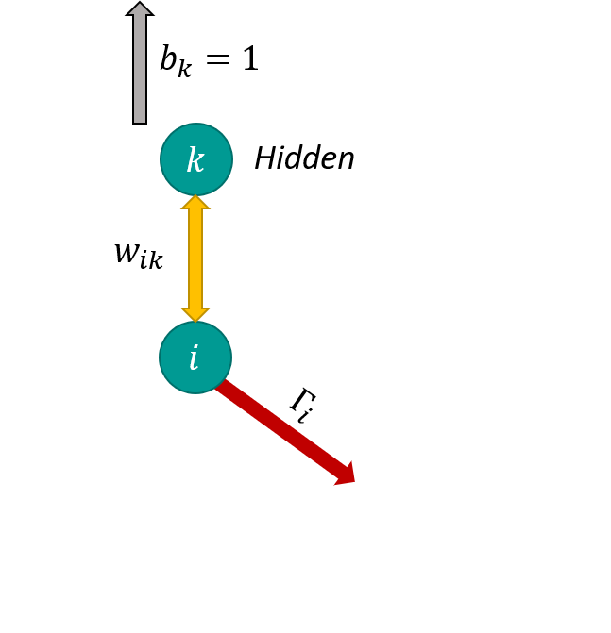
Effect of Transverse Field
Notes:
5:30

Slide 15

Implementing a QBM on a Quantum Computer
Notes:
10 seconds

Slide 16

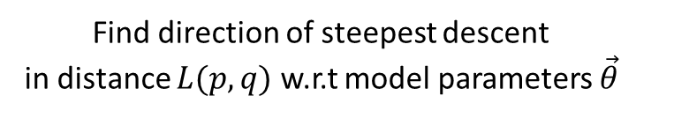
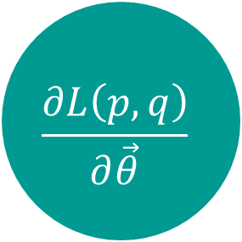
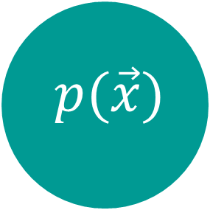
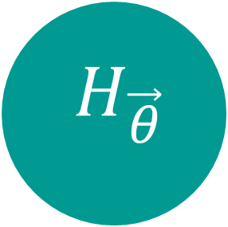
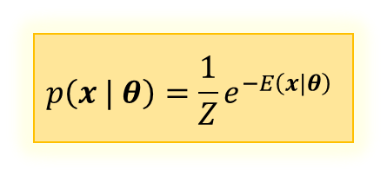
Main procedure
$$H_{\vec{θ}}$$
Update $\vec{θ}$
Prepare Gibbs State
Distribution
$$\frac{∂L\left(p, q\right)}{∂\vec{θ}}$$
$$p(\vec{x})$$
$$p\left(x | θ\right)=\frac{1}{Z}e^{−E\left(x|θ\right)}$$
Find direction of steepest descent
in distance $L(p,q)$ w.r.t model parameters $\vec{θ}$
Notes:
1 minute

Slide 17
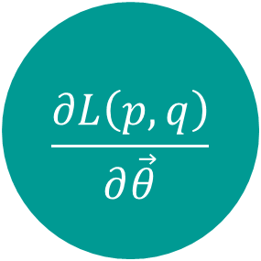
Main procedure
$$H_{\vec{θ}}$$
Quantum!
Update $\vec{θ}$
Prepare Gibbs State
Distribution
$$\frac{∂L\left(p, q\right)}{∂\vec{θ}}$$
$$p(\vec{x})$$
$$p\left(x | θ\right)=\frac{1}{Z}e^{−E\left(x|θ\right)}$$
Find direction of steepest descent
in distance $L(p,q)$ w.r.t model parameters $\vec{θ}$
Notes:
1 minutes

Slide 18
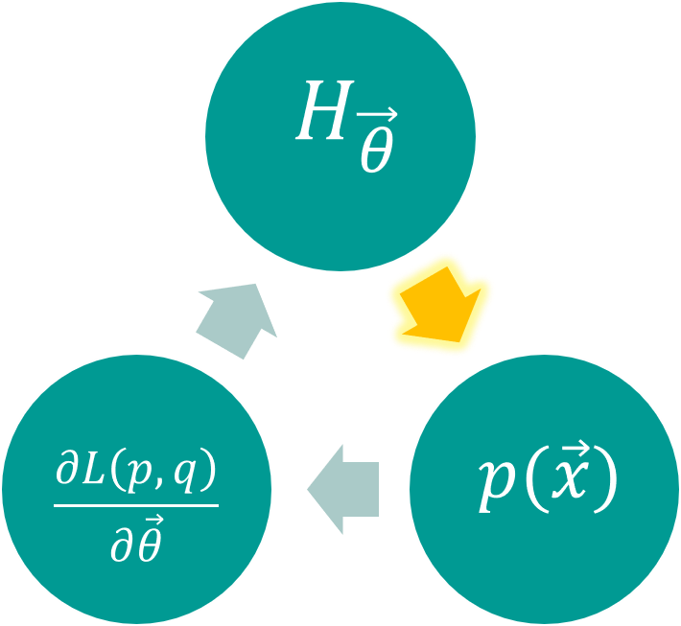
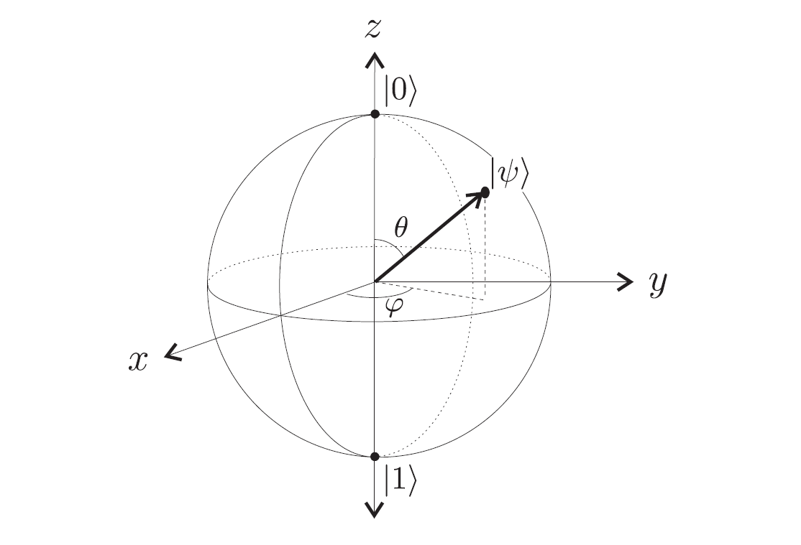


Quantum Computing Qubits
Classical bit
Quantum bit
$$\left|ψ\right\rangle =α\left|0\right\rangle +β\left|1\right\rangle$$
$${ \left|α\right|}^{2}=p(|0⟩)$$
${\left|β\right|}^{2}=p(|1⟩)$
(Kaye et al., 2007)
Notes:
40

Slide 19




Quantum Logic Gates
Gates rotate state vector around Bloch sphere
Example:
$$R_{x}(π)$$
The $R_{x}(π)$ gate
$$\left|0\right\rangle ←R_{X}(π)\left|0\right\rangle$$
(Animation courtesy of Olga Okrut)

Slide 20
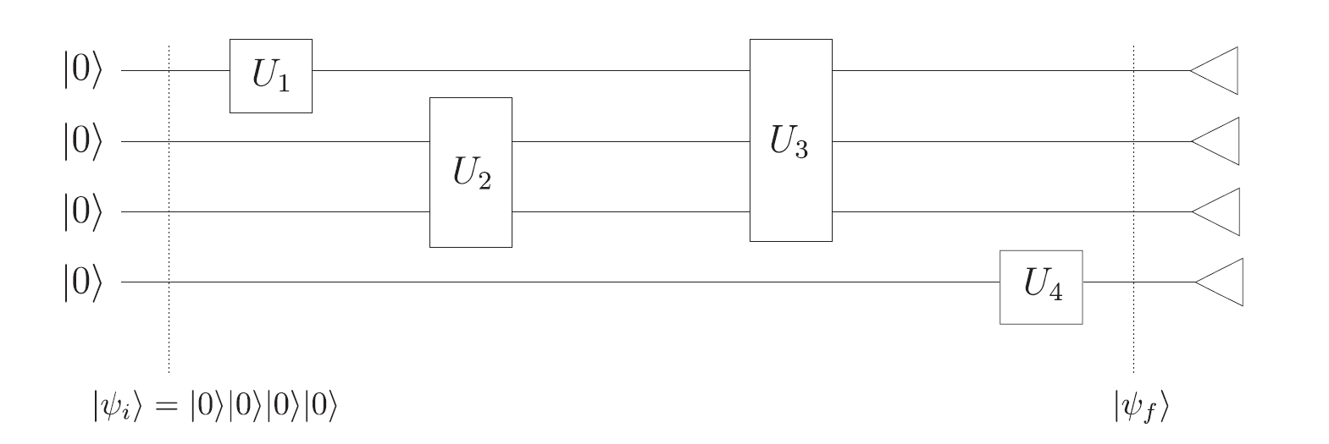






Variational Quantum Circuits
Can parametrise gates by rotation angle about arbitrary axis to get variational gates
$${ U}_{ω_{1}}$$
$${ U}_{ω_{3}}$$
$${ U}_{ω_{2}}$$
$${ U}_{ω_{4}}$$
$$\left|ψ_{0}\right\rangle =|0⟩|0⟩|0⟩|0⟩$$
$$\left|ψ(\vec{ω})\right\rangle$$
(Kaye et al., 2007)

Slide 21
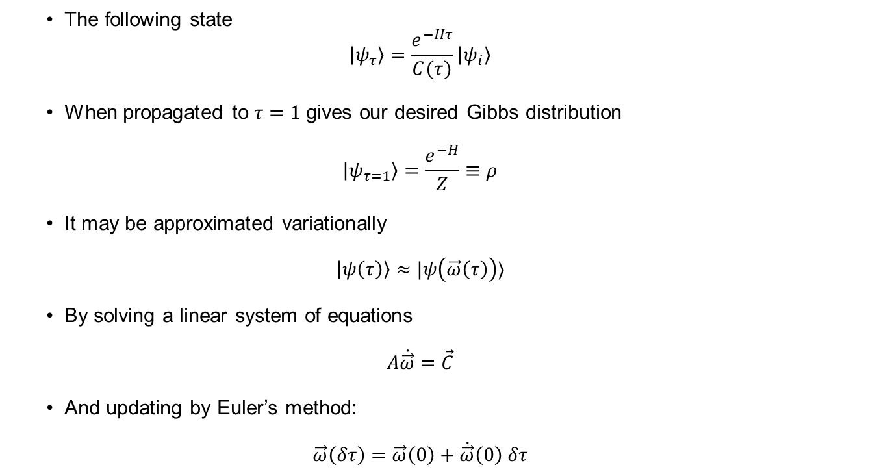
Gibbs State Preparation: VarQITE
The following state
$$\left|ψ_{τ}\right\rangle =\frac{e^{−Hτ}}{C(τ)}\left|ψ_{i}\right\rangle$$
When propagated to $τ=1$gives our desired Gibbs distribution
$$\left|ψ_{τ=1}\right\rangle =\frac{e^{−H}}{Z}≡ρ$$
It may be approximated variationally
$$\left|ψ\left(τ\right)\right\rangle ≈|ψ\left(\vec{ω}\left(τ\right)\right)⟩$$
By solving a linear system of equations
$$A\dot{\vec{ω}}=\vec{C}$$
And updating by Euler’s method:
$$\vec{ω}\left(δτ\right)=\vec{ω}\left(0\right)+\dot{\vec{ω}}\left(0\right) δτ$$
(Christa et al., 2020)
Notes:
Appendix:
Circuit details,
Derivation of system of linear equations A and C

Slide 22
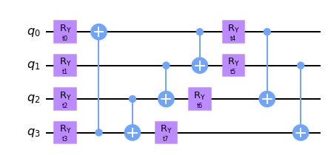

VarQITE
$$H\left(\vec{θ}\right)=H\left(\vec{b}, \vec{w}, \vec{Γ}\right)=b_{1}σ_{z}^{1}+b_{2}σ_{z}^{2}+w_{12}σ_{z}^{1}σ_{z}^{2}+Γ_{1}σ_{x}^{1}+Γ_{2}σ_{x}^{2}$$
Auxiliary qubits

Slide 23
Main procedure
$$H_{\vec{θ}}$$
Update $\vec{θ}$
Prepare Gibbs State
Distribution
$$\frac{∂L\left(p, q\right)}{∂\vec{θ}}$$
$$p(\vec{x})$$
Classical
Find direction of steepest descent
in distance $L(p,q)$ w.r.t model parameters $\vec{θ}$
Notes:
1 minutes

Slide 24
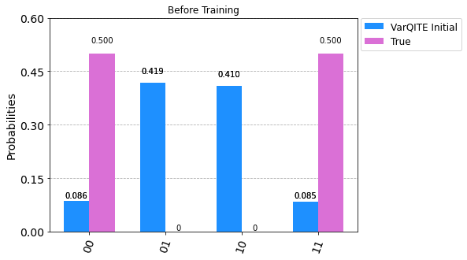
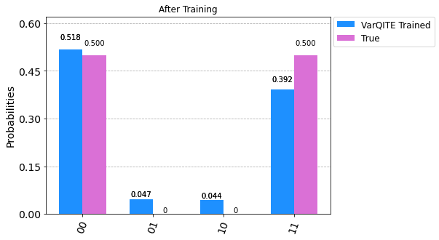
Results
$$H\left(\vec{θ}\right)=H\left(\vec{b}, \vec{w}, \vec{Γ}\right)=b_{1}σ_{z}^{1}+b_{2}σ_{z}^{2}+w_{12}σ_{z}^{1}σ_{z}^{2}+Γ_{1}σ_{x}^{1}+Γ_{2}σ_{x}^{2}$$
Notes:
Link back to ultimate goal of machine learning

Slide 25
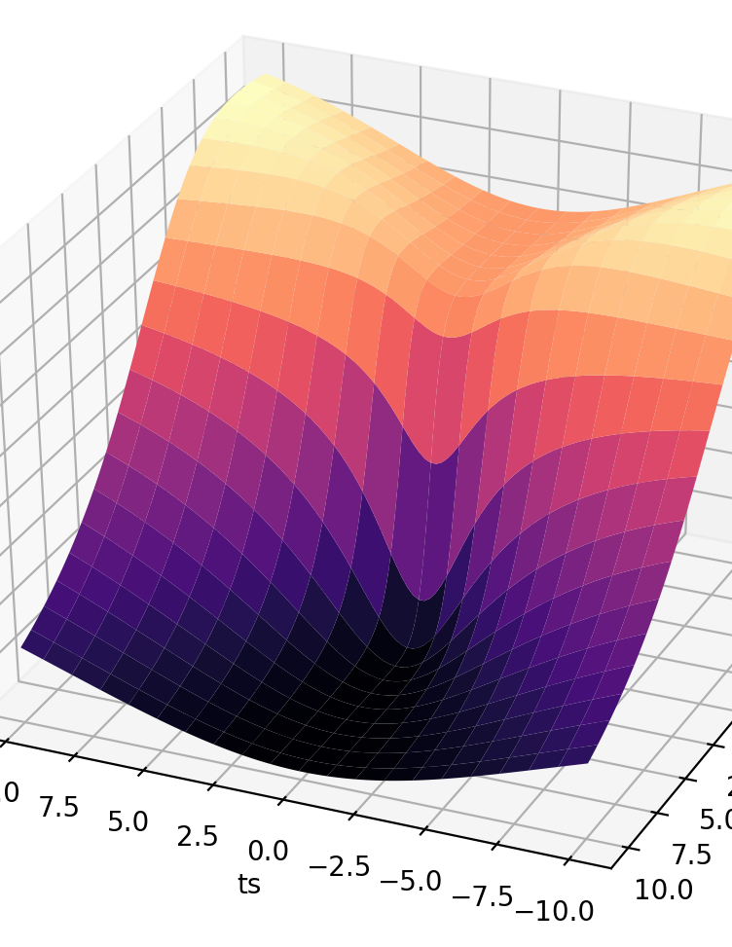
Conclusion
BMs can be implemented as QBMs on quantum computers
Shows some promise in simulating true distributions, although still noisy.
Open problems:
Classifying singularities in distance landscape
Can all Gibbs distributions be prepared faithfully with appropriate choice of variational circuit?
Special thanks to Thomas Quella and Charles Hill, Christa Zoufal, and AMSI

Slide 26
References
Watanabe, S., 2009. Algebraic geometry and statistical learning theory.
Fischer, Asja & Igel, Christian. (2014). Training restricted Boltzmann machines: An introduction. Pattern Recognition. 47. 25-39. 10.1016/j.patcog.2013.05.025.
Amin, M. H., Andriyash, E., Rolfe, J., Kulchytskyy, B. & Melko, R. Quantum Boltzmann machine. Preprint at https://arxiv.org/abs/arXiv:1601.02036 (2016).
Medium. 2021. Introduction to quantum logical gates. Part I.. [online]
Kaye, P., Laflamme, R. and Mosca, M., n.d. An introduction to quantum computing.
Available at: <https://medium.com/qc-applied-approach-to-build-your-own-quantum/introduction-to-quantum-logical-gates-part-i-80f95fa851a2> [Accessed 10 February 2021].
Zoufal, Christa & Lucchi, Aurelien & Woerner, Stefan. (2020). Variational Quantum Boltzmann Machines.
Notes:
RBM

