Slide 1
Brief Intro. To SQL

Slide 2
Textbook(s)
Main textbook, to be available at the bookstore:
Database Systems: The Complete Book, Hector Garcia-Molina, Jeffrey Ullman, Jennifer Widom
Almost identical:
A First Course in Database Systems, Jeff Ullman and Jennifer Widom
Database Implementation, Hector Garcia-Molina, Jeff Ullman and Jennifer Widom

Slide 3
Other Texts
Database Management Systems, Ramakrishnan
very comprehensive
Fundamentals of Database Systems, Elmasri, Navathe
very widely used
Foundations of Databases, Abiteboul, Hull, Vianu
Mostly theory of databases
Data on the Web, Abiteboul, Buneman, Suciu
XML and other new/advanced stuff

Slide 4
Other Readings
Reading from the Web:
SQL for Web Nerds, by Philip Greenspun, http://philip.greenspun.com/sql/
Others, especially for XML

Slide 5
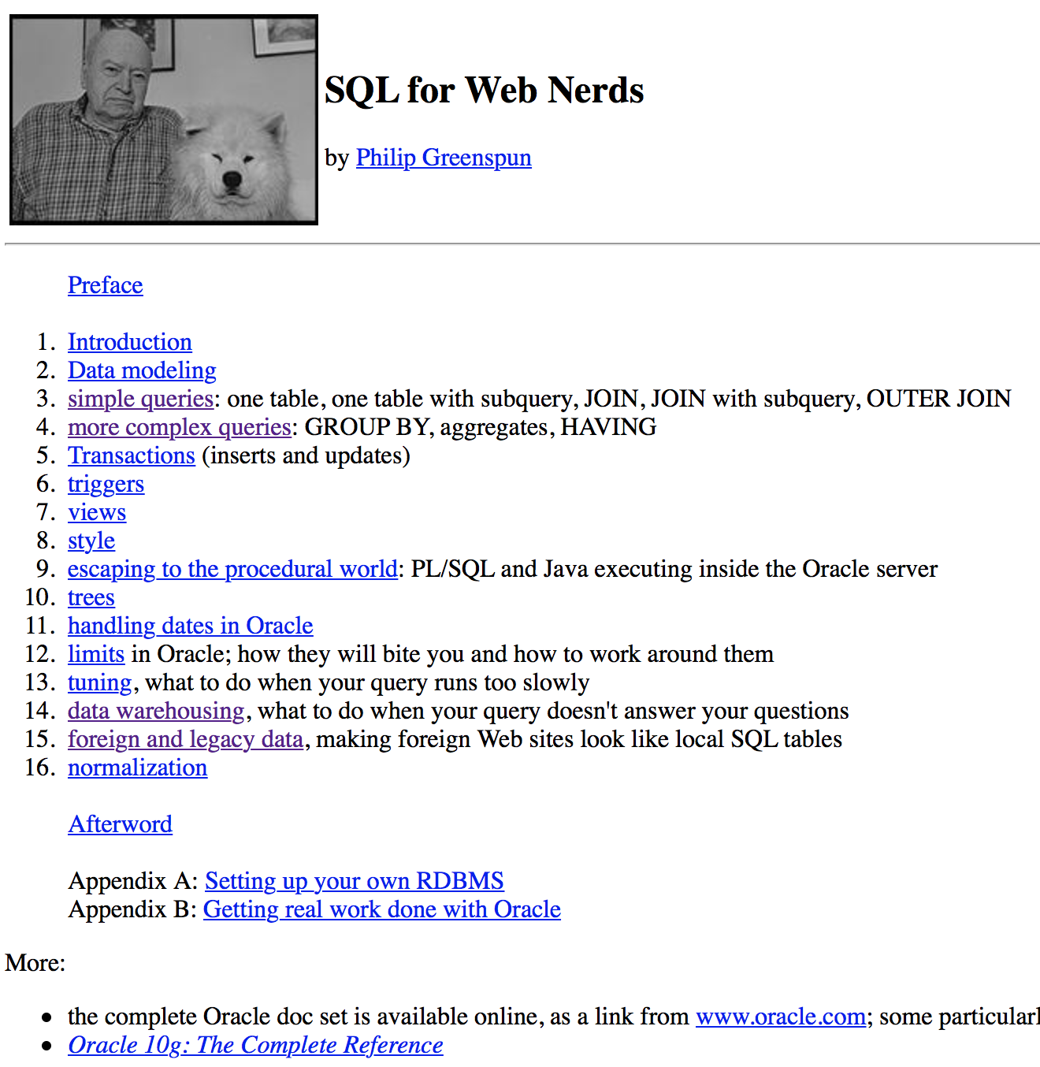

Slide 6
What Is a Relational Database Management System ?
Database Management System = DBMS
Relational DBMS = RDBMS
A collection of files that store the data
A big C program written by someone else that accesses and updates those files for you

Slide 7
Where are RDBMS used ?
Backend for traditional “database” applications
Backend for large Websites
Backend for Web services

Slide 8
Example of a Traditional Database Application
Suppose we are building a system
to store the information about:
students
courses
professors
who takes what, who teaches what

Slide 9
Can we do it without a DBMS ?
Sure we can! Start by storing the data in files:
students.txt courses.txt professors.txt
Now write C or Java programs to implement specific tasks

Slide 10
Doing it without a DBMS...
Enroll “Mary Johnson” in “CSE444”:
Write a C program to do the following:
Read ‘students.txt’
Read ‘courses.txt’
Find&update the record “Mary Johnson”
Find&update the record “CSE444”
Write “students.txt”
Write “courses.txt”

Slide 11
Problems without an DBMS...
System crashes:
What is the problem ?
Large data sets (say 50GB)
What is the problem ?
Simultaneous access by many users
Need locks: we know them from OS, but now data on disk; and is there any fun to re-implement them ?
Read ‘students.txt’
Read ‘courses.txt’
Find&update the record “Mary Johnson”
Find&update the record “CSE444”
Write “students.txt”
Write “courses.txt”
CRASH !

Slide 12
Enters a DMBS
“Two tier database system”
connection
(ODBC, JDBC)
Database server (someone else’s C program)
Data files
Applications
Notes:
ODBC: open database Connectivity
JDBC: Java Data Base Connectivity

Slide 13
Functionality of a DBMS
The programmer sees SQL, which has two components:
Data Definition Language - DDL
Data Manipulation Language - DML
query language
Behind the scenes the DBMS has:
Query optimizer
Query engine
Storage management
Transaction Management (concurrency, recovery)

Slide 14
Functionality of a DBMS
Two things to remember:
Client-server architecture
Slow, cumbersome connection
But good for the data
It is just someone else’s C program
In the beginning we may be impressed by its speed
But later we discover that it can be frustratingly slow
We can do any particular task faster outside the DBMS
But the DBMS is general and convenient

Slide 15
How the Programmer Sees the DBMS
Start with DDL to create tables:
Continue with DML to populate tables:
CREATE TABLE Students (
Name CHAR(30)
SSN CHAR(9) PRIMARY KEY NOT NULL,
Category CHAR(20)
) . . .
INSERT INTO Students
VALUES(‘Charles’, ‘123456789’, ‘undergraduate’)
. . . .
Notes:
Insert, select, delete,
Create,

Slide 16
How the Programmer Sees the DBMS
Tables:
Still implemented as files, but behind the scenes can be quite complex
Students:
Takes:
Courses:
“data independence” = separate logical view from physical implementation

Slide 17
Transactions
Enroll “Mary Johnson” in “CSE444”:
BEGIN TRANSACTION;
INSERT INTO Takes
SELECT Students.SSN, Courses.CID
FROM Students, Courses
WHERE Students.name = ‘Mary Johnson’ and
Courses.name = ‘CSE444’
-- More updates here....
IF everything-went-OK THEN COMMIT;
ELSE ROLLBACK
If system crashes, the transaction is still either committed or aborted

Slide 18
Transactions
A transaction = sequence of statements that either all succeed, or all fail
Transactions have the ACID properties:
A = atomicity
C = consistency
I = independence
D = durability

Slide 19
Queries
Find all courses that “Mary” takes
What happens behind the scene ?
Query processor figures out how to answer the query efficiently.
SELECT C.name FROM Students S, Takes T, Courses C WHERE S.name=“Mary” and S.ssn = T.ssn and T.cid = C.cid

Slide 20
Queries, behind the scene
Declarative SQL query
Imperative query execution plan:
sname
SELECT C.name
FROM Students S, Takes T, Courses C
WHERE S.name=“Mary” and
S.ssn = T.ssn and T.cid = C.cid
cid=cid
sid=sid
name=“Mary”
Students
Takes
Courses
The optimizer chooses the best execution plan for a query

Slide 21
Database Systems
The big commercial database vendors:
Oracle
IBM (with DB2) bought Informix recently
Microsoft (SQL Server)
Sybase
Some free database systems (Unix) :
Postgres
MySQL
Predator
Here we use MySQL. You may use something else, but then you are on your own.

Slide 22
New Trends in Databases
Object-relational databases
Main memory database systems
XML XML XML !
Relational databases with XML support
Middleware between XML and relational databases
Native XML database systems
Lots of research here at TAU on XML and databases
Data integration
Peer to peer, stream data management – still research

Slide 23
So The SQL
Data in SQL
Simple Queries in SQL (6.1)
Queries with more than one relation (6.2)

Slide 24
SQL Introduction
Standard language for querying and manipulating data
Structured Query Language
Many standards out there:
ANSI SQL
SQL92 (a.k.a. SQL2)
SQL99 (a.k.a. SQL3)
Vendors support various subsets of these
What we discuss is common to all of them

Slide 25
SQL
Data Definition Language (DDL)
Create/alter/delete tables and their attributes
Following lectures...
Data Manipulation Language (DML)
Query one or more tables – discussed next !
Insert/delete/modify tuples in tables
Transact-SQL
Idea: package a sequence of SQL statements → server
Won’t discuss in class

Slide 26
Data in SQL
Atomic types, a.k.a. data types
Tables built from atomic types
Unlike XML, no nested tables, only flat tables are allowed!
We will see later how to decompose complex structures into multiple flat tables

Slide 27
Data Types in SQL
Characters:
CHAR(20) -- fixed length
VARCHAR(40) -- variable length
Numbers:
BIGINT, INT, SMALLINT, TINYINT
REAL, FLOAT -- differ in precision
MONEY
Times and dates:
DATE
DATETIME -- SQL Server
Others... All are simple

Slide 28
Tables in SQL
Table name
Attribute names
Product
PName | Price | Category | Manufacturer
Gizmo | $19.99 | Gadgets | GizmoWorks
Powergizmo | $29.99 | Gadgets | GizmoWorks
SingleTouch | $149.99 | Photography | Canon
MultiTouch | $203.99 | Household | Hitachi
Tuples or rows

Slide 29
Tables Explained
A tuple = a record
Restriction: all attributes are of atomic type
A table = a set of tuples
Like a list…
…but it is unordered: no first(), no next(), no last().

Slide 30
Tables Explained
The schema of a table is the table name and its attributes:
Product(PName, Price, Category, Manfacturer)
A key is an attribute whose values are unique; we underline a key
Product(PName, Price, Category, Manfacturer)
Notes:
Schema: 纲要、架构。

Slide 31
SQL Query
Basic form: (plus many many more bells and whistles)
SELECT attributes
FROM relations (possibly multiple)
WHERE conditions (selections)

Slide 32
Simple SQL Query
Product
PName | Price | Category | Manufacturer
Gizmo | $19.99 | Gadgets | GizmoWorks
Powergizmo | $29.99 | Gadgets | GizmoWorks
SingleTouch | $149.99 | Photography | Canon
MultiTouch | $203.99 | Household | Hitachi
SELECT * FROM Product WHERE category=‘Gadgets’
PName | Price | Category | Manufacturer
Gizmo | $19.99 | Gadgets | GizmoWorks
Powergizmo | $29.99 | Gadgets | GizmoWorks
“selection”

Slide 33
Simple SQL Query
Product
PName | Price | Category | Manufacturer
Gizmo | $19.99 | Gadgets | GizmoWorks
Powergizmo | $29.99 | Gadgets | GizmoWorks
SingleTouch | $149.99 | Photography | Canon
MultiTouch | $203.99 | Household | Hitachi
SELECT PName, Price, Manufacturer FROM Product WHERE Price > 100
“selection” and
“projection”
PName | Price | Manufacturer
SingleTouch | $149.99 | Canon
MultiTouch | $203.99 | Hitachi

Slide 34
A Notation for SQL Queries
Input Schema
Product(PName, Price, Category, Manfacturer)
SELECT PName, Price, Manufacturer FROM Product WHERE Price > 100
Answer(PName, Price, Manfacturer)
Output Schema

Slide 35
Selections
What goes in the WHERE clause:
x = y, x < y, x <= y, etc
For number, they have the usual meanings
For CHAR and VARCHAR: lexicographic ordering
Expected conversion between CHAR and VARCHAR
For dates and times, what you expect...
Pattern matching on strings...

Slide 36
The LIKE operator
s LIKE p: pattern matching on strings
p may contain two special symbols:
% = any sequence of characters
_ = any single character
Product(PName, Price, Category, Manufacturer)
Find all products whose name mentions ‘gizmo’:
SELECT * FROM Products WHERE PName LIKE ‘%gizmo%’

Slide 37
Eliminating Duplicates
Category
Gadgets
Photography
Household
SELECT DISTINCT category
FROM Product
Compare to:
Category
Gadgets
Gadgets
Photography
Household
SELECT category
FROM Product

Slide 38
Ordering the Results
SELECT pname, price, manufacturer
FROM Product
WHERE category=‘gizmo’ AND price > 50
ORDER BY price, pname
Ordering is ascending, unless you specify the DESC keyword.
Ties are broken by the second attribute on the ORDER BY list, etc.

Slide 39
Ordering the Results
SELECT category
FROM Product
ORDER BY pname
PName | Price | Category | Manufacturer
Gizmo | $19.99 | Gadgets | GizmoWorks
Powergizmo | $29.99 | Gadgets | GizmoWorks
SingleTouch | $149.99 | Photography | Canon
MultiTouch | $203.99 | Household | Hitachi
?

Slide 40
Ordering the Results
Category
Gadgets
Household
Photography
SELECT DISTINCT category
FROM Product
ORDER BY category
Compare to:
SELECT category
FROM Product
ORDER BY pname
?

Slide 41
Joins in SQL
Connect two or more tables:
Product
PName | Price | Category | Manufacturer
Gizmo | $19.99 | Gadgets | GizmoWorks
Powergizmo | $29.99 | Gadgets | GizmoWorks
SingleTouch | $149.99 | Photography | Canon
MultiTouch | $203.99 | Household | Hitachi
Company
Cname | StockPrice | Country
GizmoWorks | 25 | USA
Canon | 65 | Japan
Hitachi | 15 | Japan
What is
the connection
between
them ?

Slide 42
Joins
Product (pname, price, category, manufacturer)
Company (cname, stockPrice, country)
Find all products under $200 manufactured in Japan; return their names and prices.
Join between Product and Company
SELECT pname, price FROM Product, Company WHERE manufacturer=cname AND country=‘Japan’ AND price <= 200

Slide 43
Joins in SQL
Product
Company
PName | Price | Category | Manufacturer
Gizmo | $19.99 | Gadgets | GizmoWorks
Powergizmo | $29.99 | Gadgets | GizmoWorks
SingleTouch | $149.99 | Photography | Canon
MultiTouch | $203.99 | Household | Hitachi
Cname | StockPrice | Country
GizmoWorks | 25 | USA
Canon | 65 | Japan
Hitachi | 15 | Japan
SELECT pname, price FROM Product, Company WHERE manufacturer=cname AND country=‘Japan’ AND price <= 200
PName | Price
SingleTouch | $149.99

Slide 44
Joins
Product (pname, price, category, manufacturer)
Company (cname, stockPrice, country)
Find all countries that manufacture some product in the ‘Gadgets’ category.
SELECT country FROM Product, Company WHERE manufacturer=cname AND category=‘Gadgets’

Slide 45
Joins in SQL
Product
Company
Name | Price | Category | Manufacturer
Gizmo | $19.99 | Gadgets | GizmoWorks
Powergizmo | $29.99 | Gadgets | GizmoWorks
SingleTouch | $149.99 | Photography | Canon
MultiTouch | $203.99 | Household | Hitachi
Cname | StockPrice | Country
GizmoWorks | 25 | USA
Canon | 65 | Japan
Hitachi | 15 | Japan
SELECT country FROM Product, Company WHERE manufacturer=cname AND category=‘Gadgets’
What is
the problem ?
What’s the solution ?
Country
??
??

Slide 46
Joins
Product (pname, price, category, manufacturer)
Purchase (buyer, seller, store, product)
Person(persname, phoneNumber, city)
Find names of people living in Seattle that bought some product in the ‘Gadgets’ category, and the names of the stores they bought such product from
SELECT DISTINCT persname, store FROM Person, Purchase, Product WHERE persname=buyer AND product = pname AND city=‘Seattle’ AND category=‘Gadgets’

Slide 47
When are two tables related?
You guess they are
I tell you so
Foreign keys are a method for schema designers to tell you so (7.1)
A foreign key states that a column is a reference to the key of another table ex: Product.manufacturer is foreign key of Company
Gives information and enforces constraint

Slide 48
Disambiguating Attributes
Sometimes two relations have the same attr: Person(pname, address, worksfor) Company(cname, address)
Which address ?
SELECT DISTINCT pname, address FROM Person, Company WHERE worksfor = cname
SELECT DISTINCT Person.pname, Company.address FROM Person, Company WHERE Person.worksfor = Company.cname

Slide 49
Tuple Variables
Product (pname, price, category, manufacturer)
Purchase (buyer, seller, store, product)
Person(persname, phoneNumber, city)
Find all stores that sold at least one product that the store ‘BestBuy’ also sold:
SELECT DISTINCT x.store
FROM Purchase AS x, Purchase AS y
WHERE x.product = y.product AND y.store = ‘BestBuy’
Answer (store)

Slide 50
Tuple Variables
General rule: tuple variables introduced automatically by the system:
Product (name, price, category, manufacturer)
Becomes:
Doesn’t work when Product occurs more than once:
In that case the user needs to define variables explicitly.
SELECT name
FROM Product
WHERE price > 100
SELECT Product.name
FROM Product AS Product
WHERE Product.price > 100

Slide 51
Meaning (Semantics) of SQL Queries
SELECT a1, a2, …, ak
FROM R1 AS x1, R2 AS x2, …, Rn AS xn
WHERE Conditions
1. Nested loops:
Answer = {}
for x1 in R1 do
for x2 in R2 do
…..
for xn in Rn do
if Conditions
then Answer = Answer ∪ {(a1,…,ak)}
return Answer

Slide 52
Meaning (Semantics) of SQL Queries
SELECT a1, a2, …, ak
FROM R1 AS x1, R2 AS x2, …, Rn AS xn
WHERE Conditions
2. Parallel assignment
Doesn’t impose any order !
Answer = {}
for all assignments x1 in R1, …, xn in Rn do
if Conditions then Answer = Answer ∪ {(a1,…,ak)}
return Answer

Slide 53
First Unintuitive SQLism
SELECT R.A
FROM R, S, T
WHERE R.A=S.A OR R.A=T.A
Looking for R (S T)
But what happens if T is empty?

Slide 54
Exercises
Product (pname, price, category, manufacturer)
Purchase (buyer, seller, store, product)
Company (cname, stock price, country)
Person(per-name, phone number, city)
Ex #1: Find people who bought telephony products.
Ex #2: Find names of people who bought American products
Ex #3: Find names of people who bought American products and they
live in Seattle.
Ex #4: Find people who have both bought and sold something.
Ex #5: Find people who bought stuff from Joe or bought products
from a company whose stock prices is more than $50.

