Slide 1
高级大数据解析
Module 3:深入理解Spark的运行机制

Slide 2
常用的调度算法
先来先服务(FCFS-First Come First Serve)
最短作业优先(SJF-Shortest Job First)
最短剩余时间优先(SRT-Shortest Remaining Time Next)
最高相应比优先(HRRN-Highest Response Ratio Next)

Slide 3
Spark集群对应用的调度策略
Spark集群的调度分为
应用间调度
调度策略1: 资源静态分区
调度策略2: 动态共享CPU cores
调度策略3: 动态资源申请
应用内调度： 同一个应用内的不同jobs
默认采用FIFO的调度策略
也可以被配置为"fair sharing"
http://spark.apache.org/docs/latest/job-scheduling.html
Notes:
Spark依赖集群管理器在spark应用间共享资源。
应用内调度： spark有一些长期运行的应用，比如Spark SQL 的JDBC 服务器，需要一个细粒度的调度机制来强制共享资源。

Slide 4
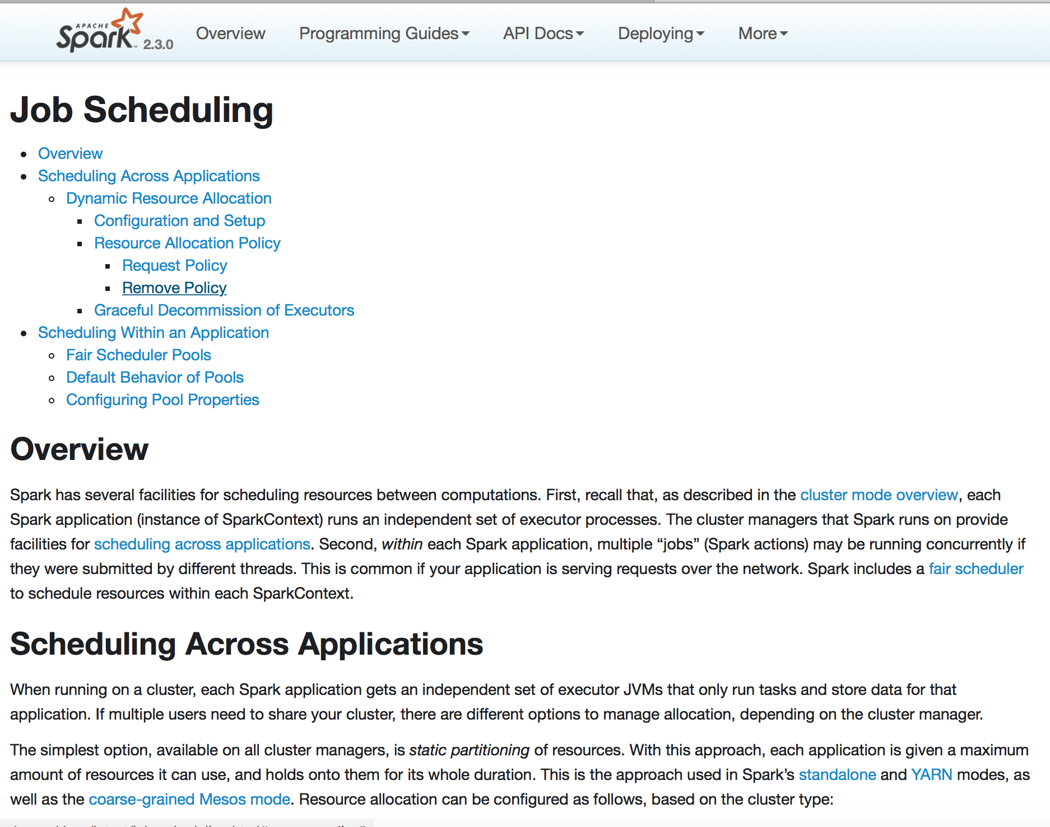

Slide 5
应用间调度（1）
调度策略1: 资源静态分区
资源静态分区是指整个集群的资源被预先划分为多个partitions，资源分配时的最小粒度是一个静态的partition。
根据应用对资源的申请需求为其分配静态的partition(s)是Spark支持的最简单的调度策略。
若Spark集群配置了static partitioning的调度策略，则它对提交的多个应用间默认采用FIFO顺序进行调度，
每个获得执行机会的应用在运行期间可占用整个集群的资源，这样做明显不友好，所以应用提交者通常需要通过设置spark.cores.max来控制其占用的core/memory资源。

Slide 6
应用间调度（2）
调度策略2: 动态共享CPU cores
若Spark集群采用Mesos模式，可以采用该策略；
每个应用仍拥有各自独立的cores/memory，但当应用申请资源后并未使用时（即分配给应用的资源当前闲置），其它应用的计算任务可能会被调度器分配到这些闲置资源上。
当提交给集群的应用有很多是非活跃应用时（即它们并非时刻占用集群资源），这种调度策略能很大程度上提升集群资源利用效率。
风险是：若某个应用从非活跃状态转变为活跃状态时，且它提交时申请的资源当前恰好被调度给其它应用，则它无法立即获得执行的机会。
Notes:
dynamic sharing of CPU cores的策略。

Slide 7
应用间调度（3）
动态资源申请
它允许根据应用的workload动态调整其所需的集群资源。
若应用暂时不需要它之前申请的资源，则它可以先归还给集群，
当它需要时，可以重新向集群申请。当Spark集群被多个应用共享时，这种按需分配的策略显然是非常有优势的。
Notes:
Dynamic Resource Allocation

Slide 8
应用内调度（1）
在应用内部，每个action（e.g. save, collect）以及计算这个action结果所需要的一系列tasks被统称为一个"job”
FIFO的调度策略
每个job被分解为不同的stages;
当多个job各自的stage所在的线程同时申请资源时，第1个job的stage优先获得资源;
如果job queue头部的job恰好是需要最长执行时间的job时，后面所有的job均得不到执行的机会，这样会导致某些job(s)饿死的情况。
Notes:
每个Application在Spark集群看来均是一个独立的Spark Context. By “job”, in this section, we mean a Spark action (e.g. save, collect) and any tasks that need to run to evaluate that action. Spark’s scheduler is fully thread-safe and supports this use case to enable applications that serve multiple requests (e.g. queries for multiple users).

Slide 9
应用内调度（2）
"fair sharing"
Spark对不同jobs的stages提交的tasks采用Round Robin的调度方式，如此，所有的jobs均得到公平执行的机会。因此，即使某些short-time jobs本身的提交时间在long jobs之后，它也能获得被执行的机会，从而达到可预期的响应时间
要启用fair sharing调度策略，需要在spark配置文件中将spark.scheduler.mode设置为FAIR。
fair sharing调度也支持把不同的jobs聚合到一个pool，不同的pools赋予不同的执行优先级。
这是FIFO和fair sharing两种策略的折衷策略，既能保证jobs之间的优先级，也能保证同一优先级的jobs均能得到公平执行的机会
Notes:
Fair Scheduler Pools, is after Hadoop Fair Scheduler. 轮询调度算法(Round-Robin Scheduling，轮盘赌算法)： 轮询调度算法的原理是每一次把来自用户的请求轮流分配给内部中的服务器，从1开始，直到N(内部服务器个数)，然后重新开始循环。也可以用于，遗传算法中，交叉选择的算法。需要一个伪随机数发生器（张楠课上讲过）。

Slide 10
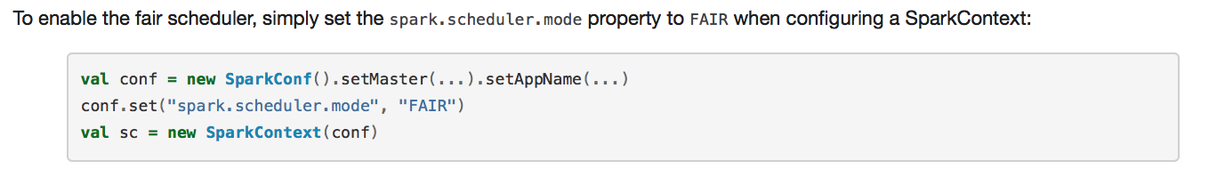
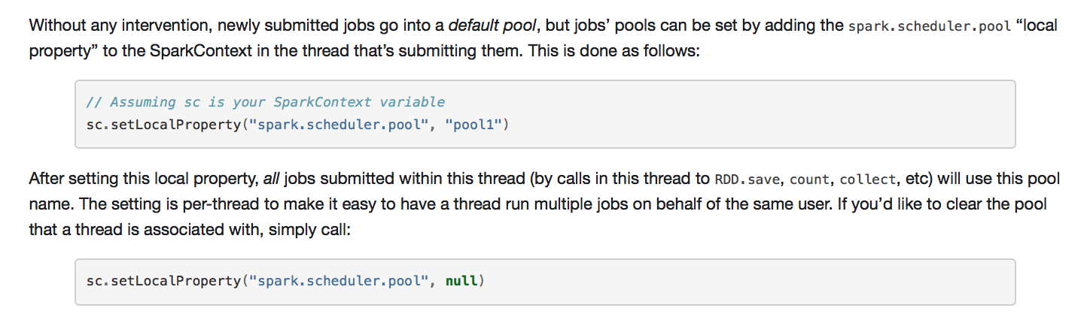
How to set?

Slide 11
Spark应用概念(1)
Application：Spark 的应用程序，用户提交后，Spark为App分配资源，将程序转换并执行，其中Application包含一个Driver program和若干Executor
SparkContext：Spark 应用程序的入口，负责调度各个运算资源，协调各个 Worker Node 上的 Executor
Driver Program：运行Application的main()函数并且创建SparkContext
RDD Graph：RDD是Spark的核心结构， 可以通过一系列算子进行操作（主要有Transformation和Action操作）。当RDD遇到Action算子时，将之前的所有算子形成一个有向无环图（DAG）。再在Spark中转化为Job，提交到集群执行。一个App中可以包含多个Job
Executor：是为Application运行在Worker node上的一个进程，该进程负责运行Task，并且负责将数据存在内存或者磁盘上。每个Application都会申请各自的Executor来处理任务
Worker Node：集群中任何可以运行Application代码的节点，运行一个或多个Executor进程

Slide 12
Spark应用概念(2)
下面介绍Spark Application运行过程中各个组件的概念：
Job：一个RDD Graph触发的作业，往往由Spark Action算子触发，在SparkContext中通过runJob方法向Spark提交Job
Stage：每个Job会根据RDD的宽依赖关系被切分很多Stage， 每个Stage中包含一组相同的Task， 这一组Task也叫TaskSet
Task：一个分区对应一个Task，Task执行RDD中对应Stage中包含的算子。Task被封装好后放入Executor的线程池中执行

Slide 13
Introduction To SQL

Slide 14
Textbook(s)
Main textbook, to be available at the bookstore:
Database Systems: The Complete Book, Hector Garcia-Molina, Jeffrey Ullman, Jennifer Widom
Almost identical:
A First Course in Database Systems, Jeff Ullman and Jennifer Widom
Database Implementation, Hector Garcia-Molina, Jeff Ullman and Jennifer Widom

Slide 15
Other Texts
Database Management Systems, Ramakrishnan
very comprehensive
Fundamentals of Database Systems, Elmasri, Navathe
very widely used
Foundations of Databases, Abiteboul, Hull, Vianu
Mostly theory of databases
Data on the Web, Abiteboul, Buneman, Suciu
XML and other new/advanced stuff

Slide 16
Other Readings
Reading from the Web:
SQL for Web Nerds, by Philip Greenspun, http://philip.greenspun.com/sql/
Others, especially for XML

Slide 17
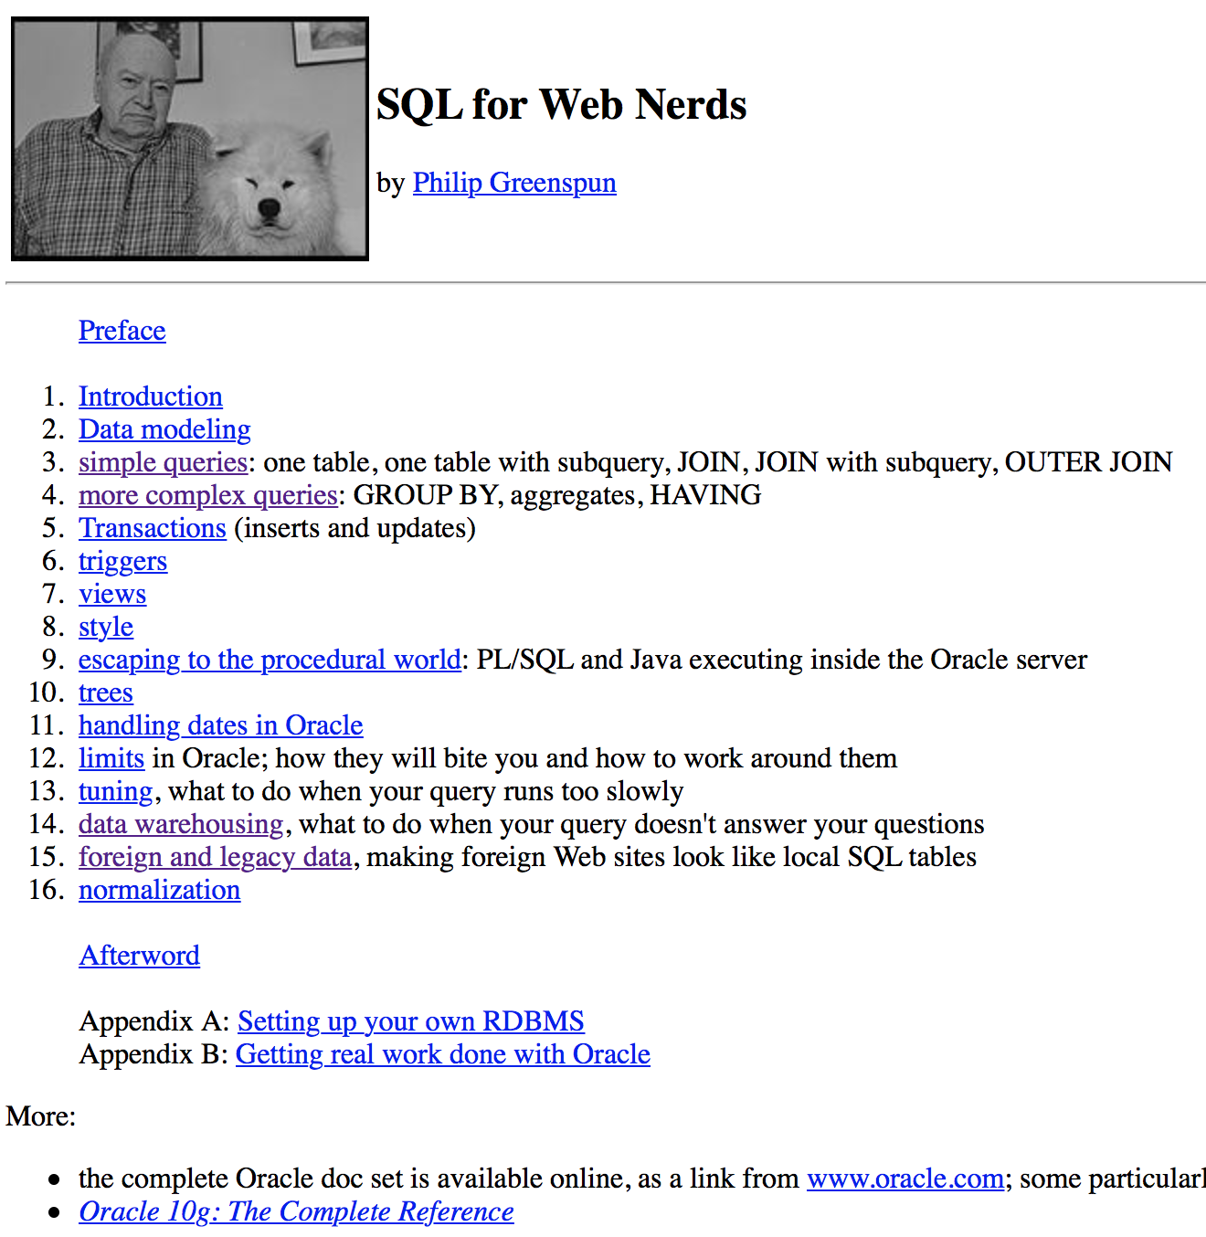

Slide 18
What Is a Relational Database Management System ?
Database Management System = DBMS
Relational DBMS = RDBMS
A collection of files that store the data
A big C program written by someone else that accesses and updates those files for you

Slide 19
Where are RDBMS used ?
Backend for traditional “database” applications
Backend for large Websites
Backend for Web services

Slide 20
Example of a Traditional Database Application
Suppose we are building a system
to store the information about:
students
courses
professors
who takes what, who teaches what

Slide 21
Can we do it without a DBMS ?
Sure we can! Start by storing the data in files:
students.txt courses.txt professors.txt
Now write C or Java programs to implement specific tasks

Slide 22
Doing it without a DBMS...
Enroll “Mary Johnson” in “CSE444”:
Write a C program to do the following:
Read ‘students.txt’
Read ‘courses.txt’
Find&update the record “Mary Johnson”
Find&update the record “CSE444”
Write “students.txt”
Write “courses.txt”

Slide 23
Problems without an DBMS...
System crashes:
What is the problem ?
Large data sets (say 50GB)
What is the problem ?
Simultaneous access by many users
Need locks: we know them from OS, but now data on disk; and is there any fun to re-implement them ?
Read ‘students.txt’
Read ‘courses.txt’
Find&update the record “Mary Johnson”
Find&update the record “CSE444”
Write “students.txt”
Write “courses.txt”
CRASH !

Slide 24
Enters a DMBS
“Two tier database system”
connection
(ODBC, JDBC)
Database server (someone else’s C program)
Data files
Applications
Notes:
ODBC: open database Connectivity
JDBC: Java Data Base Connectivity

Slide 25
Functionality of a DBMS
The programmer sees SQL, which has two components:
Data Definition Language - DDL
Data Manipulation Language - DML
query language
Behind the scenes the DBMS has:
Query optimizer
Query engine
Storage management
Transaction Management (concurrency, recovery)

Slide 26
Functionality of a DBMS
Two things to remember:
Client-server architecture
Slow, cumbersome connection
But good for the data
It is just someone else’s C program
In the beginning we may be impressed by its speed
But later we discover that it can be frustratingly slow
We can do any particular task faster outside the DBMS
But the DBMS is general and convenient

Slide 27
How the Programmer Sees the DBMS
Start with DDL to create tables:
Continue with DML to populate tables:
CREATE TABLE Students (
Name CHAR(30)
SSN CHAR(9) PRIMARY KEY NOT NULL,
Category CHAR(20)
) . . .
INSERT INTO Students
VALUES(‘Charles’, ‘123456789’, ‘undergraduate’)
. . . .
Notes:
Insert, select, delete,
Create,

Slide 28
How the Programmer Sees the DBMS
Tables:
Still implemented as files, but behind the scenes can be quite complex
Students:
Takes:
Courses:
“data independence” = separate logical view from physical implementation

Slide 29
Transactions
Enroll “Mary Johnson” in “CSE444”:
BEGIN TRANSACTION;
INSERT INTO Takes
SELECT Students.SSN, Courses.CID
FROM Students, Courses
WHERE Students.name = ‘Mary Johnson’ and
Courses.name = ‘CSE444’
-- More updates here....
IF everything-went-OK THEN COMMIT;
ELSE ROLLBACK
If system crashes, the transaction is still either committed or aborted

Slide 30
Transactions
A transaction = sequence of statements that either all succeed, or all fail
Transactions have the ACID properties:
A = atomicity
C = consistency
I = independence
D = durability

Slide 31
Queries
Find all courses that “Mary” takes
What happens behind the scene ?
Query processor figures out how to answer the query efficiently.
SELECT C.name FROM Students S, Takes T, Courses C WHERE S.name=“Mary” and S.ssn = T.ssn and T.cid = C.cid

Slide 32
Queries, behind the scene
Declarative SQL query
Imperative query execution plan:
sname
SELECT C.name
FROM Students S, Takes T, Courses C
WHERE S.name=“Mary” and
S.ssn = T.ssn and T.cid = C.cid
cid=cid
sid=sid
name=“Mary”
Students
Takes
Courses
The optimizer chooses the best execution plan for a query

Slide 33
Database Systems
The big commercial database vendors:
Oracle
IBM (with DB2) bought Informix recently
Microsoft (SQL Server)
Sybase
Some free database systems (Unix) :
Postgres
MySQL
Predator
Here we use MySQL. You may use something else, but then you are on your own.

Slide 34
Appendix

Slide 35
New Trends in Databases
Object-relational databases
Main memory database systems
XML XML XML !
Relational databases with XML support
Middleware between XML and relational databases
Native XML database systems
Lots of research here at TAU on XML and databases
Data integration
Peer to peer, stream data management – still research

Slide 36
So The SQL
Data in SQL
Simple Queries in SQL (6.1)
Queries with more than one relation (6.2)

Slide 37
SQL Introduction
Standard language for querying and manipulating data
Structured Query Language
Many standards out there:
ANSI SQL
SQL92 (a.k.a. SQL2)
SQL99 (a.k.a. SQL3)
Vendors support various subsets of these
What we discuss is common to all of them

Slide 38
SQL
Data Definition Language (DDL)
Create/alter/delete tables and their attributes
Following lectures...
Data Manipulation Language (DML)
Query one or more tables – discussed next !
Insert/delete/modify tuples in tables
Transact-SQL
Idea: package a sequence of SQL statements → server
Won’t discuss in class

Slide 39
Data in SQL
Atomic types, a.k.a. data types
Tables built from atomic types
Unlike XML, no nested tables, only flat tables are allowed!
We will see later how to decompose complex structures into multiple flat tables

Slide 40
Data Types in SQL
Characters:
CHAR(20) -- fixed length
VARCHAR(40) -- variable length
Numbers:
BIGINT, INT, SMALLINT, TINYINT
REAL, FLOAT -- differ in precision
MONEY
Times and dates:
DATE
DATETIME -- SQL Server
Others... All are simple

Slide 41
Tables in SQL
Table name
Attribute names
Product
PName | Price | Category | Manufacturer
Gizmo | $19.99 | Gadgets | GizmoWorks
Powergizmo | $29.99 | Gadgets | GizmoWorks
SingleTouch | $149.99 | Photography | Canon
MultiTouch | $203.99 | Household | Hitachi
Tuples or rows

Slide 42
Tables Explained
A tuple = a record
Restriction: all attributes are of atomic type
A table = a set of tuples
Like a list…
…but it is unordered: no first(), no next(), no last().

Slide 43
Tables Explained
The schema of a table is the table name and its attributes:
Product(PName, Price, Category, Manfacturer)
A key is an attribute whose values are unique; we underline a key
Product(PName, Price, Category, Manfacturer)
Notes:
Schema: 纲要、架构。

Slide 44
SQL Query
Basic form: (plus many many more bells and whistles)
SELECT attributes
FROM relations (possibly multiple)
WHERE conditions (selections)

Slide 45
Simple SQL Query
Product
PName | Price | Category | Manufacturer
Gizmo | $19.99 | Gadgets | GizmoWorks
Powergizmo | $29.99 | Gadgets | GizmoWorks
SingleTouch | $149.99 | Photography | Canon
MultiTouch | $203.99 | Household | Hitachi
SELECT * FROM Product WHERE category=‘Gadgets’
PName | Price | Category | Manufacturer
Gizmo | $19.99 | Gadgets | GizmoWorks
Powergizmo | $29.99 | Gadgets | GizmoWorks
“selection”

Slide 46
Simple SQL Query
Product
PName | Price | Category | Manufacturer
Gizmo | $19.99 | Gadgets | GizmoWorks
Powergizmo | $29.99 | Gadgets | GizmoWorks
SingleTouch | $149.99 | Photography | Canon
MultiTouch | $203.99 | Household | Hitachi
SELECT PName, Price, Manufacturer FROM Product WHERE Price > 100
“selection” and
“projection”
PName | Price | Manufacturer
SingleTouch | $149.99 | Canon
MultiTouch | $203.99 | Hitachi

Slide 47
A Notation for SQL Queries
Input Schema
Product(PName, Price, Category, Manfacturer)
SELECT PName, Price, Manufacturer FROM Product WHERE Price > 100
Answer(PName, Price, Manfacturer)
Output Schema

Slide 48
Selections
What goes in the WHERE clause:
x = y, x < y, x <= y, etc
For number, they have the usual meanings
For CHAR and VARCHAR: lexicographic ordering
Expected conversion between CHAR and VARCHAR
For dates and times, what you expect...
Pattern matching on strings...

Slide 49
The LIKE operator
s LIKE p: pattern matching on strings
p may contain two special symbols:
% = any sequence of characters
_ = any single character
Product(PName, Price, Category, Manufacturer)
Find all products whose name mentions ‘gizmo’:
SELECT * FROM Products WHERE PName LIKE ‘%gizmo%’

Slide 50
Eliminating Duplicates
Category
Gadgets
Photography
Household
SELECT DISTINCT category
FROM Product
Compare to:
Category
Gadgets
Gadgets
Photography
Household
SELECT category
FROM Product

Slide 51
Ordering the Results
SELECT pname, price, manufacturer
FROM Product
WHERE category=‘gizmo’ AND price > 50
ORDER BY price, pname
Ordering is ascending, unless you specify the DESC keyword.
Ties are broken by the second attribute on the ORDER BY list, etc.

Slide 52
Ordering the Results
SELECT category
FROM Product
ORDER BY pname
PName | Price | Category | Manufacturer
Gizmo | $19.99 | Gadgets | GizmoWorks
Powergizmo | $29.99 | Gadgets | GizmoWorks
SingleTouch | $149.99 | Photography | Canon
MultiTouch | $203.99 | Household | Hitachi
?

Slide 53
Ordering the Results
Category
Gadgets
Household
Photography
SELECT DISTINCT category
FROM Product
ORDER BY category
Compare to:
SELECT category
FROM Product
ORDER BY pname
?

Slide 54
Joins in SQL
Connect two or more tables:
Product
PName | Price | Category | Manufacturer
Gizmo | $19.99 | Gadgets | GizmoWorks
Powergizmo | $29.99 | Gadgets | GizmoWorks
SingleTouch | $149.99 | Photography | Canon
MultiTouch | $203.99 | Household | Hitachi
Company
Cname | StockPrice | Country
GizmoWorks | 25 | USA
Canon | 65 | Japan
Hitachi | 15 | Japan
What is
the connection
between
them ?

Slide 55
Joins
Product (pname, price, category, manufacturer)
Company (cname, stockPrice, country)
Find all products under $200 manufactured in Japan; return their names and prices.
Join between Product and Company
SELECT pname, price FROM Product, Company WHERE manufacturer=cname AND country=‘Japan’ AND price <= 200

Slide 56
Joins in SQL
Product
Company
PName | Price | Category | Manufacturer
Gizmo | $19.99 | Gadgets | GizmoWorks
Powergizmo | $29.99 | Gadgets | GizmoWorks
SingleTouch | $149.99 | Photography | Canon
MultiTouch | $203.99 | Household | Hitachi
Cname | StockPrice | Country
GizmoWorks | 25 | USA
Canon | 65 | Japan
Hitachi | 15 | Japan
SELECT pname, price FROM Product, Company WHERE manufacturer=cname AND country=‘Japan’ AND price <= 200
PName | Price
SingleTouch | $149.99

Slide 57
Joins
Product (pname, price, category, manufacturer)
Company (cname, stockPrice, country)
Find all countries that manufacture some product in the ‘Gadgets’ category.
SELECT country FROM Product, Company WHERE manufacturer=cname AND category=‘Gadgets’

Slide 58
Joins in SQL
Product
Company
Name | Price | Category | Manufacturer
Gizmo | $19.99 | Gadgets | GizmoWorks
Powergizmo | $29.99 | Gadgets | GizmoWorks
SingleTouch | $149.99 | Photography | Canon
MultiTouch | $203.99 | Household | Hitachi
Cname | StockPrice | Country
GizmoWorks | 25 | USA
Canon | 65 | Japan
Hitachi | 15 | Japan
SELECT country FROM Product, Company WHERE manufacturer=cname AND category=‘Gadgets’
What is
the problem ?
What’s the solution ?
Country
??
??

Slide 59
Joins
Product (pname, price, category, manufacturer)
Purchase (buyer, seller, store, product)
Person(persname, phoneNumber, city)
Find names of people living in Seattle that bought some product in the ‘Gadgets’ category, and the names of the stores they bought such product from
SELECT DISTINCT persname, store FROM Person, Purchase, Product WHERE persname=buyer AND product = pname AND city=‘Seattle’ AND category=‘Gadgets’

Slide 60
When are two tables related?
You guess they are
I tell you so
Foreign keys are a method for schema designers to tell you so (7.1)
A foreign key states that a column is a reference to the key of another table ex: Product.manufacturer is foreign key of Company
Gives information and enforces constraint

Slide 61
Disambiguating Attributes
Sometimes two relations have the same attr: Person(pname, address, worksfor) Company(cname, address)
Which address ?
SELECT DISTINCT pname, address FROM Person, Company WHERE worksfor = cname
SELECT DISTINCT Person.pname, Company.address FROM Person, Company WHERE Person.worksfor = Company.cname

Slide 62
Tuple Variables
Product (pname, price, category, manufacturer)
Purchase (buyer, seller, store, product)
Person(persname, phoneNumber, city)
Find all stores that sold at least one product that the store ‘BestBuy’ also sold:
SELECT DISTINCT x.store
FROM Purchase AS x, Purchase AS y
WHERE x.product = y.product AND y.store = ‘BestBuy’
Answer (store)

Slide 63
Tuple Variables
General rule: tuple variables introduced automatically by the system:
Product (name, price, category, manufacturer)
Becomes:
Doesn’t work when Product occurs more than once:
In that case the user needs to define variables explicitly.
SELECT name
FROM Product
WHERE price > 100
SELECT Product.name
FROM Product AS Product
WHERE Product.price > 100

Slide 64
Meaning (Semantics) of SQL Queries
SELECT a1, a2, …, ak
FROM R1 AS x1, R2 AS x2, …, Rn AS xn
WHERE Conditions
1. Nested loops:
Answer = {}
for x1 in R1 do
for x2 in R2 do
…..
for xn in Rn do
if Conditions
then Answer = Answer ∪ {(a1,…,ak)}
return Answer

Slide 65
Meaning (Semantics) of SQL Queries
SELECT a1, a2, …, ak
FROM R1 AS x1, R2 AS x2, …, Rn AS xn
WHERE Conditions
2. Parallel assignment
Doesn’t impose any order !
Answer = {}
for all assignments x1 in R1, …, xn in Rn do
if Conditions then Answer = Answer ∪ {(a1,…,ak)}
return Answer

Slide 66
Exercises
Product (pname, price, category, manufacturer)
Purchase (buyer, seller, store, product)
Company (cname, stock price, country)
Person(per-name, phone number, city)
Ex #1: Find people who bought telephony products.
Ex #2: Find names of people who bought American products
Ex #3: Find names of people who bought American products and they
live in Seattle.
Ex #4: Find people who have both bought and sold something.
Ex #5: Find people who bought stuff from Joe or bought products
from a company whose stock prices is more than $50.

