Slide 1
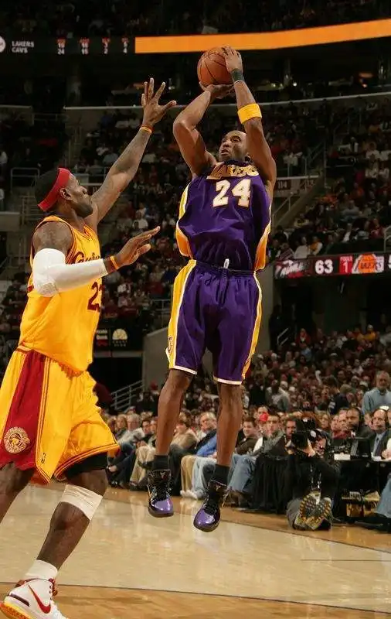
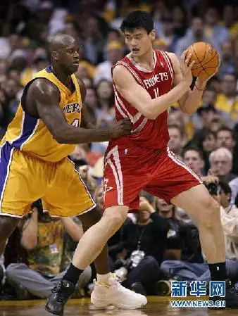
what：
the basketball game

Slide 2
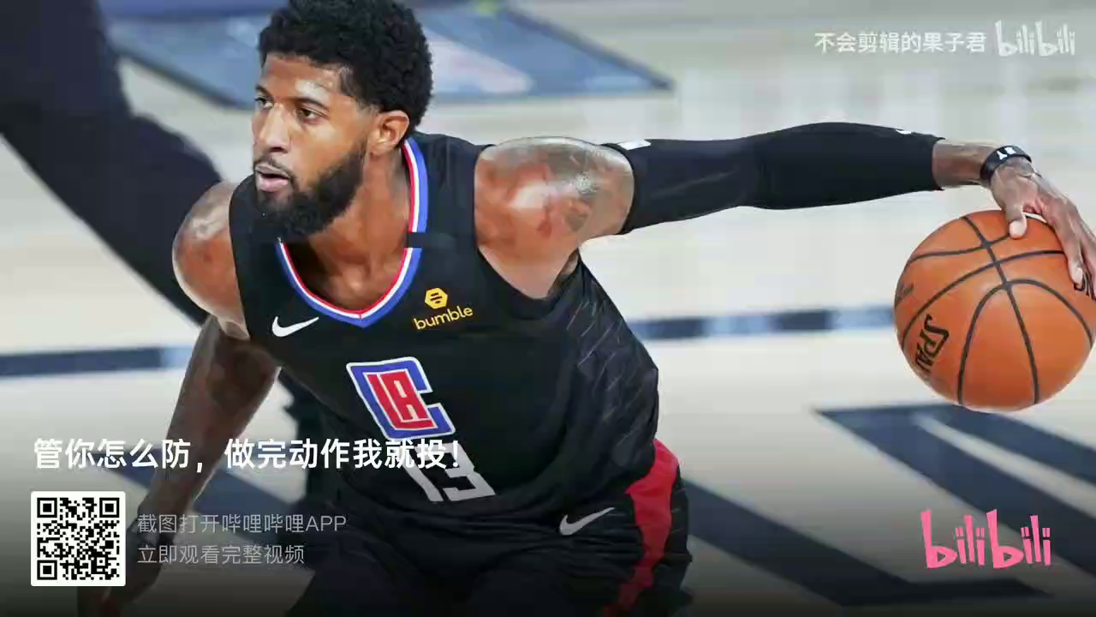

Slide 3
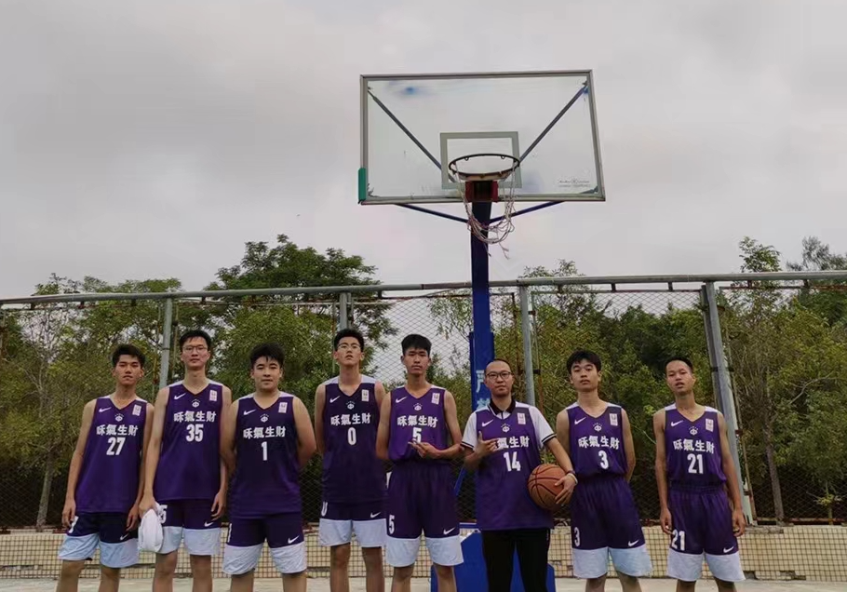
how crazy:
1.in my senior high school,I tried my best to play basketball
2.we to the ball is the people to the first love

Slide 4
why:
An performance art
Release your stress deeply and Rebuild your confidence well

